Slide 1
Photosynthesis and Chlorophyll Fluorescence: Principles, Regulation, and PAM Fluorometry

Slide 2
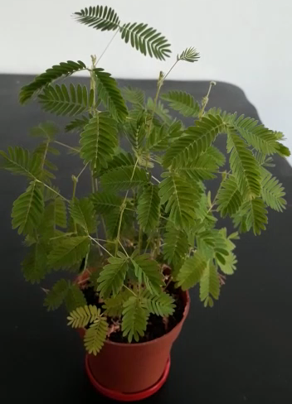
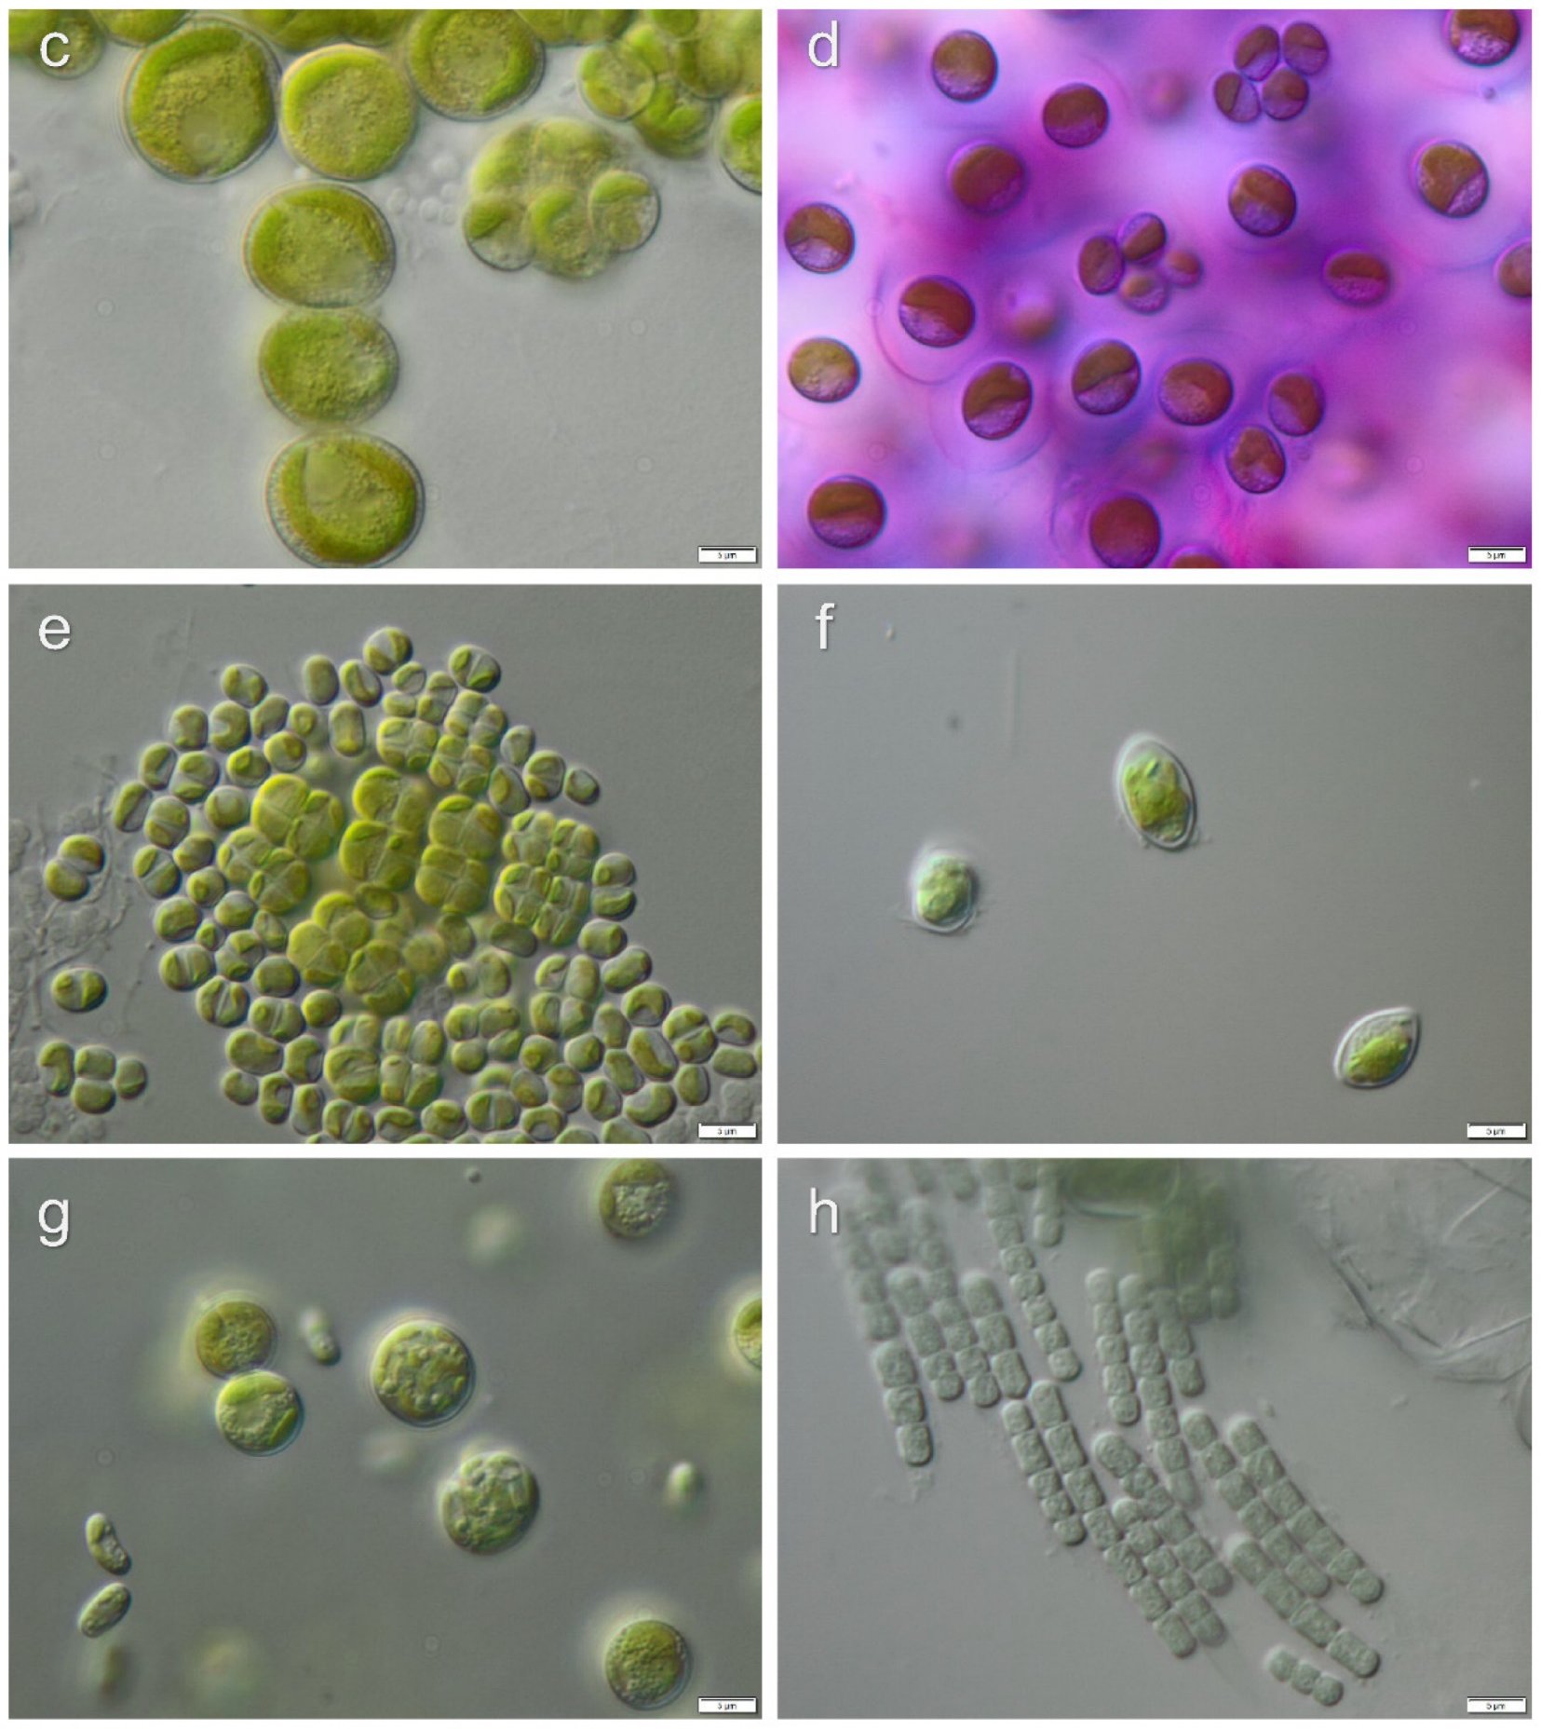
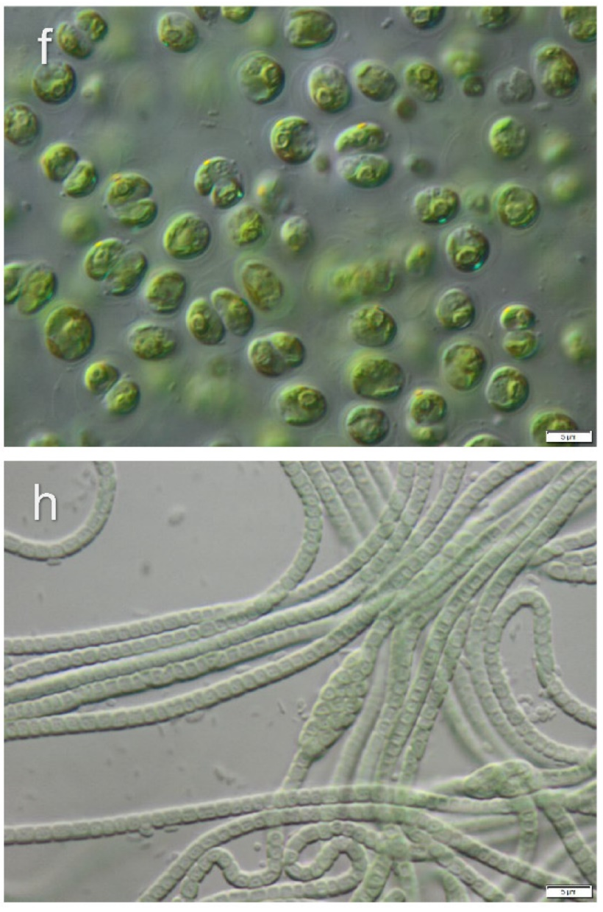

Photosynthetic organisms
Higher plants
Algae and cyanobacteria
$$5 cm$$
Samolov et al., Microorganisms, 2020

Slide 3

Photosynthesis in (too) brief
$$water+CO_{2}\underset{→}{\text{light}}O_{2}+sugar$$

Slide 4
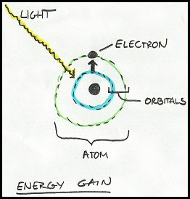
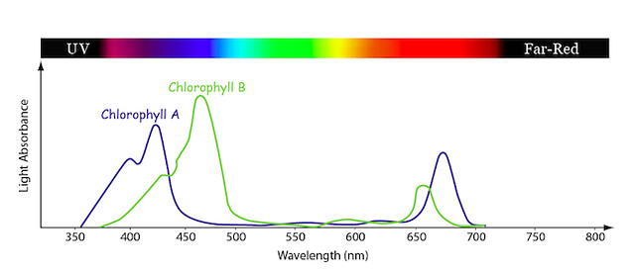
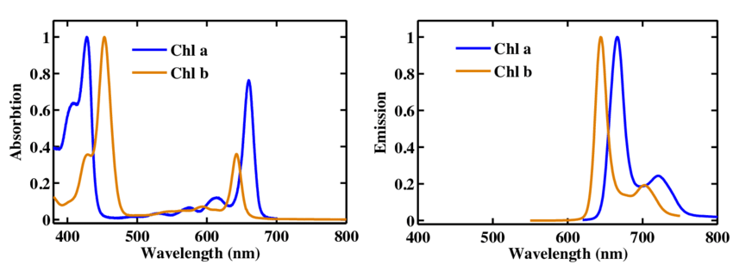
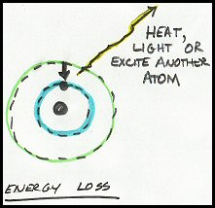
Light reaction
PhD Thesis Mammadov Gulmammad, 2015.
Energy gain and loss. Tom Michaels

Slide 5
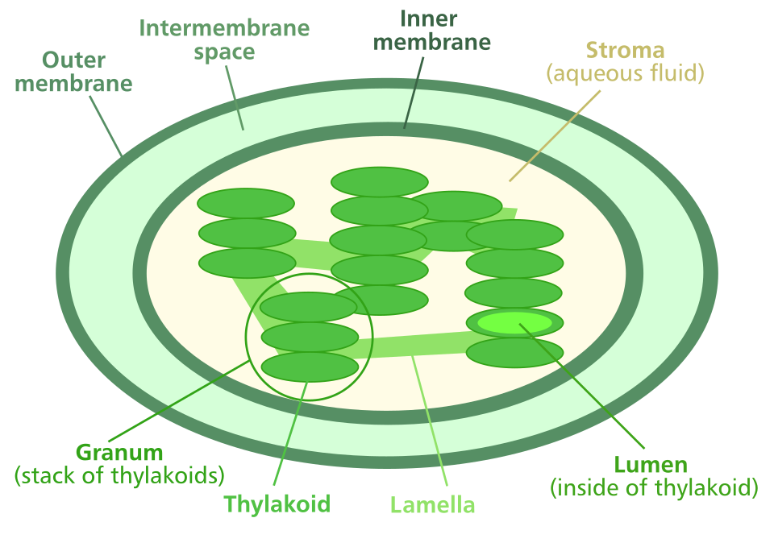
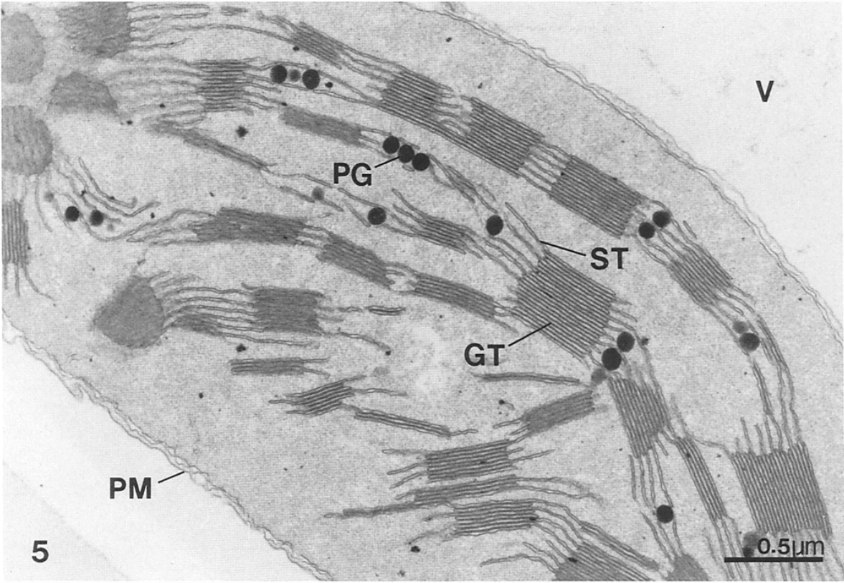
Chloroplast
Synthesis
GT: grana thylakoids ST: stromal thylakoids PM: plasma Mambrane PG: plastoglobuli
Photo
https://en.wikiversity.org/wiki/Biophysics/Introduction/Chloroplast
Allen et al, The Journal of cell biology, 1988
Notes:
Thylakoid membrane, where the light reactions is gonna happen

Slide 6
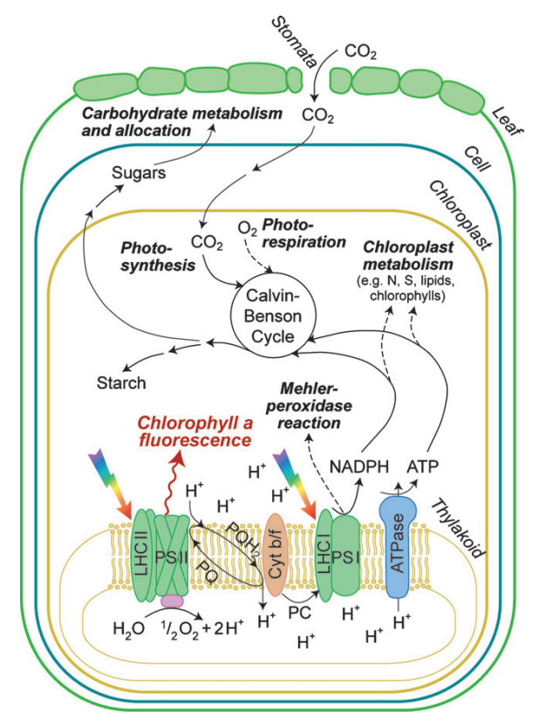

The photosynthetic system
Synthesis
stroma
Photo
$$water+CO_{2}\underset{→}{\text{l}\text{i}\text{g}\text{h}\text{t}}O_{2}+sugar$$
lumen

Slide 7
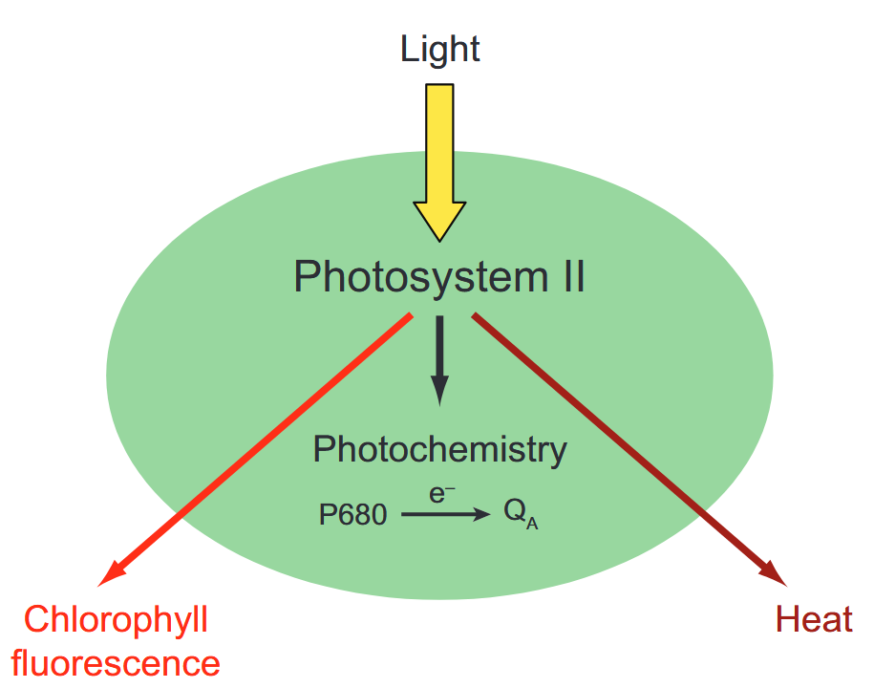




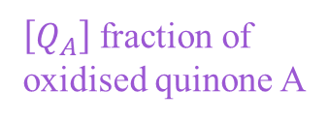


The basis of photosynthesis
$\left[Q_{A}\right]$ fraction of oxidised quinone A
Photochemical Quenching
Fluorescence
Non-Photochemical Quenching (NPQ)
$$k_{F}$$
$$k_{P}\left[Q_{A}\right]$$
$$k_{NPQ}$$
Dark-adapted
$$k_{F}^{′}=k_{F}$$
$$k_{P}^{′}\left[Q_{A}\right]$$
$$k_{NPQ}^{′}$$
Light-adapted
Baker et al., Annu. Rev. Plant Biol., 2008

Slide 8
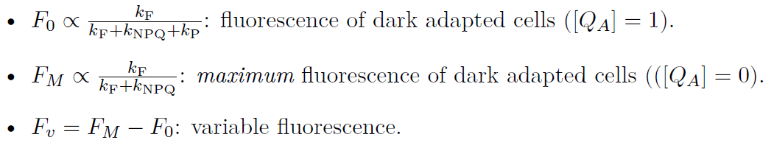





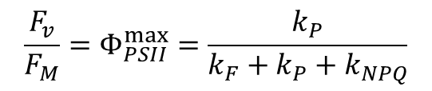
Fluorescence from dark-adapted cells
Dark-adapted
$$k_{NPQ}$$
Fluorescence signal proportional to $Φ_{F}=\frac{k_{F}}{k_{F}+k_{P}\left[Q_{A}\right]+k_{NPQ}}$
$$k_{F}$$
Photochemical Quenching
Fluo
$$k_{P}\left[Q_{A}\right]$$
NPQ
M$aximum quantum yield of photosynthesis$
$$\frac{F_{v}}{F_{M}}=Φ_{PSII}^{max}=\frac{k_{P}}{k_{F}+k_{P}+k_{NPQ}}$$

Slide 9
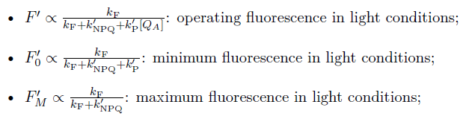
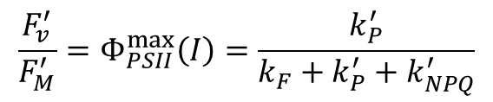
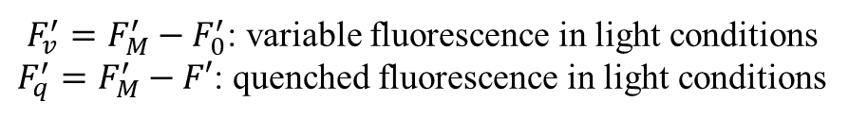


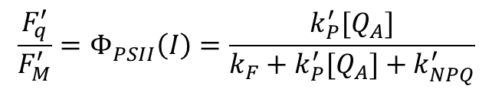
Fluorescence from light-adapted cells
Light-adapted
$$k_{NPQ}^{′}$$
$$k_{F}$$
Photochemical Quenching
Fluo
$$k_{P}^{′}\left[Q_{A}\right]$$
NPQ
$F_{v}^{′}=F_{M}^{′}−F_{0}^{′}$: variable fluorescence in light conditions
$F_{q}^{′}=F_{M}^{′}−F′$: quenched fluorescence in light conditions
$$\frac{F_{v}^{′}}{F_{M}^{′}}=Φ_{PSII}^{max}\left(I\right)=\frac{k_{P}^{′}}{k_{F}+k_{P}^{′}+k_{NPQ}^{′}}$$
$$\frac{F_{q}^{′}}{F_{M}^{′}}=Φ_{PSII}^{}\left(I\right)=\frac{k_{P}^{′}[Q_{A}]}{k_{F}+k_{P}^{′}[Q_{A}]+k_{NPQ}^{′}}$$

Slide 10
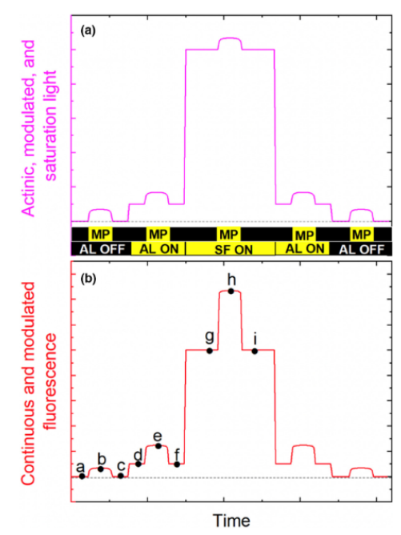
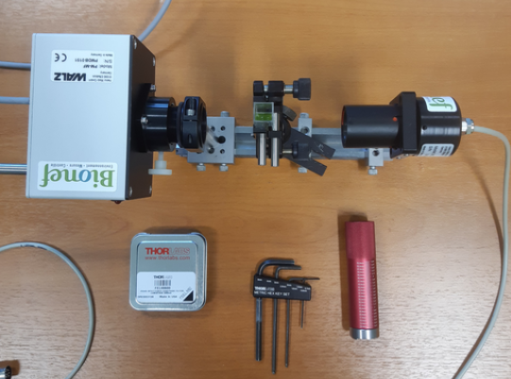
Pulse Amplitude Modulation: demonstration
Absolute fluorescent signal is not required, relative changes are enough.
ML (or MP): Mesuring Light (or Pulse), very weak, modulated light used to measure fluorescence without significantly driving photosynthesis
AL: Actinic Light, continuous illumination driving photosynthesis and physiological adaptation.
SP (or SF): Saturating Pulse (or Flash), brief and extremely intense flash that temporarily closes all PSII reaction centres
Demo on: Microscopy PAM
Zuo et al., Plant-Environment Interactions, 2022

Slide 11
Pulse Amplitude Modulation: fluorescence
Absolute fluorescent signal is not required, relative changes are enough.
ML (or MP): Mesuring Light (or Pulse), very weak, modulated light used to measure fluorescence without significantly driving photosynthesis
AL: Actinic Light, continuous illumination driving photosynthesis and physiological adaptation.
SP (or SF): Saturating Pulse (or Flash), brief and extremely intense flash that temporarily closes all PSII reaction centres
Zuo et al., Plant-Environment Interactions, 2022

Slide 12






Pulse Amplitude Modulation: inside the machine
$$k_{NPQ}$$
$$k_{NPQ}^{′}$$
$$k_{F}$$
Photochemical Quenching
$$k_{F}$$
Photochemical Quenching
NPQ
Fluo
$$k_{P}^{′}\left[Q_{A}\right]$$
NPQ
Fluo
$$k_{P}\left[Q_{A}\right]$$
$$\frac{F_{v}}{F_{M}}=\frac{F_{M}−F_{0}}{F_{M}}=Φ_{PSII}^{max}$$
$$\frac{F_{v}^{′}}{F_{M}^{′}}=\frac{F_{M}^{′}−F_{0}^{′}}{F_{M}^{′}}=Φ_{PSII}^{max}\left(I\right)$$
$$\frac{F_{q}^{′}}{F_{M}^{′}}=\frac{F_{M}^{′}−F^{′}}{F_{M}^{′}}=Φ_{PSII}^{}\left(I\right)$$
Dark-adapted
Light-adapted
$$F_{0}=b−\frac{a+c}{2}$$
$$F_{0}^{′}=e−\frac{d+e}{2}$$
$$F_{M}^{′}=h−\frac{g+i}{2}$$
Zuo et al., Plant-Environment Interactions, 2022

Slide 13
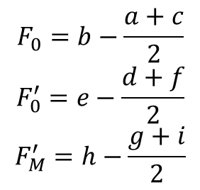



Pulse Amplitude Modulation: inside the machine
$$k_{NPQ}$$
$$k_{NPQ}^{′}$$
$$k_{F}$$
Photochemical Quenching
$$k_{F}$$
Photochemical Quenching
NPQ
Fluo
$$k_{P}^{′}\left[Q_{A}\right]$$
NPQ
Fluo
$$k_{P}\left[Q_{A}\right]$$
$$\frac{F_{v}}{F_{M}}=\frac{F_{M}−F_{0}}{F_{M}}=Φ_{PSII}^{max}$$
$$\frac{F_{v}^{′}}{F_{M}^{′}}=\frac{F_{M}^{′}−F_{0}^{′}}{F_{M}^{′}}=Φ_{PSII}^{max}\left(I\right)$$
$$\frac{F_{q}^{′}}{F_{M}^{′}}=\frac{F_{M}^{′}−F^{′}}{F_{M}^{′}}=Φ_{PSII}^{}\left(I\right)$$
Dark-adapted
Light-adapted
$$F_{0}=b−\frac{a+c}{2}$$
$$F_{0}^{′}=e−\frac{d+f}{2}$$
$$F_{M}^{′}=h−\frac{g+i}{2}$$
Zuo et al., Plant-Environment Interactions, 2022

Slide 14
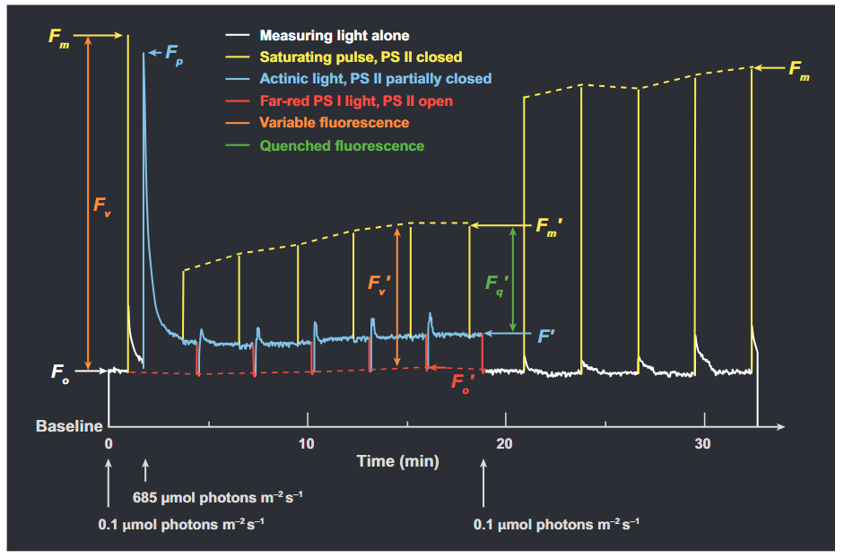



Protocol for quenching analysing
$$\frac{F_{v}}{F_{M}}=\frac{F_{M}−F_{0}}{F_{M}}=Φ_{PSII}^{max}$$
$$\frac{F_{v}^{′}}{F_{M}^{′}}=\frac{F_{M}^{′}−F_{0}^{′}}{F_{M}^{′}}=Φ_{PSII}^{max}\left(I\right)$$
$$\frac{F_{q}^{′}}{F_{M}^{′}}=\frac{F_{M}^{′}−F^{′}}{F_{M}^{′}}=Φ_{PSII}^{}\left(I\right)$$
Baker et al., Annu. Rev. Plant Biol., 2008

Slide 15
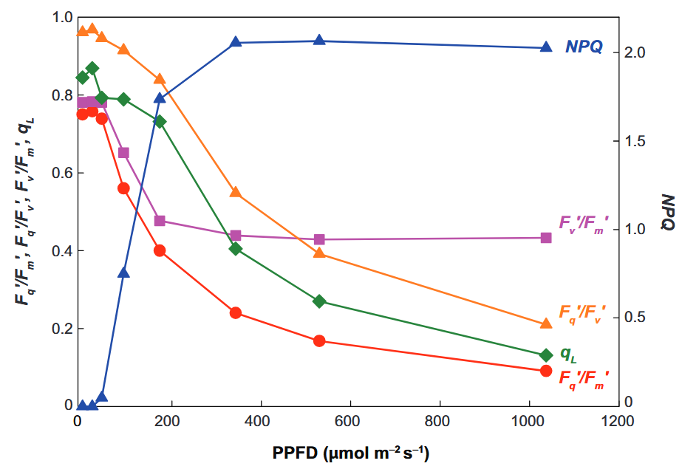
Response of photosystem II
Baker et al., Annu. Rev. Plant Biol., 2008

Slide 16
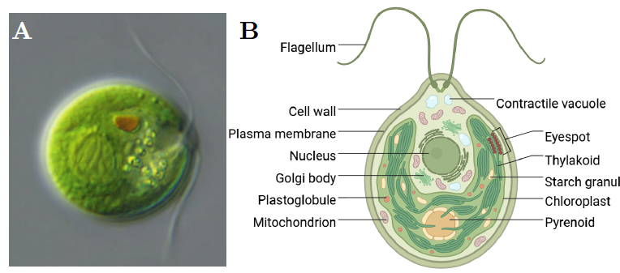
Chlamydomonas reinhardtii
Chlamydomonas reinhardtii
[klami] for intimists
Cilium
Swimming
Phototaxis
Photosynthesis
5 µm
The Science Magazine of the Max Planck Society, 2014
N. Farès, Thèse, 2025

Slide 17
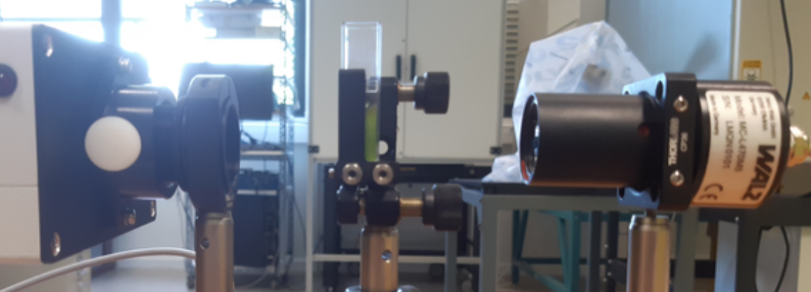
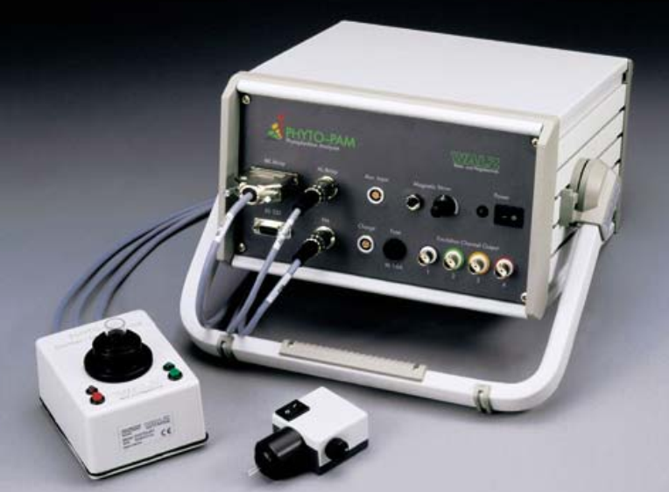
Practical
Microscopy PAM
Split in 2 groups
~1h30 with µPAM
~1h30 with phytoPAM
PhytoPAM ED
Q&A

