Slide 1
Yeast

Slide 2
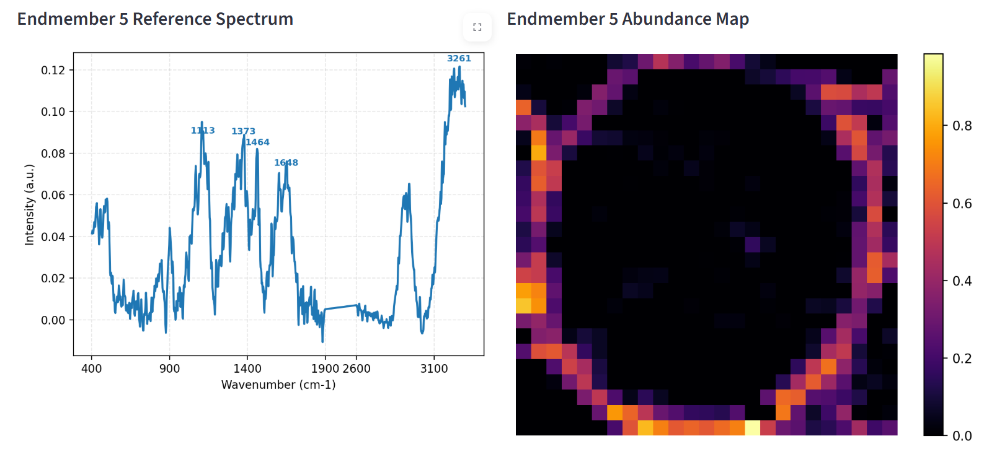
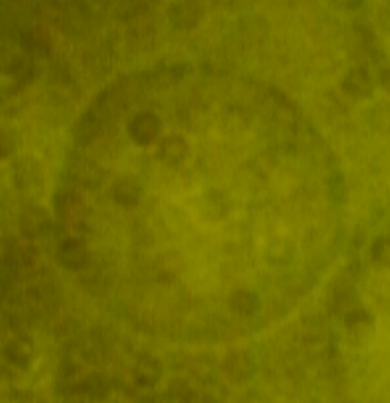
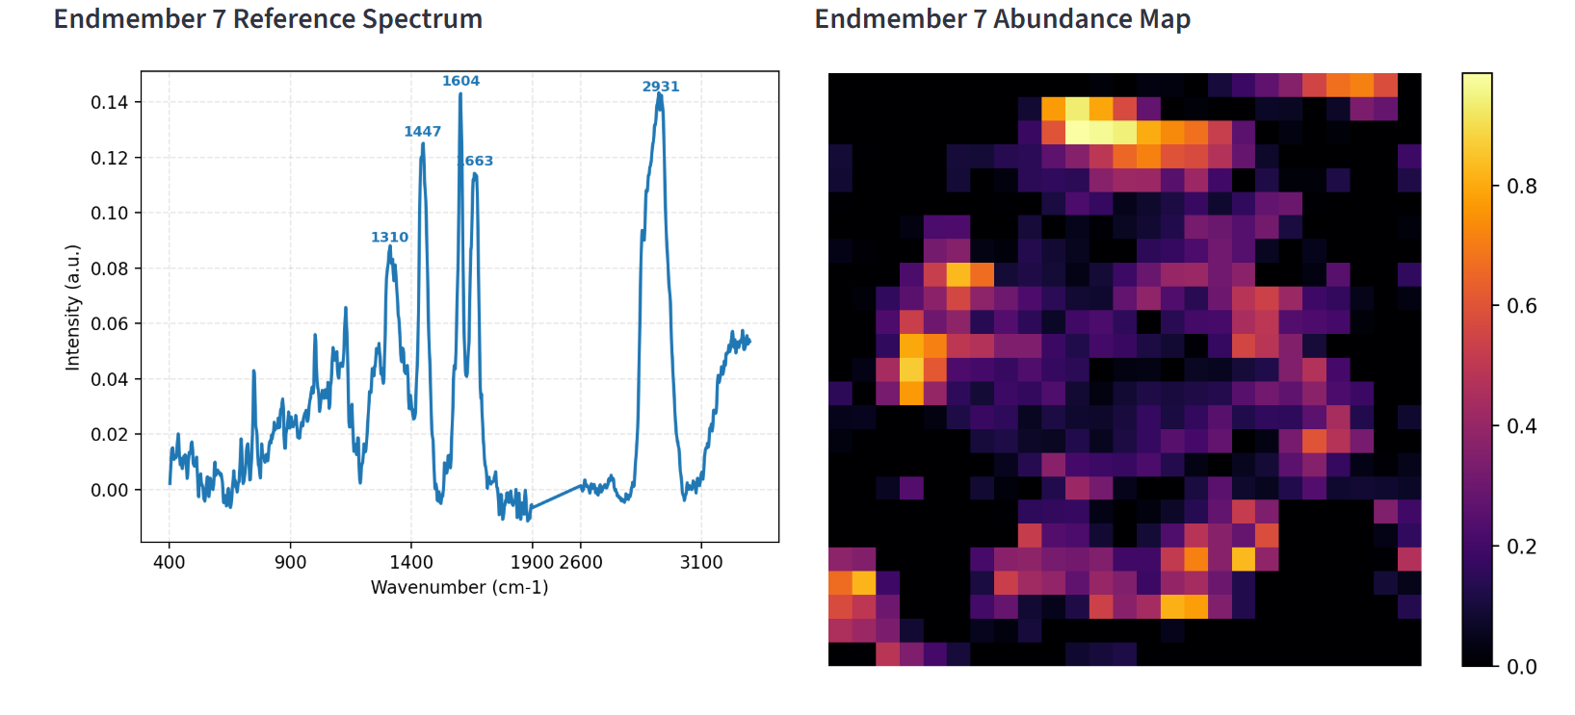
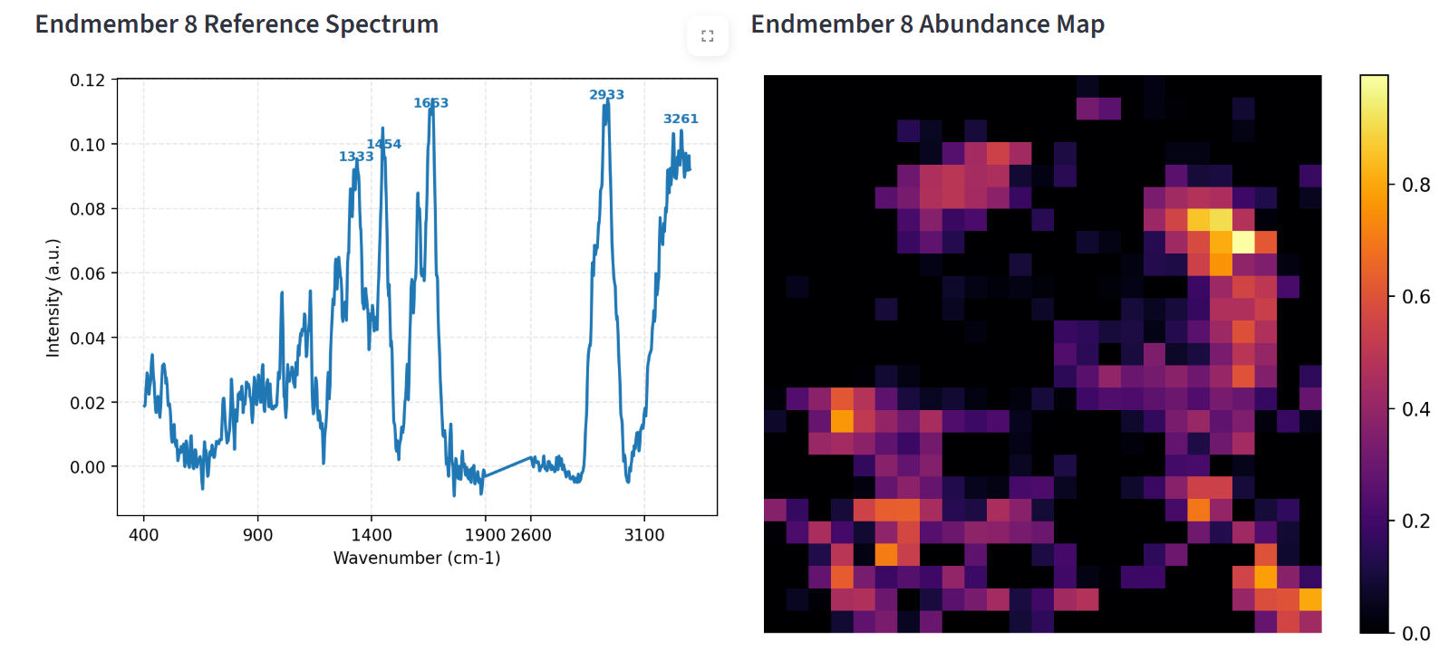
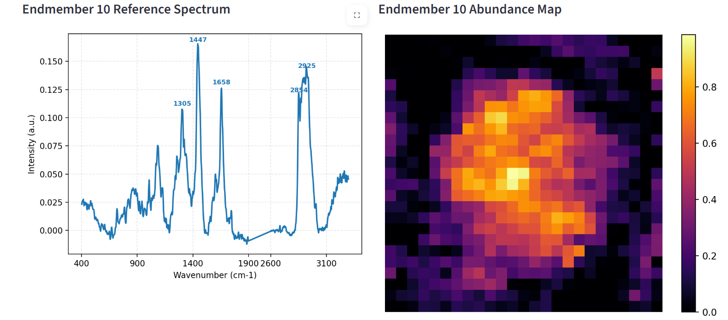
Sample 1 – 500 nm
END 5, 7, 8, 10

Slide 3
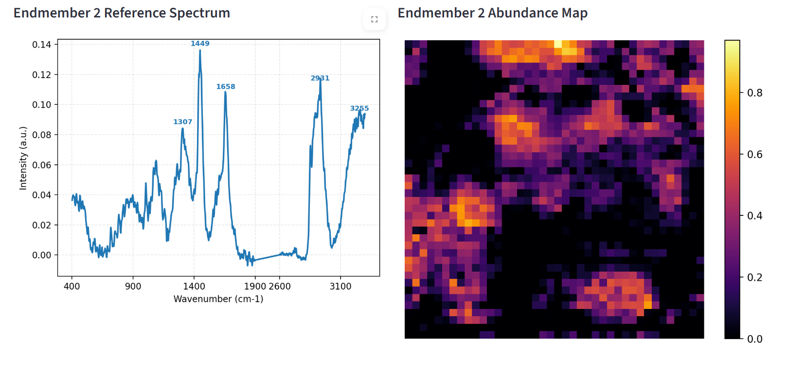
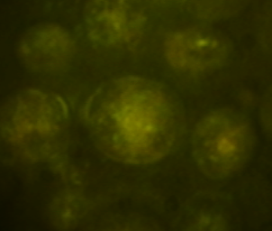
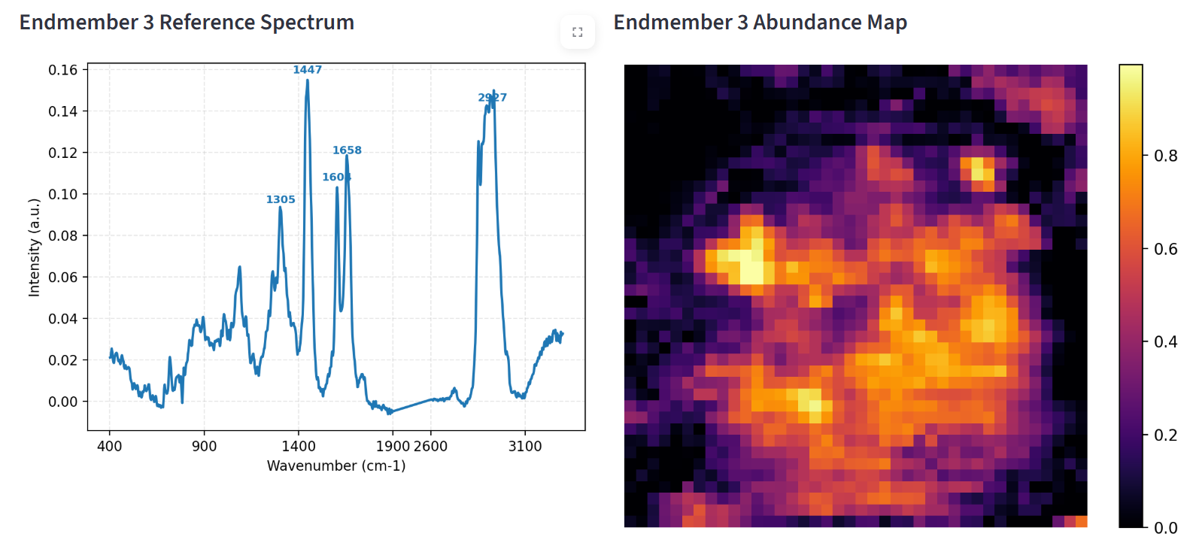
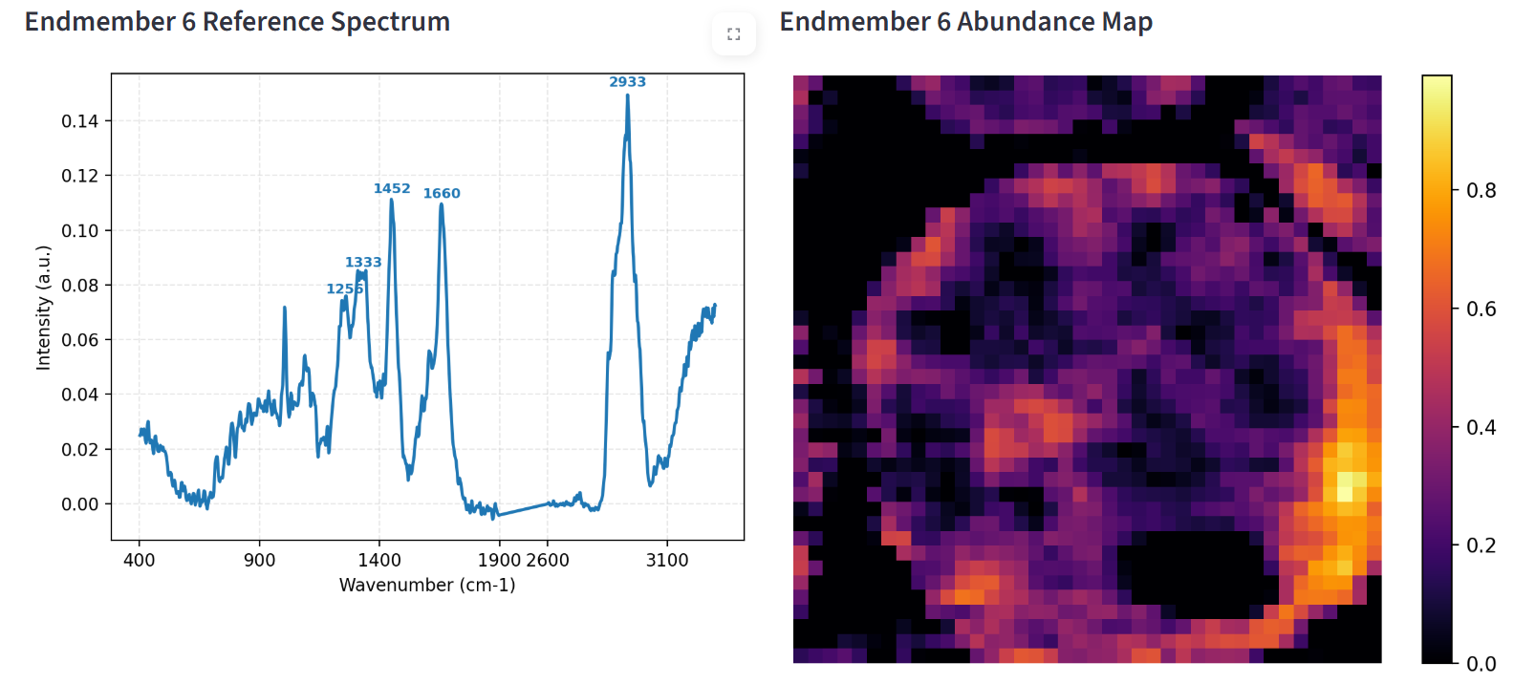
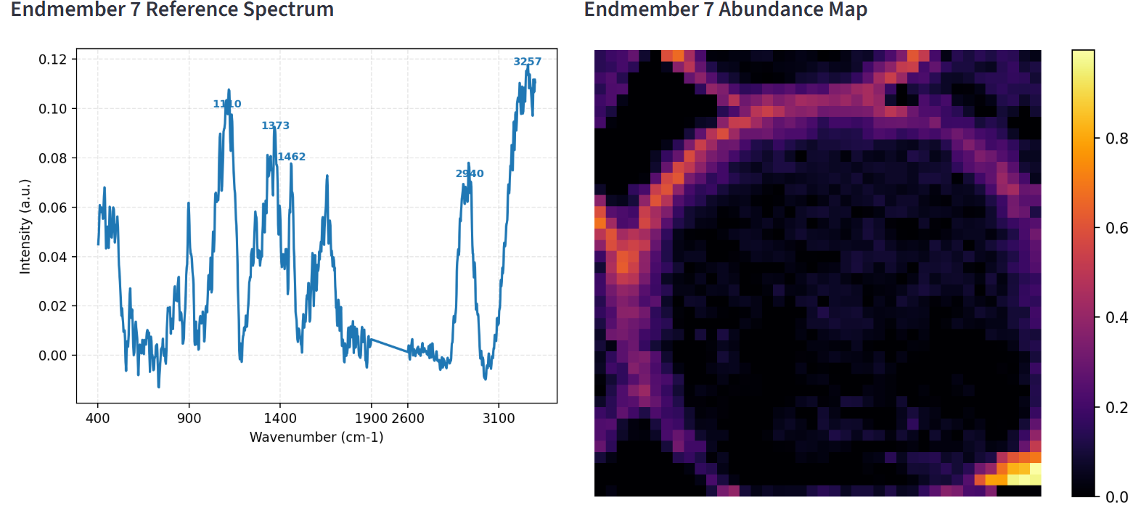
Sample 2 – 250 nm

Slide 4
Questions?
High resolution images both targets
Real chemical-biological composition between both targets

Slide 5
More papers
https://onlinelibrary.wiley.com/doi/full/10.1155/2012/746597
Single cell assessment of yeast metabolic engineering for enhanced lipid production using Raman and AFM-IR imaging

