Slide 1
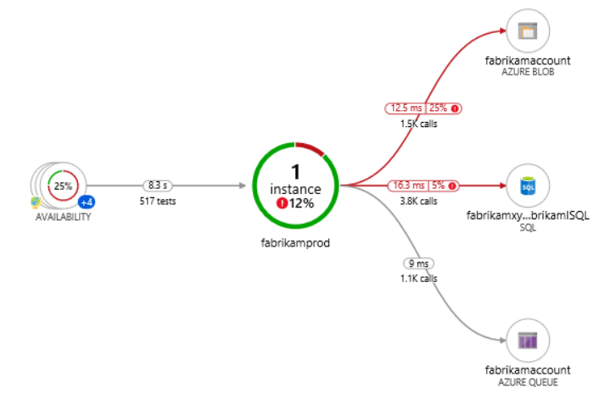









9
Azure Key Vault
6
Azure Redis Cache
8
Blazor WASM
1
2
JWT
4
5
API Mgmt
Web API
7
3
Azure SQL Server
Auth0
High Lights:
Blazor WASM UI get authenticated and pass the JWT to APIM.
APIM Validates the JWT and routes the request to Web API.
SQL Server, and Redis Cache’s credentials are stored in Azure Key Vault.
Web API investigates Azure Redis Cache before hitting SQL Azure. (Cache Aside Pattern)
We will preform Dacpac (.sqlproj) for deployment of SQL Data Store.

Slide 2
Front End
Middle Tier
Backend
Core
SQL
Blazor WASM
Angular
ReactJS
Vue.js
APP
API
/
gRPC
BLL
DAL
DMZ

Slide 3
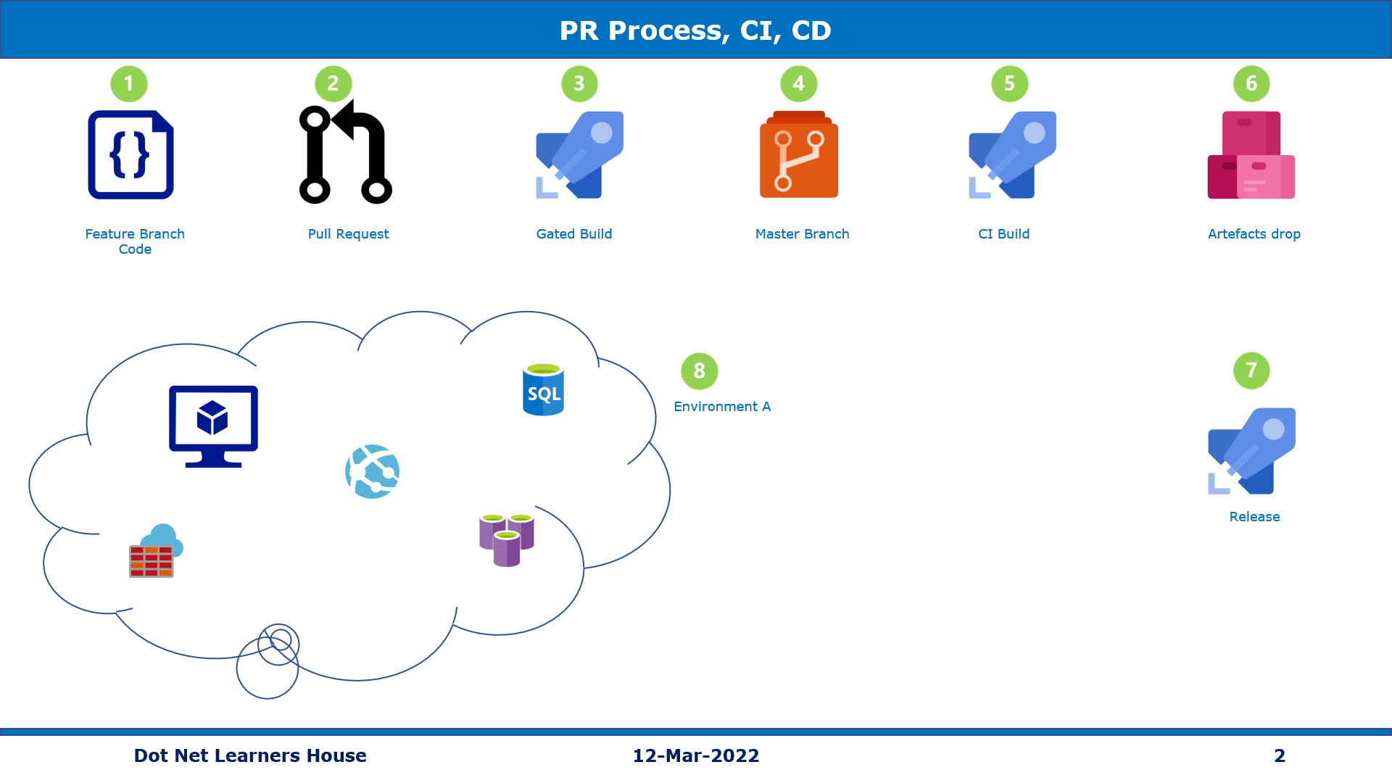

Slide 4
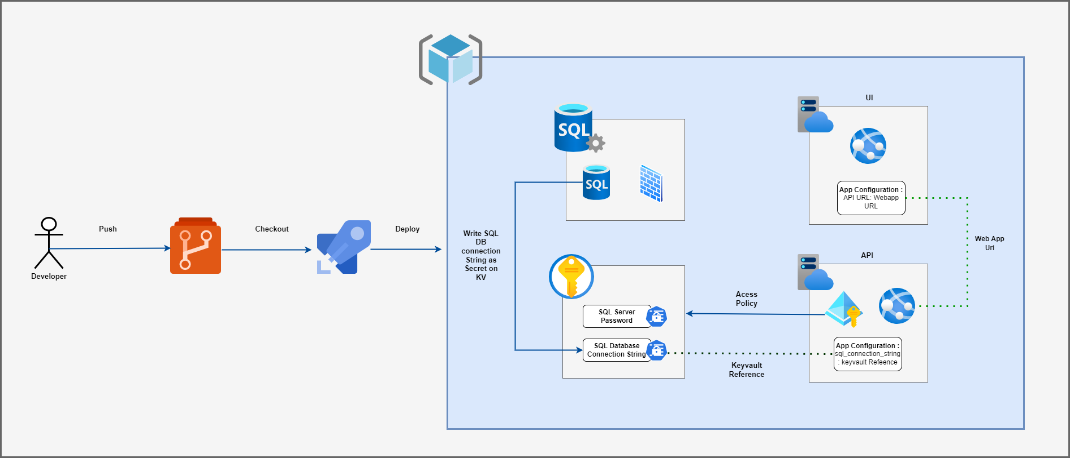

Slide 5

Real Estates

Slide 6
Welcome to the journey
Beginner to Architect
With Blood, Sweat, and Tears

