Slide 1
Introduction to programming
Using c#
Lecture 1:
Intro. to the course

Slide 2
Contents:
About the instructor.
What this is.
What this course is not.
The goal of this course.
Prerequisites.
What is programming.
What is the language computer can understand.
Why C#.
What is C#.
About Microsoft Visual Studio.
Installing Visual Studio.
Projects and Solutions.

Slide 3
About the instructor

Slide 4
What this course about
Programming in general.
C# and .Net framework.

Slide 5
What this course is not
A step in the journey,
not the whole journey

Slide 6
The goal of this course
To give you basic understanding of computer programming,
Put you in the starting of the road.
Give you the tools you need to learn more.

Slide 7
Prerequisites
Basic computer skills.
English language basics
Strong will.

Slide 8
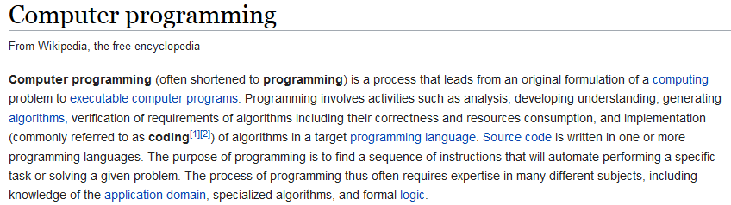
What is programming
text

Slide 9
the language computer can understand
Computer can understand/execute machine code only.
It’s hard to write programs in machine code.
We use compilers or interpreters to translate programming language code into machine code.

Slide 10
Why C# Sharp
C# is simple.
C# is modern.
C# is object-oriented.
C# is powerful and flexible.
C# is a language of few words.

Slide 11

What is C#
1999 - Starting the project Cool, The .Net language
2000 – Renamed to C#.
C-style syntax.
C# is compiled language.
C# is case sensitive.

Slide 12

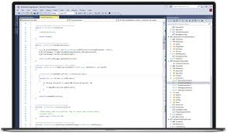
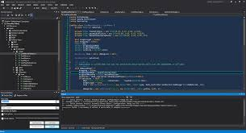
Microsoft Visual Studio
https://www.visualstudio.com/

Slide 13
Installing Visual Studio
Community edition is free.
Download from https://www.visualstudio.com/free-developer-offers/

Slide 14
Projects and Solutions
What’s a project.
What’s a solution.
Opening an existing project.
Creating a new project.

Slide 15
Next
Hello World, Our first project.
Variables and data types.
Inputs and outputs.
C# syntax.

