Slide 1
Introduction to programming
Using c#
Lecture 2:
Hello World!, Our first program

Slide 2
Contents:
Hello World!
Console Applications.
Printing text to the console.
Halting execution.
Printing line of text to the console.
Variables and constants.
Data types.
Reading text from the user.
Users and Programmers.
Console colors.
Getting and setting properties.
Demo (chat with pc)

Slide 3
Hello World!
It is a tradition in programming books and courses to start with a simple example that prints the text “Hello World!”

Slide 4
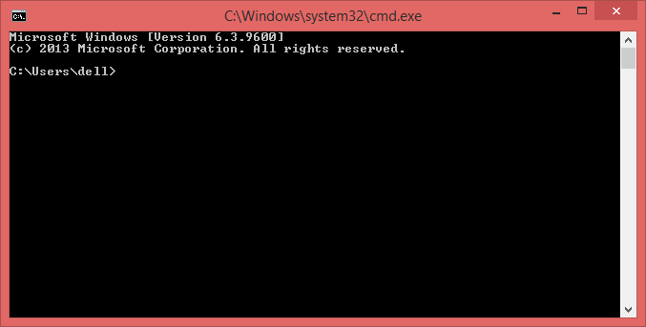
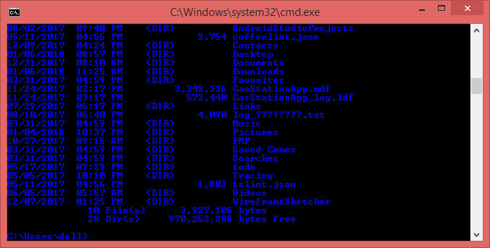
Console Applications
An application with the simplest UI ever, Just text.
You can pass arguments to console app by appending them to command line separating them with a space.
It’s an option for programs that do single task with no much Interactivity from the user.

Slide 5
Printing text to the console

Slide 6

Halting execution

Slide 7

Printing line of text to the console

Slide 8

Printing line of text to the console

Slide 9
Variables and constants
A variable is a named place in the memory that hold some value
A variable value can change, Constant value can’t be changed.
You can define new variable using the form
Datatype VariableName [=value];

Slide 10
Variables and constants
To define new constant use the following form
const Datatype constantName [=value];

Slide 11
Variables and constants
Variable and constant naming roles :
Must start with a letter.
Can’t contain white space or special characters.
Not a reserved word.

Slide 12
Data types
Data can exists in many types
Numerical (integer, decimal, float …)
Strings
Date and time
Structures

Slide 13
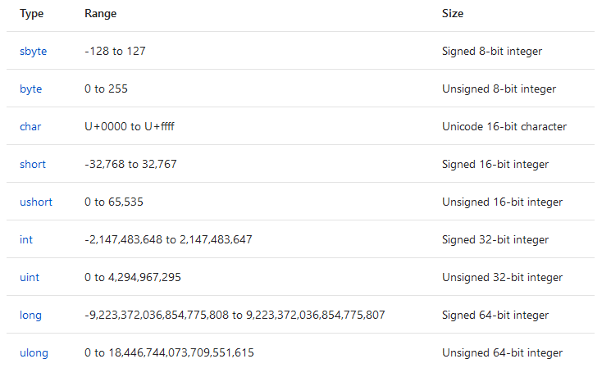
Data types
Numerical data types / Integral types :
https://docs.microsoft.com/en-us/dotnet/csharp/language-reference/keywords/value-types

Slide 14
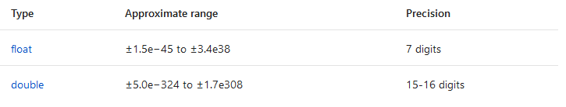
Data types
Numerical data types / Floating-Point types :
https://docs.microsoft.com/en-us/dotnet/csharp/language-reference/keywords/value-types

Slide 15
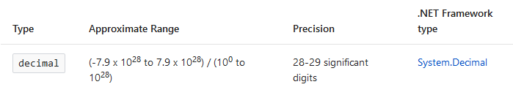
Data types
Numerical data types / decimal:
https://docs.microsoft.com/en-us/dotnet/csharp/language-reference/keywords/value-types

Slide 16

Data types
Boolean data types:

Slide 17
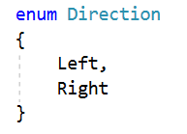
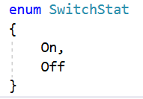
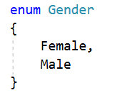
Data types
Enumeration data types:

Slide 18
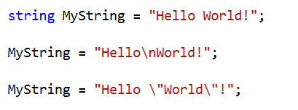
Data types
Strings data types:

Slide 19

Reading text from the user

Slide 20
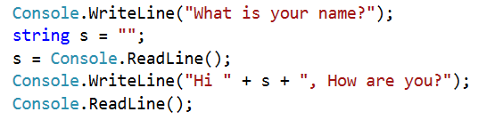
Reading text from the user

Slide 21
Users and Programmers
Programmer is you, who writes programs.
User is the one who use your program

Slide 22

Console colors
You can change the text color or the background color using something like the following code:

Slide 23
Getting and setting properties
VariableName = object.ProperityName;
object.ProperityName = value | variableName

Slide 24
Demo
Chatting with PC

Slide 25
Next
Mathematics operations.
Conditions and loops.

