Slide 1
Introduction to programming
Using c#
Lecture 3:
Conditions and loops

Slide 2
Contents:
if statement.
else statement.
Mathematics operations.
while loop.
for loop.
Breaking the loop.

Slide 3
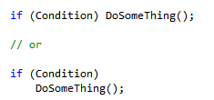
If statement

Slide 4
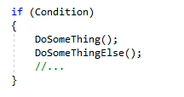
If statement

Slide 5
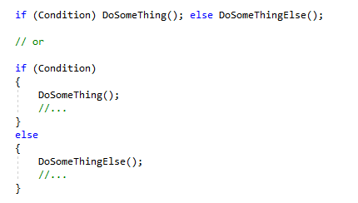
else statement

Slide 6
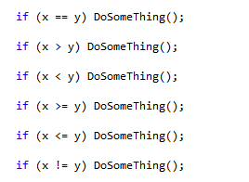
Conditions
Any expression that return Boolean value (true or false)

Slide 7

Logical Operators
&& and
|| or
! not

Slide 8
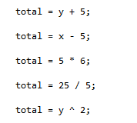
Mathematics operations

Slide 9
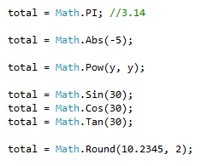
Mathematics operations

Slide 10
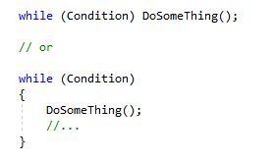
while loop

Slide 11
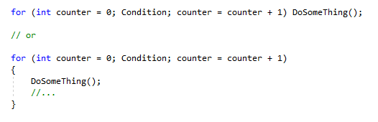
for loop

Slide 12
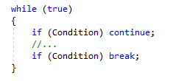
Breaking the loop

Slide 13
Next
Functions

