Slide 1
Introduction to programming
Using c#
Lecture 4:
Functions

Slide 2
Contents:
What’s a function and why we should use it.
Define a new function.
Functions naming roles.
Calling a function.
Functions that return value.
Functions that takes values as inputs.
Named arguments.
Optional arguments.
Access modifiers.

Slide 3
What’s a function
A function is some lines code that called frequently

Slide 4

Define a new function

Slide 5
Functions naming roles
The same as variable naming roles.

Slide 6

Calling a function

Slide 7

Functions that return value

Slide 8


Functions that takes values as inputs

Slide 9

Named arguments

Slide 10


Optional arguments

Slide 11
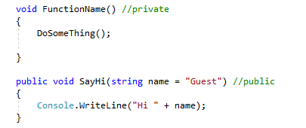
Access modifiers
Private is the default access modifier for functions.

Slide 12
Next
Class and interfaces.

