Slide 1
Introduction to programming
Using c#
Lecture 5:
Classes and Interfaces

Slide 2
Contents:
What’s a namespace.
What’s a class.
Defining a new class.
Class members
Methods.
Defining new variables from the class type.
Calling a class function/method.
What’s an interface is.
Defining an interface.
Implementing an interface.

Slide 3
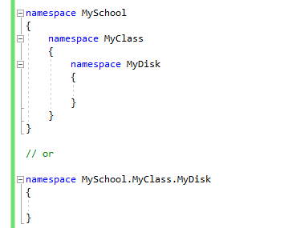
What’s a namespace

Slide 4
What’s a class
A class is a blueprint for objects of the same type.

Slide 5
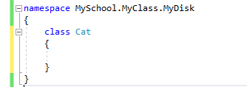
Defining a new class

Slide 6
Class members
A class can contain:
Variables (fields).
Functions (Methods)
Prosperities.

Slide 7
Methods
A function inside a class is called method.

Slide 8

Defining variables from the class type

Slide 9
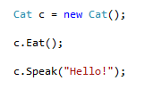
Calling a class function/method

Slide 10
What’s an interface is
Interface is a contract that specify the members that class should have.

Slide 11
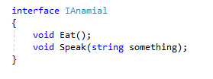
Defining an interface

Slide 12
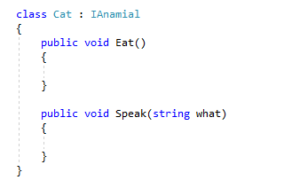
Implementing an interface

Slide 13
Next
Inheritance.

