Slide 1
Introduction to programming
Using c#
Lecture 5:
Inheritance

Slide 2
Contents:
What’s inheritance.
Why we should use inheritance.
Examples.
Adding new members to inherited class
Overriding old members.
Access modifiers.
Sealed classes.
Extending sealed classes.
Extension methods.
Demo.

Slide 3
What’s inheritance
Is relationship between two classes in which one class (child) copy all members from the other class (parent)

Slide 4
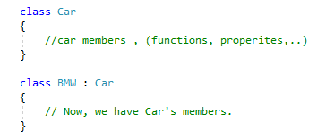
What’s inheritance

Slide 5
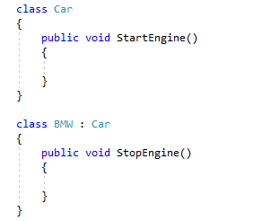
Adding new members to inherited class

Slide 6
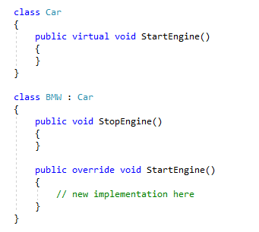
Overriding inherited members

Slide 7
Sealed Classes
A class that you can’t inherit from.

Slide 8
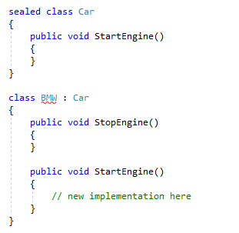
Sealed Classes

Slide 9
Extending sealed classes
By adding a new helper class that contains static methods that add the functionality you want.
By adding an extinction method.

Slide 10
Extension methods
An static method that extend the functionality of anther class and appear as a class member.

Slide 11
Extension methods
Roles :
Must be a static method.
Must be in the same namespace as the target class.
Must take an argument of the same type as target class preceded by the keyword this.

Slide 12
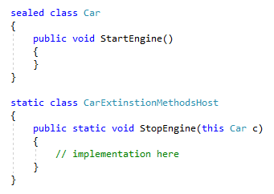
Extension methods

Slide 13
Demo

Slide 14
Next
Data Structures.

