Slide 1
Introduction to programming
Using c#
Lecture 5:
Data Structures

Slide 2
Contents:
What’s data structures.
Why we need data structures.
Real life examples.
Arrays.
Lists.
Queues.
Stacks.
Demo.

Slide 3
What’s data structures
From Wikipedia
A data structure is a particular way of organizing and storing data in a computer so that it can be accessed and modified More precisely, a data structure is a collection of data values, the relationships among them, and the functions or operations that can be applied to the data

Slide 4
Why we need data structures
Organizing related data in single unit.
A good representation of data
Easy to talk about

Slide 5
Real life examples
Supermarket casher queue.
Dictionary and phonebook.
Google maps.
…

Slide 6
Arrays
A fixed-size collection of data of same type.

Slide 7

Arrays

Slide 8
Lists
A collection of data of same type that you can add or remove from.

Slide 9
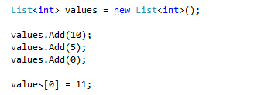
Lists

Slide 10
Queues
A collection of data items where the first item inserted is the first item to be removed.

Slide 11
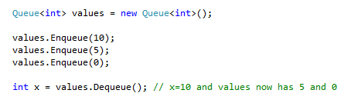
Queues

Slide 12
Stacks
A collection of data items where the last item inserted is the first item to be removed.

Slide 13
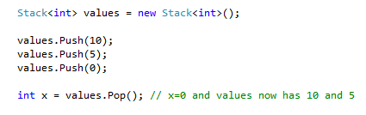
Stacks

Slide 14
Demo

Slide 15
Next
The file system.

