Slide 2
Lighting up your Unity game on Windows 10
L708
Jaime Rodriguez
@jaimerodriguez, jaimer@microsoft.com
Notes:
Hi,
Welcome to Lighting up your Unity Game on Windows 10.
I am Jaime Rodriguez, I lead the mobile games evangelism team at Microsoft.
In my day job, I spent a lot of time helping top publishers port iOs/Android/Steam titles to Windows..

Slide 3
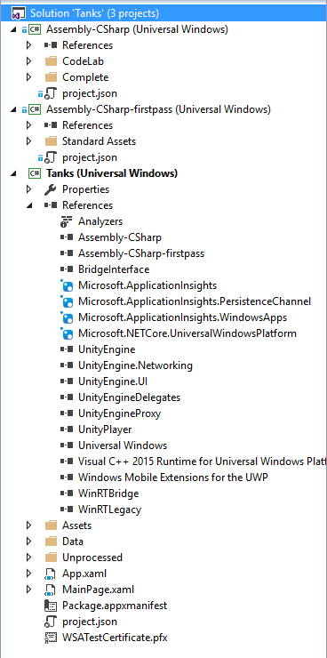
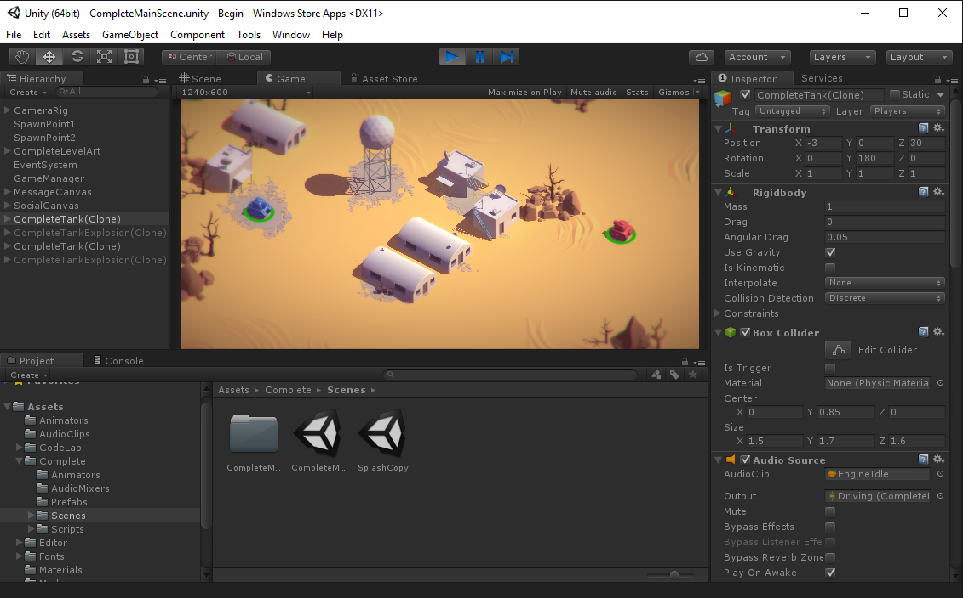
Agenda for today (1/2):
Targeting Windows
Notes:
With Unity being a very popular middleware, we port a lot of Unity games. For today’s session, this is where we are going to start.
We will begin with a functional Unity game; that is not (yet) targeting Windows.. And I will walk you through targeting Windows from within Unity Editor..

Slide 4
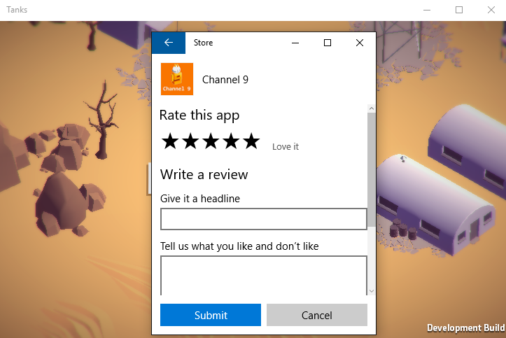

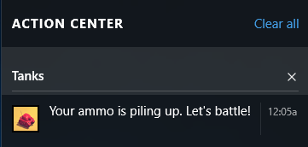
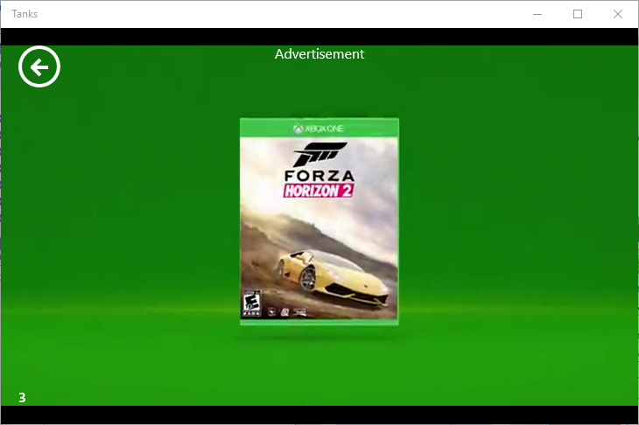
Agenda for today (2/2): Light-up techniques
1
UnityEngine.WSA
2
Inline WinRT code
3
Plugins & bridges
App Rating
Uri launching for help files
Live tiles
Notifications
Vungle Ads
Microsoft Ads
Notes:
Once our game is targeting Windows, we will cover several lightup techniques to add native integration to our game..

Slide 5
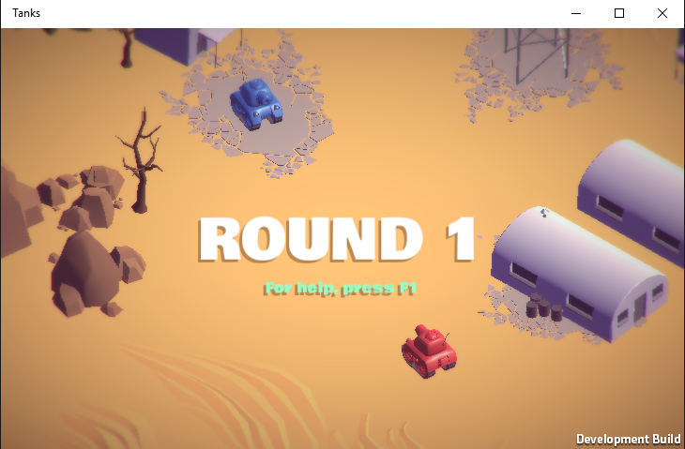
Key driving principle to remember
Code running on Mono run-time
If built in VS, targets .NET 3.5 APIs, compiles to Mono
Code runs against .NET run-time for Windows Store Can reference WinRT APIs

Slide 6
Our content for today
http://aka.ms/BuildUnityLightUp
README.md (script)
C:\labs\CodeLabs-GameDev-2-UnityWin10

Slide 7
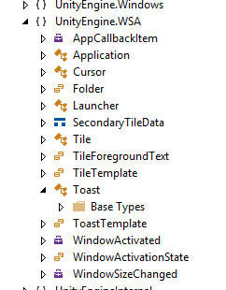
UnityEngine.WSA namespace
Notes
Convenient
Abstracts/hides threading issues
Does not cover every possible integration scenario

Slide 8
Inline WinRT (1/2): Pre-processor directives
Pre-processor | Use when/for | Notes
NETFX_CORE | Compiling C# against .NET Core
WINDOWS_UWP | Targeting UWP
UNITY_WINRT | Equivalent to UNITY_WP8 | UNITY_WSA | Use for Win8x compatibility. Going forward use WINDOWS_UWP
UNITY_EDITOR | Filter out code that will only run inside editor (most of the time code within NETFX_CORE should not run in editor
UNITY_WSA | UNITY_WSA_10_0 | Targeting Windows Store apps earlier than 10. It includes 10 too. | Going forward use WINDOWS_UWP
http://docs.unity3d.com/Manual/PlatformDependentCompilation.html

Slide 9
Inline WinRT code (1/2): Threading
//Dispatch from Windows UI Thread to Unity Thread
UnityEngine.WSA.Application.InvokeOnAppThread(() =>
{
// Unity thread work goes here GetComponent<AudioSource>().mute = false ;
}, false);
//Dispatch from Unity App thread to Windows UI Thread
UnityEngine.WSA.Application.InvokeOnUIThread( ()=>
{
//Windows UI work goes here
var appView = Windows.UI.ViewManagement.ApplicationView.GetForCurrentView();
appView.TryEnterFullScreenMode();
} , false);

Slide 10
Plugins (1/2): Folders Names
Plugins Folder | Target
Plugins | Global (scope with plugin inspector)
Plugins\Editor | Compatible w/ Editor
Plugins\x86|x64 | Desktop (aka standalone), not Windows store
Plugins\WP8 | Windows Phone (Silverlight only)
Plugins\WSA | Windows Store Apps & Windows Phone 8.1 (Universal)
Plugins\WSA\ x86 | | x64 | ARM) | CPU values for WSA
Plugins\WSA\SDK80|SDK81\ | SDK values for WSA. CPU folders can follow.
Notes
Hierarchy not required (Unity 5.0+)
Metro can be used instead of WSA. These two are interchangeable.
WP8 support deprecated with Unity 5.3)
http://docs.unity3d.com/Manual/PluginInspector.html

Slide 11
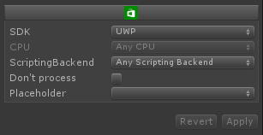
Plugins (2/2): Import Settings
UWP for Universal projects (phone and desktop)
For .winmd use Any CPU For .dlls, select platform
Select “Any” or “Dot net”
Checked most of the time. Only uncheck if your DLL contains MonoBehaviours
Use only if you have a plugin that runs within the Unity Editor
Notes:
http://docs.unity3d.com/Manual/windowsstore-plugins.html

Slide 12
Bridging Unity to Windows
Unity Editor/Game
Platform specific Project
Abstract class / interface
Factory/Instantiation
Game logic targeting abstract class
Implementation of interface
Instantiate Factory & ‘connect it’ to Unity

Slide 13
Conclusion & Useful References
Integrating native code into Unity games is easy. Lots of choices & flexibility.
https://github.com/Microsoft-Build-2016/CodeLabs-GameDev-2-UnityWin10
https://github.com/microsoft/unityplugins
https://unity3d.com/learn
https://unity3d.com/learn/tutorials/projects/tanks-tutorial

Slide 14



Thank You!!!
Questions /Feedback
jaimer@microsoft.com
@jaimerodriguez
@jaimerodriguez

Slide 15
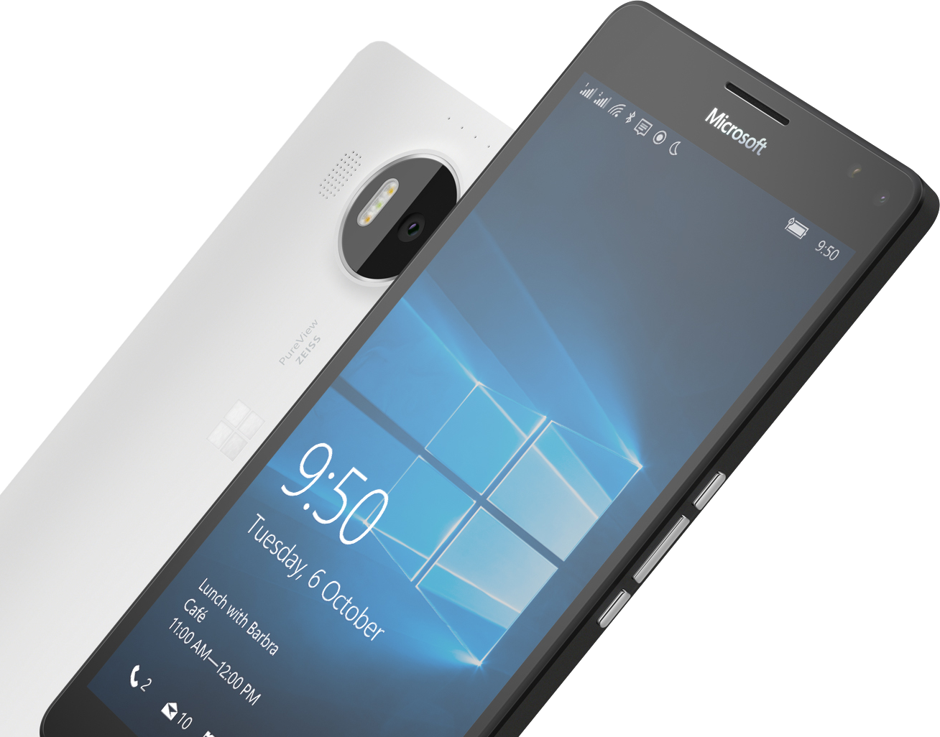
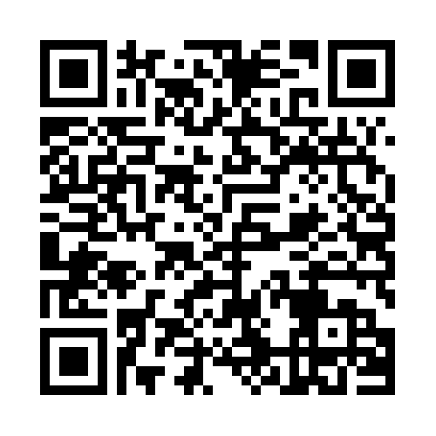

Please Complete An Evaluation Form Your input is important!
Required Slide
*delete this box when your slide is finalized
SAMPLE
or
Notes:
Update phone image to a Microsoft phone.

Slide 16
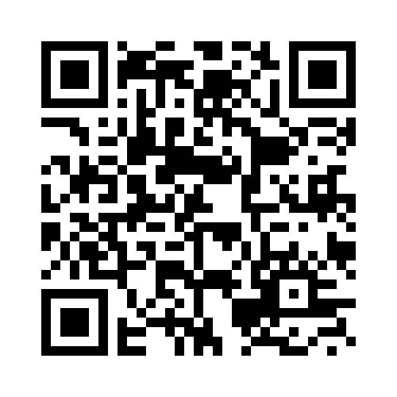
Please evaluate this session
Your feedback is
very important
Notes:
Speakers: Please note this slide will be updated with your session’s QR code during the scrub process which is outlined on side 3. Attendees can scan the QR code for access to your session’s eval.

