Slide 2
How to use this template
This is the Microsoft Build PPT template. The template itself is formatted to reflect the event brand.
White is the lead template background color and the supporting colors are blue, dark blue, and cyan.
Please note there is a dark template master for speaker use if they choose.
PLEASE REMOVE THIS SLIDE 2 & THE FOLLOWING HIDDEN SLIDES 3-7 BEFORE PRESENTING!
Notes:
Update second bullet with new colors.

Slide 3
Deadlines & Resources
Below is a list of key dates and resources:
Important Content Deadlines – detailed instructions are found on the Speaker Portal:
ASAP Complete your event registration ASAP
February 29th Fill out an ERT Request for additional equipment needed for your session
March 24th Upload your FINAL PPT at the Speaker Portal
Your spoken presentation may change until delivery of the session, but create and lock your PPT by the deadline
YOUR PROMPT FINAL PPT SUBMISSION IS APPRECIATED
Limited PPT support is available onsite
Points of Contact
Direct presentation questions to Erika Seven at v-erseve@microsoft.com
Direct content questions to your Track Owner
NOTE: PPTs or Recordings with licensing issues will not be published until resolved.
Notes:
© 2010 Microsoft Corporation. All rights reserved. Microsoft, Windows, Windows Vista and other product names are or may be registered trademarks and/or trademarks in the U.S. and/or other countries.
The information herein is for informational purposes only and represents the current view of Microsoft Corporation as of the date of this presentation. Because Microsoft must respond to changing market conditions, it should not be interpreted to be a commitment on the part of Microsoft, and Microsoft cannot guarantee the accuracy of any information provided after the date of this presentation. MICROSOFT MAKES NO WARRANTIES, EXPRESS, IMPLIED OR STATUTORY, AS TO THE INFORMATION IN THIS PRESENTATION.

Slide 4
Scrub Checklist
Upload your final deck on the speaker portal on or before March 24, 2016.
The Scrub Process will include:
Verification that required slides are included
Remove any non-template logos and graphics from the walk-in slide
Remove all comments, hidden slides and speaker notes from slides
Set file properties box
Reset printability to grayscale
Notify Speaker of any images identified as unlicensed for immediate resolution
Rename files to match naming convention
Correct session title and session code to match printed Session Schedule and Schedule Builder
Add QR code for use onsite
PRINTING: This template is intentionally set to print in color or grayscale, not black and white
As speakers, you must:
Use the provided event template and associated colors, fonts, layout and transition slides
Correct product names to follow applicable branding rules
Remove any unlicensed images
Notes:
Red on black is hard to read.

Slide 5
ATTENTION: PLEASE READ
Photography and copyright infringement.
Due to copyright laws, please refrain from searching for photography online and utilizing them in your presentations. Using imagery from movies, television, music and pop-culture is illegal, unless purchased from a stock photography site or given expressed written consent from the owner. If you have any questions regarding your imagery please consult with CELA and/or read more at this site.
Alternatively, please see the photography section below for instruction on impactful photo usage and links to Microsoft owned images.
Please also consider brand illustrations. See the illustration slides
for details. Custom illustrations created by
Silver Fox Productions are also available.

Slide 6
Common Copyright Myths
If an image is on the Internet/Bing it is in the public domain.
If there is no copyright notice on the image, I don’t need permission.
If I don’t profit from the use, I don’t need permission.
If I remove the image after notice, I don’t owe any money to the copyright.
If I alter the image X%, I don’t need permission.
If I only use a part of the image, I don’t need permission.
If I only include a hyperlink in my presentation and click it to show the image, I don’t need permission.
Notes:
Red on black is hard to read.

Slide 7
Where can I find imagery?
A few great places to start…
Brand Central: A resource for information on the Microsoft brand
https://microsoft.sharepoint.com/teams/BrandCentral/
Microsoft News Center A great place for the latest and greatest
www.microsoft.com/en-us/news
Xbox Wire Media Assets library
http://news.xbox.com/media/
Featured Devices: PC, tablet and phone hardware imagery and marketing materials
https://www.featureddevices.com/
Presentation Resources: Presentation guidelines and PowerPoint templates
https://microsoft.sharepoint.com/teams/BrandCentral/Pages/Presentations.aspx
Respect intellectual property rights
Photography and graphics used in presentations, for both internal and external audiences, must be owned by Microsoft or licensed appropriately.
Microsoft has agreements in place with several stock providers. More information about approved stock providers and instructions for requesting licenses is available here: https://microsoft.sharepoint.com/teams/MediaAcquisition/Pages/knowledgeBase.aspx
Avoid intellectual property theft: Do not use photos or graphics copied from the web in presentations. When in doubt, consult with LCA http://lcaweb/CTP/Copyrights/Third-Party-Content-Use/Pages/default.aspx

Slide 9
Presentation title goes here
Session code
Speaker name
Title

Slide 10
Preferred text layout (no bullets)
Main topic 1: size 40pt
Size 20pt for the subtopics
Size 20pt for the subtopics
Main topic 2: size 40pt
Size 20pt for the subtopics
Size 20pt for the subtopics
Main topic 3: size 40pt
Size 20pt for the subtopics
Size 20pt for the subtopics

Slide 11
Preferred text layout (no bullets)
Main topic 1: size 40pt
Size 20pt for the subtopics
Size 20pt for the subtopics
Main topic 2: size 40pt
Size 20pt for the subtopics
Size 20pt for the subtopics
Main topic 3: size 40pt
Size 20pt for the subtopics
Size 20pt for the subtopics

Slide 12
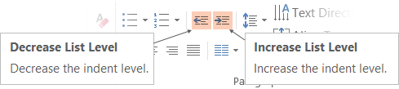
Adjusting list levels
Main topic 1: size 40pt
Size 20pt for the subtopics
Size 20pt for the subtopics
Main topic 2: size 40pt
Size 20pt for the subtopics
Size 20pt for the subtopics
Main topic 3: size 40pt
Size 20pt for the subtopics
Size 20pt for the subtopics
Use the “Decrease List Level” and “Increase List Level” tools on the Home Menu to change text levels.
Try this:
Place your cursor in any row of text to the left that says “Size 20pt for subtopics”
Next click the Home tab, and then on the “Decrease List level” tool. Notice how the line moves up one level.
Now try placing your cursor in one of the “Main topic…” lines of text. Click the “Increase List Level” tool and see how the text is pushed in one level
Use these 2 tools to adjust your text levels as you work

Slide 13
Bullet points layout with subtitle Subtitle
Example of a bulleted slide with a subhead
Set the slide title to “Sentence case”
Set subheads to “Sentence case”
Hyperlink style
www.microsoft.com

Slide 14
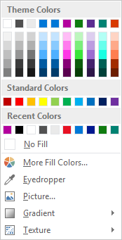
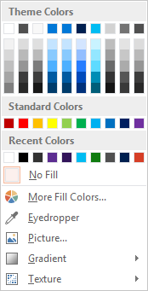
Slide palette info
The PowerPoint palette for this template has been built for you and is shown below. Avoid using too many colors in your presentation.
Select the 4th color from the left for subheads and 1st level non-bulleted text color, or wherever “color” text is preferred over the default black/white text
Accent colors 1-6 – (6 Theme Colors to the far right)
Text
Dark 2
Accent 1
Accent 2
Accent 3
Accent 4
Accent 5
Accent 6
Use Accent 1 as the main accent color. Use Accent 2 and Accent 3 when additional colors are needed.
Use Accents 4-6 sparingly – only when more colors are necessary.

Slide 15
Charts
For content: Type is what articulates the message. Text doesn’t need to be bulleted. Text size can reinforce and impact.

Slide 16
Charts
For content: Type is what articulates the message. Text doesn’t need to be bulleted. Text size can reinforce and impact.

Slide 17
Table
Column 1 | Column 2 | Column 3 | Column 4 | Column 5
Text | Text | Text | Text | Text
Text | Text | Text | Text | Text
Text | Text | Text | Text | Text
Text | Text | Text | Text | Text
Text | Text | Text | Text | Text
Text | Text | Text | Text | Text
Text | Text | Text | Text | Text
Text | Text | Text | Text | Text
This is a content box, always 24pts and sentence case.

Slide 18
Diagram with text
This is a content box, always 24pts and sentence case.
Windows Style App
<audio src=“…”>
<video src=“…”>
Windows Runtime (WinRT)
Playback/Preview
(Media Engine)
Capture
(Capture Engine)
Transcode
Streaming
(Sharing Engine)
Media Foundation
Audio/Video
Source
Video
Decoder
Video
Effect 1
Video
Effect N
Video
Encoder
Audio/Video
Sink
Audio
Decoder
Audio
Effect 1
Audio
Effect N
Audio
Encoder

Slide 19
Diagram without text
New Windows 8 app
<audio src=“…”>
<video src=“…”>
Windows Runtime (WinRT)
Playback/Preview
(Media Engine)
Capture
(Capture Engine)
Transcode
Streaming
(Sharing Engine)
Media Foundation
Audio/Video
Source
Video
Decoder
Video
Effect 1
Video
Effect N
Video
Encoder
Audio/Video
Sink
Audio
Decoder
Audio
Effect 1
Audio
Effect N
Audio
Encoder

Slide 20
Video

Slide 21
Demo
Speaker name

Slide 22
Photo layout 1
Notes:
Use developer type photo.

Slide 23
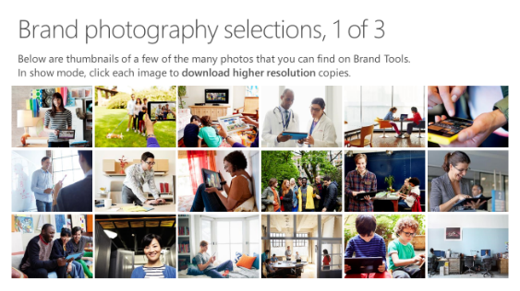
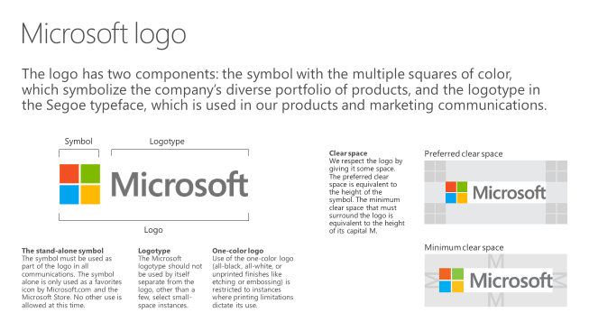
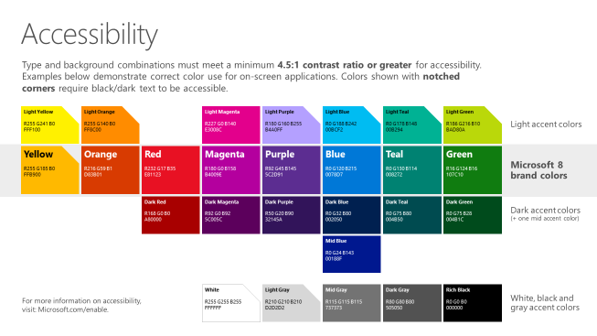
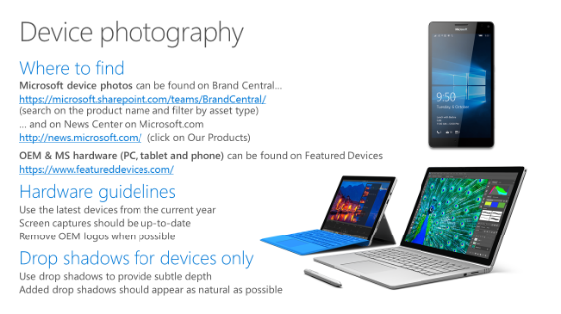
Microsoft brand guidelines
Looking for more slide resources?
Brand guidelines for PowerPoint templates is a separate slide deck that provides an overview of the Microsoft brand, guidelines, resources, tips and much more.
A few of the slides are shown at right.
Download from: https://microsoft.sharepoint.com/teams/BrandCentral/Pages/Presentations.aspx

Slide 24
Section title

Slide 25
Section title
Notes:
Make text black in master.

Slide 26
“If you could only sense how important you are to the lives of those you meet; how important you can be to the people you may never even dream of. There is something of yourself that you leave at every meeting with another person.”
FRED ROGERS

Slide 27
Software code slide
This slide layout uses Consolas, a monotype font which is ideal for showing software code.

Slide 28
Notes (hidden)
Some speakers at Microsoft like to use this slide for hidden “notes slides”.
Delete it if you don’t want to use it.
NEXT: <next slide title>

Slide 29
Call to Action
Use this slide to list resources, white papers, videos and links.
Let attendees know their next step after seeing this session.
Re-visit Build on Channel 9.
Continue your education at Microsoft Virtual Academy online.

Slide 30
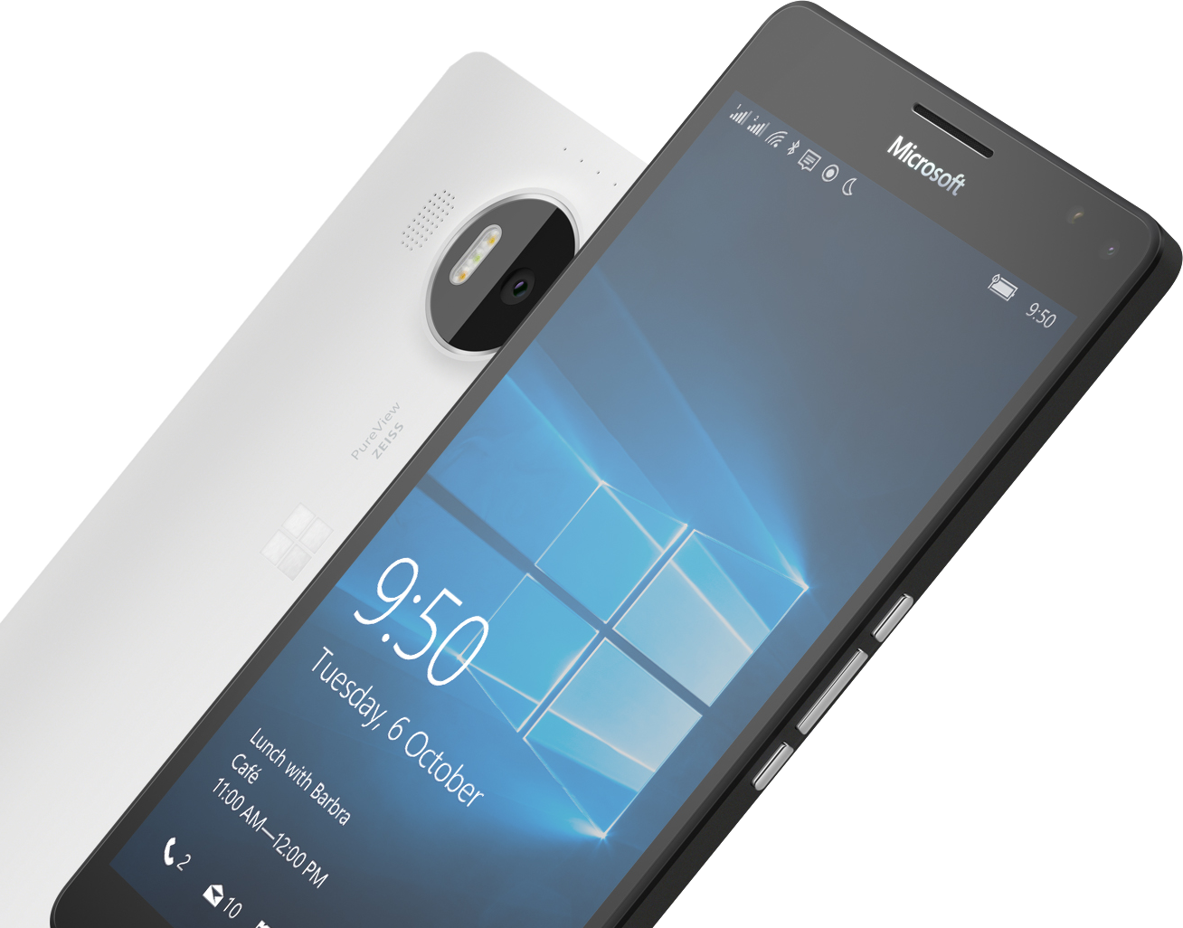
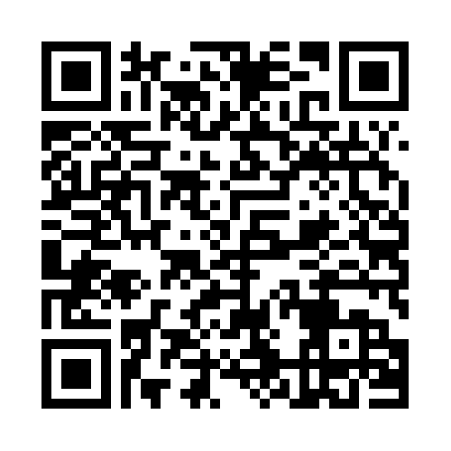

Please Complete An Evaluation Form Your input is important!
Required Slide
*delete this box when your slide is finalized
SAMPLE
or
Notes:
Update phone image to a Microsoft phone.

Slide 31
Evaluate this session
Required Slide
*delete this box when your slide is finalized
Speakers: This slide will be updated during the scrub process with a unique QR code. Attendees scan the QR code to access the eval for your session.
SAMPLE
Notes:
Speakers: Please note this slide will be updated with your session’s QR code during the scrub process which is outlined on side 3. Attendees can scan the QR code for access to your session’s eval.

Slide 32
Notes:
Dark gray background.

Slide 34
Presentation title goes here
Speaker name
Title

Slide 35
Preferred text layout (no bullets)
Main topic 1: size 40pt
Size 20pt for the subtopics
Size 20pt for the subtopics
Main topic 2: size 40pt
Size 20pt for the subtopics
Size 20pt for the subtopics
Main topic 3: size 40pt
Size 20pt for the subtopics
Size 20pt for the subtopics

Slide 36
Bullet points layout with subtitle Subtitle
Example of a bulleted slide with a subhead
Set the slide title to “Sentence case”
Set subheads to “Sentence case”
Hyperlink style
www.microsoft.com

Slide 37
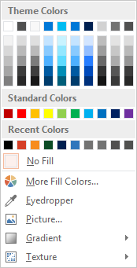
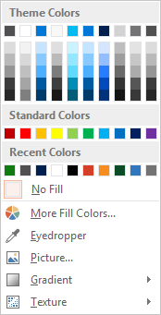
Slide palette info
The PowerPoint palette for this template has been built for you and is shown below. Avoid using too many colors in your presentation.
Accent colors 1-6 – (6 Theme Colors to the far right)
Accent 1
Accent 2
Accent 3
Accent 4
Accent 5
Accent 6
Use Accent 1 as the main accent color. Use Accent 2 and Accent 3 when additional colors are needed.
Use Accents 4-6 sparingly – only when more colors are necessary.

Slide 38
Charts
For content: Type is what articulates the message. Text doesn’t need to be bulleted. Text size can reinforce and impact.

Slide 39
Charts
For content: Type is what articulates the message. Text doesn’t need to be bulleted. Text size can reinforce and impact.

Slide 40
Table
Column 1 | Column 2 | Column 3 | Column 4 | Column 5
Text | Text | Text | Text | Text
Text | Text | Text | Text | Text
Text | Text | Text | Text | Text
Text | Text | Text | Text | Text
Text | Text | Text | Text | Text
Text | Text | Text | Text | Text
Text | Text | Text | Text | Text
Text | Text | Text | Text | Text
This is a content box, always 24pts and sentence case.

Slide 41
Diagram with text
This is a content box, always 24pts and sentence case.
Windows Style App
<audio src=“…”>
<video src=“…”>
Windows Runtime (WinRT)
Playback/Preview
(Media Engine)
Capture
(Capture Engine)
Transcode
Streaming
(Sharing Engine)
Media Foundation
Audio/Video
Source
Video
Decoder
Video
Effect 1
Video
Effect N
Video
Encoder
Audio/Video
Sink
Audio
Decoder
Audio
Effect 1
Audio
Effect N
Audio
Encoder

Slide 42
Diagram without text
New Windows 8 app
<audio src=“…”>
<video src=“…”>
Windows Runtime (WinRT)
Playback/Preview
(Media Engine)
Capture
(Capture Engine)
Transcode
Streaming
(Sharing Engine)
Media Foundation
Audio/Video
Source
Video
Decoder
Video
Effect 1
Video
Effect N
Video
Encoder
Audio/Video
Sink
Audio
Decoder
Audio
Effect 1
Audio
Effect N
Audio
Encoder

Slide 43
Video

Slide 44
Demo
Speaker name

Slide 45
Photo layout 1
Notes:
Use developer type photo.

Slide 46
“If you could only sense how important you are to the lives of those you meet; how important you can be to the people you may never even dream of. There is something of yourself that you leave at every meeting with another person.”
FRED ROGERS

Slide 47
Section title

Slide 48
Section title
Notes:
Make text black in master.

Slide 49
Software code slide
This slide layout uses Consolas, a monotype font which is ideal for showing software code.

Slide 50
Notes (hidden)
Some speakers at Microsoft like to use this slide for hidden “notes slides”.
Delete it if you don’t want to use it.
NEXT: <next slide title>

Slide 51
Call to Action
Use this slide to list resources, white papers, videos and links.
Let attendees know their next step after seeing this session.
Re-visit Build on Channel 9.
Continue your education at Microsoft Virtual Academy online.

Slide 52
Please Complete An Evaluation Form Your input is important!
Required Slide
*delete this box when your slide is finalized
SAMPLE
or
Notes:
Update phone image to a Microsoft phone.

Slide 53
Evaluate this session
Required Slide
*delete this box when your slide is finalized
Speakers: This slide will be updated during the scrub process with a unique QR code. Attendees scan the QR code to access the eval for your session.
SAMPLE
Notes:
Speakers: Please note this slide will be updated with your session’s QR code during the scrub process which is outlined on side 3. Attendees can scan the QR code for access to your session’s eval.

Slide 54
Notes:
Dark gray background.

