Slide 2
Porting your OpenGL ES 2.0 Game to Windows 10 using ANGLE
L709
Dale Stammen
Senior Software Engineer

Slide 3
Background
Almost
Native
Graphics
Layer
Engine
“An open-source project that allows Windows users to seamlessly run OpenGL ES 2.0 content by translating OpenGL ES 2.0 API calls to DirectX 11 API calls.” – ANGLE Project
Started in 2010
by Google, Inc.
Coordinated/managed by Google, Inc.
15 Companies
66+ Individuals
Goal: provide a way to universally run OpenGL ES 2.0 applications on Windows

Slide 4
ANGLE
Almost Native Graphics Layer Engine
Windows 10 UWP apps do not natively support OpenGL ES 2.0.
Microsoft has contributed code to enable Windows 8.1 and 10 UWP apps to run OpenGL ES 2.0 content.
https://github.com/MSOpenTech/angle
You don’t need to port your OpenGL ES 2.0 code to DirectX. ANGLE does the conversion for you.

Slide 5
Architecture
OpenGL ES Validation Layer
Provides validation of API parameters before passing to translation layer
ANGLE Translation Layer
Translates API calls to appropriate DirectX API(s)
GLSL ES (ESSL) converted to HLSL
Rendering
Performed by Direct3D 11
Leverages Direct3D 11 driver support for the Windows ecosystem
Windows App
(Calls to OpenGL ES)
ANGLE
OpenGL ES Validation Layer
ANGLE Translation Layer
ANGLE Direct3D 11 Renderer
Direct3D 11

Slide 6
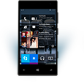
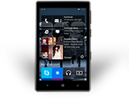
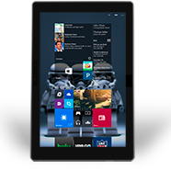
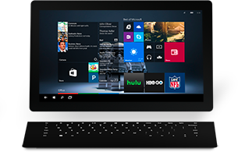
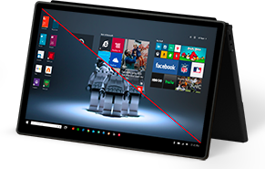
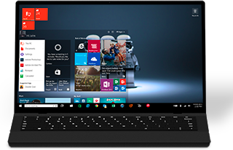
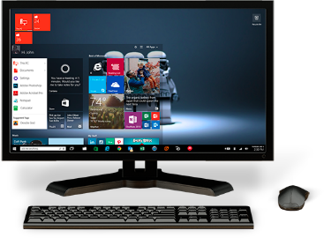
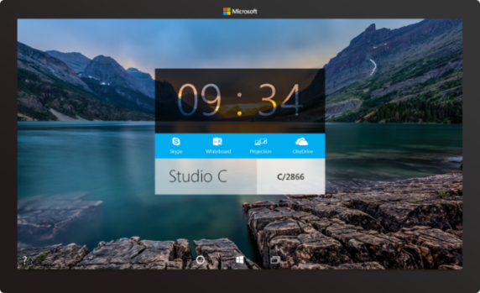
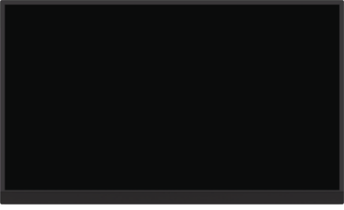
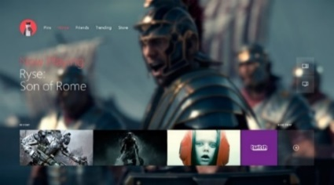
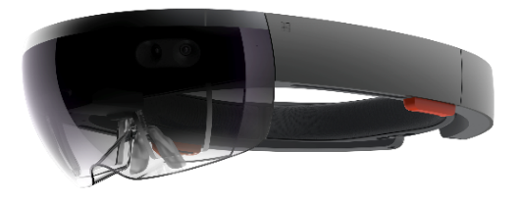
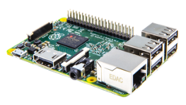

Windows on a full range of devices…
2-in-1s (Tablet or Laptop)
Classic Laptop
Desktops & All-in-Ones
Phone
Phablet
Small Tablet
Large Tablet
Windows 10
Surface Hub
Xbox
Holographic
IoT
Notes:
“With Windows 10, we’ve taken our best work from Desktop, Windows Phone, and Xbox merged it into a single core operating system with a tailored experience for each device. Windows 10 runs on everything from Phone to laptop to desktop to IoT devices and Hololens.”

Slide 7
ANGLE Device Support
Hardware Feature Level | Device | OpenGL ES Support
11_1, 11_0, 10_1, 10_0 | Modern Desktop PCs Surface Pros Lumia 950, 950XL | OpenGL ES 2.0 Most of OpenGL ES 3.0
9_3 | Windows Phones | OpenGL ES 2.0
9_2, 9_1 | Surface RT | OpenGL ES 2.0 (WARP)
None | Raspberry Pi 2 | OpenGL ES 2.0 (WARP)

Slide 8
ANGLE
ANGLE fully supports these C++ app types:
Universal Windows Apps (Windows 10) UWP
Windows 8.1 and Windows Phone 8.1 apps
Windows desktop applications
ANGLE provides templates for Visual Studio 2013 and 2015 that work as starting points for porting your game.
Code your application to the Khronos OpenGL ES 2.0 and EGL 1.4 APIs.
Known Issues: https://github.com/MSOpenTech/angle/wiki/Known-Issues

Slide 9
ANGLE Lab Exercises
1
Create a new ANGLE project using a Visual Studio Template
2
Integrate your game code with ANGLE
3
Handle window resizing
4
Add touch and keyboard events to your app
Notes:
“As a follow-on to this lab, we also have the Azure IoT lab. In that, you’ll learn how to use the Raspberry Pi to send sensor data to IoT Hub and process it using other Azure IoT services.
If you are interested in the underlying IO and other capabilities on devices like the Raspberry Pi, or want to explore more with Azure and devices, we also have the Open Hack in this same room, starting on Day 2.”

Slide 10
ANGLE Lab Exercises (Optional)
5
Add game resources to your app
6
Run your game on Windows 10 Phone
7
Adding ANGLE using NuGet
Notes:
“As a follow-on to this lab, we also have the Azure IoT lab. In that, you’ll learn how to use the Raspberry Pi to send sensor data to IoT Hub and process it using other Azure IoT services.
If you are interested in the underlying IO and other capabilities on devices like the Raspberry Pi, or want to explore more with Azure and devices, we also have the Open Hack in this same room, starting on Day 2.”

Slide 11
Lab
Share your photos and experiences!
#Build2016
Notes:
You should get to this slide no later than 10 minutes into the session
Show how to get to the lab on the workstation, and then leave this slide up on the projector.

Slide 12
Lab
http://aka.ms/angle-hol
ANGLE.shortcut
Notes:
You should get to this slide no later than 10 minutes into the session
Show how to get to the lab on the workstation, and then leave this slide up on the projector.

Slide 13
ANGLE Lab Exercises
1
Create a new ANGLE project using a Visual Studio Template
http://aka.ms/angle-ex1
Notes:
“As a follow-on to this lab, we also have the Azure IoT lab. In that, you’ll learn how to use the Raspberry Pi to send sensor data to IoT Hub and process it using other Azure IoT services.
If you are interested in the underlying IO and other capabilities on devices like the Raspberry Pi, or want to explore more with Azure and devices, we also have the Open Hack in this same room, starting on Day 2.”

Slide 14
ANGLE Lab Exercises
2
Integrate your game code with ANGLE
http://aka.ms/angle-ex2
Notes:
“As a follow-on to this lab, we also have the Azure IoT lab. In that, you’ll learn how to use the Raspberry Pi to send sensor data to IoT Hub and process it using other Azure IoT services.
If you are interested in the underlying IO and other capabilities on devices like the Raspberry Pi, or want to explore more with Azure and devices, we also have the Open Hack in this same room, starting on Day 2.”

Slide 15
ANGLE Lab Exercises
3
Handle window resizing
http://aka.ms/angle-ex3
Notes:
“As a follow-on to this lab, we also have the Azure IoT lab. In that, you’ll learn how to use the Raspberry Pi to send sensor data to IoT Hub and process it using other Azure IoT services.
If you are interested in the underlying IO and other capabilities on devices like the Raspberry Pi, or want to explore more with Azure and devices, we also have the Open Hack in this same room, starting on Day 2.”

Slide 16
ANGLE Lab Exercises
4
Add touch and keyboard events to your app
http://aka.ms/angle-ex4
Notes:
“As a follow-on to this lab, we also have the Azure IoT lab. In that, you’ll learn how to use the Raspberry Pi to send sensor data to IoT Hub and process it using other Azure IoT services.
If you are interested in the underlying IO and other capabilities on devices like the Raspberry Pi, or want to explore more with Azure and devices, we also have the Open Hack in this same room, starting on Day 2.”

Slide 17
ANGLE Lab Exercises (Optional)
https://github.com/Microsoft-Build-2016/CodeLabs-GameDev-3-ANGLE/blob/master/Source/Ex4/README.md
7
Adding ANGLE using NuGet
http://aka.ms/angle-ex7
Notes:
“As a follow-on to this lab, we also have the Azure IoT lab. In that, you’ll learn how to use the Raspberry Pi to send sensor data to IoT Hub and process it using other Azure IoT services.
If you are interested in the underlying IO and other capabilities on devices like the Raspberry Pi, or want to explore more with Azure and devices, we also have the Open Hack in this same room, starting on Day 2.”

Slide 18
For more information:
ANGLE: https://github.com/MSOpenTech/angle
Wiki: https://github.com/MSOpenTech/angle/wiki
Lab: https://github.com/Microsoft-Build-2016/CodeLabs-GameDev-3-ANGLE
Breakout Tutorial: http://learnopengl.com/#!In-Practice/2D-Game/Breakout
Khronos: OpenGL ES 2.0 and EGL 1.4 APIs

Slide 19
Related session
The Future of Game Development on Windows
Date: Wednesday, March 30
Time: 5:00pm – 6:00pm
Room: Marriott 6

Slide 20
Build Game Labs
L707
Introduction to Unity
L708
Lighting up your Unity Game on Windows 10
L711
Introduction to MonoGame
L712
Engaging Players with Azure
L713
Integrating your Windows 10 UWP Game with Xbox Live
Notes:
“As a follow-on to this lab, we also have the Azure IoT lab. In that, you’ll learn how to use the Raspberry Pi to send sensor data to IoT Hub and process it using other Azure IoT services.
If you are interested in the underlying IO and other capabilities on devices like the Raspberry Pi, or want to explore more with Azure and devices, we also have the Open Hack in this same room, starting on Day 2.”

Slide 21
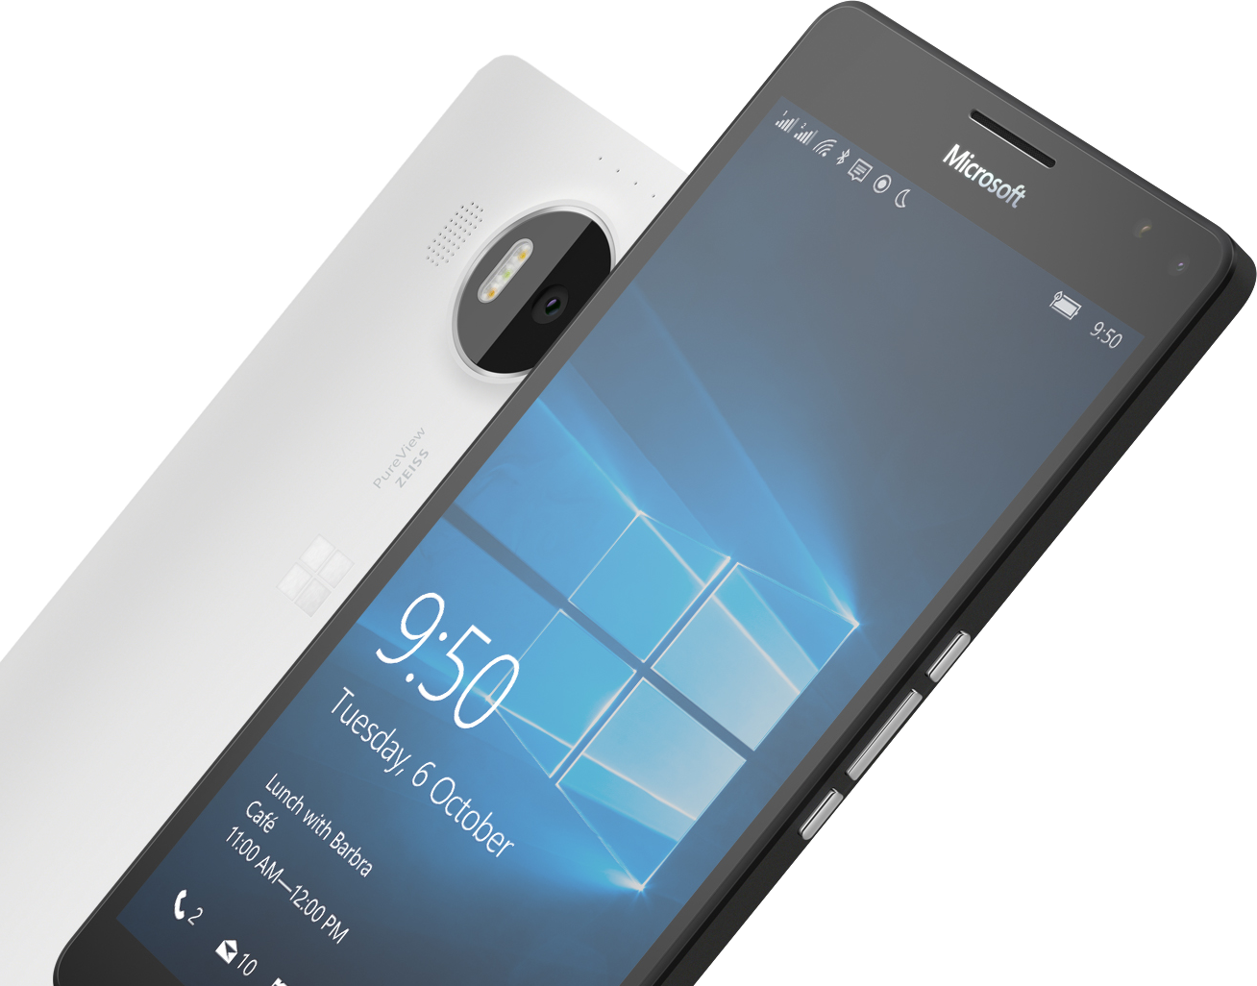
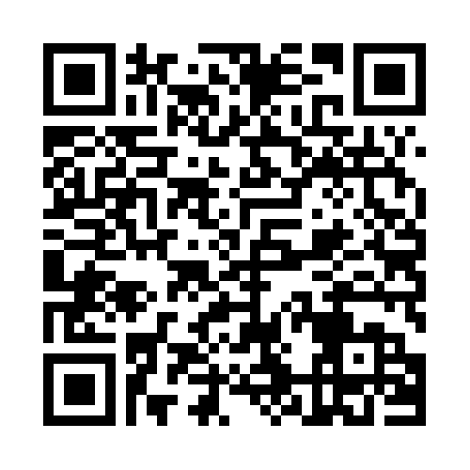

Please Complete An Evaluation Form Your input is important!
Required Slide
*delete this box when your slide is finalized
SAMPLE
or
Notes:
Update phone image to a Microsoft phone.

Slide 22
Evaluate this session
Required Slide
*delete this box when your slide is finalized
Speakers: This slide will be updated during the scrub process with a unique QR code. Attendees scan the QR code to access the eval for your session.
SAMPLE
Notes:
Speakers: Please note this slide will be updated with your session’s QR code during the scrub process which is outlined on side 3. Attendees can scan the QR code for access to your session’s eval.

