Slide 2
Build Code Lab Office 365 Development 1: Building Office Add-ins with Web Development
L722
Richard diZerega
@richdizz

Slide 3
Proctors
Proctors are here to help you!
Raise your hand if you need any assistance
Andrew Coates DX
Dan Kershaw Identity
Doug Perkes DX
Gareth Jones Microsoft Graph
Juan Balmoir Labra Office
Simon Michael DX
Stuart Kwan Identity
Sudheer Maremanda Office
Wey Mania Outlook

Slide 4
Office 365 Lab Modules
1
Mobile Development and the Microsoft Graph
2
Web Development and the Microsoft Graph
3
Building Office Add-ins with Web Development
3
Integrating Conversations with Skype and Office 365 Connectors
Notes:
“As a follow-on to this lab, we also have the Azure IoT lab. In that, you’ll learn how to use the Raspberry Pi to send sensor data to IoT Hub and process it using other Azure IoT services.
If you are interested in the underlying IO and other capabilities on devices like the Raspberry Pi, or want to explore more with Azure and devices, we also have the Open Hack in this same room, starting on Day 2.”

Slide 5
In this module…

Slide 6
Historical Challenges with Office Add-ins
Proposals would be much more enjoyable as a game!
But where to fine one???
Will Pac-Man Proposals work on the latest version of Windows and Office?
We have 100K employees that build proposals…how will we distribute???
Proprietary Development
Discoverability
Decentralize Distribution
Updates/Upgrades
Devices/Mobility
Internet Ready
Can I run Pac-Man Proposals on my iPad?
Behold…I bring the world…
Pac-Man Proposals for Word!!!
Ewww…COM, VBA, and VSTO Development…REALLY?!?!
My Chromebook has an awesome browser!
v
v
Notes:
Traditional Office add-ins have been built using old or proprietary development technologies like VBA, COM, and VTSO
(ok…our developer got past the development tools and built a great Office add-in…but how are people going to find it?)
Great Office add-ins were hard to find as there was no centralized marketplace to find them
(ok…lets say people find the great Office add-in…what about distribution)
Traditional Office add-ins were installed along side Office and execute with Office, meaning you have to distribute it
What if you want to upgrade to a new version of Office…does the add-in support that? How many of you have heard of someone stuck in an old version of Office because of an add-in?
We are living in a mobile world these days and users want to be productive on the go…traditional add-ins certainly won’t install on mobile devices
We are also living in an age were many users just want to use a browser…traditional add-ins can’t run in Office Online

Slide 7
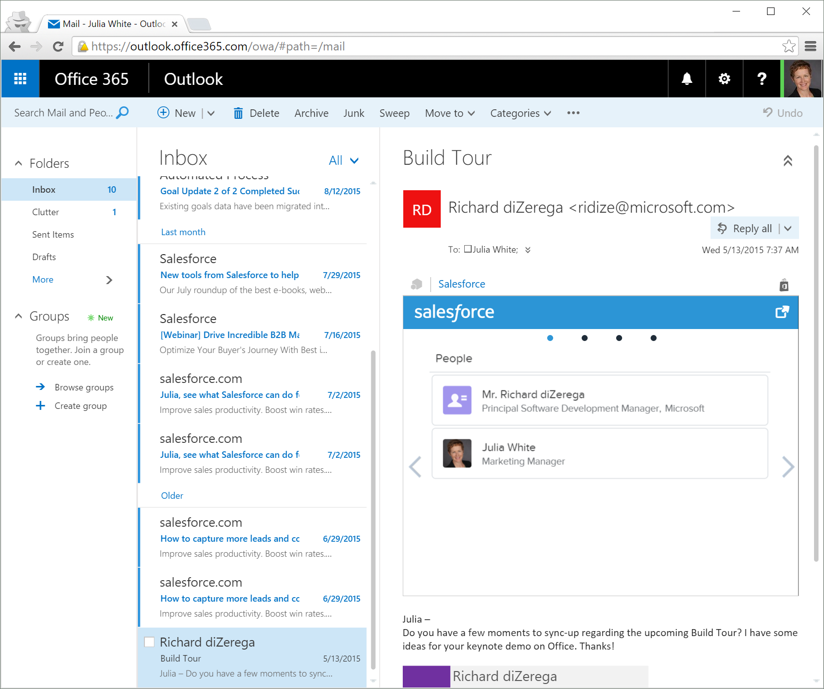
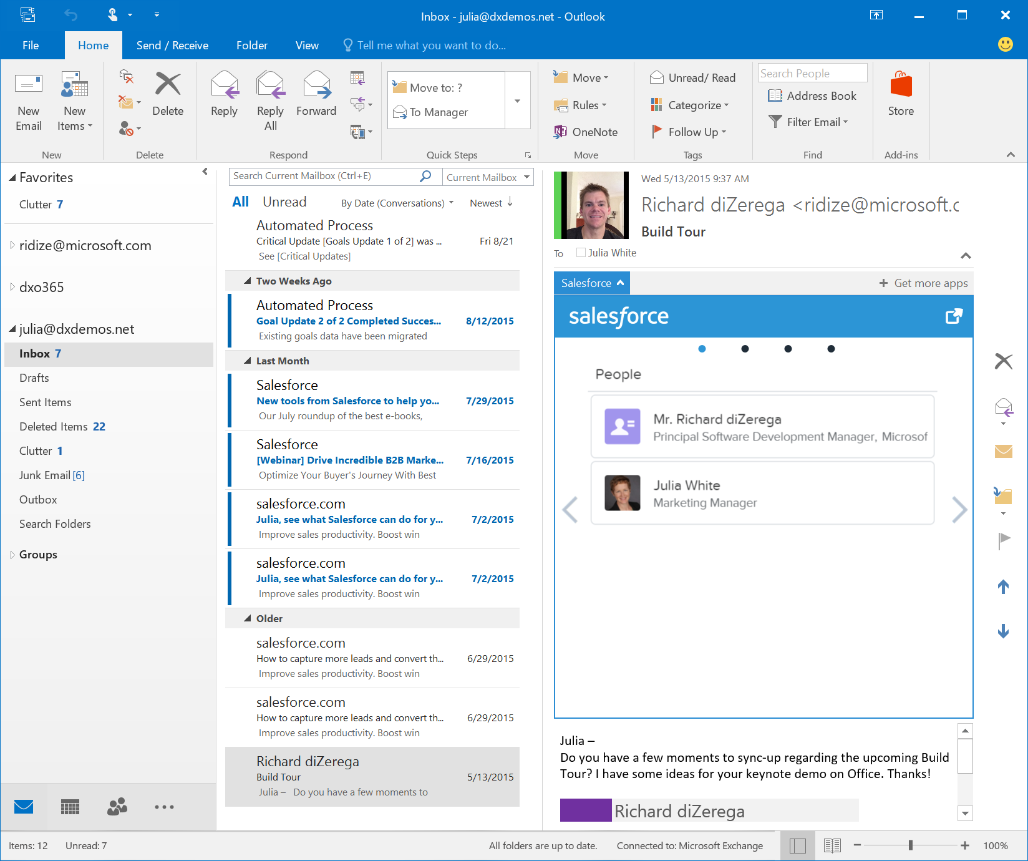
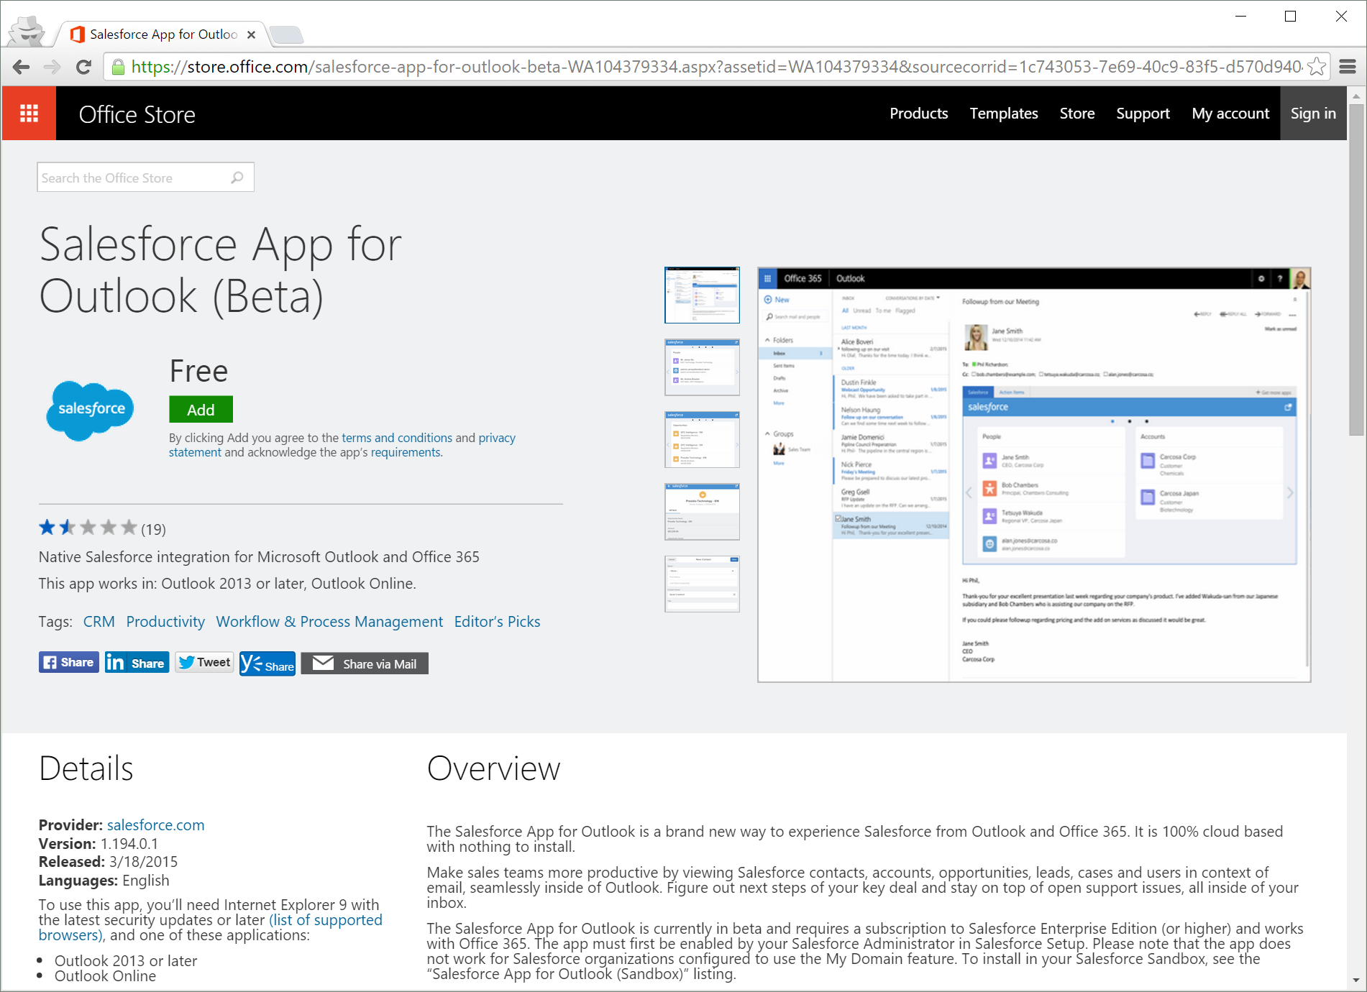
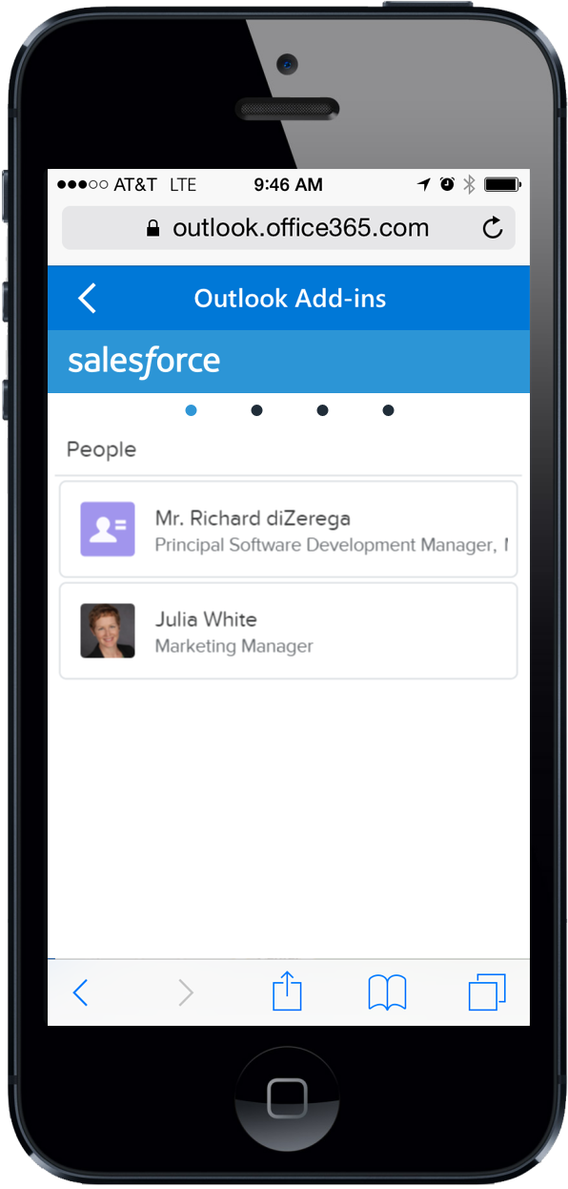
Enter the Modern Web Add-in
<?xml version="1.0" encoding="UTF-8"?>
<OfficeApp xsi:type="MailApp">
<Version>1.0.0.0</Version>
<ProviderName>Salesforce.com</ProviderName>
<DefaultLocale>en-US</DefaultLocale>
<DisplayName DefaultValue=“Salesforce" />
<Capabilities>
<Capability Name="Mailbox" />
</Capabilities>
<DesktopSettings>
<SourceLocation DefaultValue=“https://salesforce.com/office" />
<RequestedHeight>300</RequestedHeight>
</DesktopSettings>
<Permissions>ReadItem</Permissions>
<Rule xsi:type="RuleCollection" Mode="Or">
<Rule xsi:type="ItemIs" ItemType="Message"/>
<Rule xsi:type="ItemIs" ItemType="Appointment"/>
</Rule>
</OfficeApp>
Built with web standards
Office.js provides interop
Hosted centrally
Almost zero client footprint
Runs where Office runs
Discoverable marketplace
Office.js
Browser Control
or iFrame
With HTML5,
JavaScript, CSS
Web Server

Slide 8
Office Add-ins A new way to build extensions for Office
Contextual Mail Add-in
Add-in launched contextually from a mail message or appointment
Outlook and Outlook Web Access (OWA)
Task Pane Add-in
Add-in that runs beside a document/mail with read/write access
Word, Excel, PowerPoint, Project, Outlook
Content Add-in
Add-in that runs within a document content with read/write access
Excel, PowerPoint, Access
Add-in Command
Command in the Office UI to launch add-in or perform UI-less operation
Outlook, Excel, PowerPoint, Word

Slide 9
Getting setup…

Slide 10
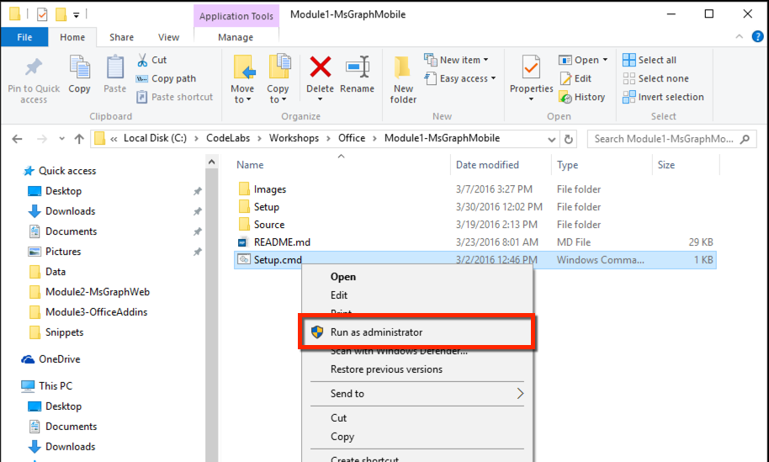
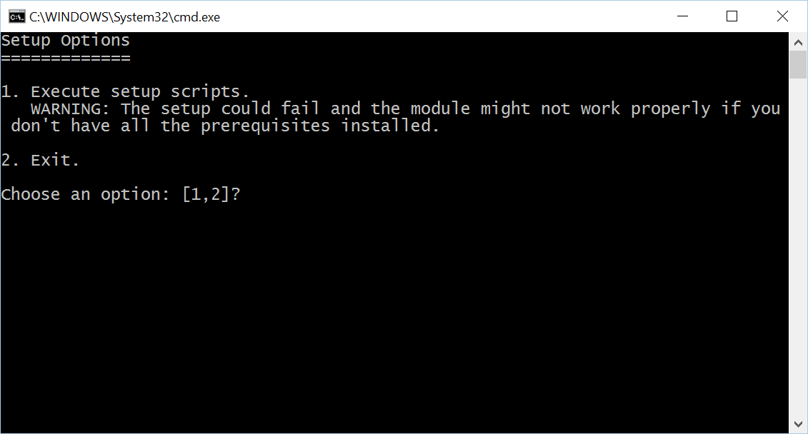
Install Code Snippets
Go to C:\Labs\CodeLabs-Office\Module1-MsGraphMobile
Right-click on Setup.cmd, click on Run as administrator
Click Yes at the User Account Control prompt
Select option 1 in the command window

Slide 11
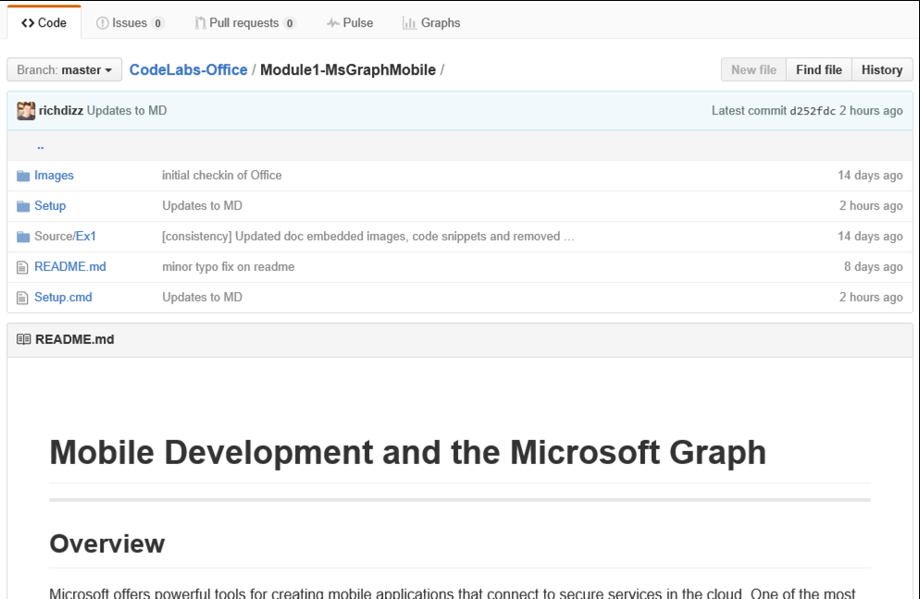
View lab manual
On your desktop, click the Office CodeLabs icon to open the browser at the Github repository for these labs: https://github.com/Microsoft-Build-2016/CodeLabs-Office
Click on the folder for the current module (Module3-Addins)
Scroll down for the README.md – this is your lab manual

Slide 12
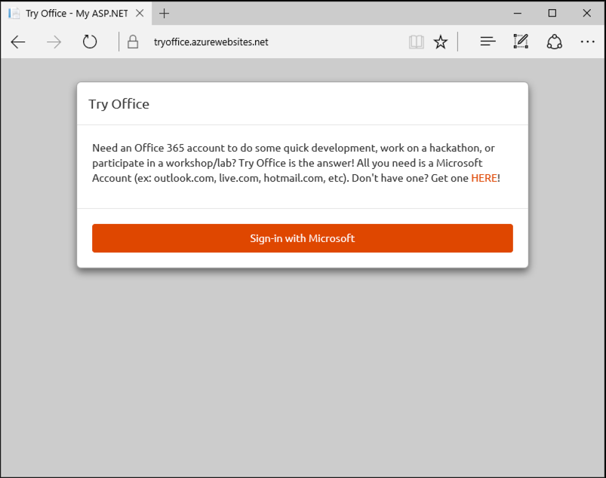
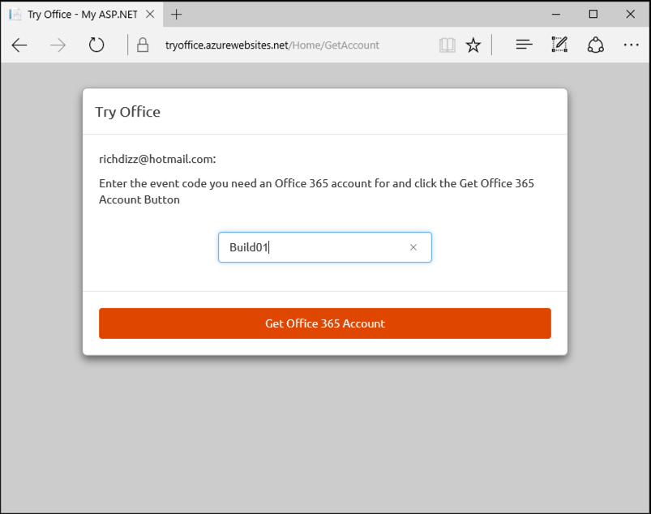
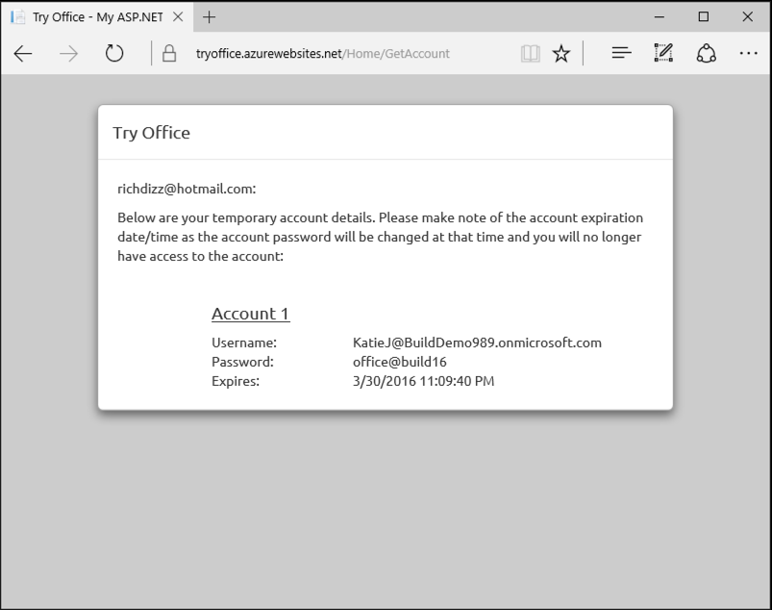
Get Office 365 Account
Navigate to https://aka.ms/tryo365dev and sign-in with a Microsoft Account (ex: Hotmail, Live, Outlook.com, etc)
Enter Event Code Build01 and click “Get Office 365 Account”
Capture the provided credential for use in the lab exercises
1
2
3

Slide 13
Let’s start coding!!!

Slide 14
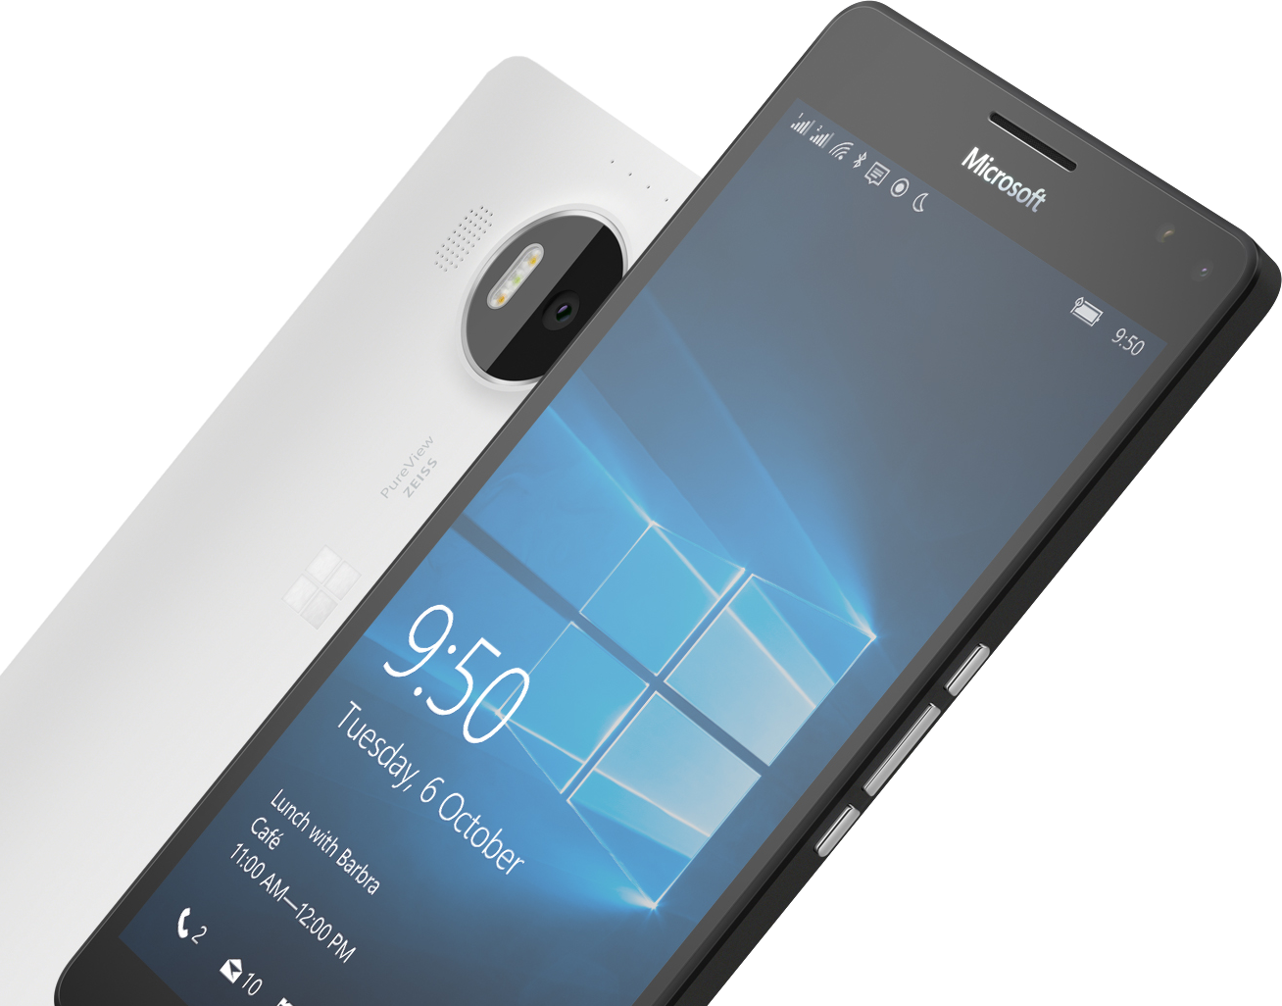
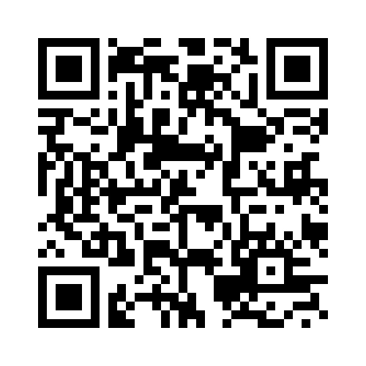


Please Complete An Evaluation Form Your input is important!
SAMPLE
or
Notes:
Update phone image to a Microsoft phone.

Slide 15
Evaluate this session
SAMPLE
Notes:
Speakers: Please note this slide will be updated with your session’s QR code during the scrub process which is outlined on side 3. Attendees can scan the QR code for access to your session’s eval.

