Slide 2
Build Code Lab Office 365 Development 1: Mobile Development and the Microsoft Graph
L720
Richard diZerega
@richdizz

Slide 3
Proctors
Proctors are here to help you!
Raise your hand if you need any assistance
Andrew Coates DX
Dan Kershaw Identity
Doug Perkes DX
Gareth Jones Microsoft Graph
Simon Michael DX
Stuart Kwan Identity
Yina Arenas Microsoft Graph

Slide 4
Office 365 Lab Modules
1
Mobile Development and the Microsoft Graph
2
Web Development and the Microsoft Graph
3
Building Office Add-ins with Web Development
3
Integrating Conversations with Skype and Office 365 Connectors
Notes:
“As a follow-on to this lab, we also have the Azure IoT lab. In that, you’ll learn how to use the Raspberry Pi to send sensor data to IoT Hub and process it using other Azure IoT services.
If you are interested in the underlying IO and other capabilities on devices like the Raspberry Pi, or want to explore more with Azure and devices, we also have the Open Hack in this same room, starting on Day 2.”

Slide 5
In this module…

Slide 6

Building Connected Mobile Applications
Identity
APIs
Notes:
In many cases, you will use the same display but adapt it using Visual States and – a new feature in UWP XAML - Adaptive Triggers to move content around, or to show/hide bits of content. Another new control, RelativePanel, is great for repositioning content under the control of Visual States – for example, repositioning the ‘End Call’ button underneath the other control buttons on the phone display shown here.

Slide 7
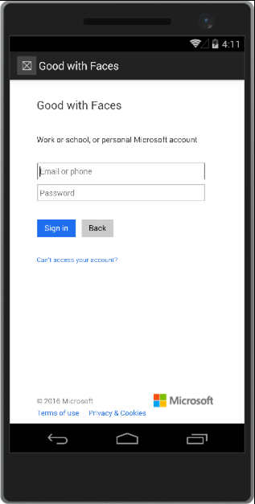
Identity - Azure Active Directory
Single authentication flow
Across all Office 365 services
“Native” apps and web sites
Admin and end-user consent
Secure protocol
OAuth 2.0 (no capturing user credentials)
Fine-grained access scopes
Supports multi-factor and federated authentication
Long-term access through refresh tokens
“Native” Azure Apps
Inherently multi-tenant
No client/app secret (think about distribution)
No application-only permissions (can go through proxy service)
Notes:
When you think of the broad range of screen sizes available across all Windows 10 devices, from 4.5” phones up to the 84” Surface Hub, it can seem daunting to create an adaptive UI that will work well across all of these.
Our advice is to target a few key scenarios:
5” phone in portrait
8” tablet in portrait and landscape
13” laptop/PC in landscape
If you focus on these key targets, and use adaptive layout techniques such as Grid layout and controls that can wrap and flow output such as the TextBlock with Wrapping set to true, then you should find that you will end up with good results across all the targeted devices and also on those intermediaries.
You can then target additional screens such as large monitors, Surface Hub or Xbox if it makes sense for your app.

Slide 8
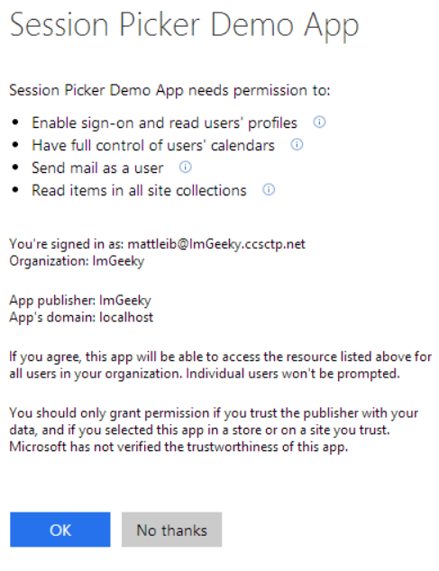
Azure AD Authentication Libraries
Makes authentication easy
Simplifies the authentication flow (supports multiple flows)
Handles token acquisition and caching
Delivers the sign-in form/control for mobile applications
Available for most platforms
Native Applications (UWP, Android, iOS, Cordova, etc)
Web Applications (.NET, Node.js, JavaScript/Angular, Python, Ruby, etc)
Open Source
https://github.com/AzureAD
Notes:
When you think of the broad range of screen sizes available across all Windows 10 devices, from 4.5” phones up to the 84” Surface Hub, it can seem daunting to create an adaptive UI that will work well across all of these.
Our advice is to target a few key scenarios:
5” phone in portrait
8” tablet in portrait and landscape
13” laptop/PC in landscape
If you focus on these key targets, and use adaptive layout techniques such as Grid layout and controls that can wrap and flow output such as the TextBlock with Wrapping set to true, then you should find that you will end up with good results across all the targeted devices and also on those intermediaries.
You can then target additional screens such as large monitors, Surface Hub or Xbox if it makes sense for your app.

Slide 9
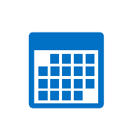



APIs – Microsoft Graph
https://graph.microsoft.com/
USERS
GROUPS
DRIVES
MAIL
CALENDAR
TASKS
Insights and relationships from Office Graph

Slide 10

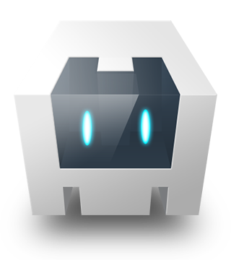
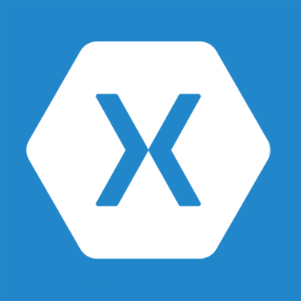
SDKs and Frameworks
ADAL Library/Plugin
Microsoft Graph SDK
Office 365 APIs

Slide 11
Getting setup…

Slide 12
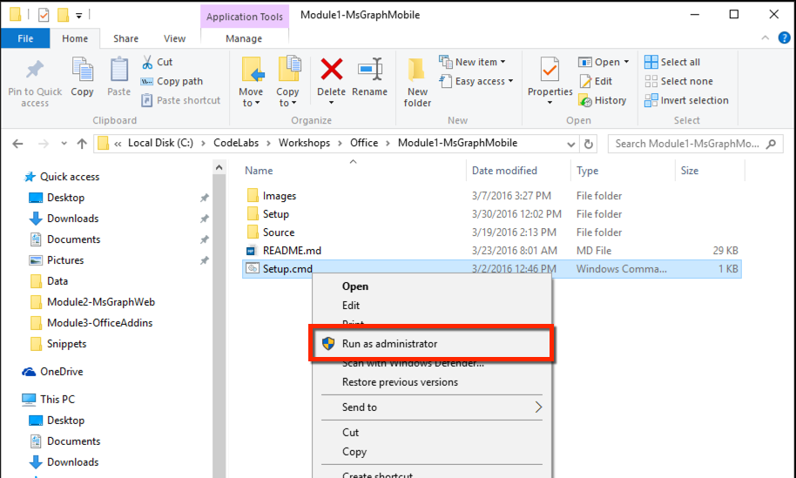
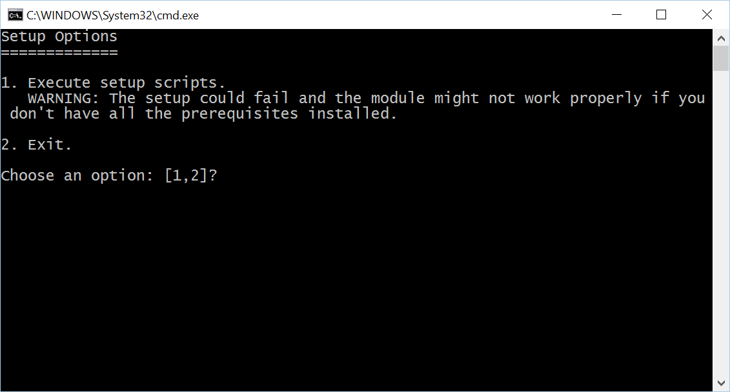
Install Code Snippets
Go to C:\Labs\CodeLabs-Office\Module1-MsGraphMobile
Right-click on Setup.cmd, click on Run as administrator
Click Yes at the User Account Control prompt
Select option 1 in the command window

Slide 13
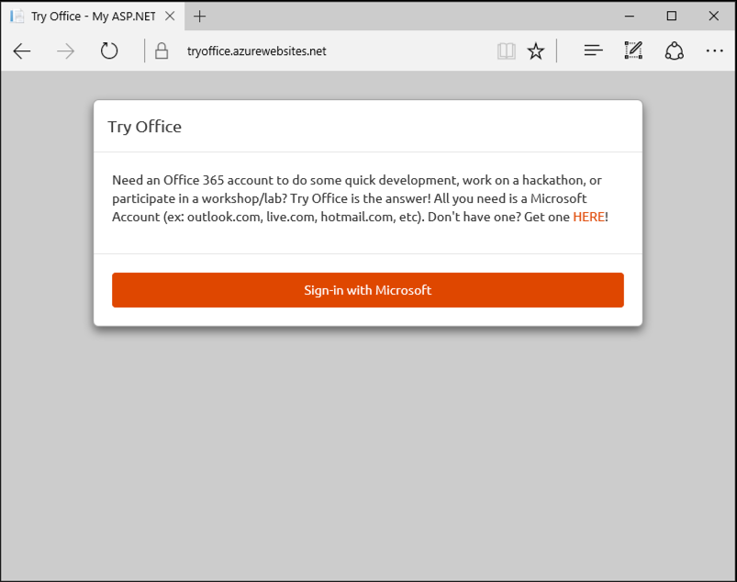
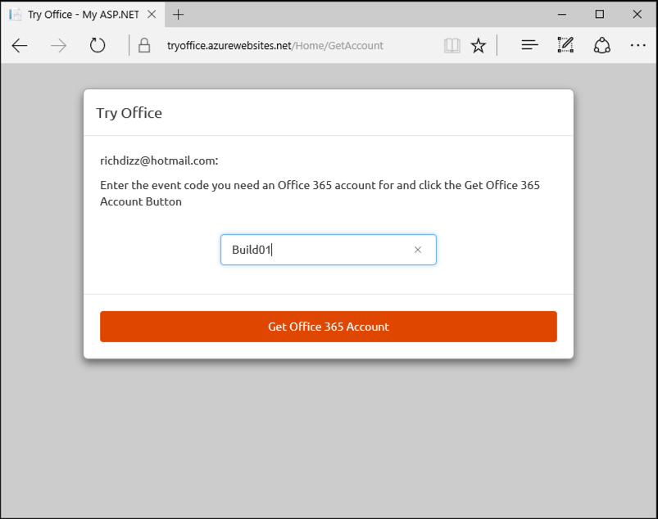
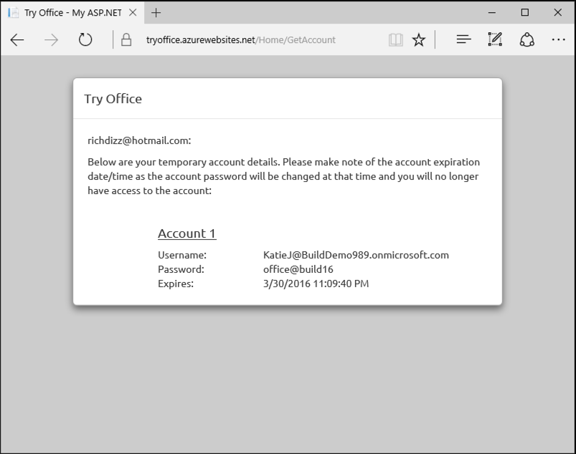
Get Office 365 Account
Navigate to https://aka.ms/tryo365dev and sign-in with a Microsoft Account (ex: Hotmail, Live, Outlook.com, etc)
Enter Event Code Build01 and click “Get Office 365 Account”
Capture the provided credential for use in the lab exercises
1
2
3

Slide 14
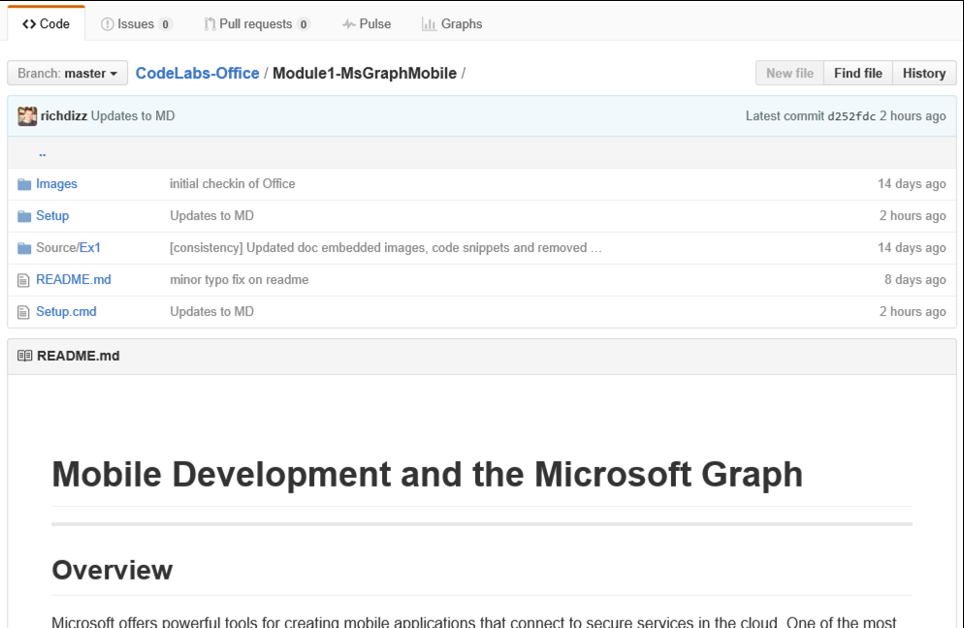
View lab manual
On your desktop, click the Office CodeLabs icon to open the browser at the Github repository for these labs: https://github.com/Microsoft-Build-2016/CodeLabs-Office
Click on the folder for the current module
Scroll down for the README.md – this is your lab manual

Slide 15
Let’s start coding!!!

Slide 16
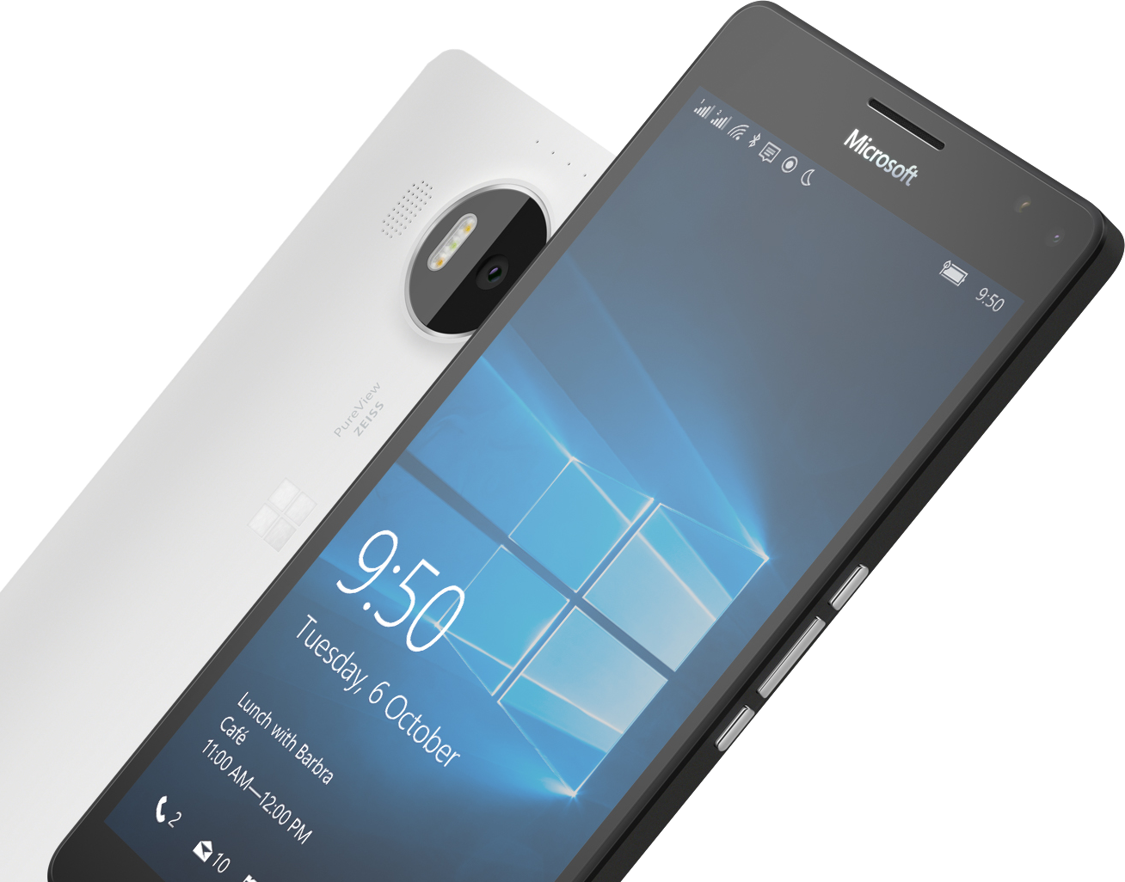
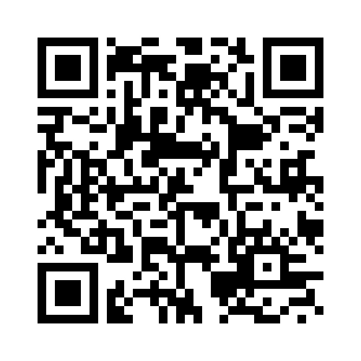
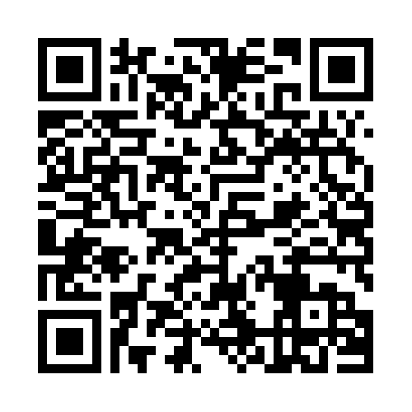

Please Complete An Evaluation Form Your input is important!
SAMPLE
or
Notes:
Update phone image to a Microsoft phone.

Slide 17
Evaluate this session
SAMPLE
Notes:
Speakers: Please note this slide will be updated with your session’s QR code during the scrub process which is outlined on side 3. Attendees can scan the QR code for access to your session’s eval.

