Slide 1
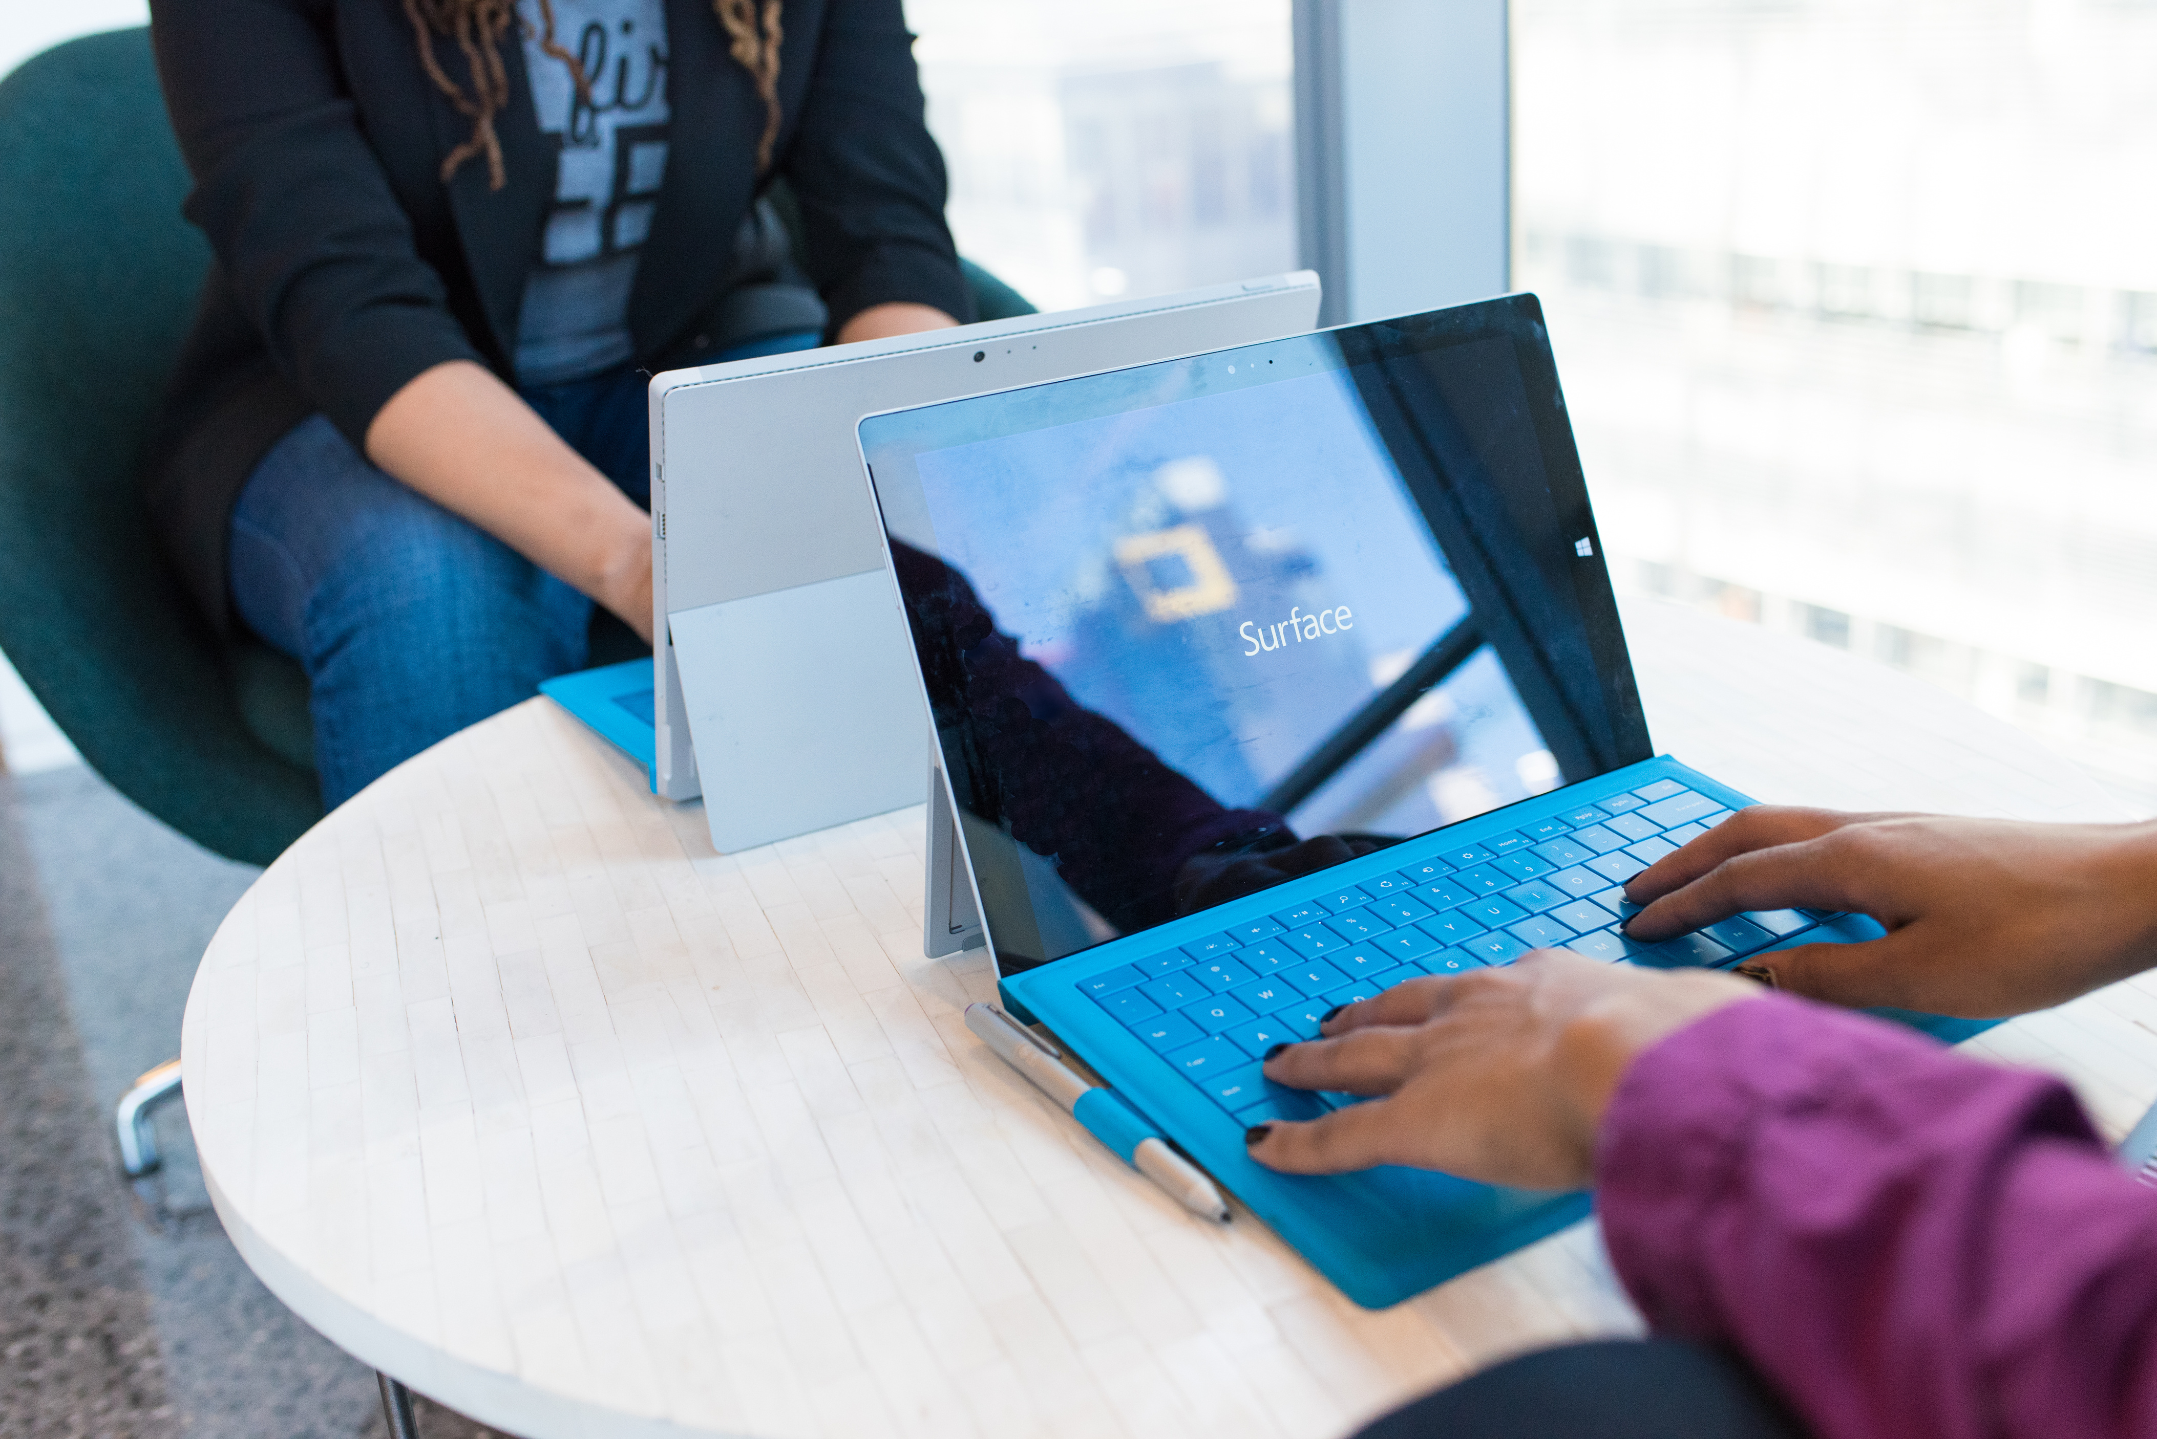
WELCOME TO
CLOUDHOUR
CloudHour will be starting shortly...
Please feel free to grab a drink and invite your friends!

Slide 2
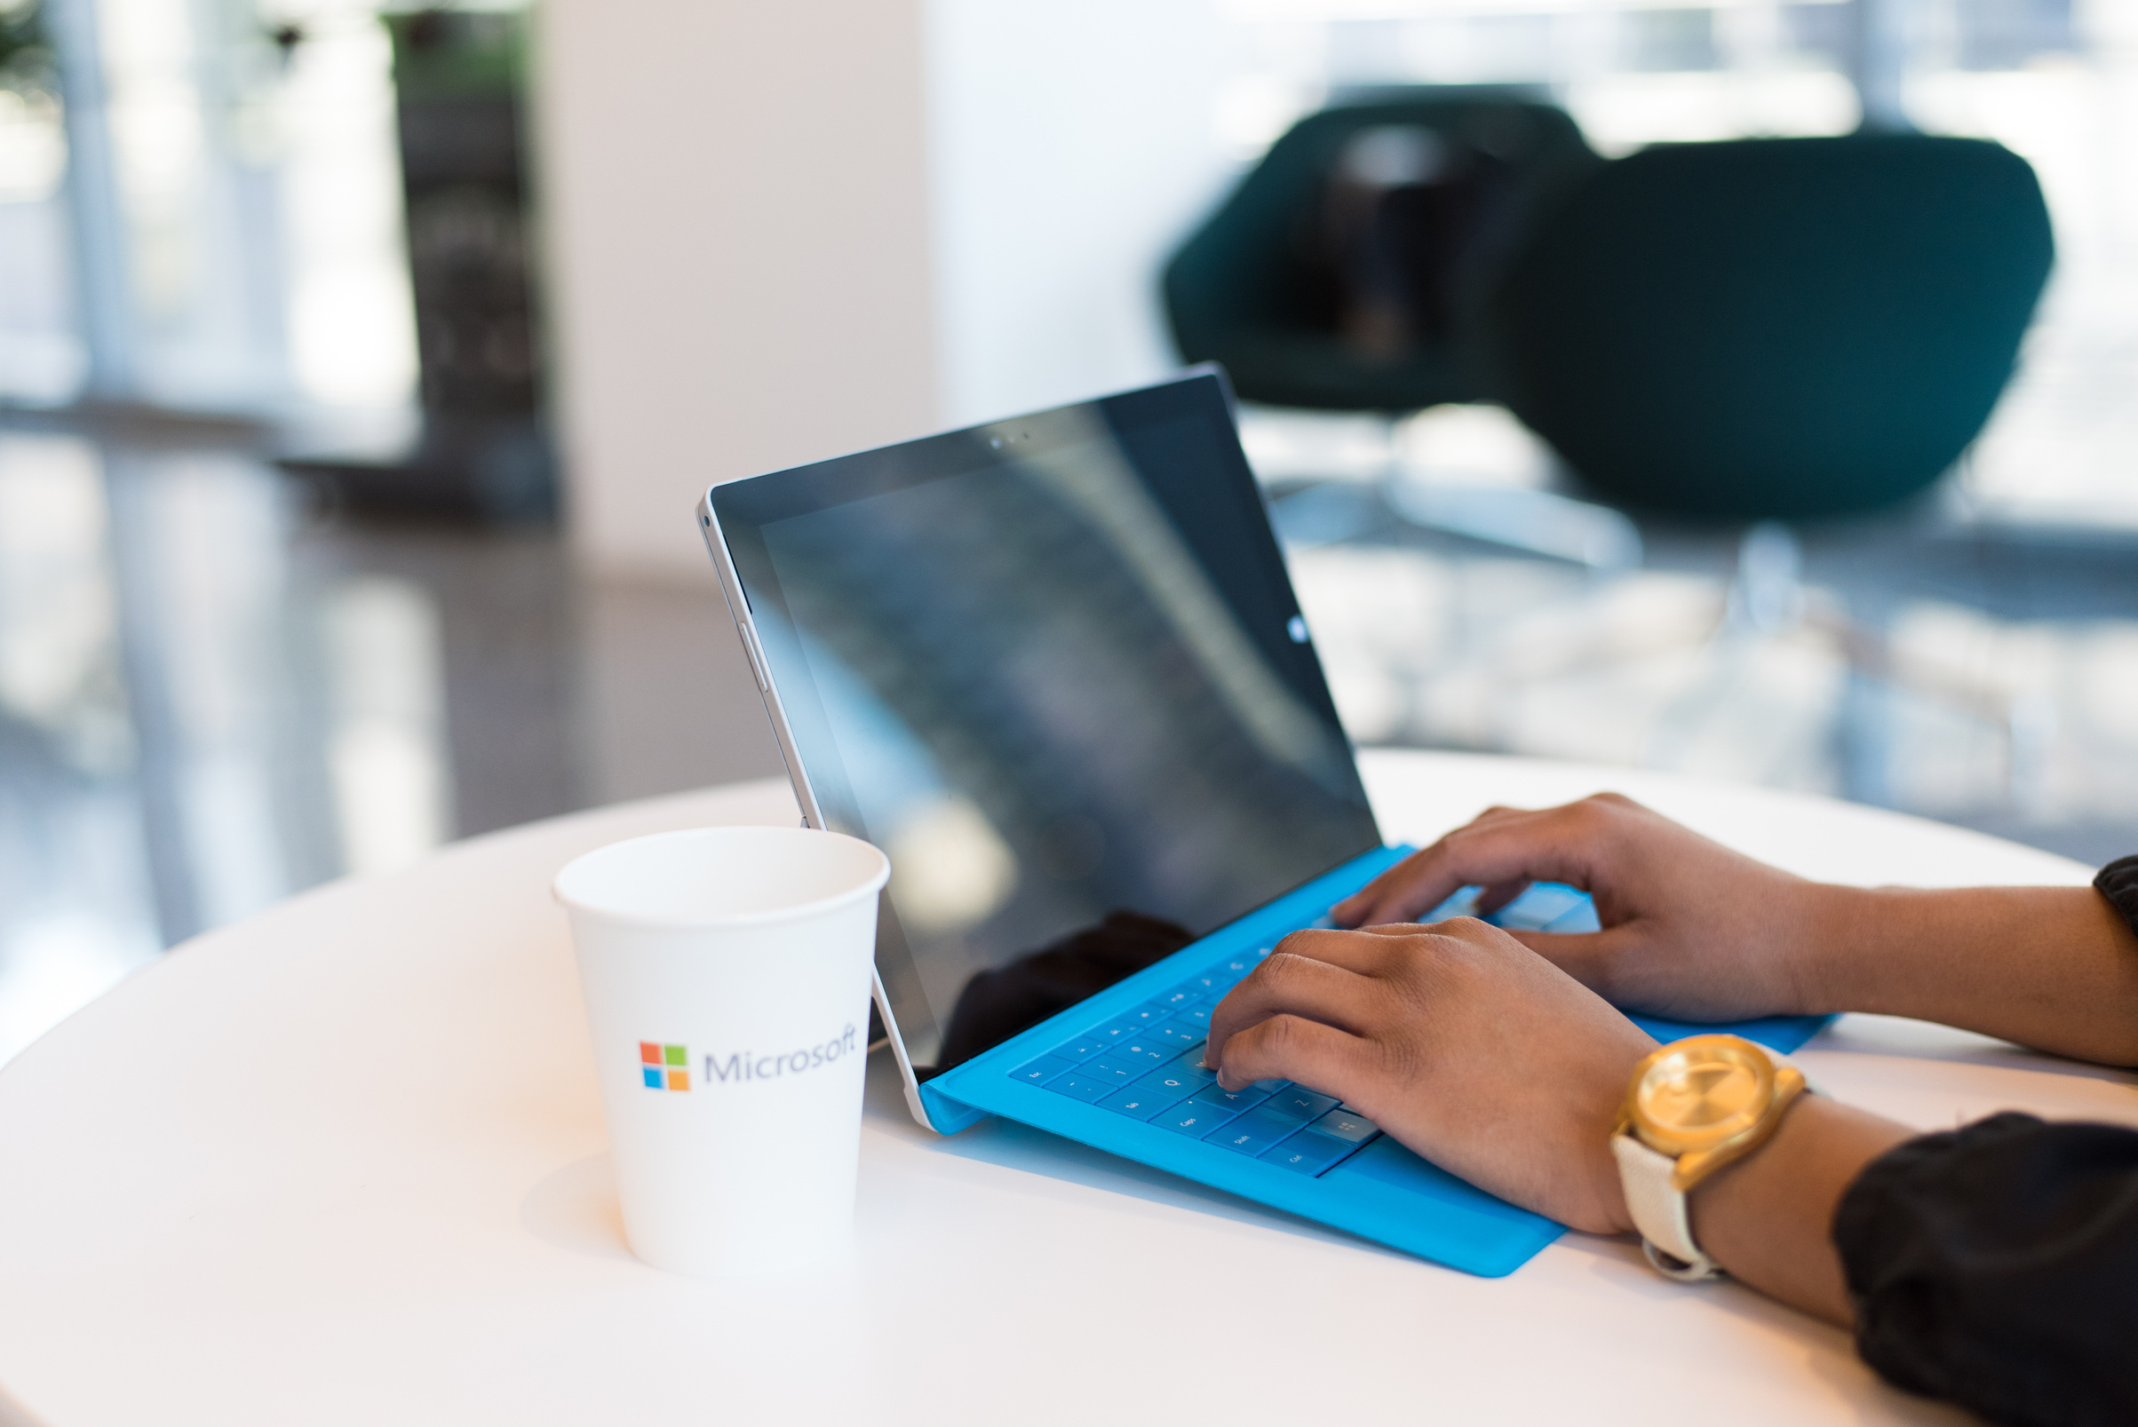
WHAT IS
CLOUD HOUR
CloudHour is a round-table discussion where we focus on a few key topics for collaborative discussion
Why it is important
Rapid changes in cloud security and tech
Stay updated and connected for growth as a community.
How will it benefit the community
Real-time engagement with hosts and community members
Ask open questions and speak your opinion
Opportunity to shape the next agenda

Slide 3
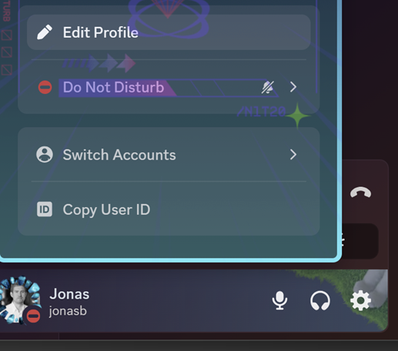
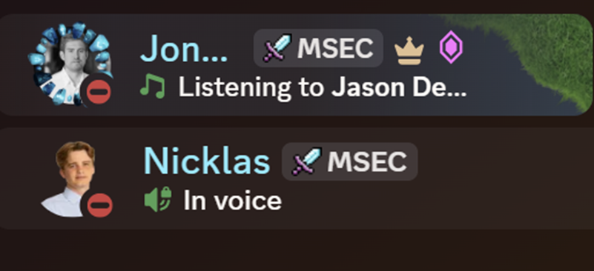
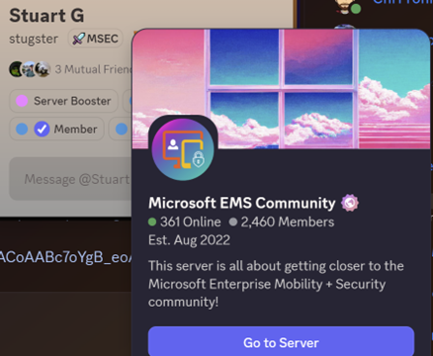
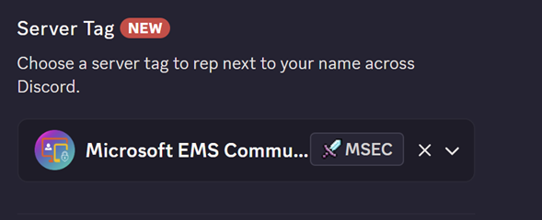
DISCORD
SERVER TAG

Slide 4
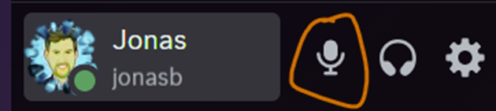
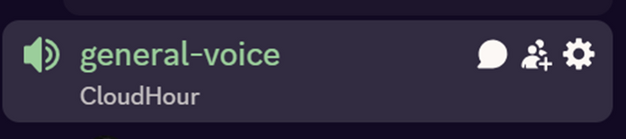
BEFORE WE
START
If you prefer not to talk or be asked questions, please press mute
Open mic is allowed
Remember to open the chat and engage with our community!

Slide 5

AGENDA
Links to share
Sebastian – Low hanging fruit
Stryker incident
Open floor

Slide 6

SHARING
LINKS TO SHARE - Entra
Entra connect - Upcoming
Entra Connect update to block hard match for users with Microsoft Entra roles
Entra Backup and Recovery - Preview
Native solution restores users, groups, applications, and Conditional Access policies
External MfA - GA
External Authentication methods GA in Entra ID
Notes:
https://learn.microsoft.com/en-us/entra/fundamentals/whats-new#upcoming-change--microsoft-entra-connect-security-update-to-block-hard-match-for-users-with-microsoft-entra-roles
https://techcommunity.microsoft.com/blog/microsoft-entra-blog/strengthen-identity-resilience-recover-with-confidence-using-microsoft-entra-bac/4462426 https://learn.microsoft.com/en-us/entra/fundamentals/whats-new#general-availability---external-mfa-is-generally-available

Slide 7
SHARING
LINKS TO SHARE
Cross-tenant MAM for Edge - preview
Cross tenant MAM policies in Edge profiles
Identity security enhancements - preview
Widely identity security enhancements
RSAC 2026 Sentinel news
RSAC announcements for Microsoft Sentinel
LAPS for Azure arc - preview
Manage LAPS for Azure Arc onboarded machines
Notes:
https://learn.microsoft.com/en-us/deployedge/microsoft-edge-cross-tenant-support-using-intune-mam
https://www.linkedin.com/feed/update/urn:li:activity:7444339740335616000/?originTrackingId=z1XhISGG8icH52tvvZOxnw%3D%3D
https://learn.microsoft.com/en-us/defender-xdr/whats-new#march-2026
https://techcommunity.microsoft.com/blog/microsoftsentinelblog/what%E2%80%99s-new-in-microsoft-sentinel-rsac-2026/4503971 https://learn.microsoft.com/en-us/azure/osconfig/overview-laps-azure-arc?tabs=azure-vm

Slide 8
TOPIC
Stryker incident
Lessons in MDM Weaponization and Administrative Governance
Incident
On March 11, 2026, the Iran-linked threat actor Handala weaponized compromised administrative credentials to issue mass "Remote Wipe" commands via Microsoft Intune, factory-resetting over 80,000 devices globally and causing severe disruption to Stryker’s manufacturing, shipping, and medical supply chain.
Security takeaways
Multi-admin approval (MAA)
RBAC
Hardware-bound identity
Administrative Units (Aus)
Notes:
https://www.cisa.gov/news-events/alerts/2026/03/18/cisa-urges-endpoint-management-system-hardening-after-cyberattack-against-us-organization

Slide 9

Btw, you guys know he got MVP today?
Sebastian’s low hanging fruit
Forgotten configurations that are bringing value and a more secure environment that aren’t difficult to configure.

Slide 10
TOPIC
Open floor
Notes:
https://www.cisa.gov/news-events/alerts/2026/03/18/cisa-urges-endpoint-management-system-hardening-after-cyberattack-against-us-organization

Slide 11
THANK YOU FOR JOINING
CLOUDHOUR
We hope that you found this session useful!
Please don’t forget to share our community with your friends and colleagues, and we look forward to seeing you next month!

