Slide 1

WELCOME TO
CLOUDHOUR
CloudHour will be starting shortly...
Please feel free to grab a drink and invite your friends!

Slide 2

WHAT IS
CLOUD HOUR
CloudHour is a round-table discussion where we focus on a few key topics for collaborative discussion
Why it is important
Rapid changes in cloud security and tech
Stay updated and connected for growth as a community.
How will it benefit the community
Real-time engagement with hosts and community members
Ask open questions and speak your opinion
Opportunity to shape the next agenda

Slide 3
👀
Aka.ms/M365EMSDiscord
Notes:
https://aka.ms/M365EMSDiscord

Slide 4
Community
Ewelina Paczkowska
Docs Tracker
KQLsearch

Slide 5
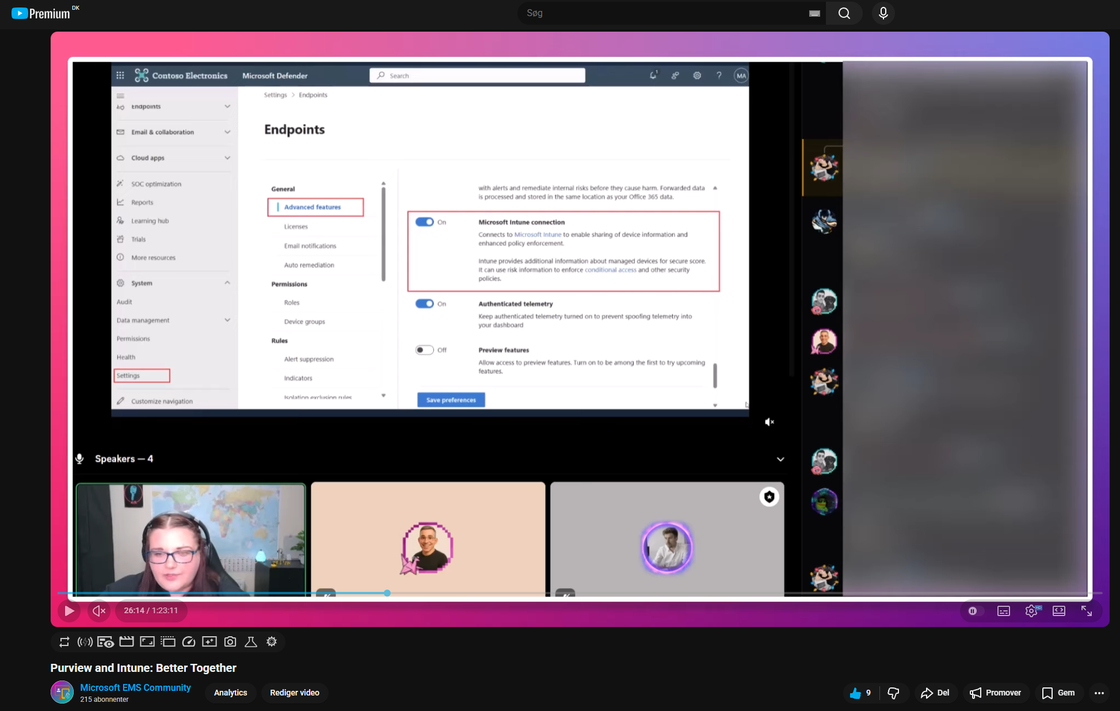
Ewelina Paczkowska Purview and Intune: Better Together
Want to re-watch the magic?
Thank you Ewelina Paczkowska (LinkedIn)
welkasworld.com
Notes:
https://www.youtube.com/watch?v=cRZnxh2u5Wk

Slide 6
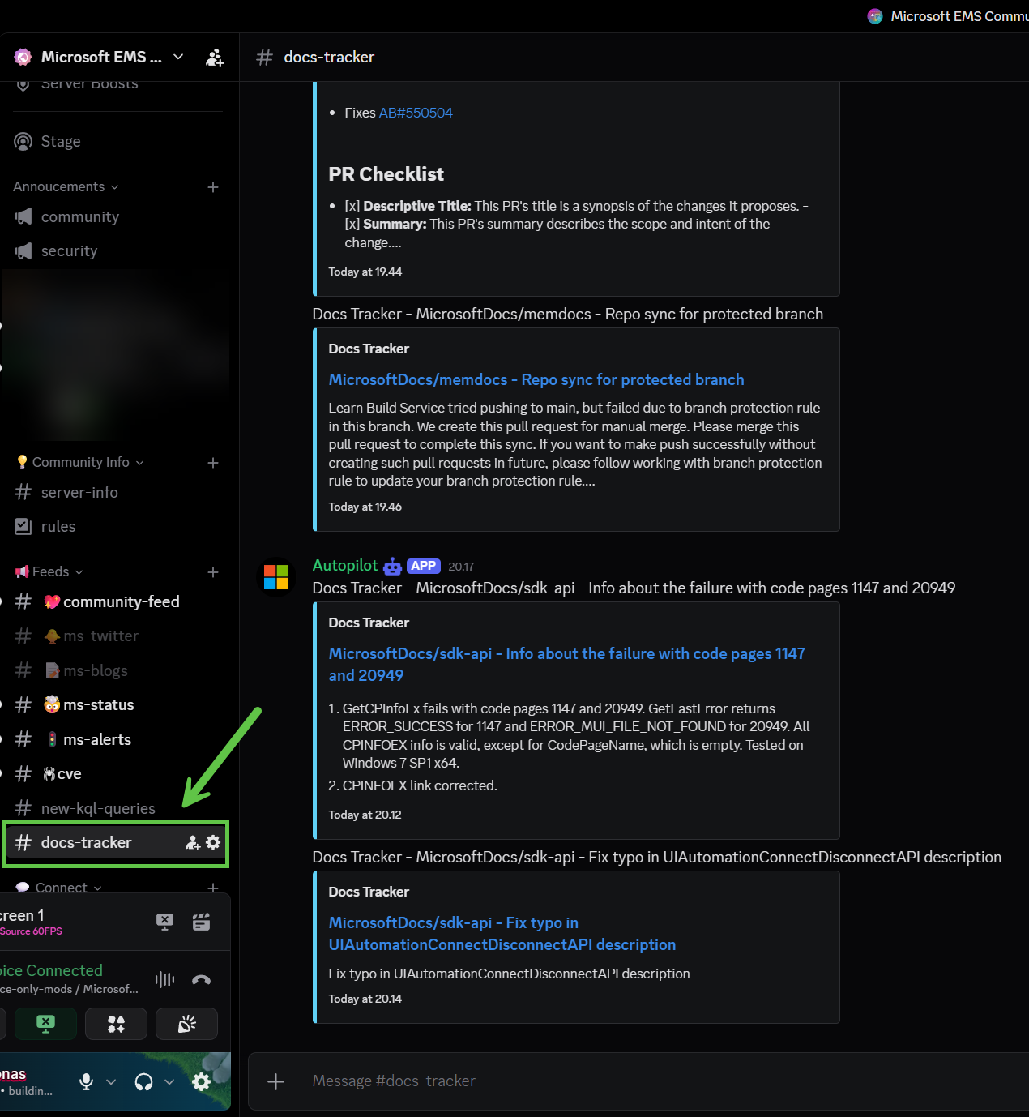
Docs Tracker
Browse changes, see which repositories are evolving, and stay ahead of what’s new in Microsoft security and tech docs.
Good indicator of development
Author Philip Marsh (LinkedIn)
docstracker.marshsecurity.org
Notes:
https://www.linkedin.com/in/%F0%9F%9B%A1%EF%B8%8F-philip-marsh-6b4657145/
https://docstracker.marshsecurity.org/

Slide 7
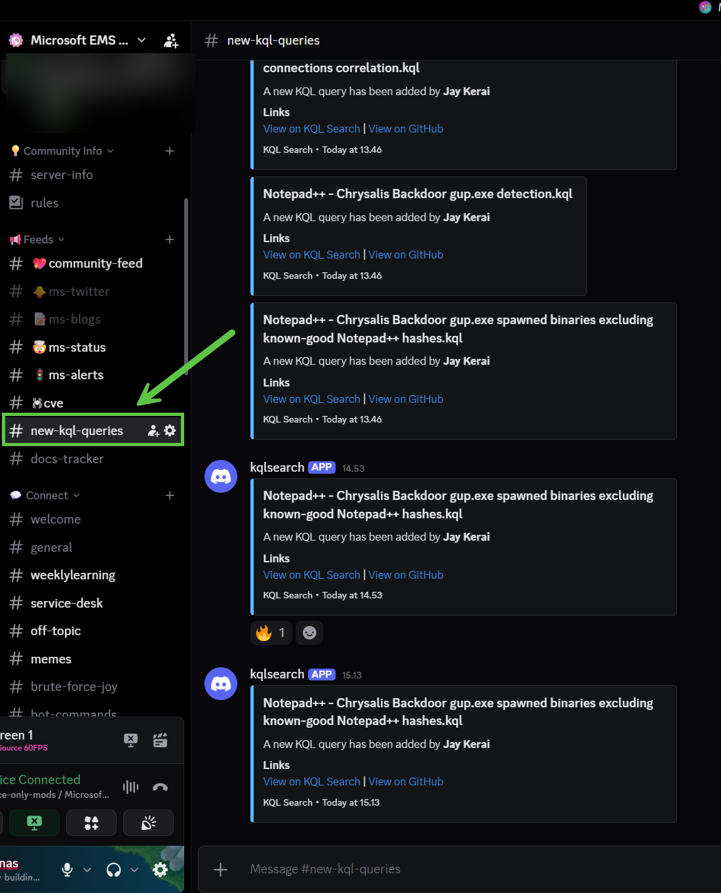
KQLsearch
Anytime a query is added to KQLsearch, sends a message to the feed!
Author Ugur Koc
kqlsearch.com
Notes:
https://www.kqlsearch.com/
Where Jay is very active

Slide 8


BEFORE WE
START
If you prefer not to talk or be asked questions, please press mute
Open mic is allowed
Remember to open the chat and engage with our community!

Slide 9
SHARING
LINKS TO SHARE
Advanced Hunting API retirement
Organizations must manually migrate workflows to the Microsoft Graph Security API by January 31, 2027
Entra Agent ID (next slide)
Track agent usage across your org over the last 30 days and take steps to improve impact.
Entra ID Governance guest billing meter enforcement (next slide)
Account Recovery video by John Savil
For Entitlement Management and Lifecycle Workflows (Access Reviews will be enforced later in CY26 Q1)
A dive into the new ability to recovery accounts using only government issued IDs and third-party identity verification services.
Anything else you would like to share?
Notes:
Advanced Hunting API retirement
https://mc.merill.net/message/MC1220762
X
John Savil video
https://www.youtube.com/watch?v=WYji1oV7GQI

Slide 10
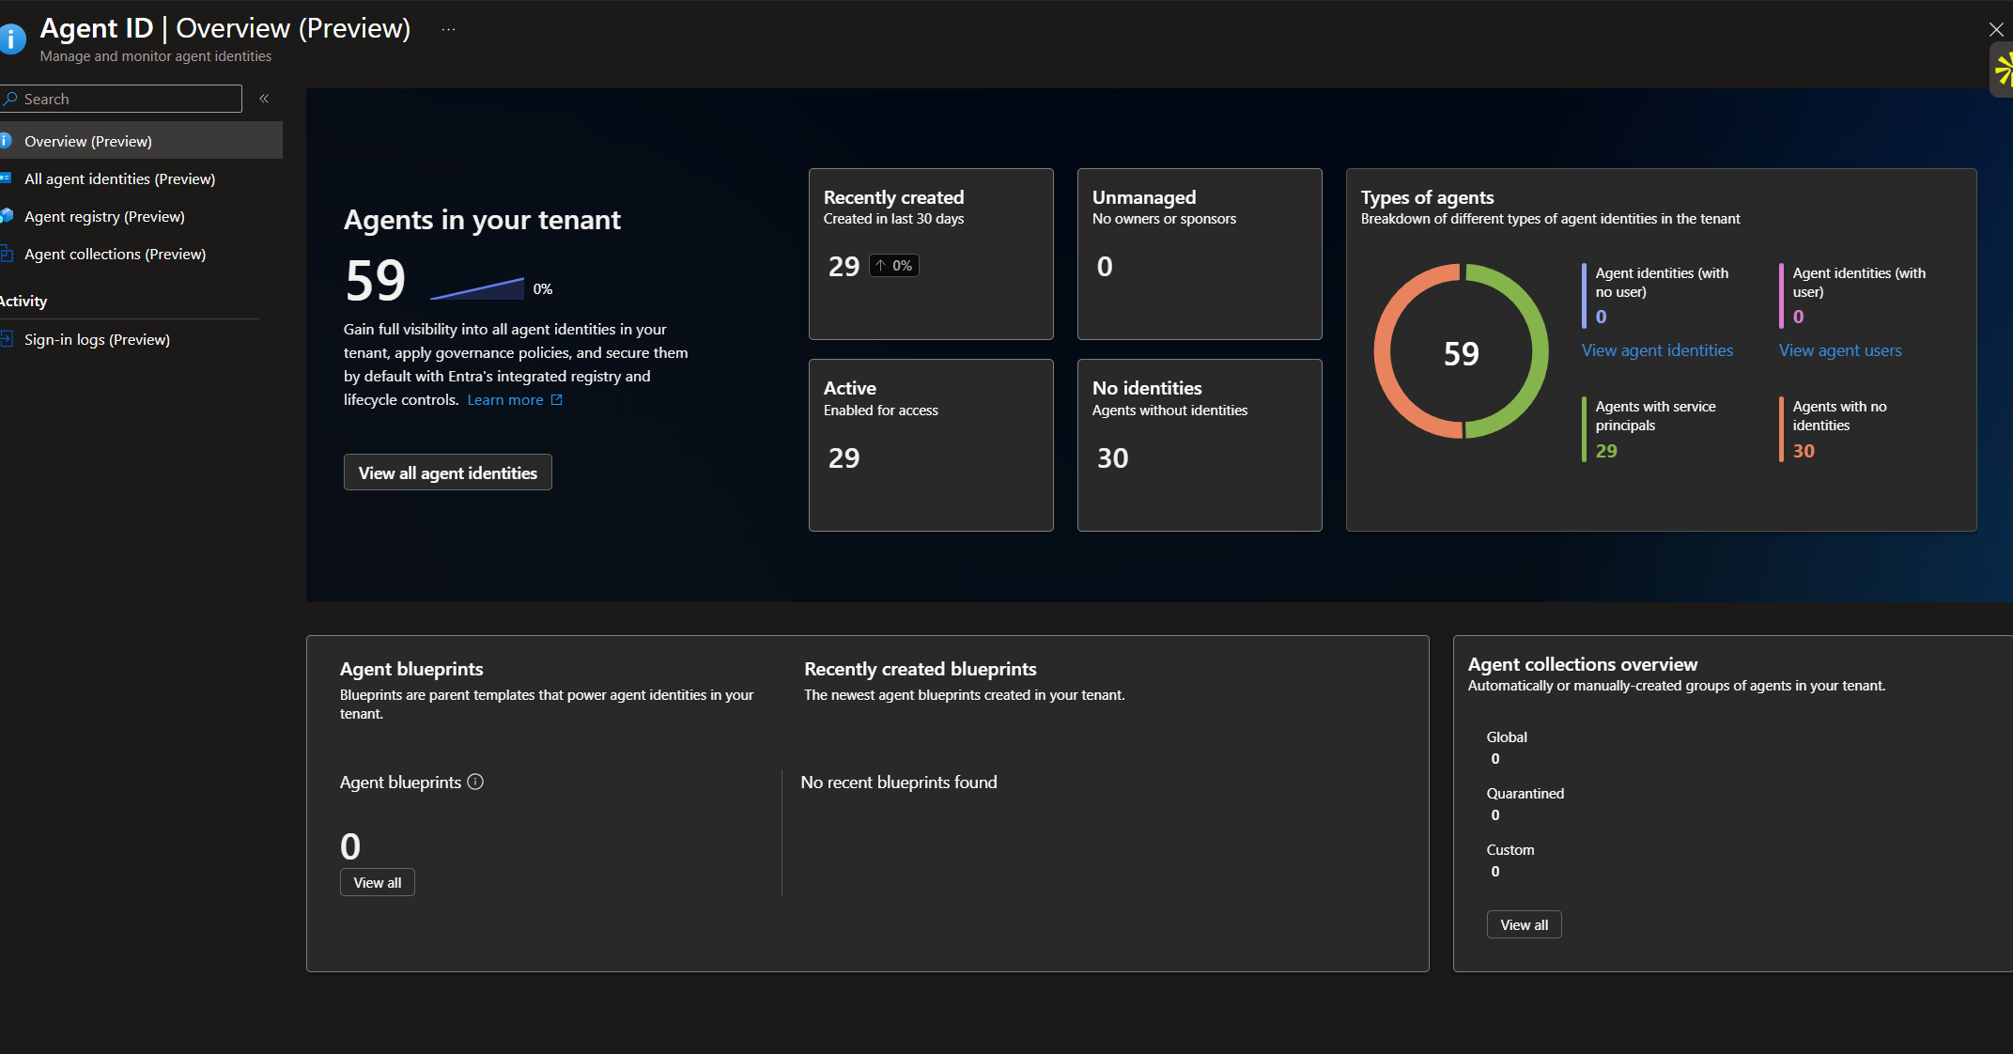
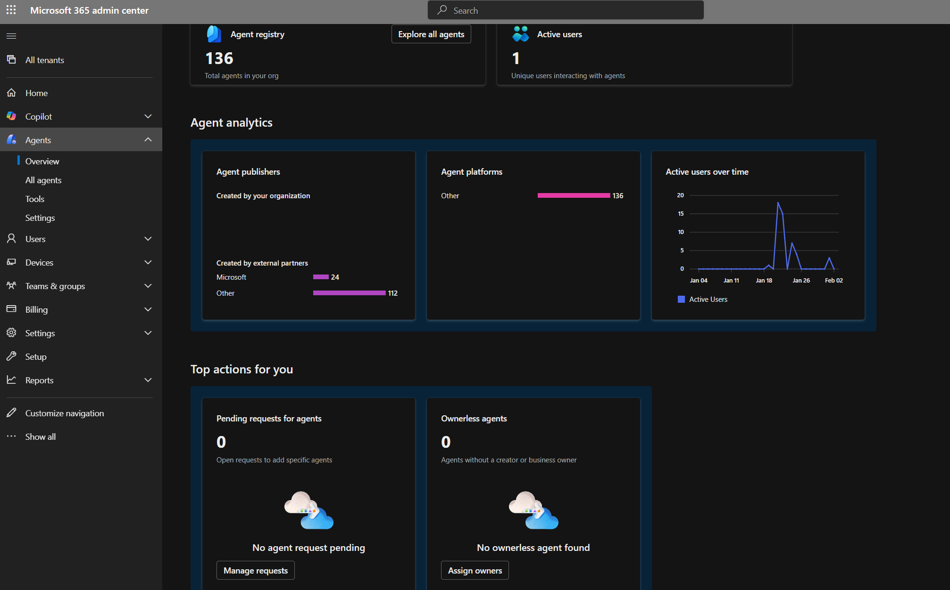

Slide 11
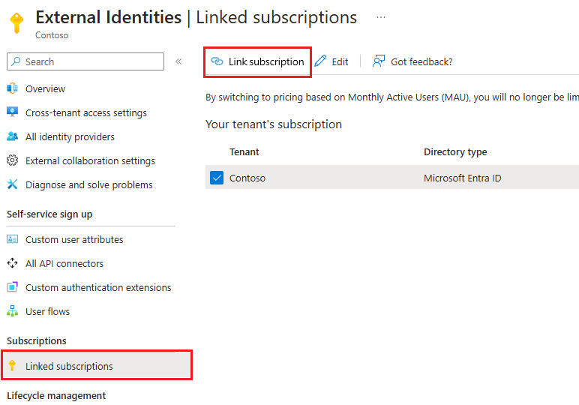

Slide 12

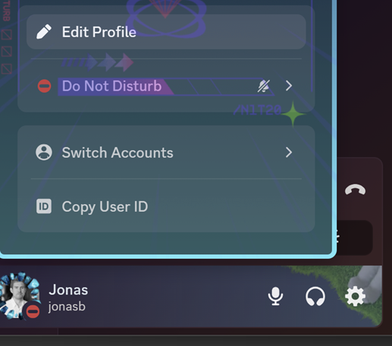

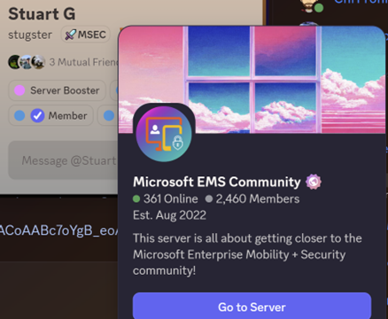
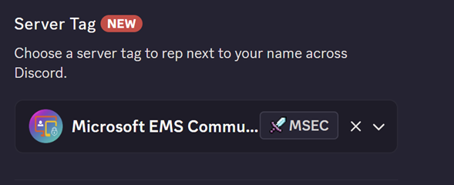

DISCORD
SERVER TAG

Slide 13

AGENDA
Protection against AI
Intune P2 to MS E3+E5
Security Copilot in E5
Random subject

Slide 14



Slide 15
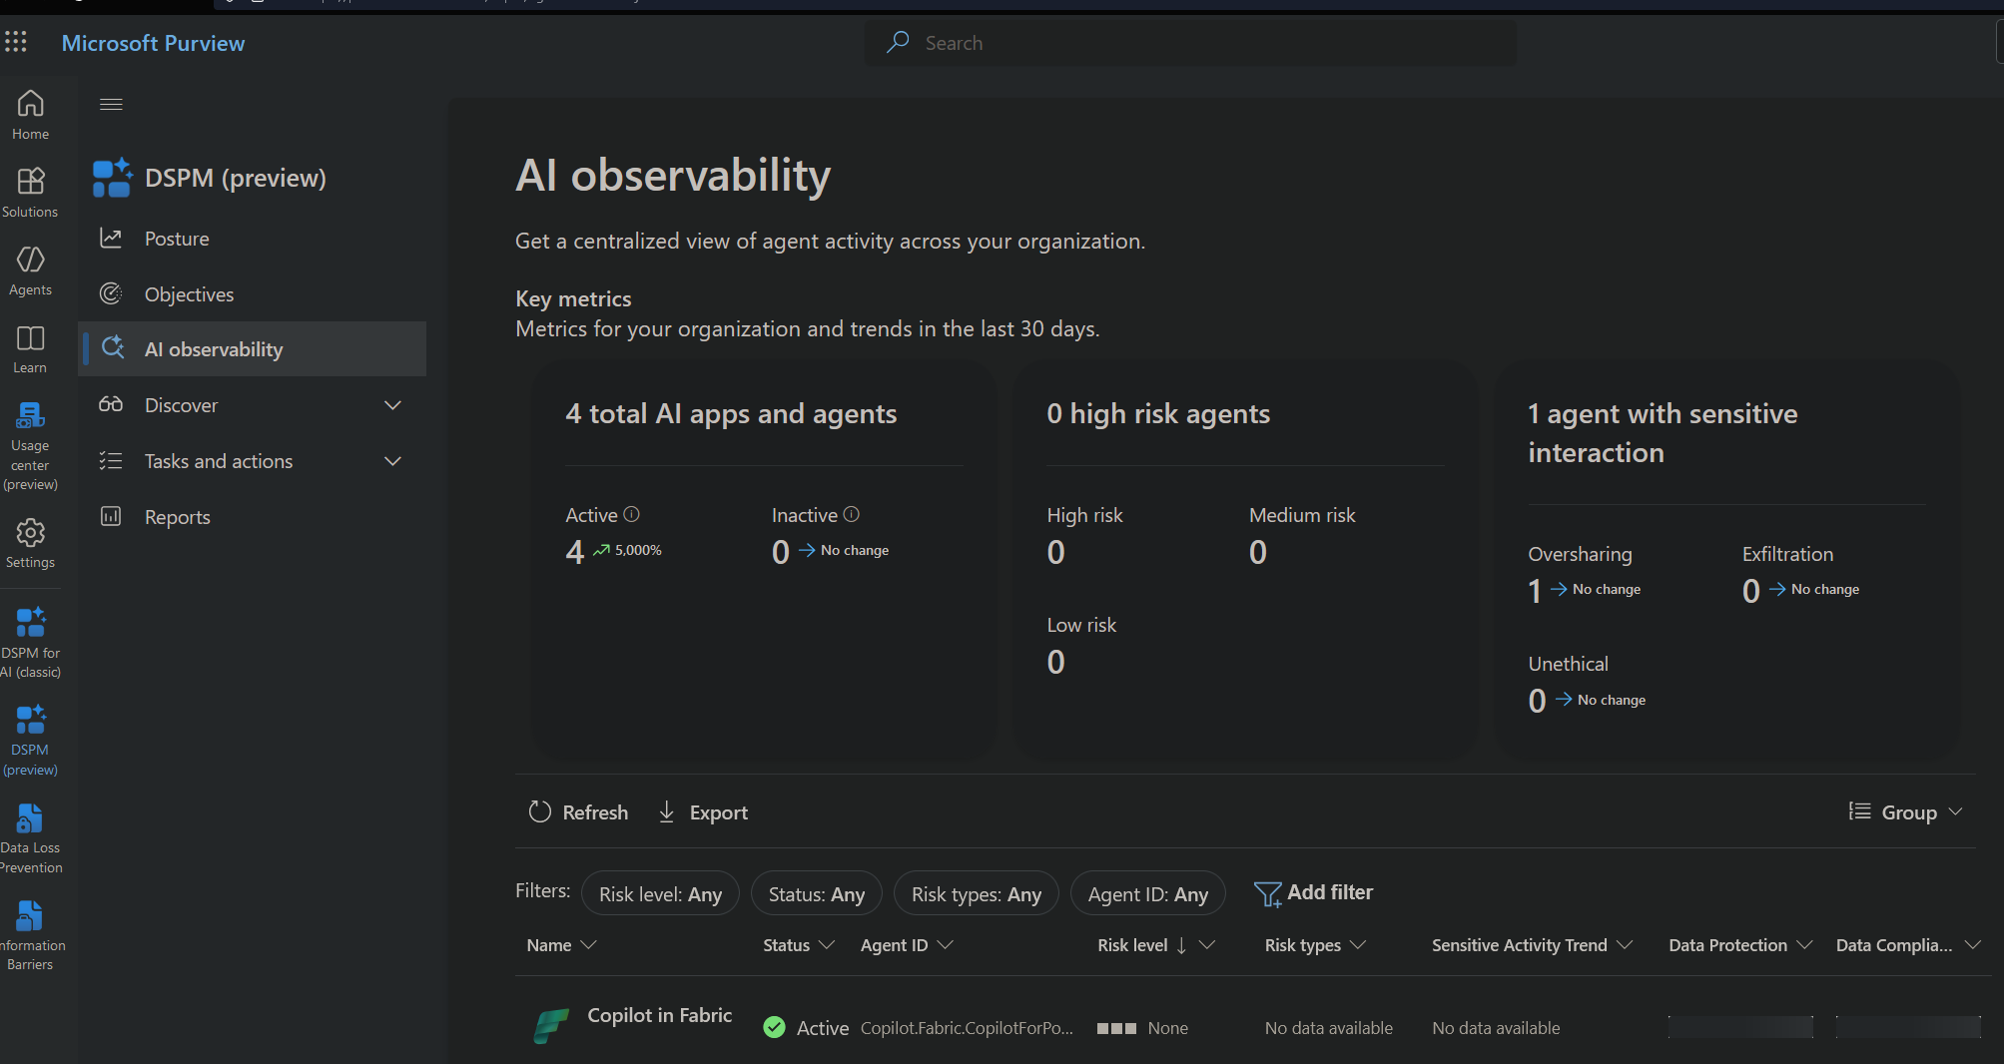
Protection against AI
Open question
Entra Agent ID Governance
GSA
MDA
Purview
DSPM for AI

Slide 16
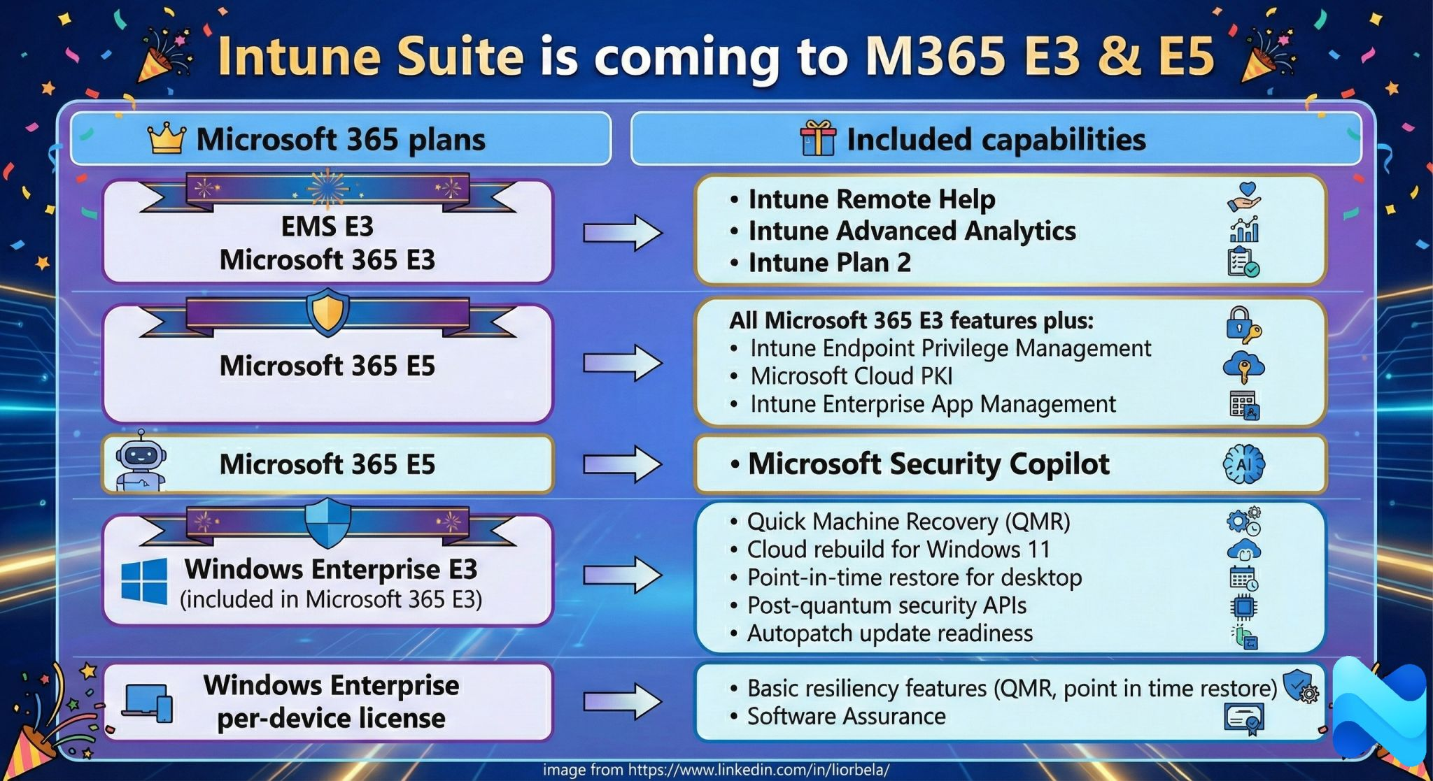
Intune P2 to MS E3+E5
Notes:
https://www.microsoft.com/en-us/security/business/microsoft-intune-pricing

Slide 17
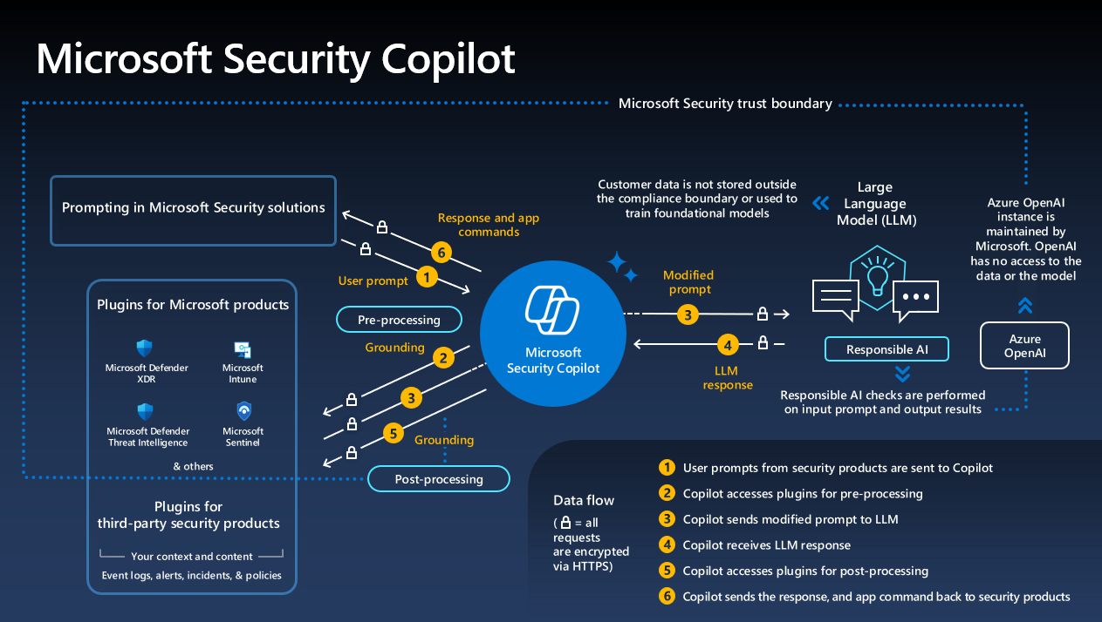
Security Copilot in E5
Notes:
Get started:
https://learn.microsoft.com/en-us/shows/microsoft-security-copilot-flight-school/
Calculator:
https://securitycopilot.microsoft.com/calculator

Slide 18

Topic from the audience

Slide 19
THANK YOU FOR JOINING
CLOUDHOUR
We hope that you found this session useful!
Please don’t forget to share our community with your friends and colleagues, and we look forward to seeing you next month!

