Slide 1
Linux Running on an Azure Virtual Network
Speaker
Title
Organization
Notes:
Slide Objectives:
Introduce Windows Azure Virtual Machines with Linux Operating System
Speaking Points:
Introduce Yourself
Why you’re an expert

Slide 2
Agenda
Why Linux
Linux Deployments
Understanding a Linux VM
Top Linux Provisioning Scenarios for Customers
Top Linux Scenarios for Partners
Linux Open Source Strategy
Notes:
Slide Objectives:
Outline the Lessons to be learned by watching this presentation.
Speaking Points:
1) Why would Microsoft Deploy Linux on Windows Azure?
2) Understanding how Linux is deployed on Windows Azure
3) Close up by taking a look at Microsoft’s Open Source Strategy around Linux VMs

Slide 3


Why Linux
Our customers have Linux Workloads that they want to run in Windows Azure
IaaS enables us to satisfy this need
Notes:
Slide Objectives:
Provide an understanding as to why Microsoft is offering Linux on Windows Azure.
Speaking Points:
1) Microsoft understands that the server market isn’t a homogeneous space
2) As such, they understand that Linux is a necessary Operating System for those looking to leverage Windows Azure as their Data Center.
3) The Introduction of Infrastructure as a Service has enabled Windows Azure to satisfy the needs of the heterogeneous Data Center.

Slide 4
Understanding a Linux VM

Slide 5





Distributions
We will support
SUSE SLES 11 sp2
Open SUSE 12.1
CentOS 6.2 by OpenLogic*
Ubuntu 12.04
Specific versions are endorsed
Integration Components
Testing and validation by partners
Bring other variants at your own risk**
( at GA only)
*Image provided by OpenLogic based on CentOS 6.2
**Integration Work will be needed
Notes:
Slide Objectives:
Provide an understanding of which Distributions of Linux are offered in the Windows Azure Image Gallery.
Speaking Points:
1) Only Certain distributions of Linux are officially supported: SUSE Enterprise 11 SP2, OpenSUSE 12.1, CentOS 6.2, Ubuntu 12.04
2) Virtual Machine Images of these Distributions are provided by Partners who are experts in each distribution
3) Other Distributions of Linux can be installed as “Bring-Your-Own-Linux” however, some integration work will be needed.
Notes:
Linux Virtual Machines Product Page: http://www.windowsazure.com/en-us/manage/linux

Slide 6



Linux Offering
1ST
Open Source Community
Support
First Class Citizen
Enterprise + ISV
Notes:
Slide Objectives:
Provide a better understanding of Microsoft’s Linux offering on Windows Azure
Speaking Points:
1) Linux as a first class citizen in Azure
2) We will focus mainly on Enterprises and ISVs but will also reach out to the community
a) Open Sourcing critical components
b) Documenting API
3) We will offer both Community and Commercial Distributions
4) You will be able to buy support for the commercial distributions (GA only)
Trainsitions:
1) First Class Citizen
2) Enterprise + ISV
3) Open Source Community
4) Support
Notes:
Any notes go here

Slide 7
IaaS Enables Linux

Slide 8


What Does Persistent Mean?
Persistent OS Disk
…and highly durable
Windows Azure Storage (Disaster Recovery)
Windows Azure Storage
Virtual
Machine
Notes:
Slide Objectives:
Give a high level overview of the Storage Architecture behind the Virtual Machine offering
Transition:
1) Virtual Machine & Disk
2) Virtual Machine OS Disk is created in Windows Azure Storage
a) Windows Azure Storage provides 2 redundant copies of the drive
3) If Geo-Replication is enabled on the storage account, the three disks are duplicated in a different Geographical Region
Notes:
Local Redundant Storage/Geo-Redundant Storage: http://blogs.msdn.com/b/windowsazure/archive/2012/06/08/introducing-locally-redundant-storage-for-windows-azure-storage.aspx

Slide 9

What Does Persistent Mean?
Persistent OS Disk
…and highly durable
Windows Azure Storage (Geo-Replication)
Windows Azure Storage
Virtual
Machine
Virtual
Machine
Notes:
Slide Objectives:
Provide a greater understanding for what happens when a Virtual Machine Crashes.
Transition:
1) Our Virtual Machine is up and running
2) Something goes wrong and the VM Fails
3) Windows Azure Fabric Controller recognizes the VM Failure, and spins up a new VM by attaching the disk to the new VM.

Slide 10







The Technology to Provision a Platform Image
HyperVisor
Customer’s
Storage Account
Platform Storage Repository
Stock Images
VM
Data
Data Disk
OS
OS Disk
ISO
Provisioning Repository
Cache
Unattend
Storage API
Add Server
Hostname
Password
…
Cache.VHD
Portal (API)
Notes:
Slide Objectives:
Explaining the process in which VMs are provisioned in Windows Azure.
Transition:
1) User inputs custom settings for provisioning a VM into an PowerShell or Windows Azure Management Portal
2) Custom Settings are delivered to the Windows Azure Management API
3) The management API creates an ISO with an Unattend file on it
4) The images from the Gallery will be copied from the Microsoft Repository into your Storage Account.
5) A blob lease is taken out on your OS disk (and data disk if configured)
6) Connect a Caching disk (LocalStorage, if you’re familiar with Cloud Services)
7) Connect the OS Disk
8) Connect additional Data Disks (if provided)
9) Connect the ISO, which has the unattend file with your custom settings on it.
10) VM is booted, Windows Setup utilizes the unattend file to setup the new VM. The ISO also configures the Agent which talks to the Fabric Controller.
Notes:
See Corey Sanders describe this: http://channel9.msdn.com/Events/TechEd/NorthAmerica/2012/AZR201 [00:13:15]

Slide 11
Linux Built on Persistent VM Role
*Some Features not present in Linux at Preview
Linux
Windows
IC
Drivers
SSH Keys
WA Linux Agent
Certs
Windows Setup
Windows Azure Virtual Machines
Notes:
Slide Objectives:
Demonstrates how both Windows and Linux are utilitizing Windows Azure Virtual Machines
Speaking Points:
1) As you can see, a Linux VM has a similar Architecture as the Windows VM which we just provisioned. Let’s take a look of how the Linux Provisioning works.

Slide 12
The Technology to Provision a Linux Platform Image
HyperVisor
Customer’s
Storage Account
Partner Repository
Stock Images
VM
Data
Data Disk
OS
ICs
OS Disk
ISO
Provisioning Repository
Cache
Linux Agent
Unattend
Storage API
Add Server
Hostname
Password
…
Cache.VHD
Portal (API)
Notes:
Slide Objectives:
Understand the way in which Linux VMs are published in Windows Azure
Transition:
Same build ups as last Provision build up.
Speaking Points:
As you can see the process is practically the same as before, with the slight caveat that we have a Distribution specific agent which has been added to the VM.
Notes:
Any notes go here

Slide 13


Windows Azure Linux Agent
Service Management API
Windows Azure
provided DNS
VM
Host1
Host2
HV1
HV2
Notes:
Slide Objectives:
Depicts a failover scenario with the Linux VM
Speaking Points:
The Linux Agent communicates with the Windows Azure Service Management API in order to Notify the Fabric Controller to update the DNS Location in a Failover scenario
Legend:
HV1 – Hypervisor 1
HV2 – Hypervisor 2

Slide 14
Top Linux VM Provisioning Scenarios for Customers
Gallery Experience
Third Party Tool Provisioning
Bring Your Own Linux

Slide 15
Gallery Experience
Lowest barrier of entry
Partner created images
Click through provisioning
Leverage portal to:
Provide Images (VHDs that include ICs and agent)
Associate SSH Keys
Collect configuration information
Drive provisioning
Notes:
Slide Objectives:
Provide context for functionality available in the Gallery experience

Slide 16
Demo
Quick Create Demo
Notes:
Open manage.windowsazure.com
Login
Click “+ New”
Hover over Compute
Hover over Virtual Machine
Click Quick Create
Select a Linux Distribution from the Gallery list
Fill out the Wizard to provision the machine
~ 6 minutes to Create, move on to more slides
Come back and show how to SSH into the machine.

Slide 17
Third Party Tool Provisioning
Currently Only SUSE
Ease the creation of custom images, configuration and resources
Customize a partner image
Select packages to include
Tool will include the appropriate ICs and Agent
Tool will drive provisioning for Customer if it chooses to provide it access
Notes:
Slide Objectives:
Explaining support for Third Party Provisioining Tools such as SUSE Studio
Notes:
See SUSE Studio in action at http://susestudio.com/

Slide 18
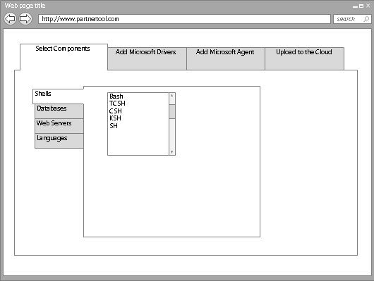

Tool Based Provisioning
XStore
VHD
Customer Personal Image Repository
VHD
VHD
Service Management API
Customer Storage Account
P
O
R
T
A
L
VM
VM2
Notes:
Slide Objectives:
Objective #1
Transition:
Transition statement(s) to setup the slide
Speaking Points:
Speaking Point #1
Speaking Point #2
Notes:
Any notes go here

Slide 19

Bring Your Own Linux
Expert Customers that want to tweak , customize, create images based on supported* distributions
Customer will
Use Hyper-V to install Distribution
Add ICs and Agent
Generate the VHD
Capture configuration
Generate resources
Upload and start instance
Linux Native: Tools, libraries, scripts
Notes:
Slide Objectives:
Explain the process around Bring-Your-Own-Linux VHD which supports customized images created in Hyper-V
Notes:
Tutorial on WindowsAzure.com: http://www.windowsazure.com/en-us/manage/linux/common-tasks/upload-a-vhd/

Slide 20
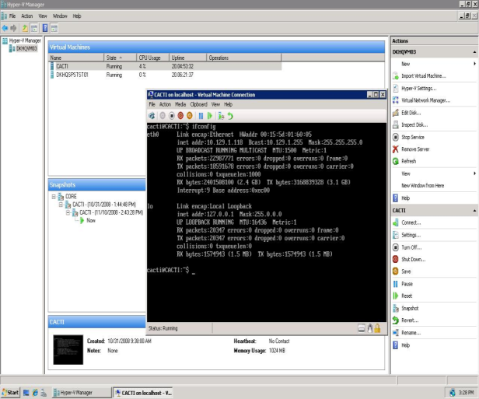
Bring Your Own Linux
XStore
VHD
Customer Personal Image Repository
VHD
Service Management API
Customer Storage Account
P
O
R
T
A
L
VHD
VM
Notes:
Slide Objectives:
Describes the workflow for provisioning a custom Linux VHD.

Slide 21
Top Linux Scenarios for Partners
Creating a Partner Supported Image
Creating a Third Party Provisioning Tool
Creating and Managing Linux Images for Customers

Slide 22
Creating a Partner Supported Image
Same Bring your own Linux operations
Register as a partner (Small, select number of partners)
Publish image in your own repository
Register the image with the platform so that it is listed
Support that image*
Notes:
Slide Objectives:
Describes the process for becoming a partner which supplies a supported Linux Distribution

Slide 23
Creating a Partner Supported Image
Partner Personal
Storage Account
VHD
VHD
Partner Registration
Azure Platform
Customer Personal Storage Account
Customer VM
Notes:
Slide Objectives:
Describes the workflow for provisioning a Partner Supported Image.

Slide 24
Creating a Third Party Provisioning Tool
Provide a distribution that is supported
Create an experience to allow customers to create VHDs
Interface with the service management API
Correctly retrieve and store user credentials
Upload image, configuration and resources
Create and start instances
Notes:
Slide Objectives:
Describes the ability to create a third party provisioning tool for your partner provided VHD image.

Slide 25
Creating and Managing Linux Images for Customers
Same Bring your own Linux Operations
Upload and publish image to
Customer’s Personal Repository
Platform Repository
Manage Images and Instances

Slide 26

Creating and Managing Linux Images for Customers
Platform Image Repository
VHD
VHD
Customer Personal Storage Account
VHD
Azure Platform
Customer VM

Slide 27
Linux on Azure Open Source Strategy
Open Source Linux Agent
Fully documented APIs
For Linux IT professionals provisioning and management operations:
Native scripts
Native libraries (open sourced)
Native tools (open sourced)
For Linux developers
Client Libraries
Documented interfaces
Notes:
Slide Objectives:
Describe the Linux on Windows Azure Open Source Strategy
Speaking Points:
1) Linux Agents will be Open Source to accept contributions from the community
2) All APIs are to be fully documented
3) Provide IT Pros with Linux Workloads with Native support to Manage the platform
4) Proivide Developers with Client Libraries and Interface Documentation for building on Windows Azure

