Slide 1
Introduction to ASP.NET & Visual Studio 2013 Web Tools
[Speaker]
[Company]
Email: [Email]
Twitter: [Twitter]

Slide 2
Session | Start | End
Keynote | 8:30 | 9:00
Introduction to ASP.NET and Visual Studio 2013 Web Tools | 9:00 | 10:00
Building Web Applications using the latest ASP.NET technologies | 10:00 | 11:00
Break | 11:00 | 11:15
Building web front ends for both desktop and mobile using the latest web standards | 11:15 | 12:15
Lunch | 12:15 | 1:15
API Services for both web and devices | 1:15 | 2:15
Running, improving and maintaining a site in the real world | 2:15 | 3:15
Break | 3:15 | 3:30
Real-time Communications with SignalR | 3:30 | 4:30
Wrap Up | 4:30 | 5:00

Slide 3
Agenda
One ASP.NET
Visual Studio 2013 + Web Essentials
What’s new in ASP.NET

Slide 4
One ASP.NET
Web Forms? Or MVC? Or Web API? Or SignalR?
All of them, please!

Slide 5
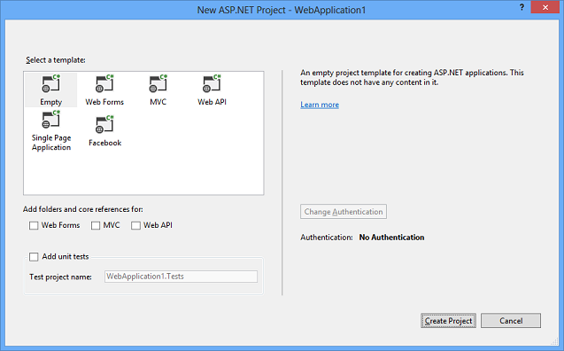
One ASP.NET
Visual Studio 2013 – New ASP.NET Project

Slide 6
Demo
One ASP.NET

Slide 7
Visual Studio 2013 + Web Essentials
THE editor for HTML, CSS, JavaScript and more

Slide 8
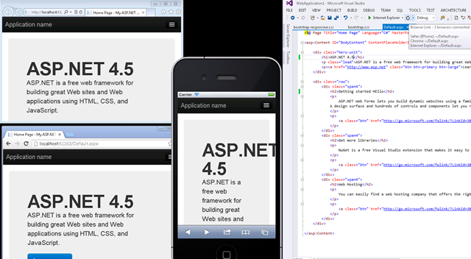
Browser Link

Slide 9
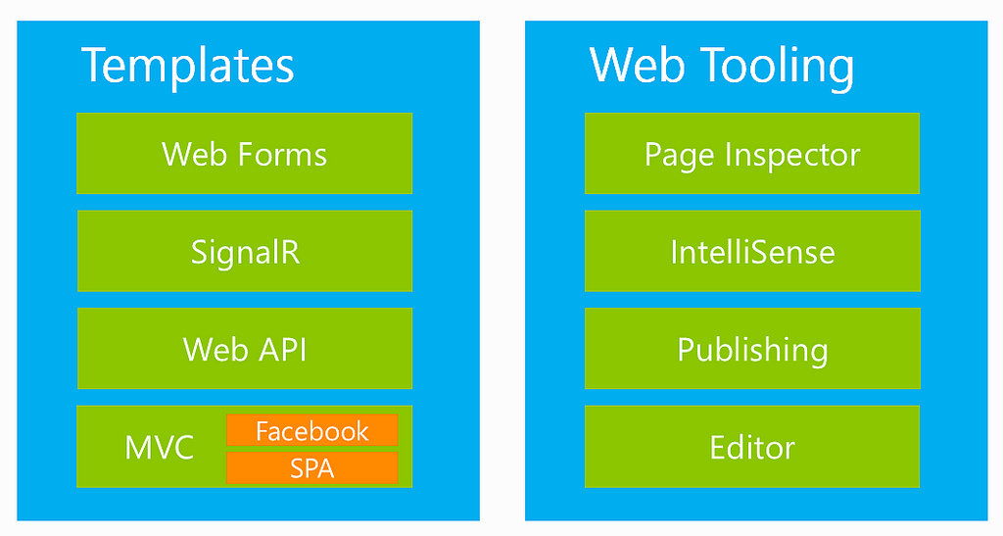
ASP.NET & Web Tools 2012.2 (Included in Visual Studio Updates)

Slide 10
Visual Studio 2013 RC
One ASP.NET
Browser Link
New HTML editor
Azure Web Sites tooling
Scaffolding
OWIN
ASP.NET Identity
Download and more info at: http://www.asp.net/vnext

Slide 11
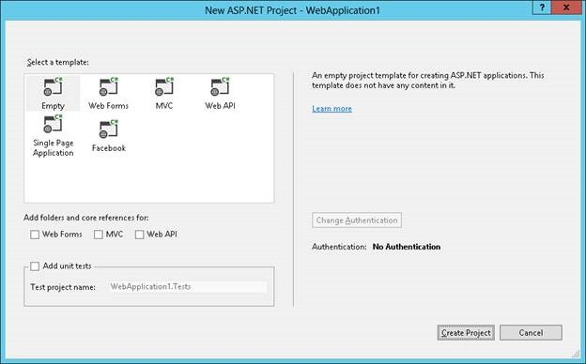
Visual Studio 2013 RC
One ASP.NET
Browser Link
New HTML editor
Azure website tooling
Scaffolding
OWIN
ASP.NET Identity
Download and more info at: http://www.asp.net/vnext

Slide 12
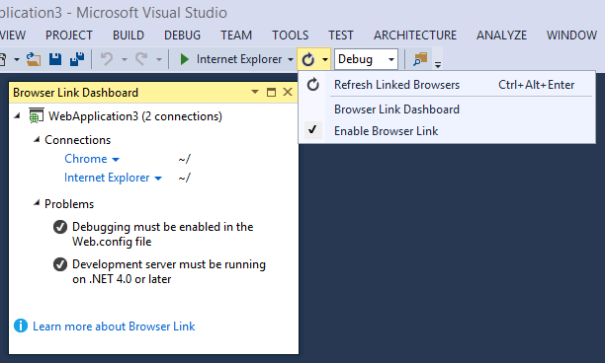
Visual Studio 2013 RC
One ASP.NET
Browser Link
New HTML editor
Azure website tooling
Scaffolding
OWIN
ASP.NET Identity
Download and more info at: http://www.asp.net/vnext

Slide 13
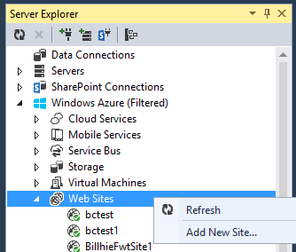
Visual Studio 2013 RC
One ASP.NET
Browser Link
New HTML editor
Azure website tooling
Scaffolding
OWIN
ASP.NET Identity
Download and more info at: http://www.asp.net/vnext

Slide 14
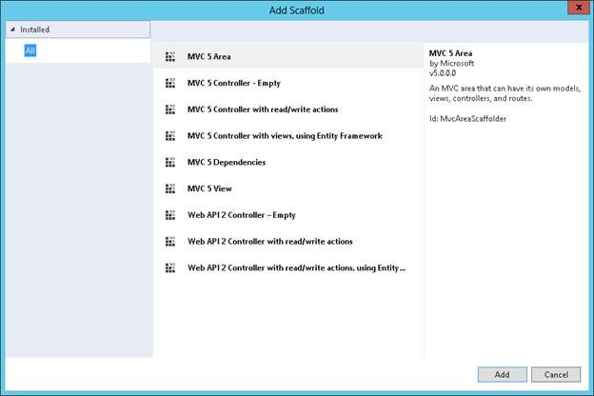
Visual Studio 2013 RC
One ASP.NET
Browser Link
New HTML editor
Azure website tooling
Scaffolding
OWIN
ASP.NET Identity
Download and more info at: http://www.asp.net/vnext

Slide 15
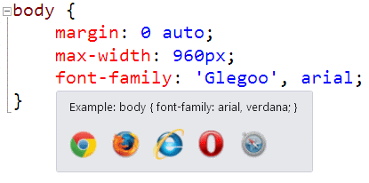
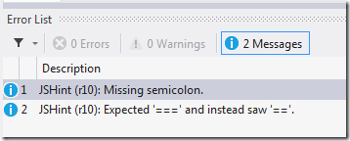
Web Essential Extensions
http://vswebessentials.com

Slide 16
Demo
Visual Studio Web Editor Features

Slide 17
What’s new in ASP.NET
→ New Templates (Bootstrap)
→ New Scaffolding System
→ New Identity System

Slide 18
Demo
What’s new in ASP.NET

Slide 19
Recap
→ One ASP.NET
→ Visual Studio and Web Essentials
→ What’s new in ASP.NET

Slide 20
Resources
Install 2013 (link)
Bootstrap articles (links)
Identity Articles (links)
OWIN Article

