Slide 1
Running, improving and maintaining a site in the real world
[Speaker]
[Company]
Email: [Email]
Twitter: [Twitter]

Slide 2
Agenda
Scenario: Scale
Scenario: Adapt to Change
Scenario: Environments

Slide 3
Let’s get Real

Slide 4
Scenario: Scale

Slide 5
Scenario description
Your site load varies over time.
You need to adapt.
Smoothly.

Slide 6
Load profiles
BATCH
PREDICTABLE
No
load
Load
Load
INCREASING
UNPREDICTABLE
Load
Load

Slide 7
Step 1: Preserve server bandwidth
PROBLEM:
Your servers are wasting bandwidth serving static files.

Slide 8
Step 1: Preserve server bandwidth
SOLUTION:
Serve static files from blob storage.
This is a step towards to delivering content from a content delivery network (CDN).

Slide 9
Step 2: Caching
PROBLEM:
Your servers have finite resources.
You don’t want to repeat work you don’t have to.

Slide 10
Step 2: Caching
SOLUTION:
Store ASP.NET page output cache in Windows Azure Caching Service.

Slide 11
Step 3: Manual scale
PROBLEM:
You need more server resources.

Slide 12
Step 2: Manual Scale
SOLUTION:
Add more servers (horizontal scaling).
Use more powerful servers (vertical scaling).

Slide 13
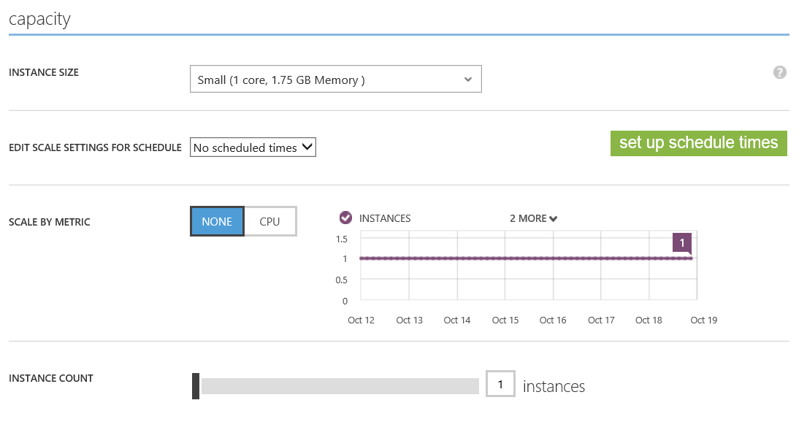

Slide 14
Step 3: Auto-scale
PROBLEM:
Manual scaling reaction time means outages.
Manual scaling is busy work.

Slide 15
Step 2: Auto-scale
SOLUTION:
Use auto-scale.

Slide 17
Demo
Scenario: Scale

Slide 18
Scenario: Change

Slide 19
Scenario description
Your site isn’t done when you deploy to production.
You need to add new features.
Change adds risk.

Slide 20
Step 1: Manage database schema
PROBLEM:
Your database and application code need to stay in sync.

Slide 21
Step 1: Manage database schema
SOLUTION:
Use Entity Framework Data Migrations.

Slide 22
Demo
Scenario: Data migrations

Slide 23
Step 2: Manage deployments
PROBLEM:
People sometimes make misteaks.

Slide 24
Step 2: Manage deployments
SOLUTION:
Use deployment rollback.

Slide 25
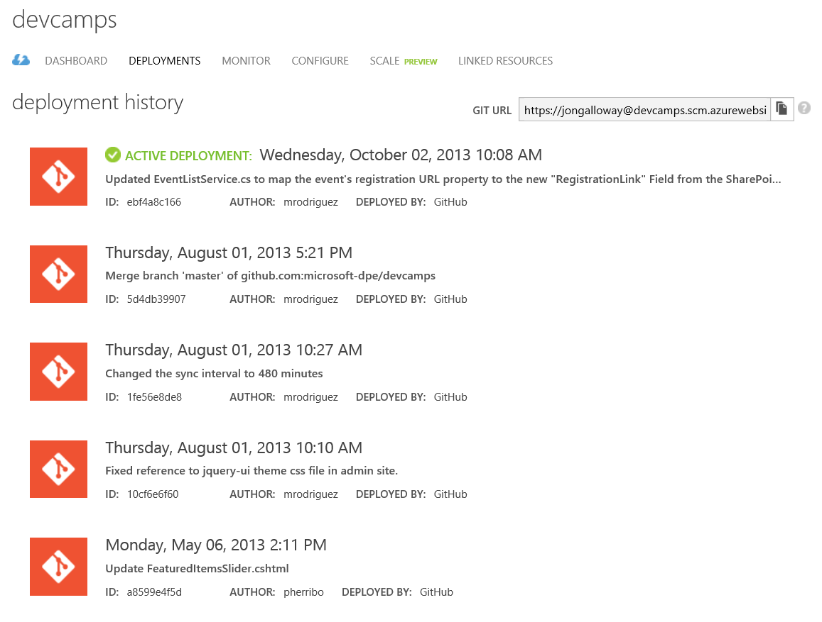

Slide 26
Demo
Scenario: Deployment rollback

Slide 27
Step 3: Leverage services
PROBLEM:
Large changes often require you to add new features quickly.

Slide 28
Step 3: Leverage services
SOLUTION:
Take advantage of available Windows Azure services.

Slide 29
Demo
Scenario: Windows Azure Active Directory

Slide 30
Scenario: Multiple Environments

Slide 31
Scenario description
Running a real site requires several environments.

Slide 32
Step 1: Continuous Integration
PROBLEM:
Bugs and issues in your code get harder to fix the longer it takes to find out about them.

Slide 33
Step 1: Continuous Integration
SOLUTION:
[Cory?]

Slide 34
Scenario description
Running a real site requires several environments.

Slide 35
Running, improving and maintaining a site in the real world
60 minutes
“Real world” content
Scenario: Scale
Static content to storage (using URL rewrite)
Manual scale
Auto-scale
Caching
Use WCAT to show load?
Scenario: Change
EF Migrations – both up and down (mention other migration options?)
Deployment rollback (Git / TFS)
WAAD (selling private label version of site w/ AD support)
Scenario: Dev / Test
Continuous Integration
Multi-environment
VM
Test Manager?
Note:
AD here + SSL (slide driven) – Note: Talk to Vittorio about ACS / AD
Slides in appendix to go in depth
Make this 75-90 minutes?
3 Calls to action for each scenario
Include New Relic, maybe Glimpse too
Optimization – Web Dev Checklist
Selective publishing

Slide 36
Shared - ?? Bandwidth – Images to blob storage
Scalability – ARR, ARR Cookie, Affinity, -- Beyond to Cloud Services – Stateless
Demo Scale Manual
Demo Scale Auto – Test Project in VS

Slide 37
Resources
http://www.windowsazure.com/en-us/manage/services/cache/net/how-to-cache-service/ - aka.ms this

