Slide 1
Web Camps
[Speaker]
[Company]
Email: [Email]
Twitter: [Twitter]

Slide 2
Today’s Agenda
Session | Start | End
Keynote | 8:30 | 9:00
Introduction to ASP.NET and Visual Studio 2013 Web Tooling | 9:00 | 10:00
Building Web Applications using the latest ASP.NET technologies | 10:00 | 11:00
Break | 11:00 | 11:15
Building web front ends for both desktop and mobile using the latest web standards | 11:15 | 12:15
Lunch | 12:15 | 1:15
API Services for both web and devices | 1:15 | 2:15
Running, improving and maintaining a site in the real world | 2:15 | 3:15
Break | 3:15 | 3:30
Real-time Communications with SignalR | 3:30 | 4:30
Wrap Up | 4:30 | 5:00

Slide 3
The foundation: tools & frameworks
Visual Studio
Windows Azure
NuGet
ASP.NET

Slide 4


Visual Studio 2013: The editor for serious web dev
HTML5 / CSS3 standards and smarts
JavaScript language features
Page Inspector + Browser Link
One code editor for client and server
Web Essentials extension

Slide 5

NuGet: The smart, easy way to manage dependencies
Find the latest release
Install and configure in your project
Handle dependencies and versions
Updates with dependency checking
Common list of installed packages
Simplified uninstalls
Streamlined deployment with Package Restore

Slide 6
One ASP.NET: A Framework for us all
Sites
Services
Web
Forms
Web
Pages
Single Page Apps
SignalR
MVC
Web API
ASP.NET

Slide 7

Deploying ASP.NET Apps to the Cloud
Windows Azure Web Sites (10 free!)
Fast site creation and deployment
Nothing new to learn
Easy to scale

Slide 8
Windows Azure signup
demo…
http://aka.ms/webcamps-azure
Notes:
http://aka.ms/webcamps-azure

Slide 9
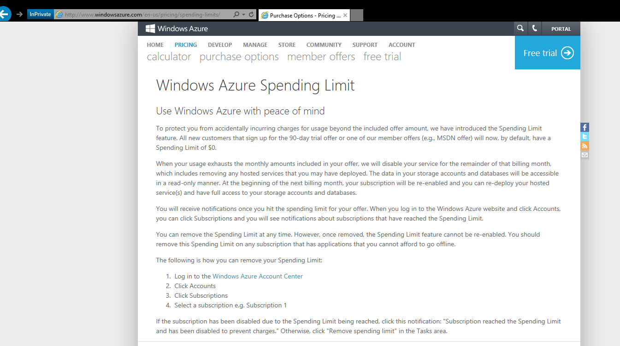

Slide 10
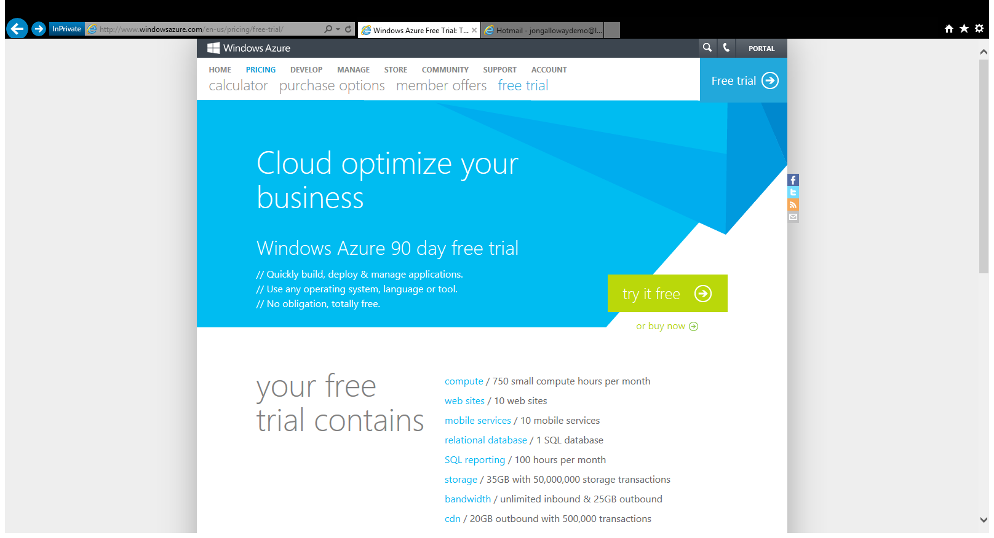

Slide 11
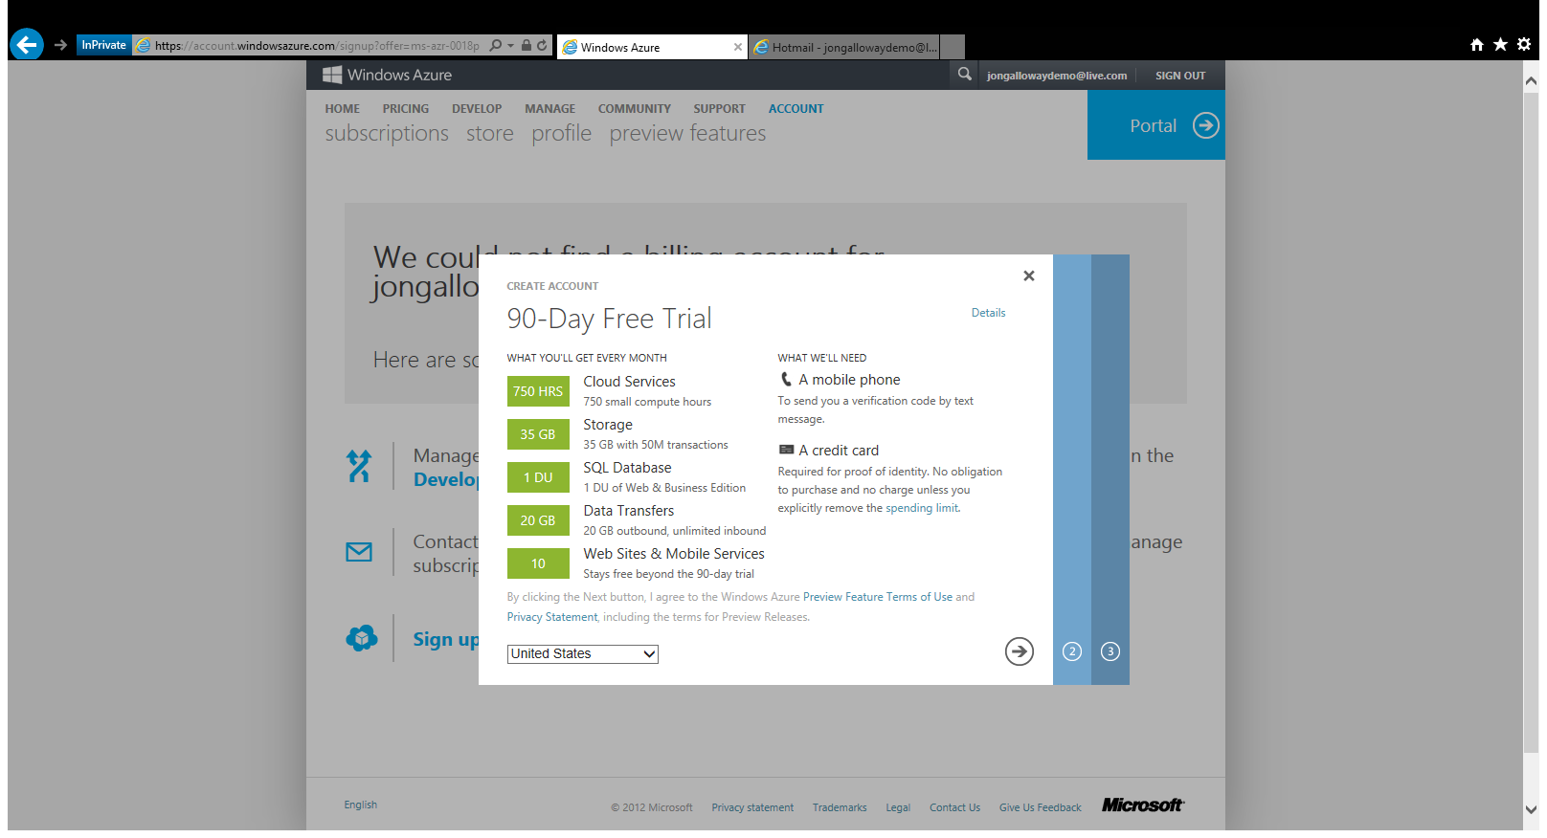

Slide 12
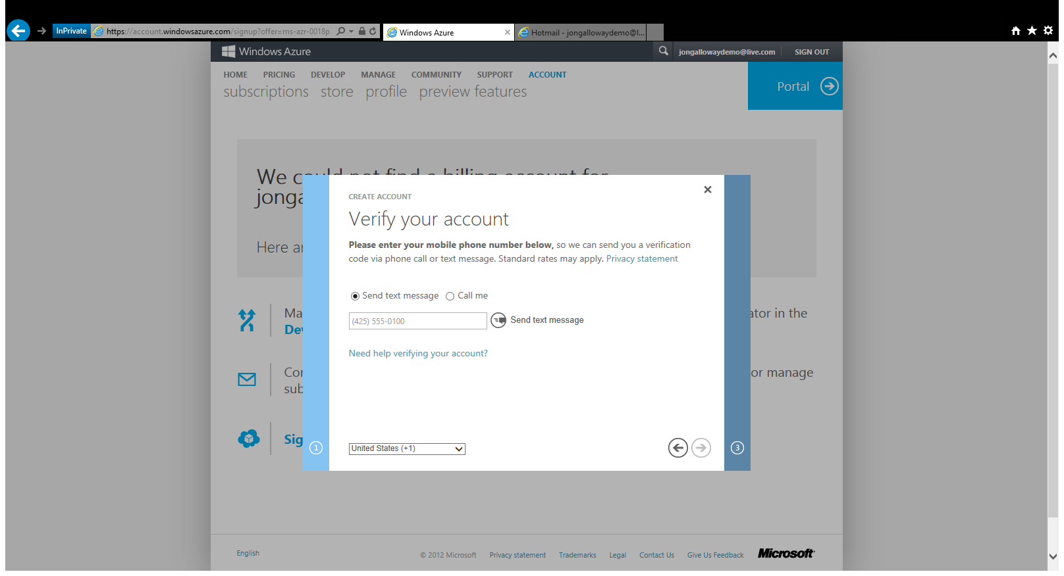

Slide 13
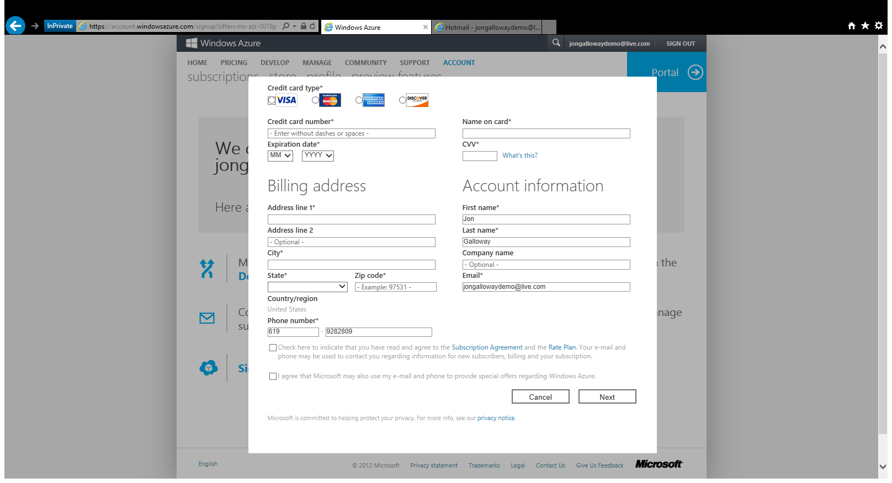

Slide 14
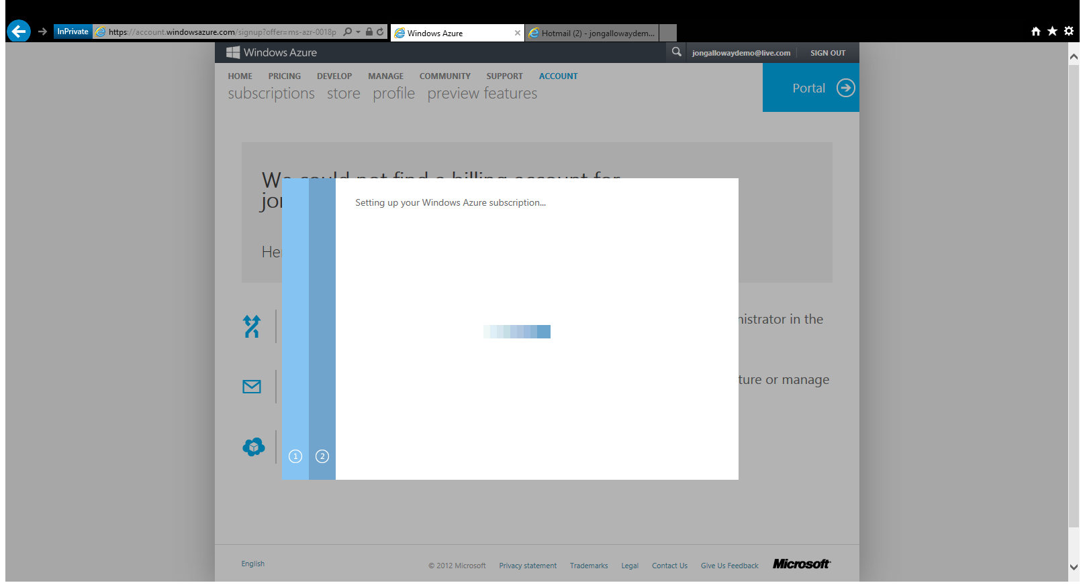

Slide 15
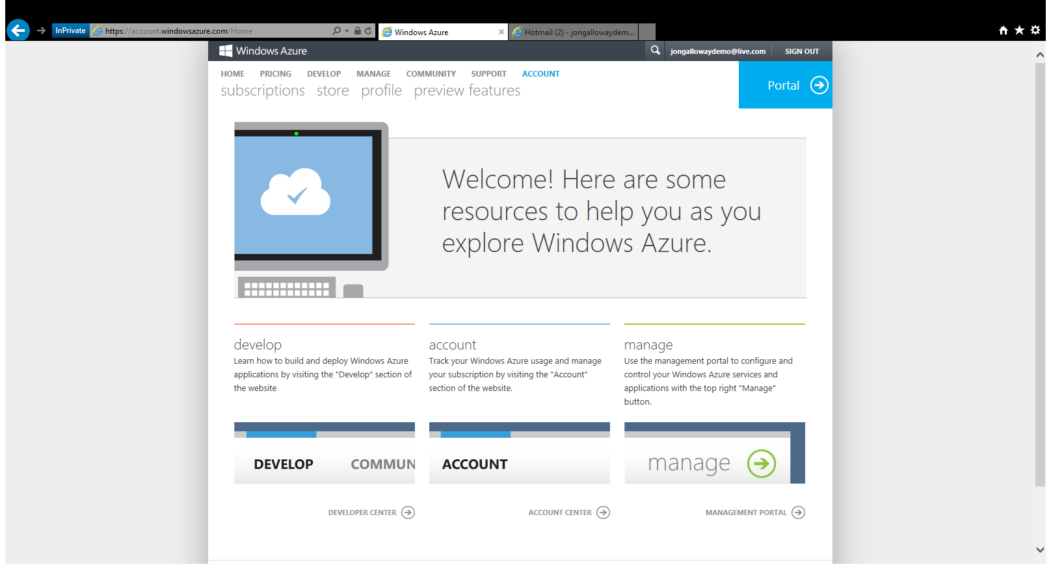

Slide 16
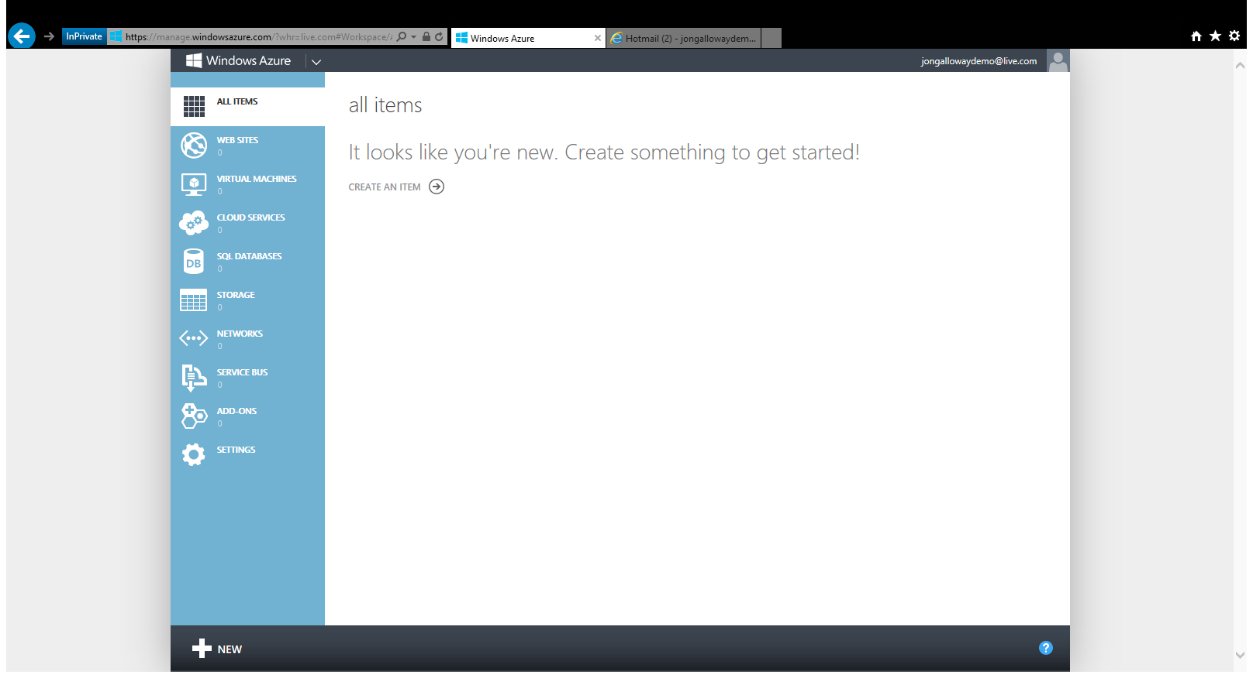

Slide 17

Windows Azure

Slide 18

Windows Azure

Slide 19

Windows Azure

Slide 20

Windows Azure

Slide 21
The foundation: tools & frameworks
Visual Studio
Windows Azure
NuGet
ASP.NET

Slide 22
Resources
Feedback and questions http://asp.net
http://asp.net/vnext
http://www.devcamps.ms/web
http://windowsazure.com
http://aka.ms/webcamps-training-kit
http://aka.ms/webcamps-azure (free trial)

