Slide 1
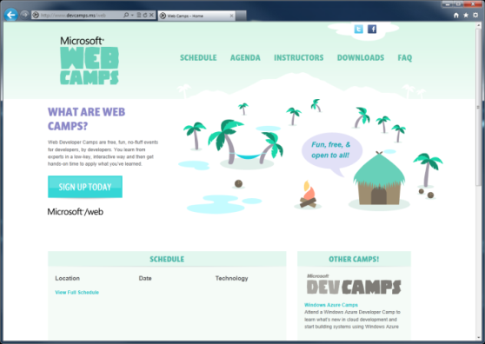

WebCamps Online
Twitter: Follow @webcamps Hashtag #devamps
SPEAKER NAME/HANDLE HERE
Website: http://www.devcamps.ms/web
What are web camps?
Web Developer Camps are free, fun, no-fluff events for developers, by developers. You learn from experts in a low-key, interactive way and then get hands-on time to apply what you’ve learned.

Slide 2
Building and Deploying Websites with ASP.NET MVC 4
Name
Title
Microsoft Corporation

Slide 3
Agenda
Introduction to ASP.NET MVC
Creating a new ASP.NET MVC site
Adding a model / controller / view
Entity Framework Code First
Deploying to Windows Azure Web Sites
Entity Framework Migrations

Slide 4
MVC is Another Alternative in the Stack
XML
HTML
JSON
Web Forms
Razor View Engine
Code
Web Pages
MVC
MVC 4
Web API
ASP.NET Core
Self Host
Modules
Handlers
Membership
Intrinsics
Caching
Etc.
Notes:
Estimated Time: 2 minutes
No matter which type of developer you are, you get the benefit of the ASP.NET Core runtime, which provides many useful modules that provide functionality that you are likely to need when creating web applications. For example: Profile, Roles and Membership is important if you want to build in users and security around different parts of your website.
[Build x 3]
ASP.NET Web Forms, ASP.NET MVC and ASP.NET Web Pages are three different approaches to building web applications on the server side with ASP.NET. They all build on top of the same core runtime that provides them with the same powerful set of modules that web developers can leverage from within their web applications.
ASP.NET Web Forms is great for developers coming from desktop application development where they are accustomed to controls, event-driven development and code-behind. Despite not being concepts that are native to the web, Web Forms achieves this by abstracting away things like maintaining state, form posting and much more. This ease of development means that developers relinquish a certain amount of control as Web Forms manages communication between the server and client on your behalf.
ASP.NET MVC, in contrast, is for developers that like to be in full control of the interactions between client and server and provides a more “raw” approach to what happens in the web application. Due to its loosely coupled architecture, MVC is also very extensible with many places for developers to customize and plugin components as well write test code easily.
Developing in ASP.NET Web Pages is centered around inline code and is similar to PHP or classic ASP in that compilation of your application isn’t required (it is in WebForms and MVC). It is designed to provide the simplest approach to building websites with the fewest number of concepts to learn.
[Build x 2]
When it comes to controlling the markup that is rendered to the client there are two view engines you may use. The Web Forms view engine is shared by both Web Forms and MVC and uses the familiar <% %> syntax. With ASP.NET MVC 3 and ASP.NET Web Pages Microsoft introduced the Razor View Engine which uses a different syntax centered around the @ symbol. The Razor syntax uses fewer characters to achieve the same things in Web Forms and allows the developer to mix markup and code really easily.

Slide 5
ASP.NET MVC 101
Model
(Data)
Controller
(Input)
View
(Presentation)
Notes:
Estimated Time: 2 minutes
MVC is a design pattern that stands for Model-View-Controller. What is strives to do is separate the concerns of an application’s presentation layer by assigning specific roles to the three different components.
The Controller is responsible for handling all user input. Once input has been received, the Controller will perform any operations/actions it needs to, which might include interacting with the Model.
The Model represents the data in the application. Once the Controller retrieves some model data and performs any work with the model, it constructs a presentation model that describes the model in terms the View can understand.
The View is the visual representation of the model. It presents the model data to the actual user in a way that is meaningful. In a web application, this would typically be HTML.

Slide 6
How MVC Works
What does MVC look like?
Request
Controller
Controller
Retrieves Model
“Does Stuff”
Response
View
View
Visually represents
the model
Notes:
Estimated Time: 4 minutes
So what does MVC look like when implemented over the web?
When an HTTP request comes into the application it is mapped to a controller. Remember as we mentioned in the previous slide, in the MVC design pattern, the controller is the piece of the triad that handles all user input. In the case of a web application, user input is represented as HTTP requests [Advance Animation].
Once the controller has received input, it performs whatever operations it needs to and then assembles a presentation model [Advance Animation].
The controller then takes the model and passes it off to the view. Remember that the view is simply a visual representation of the model [Advance Animation].
The view then “transforms” the model into whatever format it uses to represent it. In a web application, this would typically be HTML [Advance Animation].
The view then serves the request by responding with its visual representation.

Slide 7
Creating a new ASP.NET MVC 4 Application
demo…
Notes:
Steps (10 minutes):
File / New MVC Project
Explain different templates
Select Internet Application Template
Explain folder structure
Show HomeController and /Views/Home/Index.cshtml
Run application and demonstrate the the HomeController displays the Home Index view

Slide 8
Adding a model, controller, view
demo…
Notes:
Steps (10 minutes)
Create an Album model class
Right-click Model folder
Add Album class
Add int Album property
Add string Title property
Add decimal Price property
Build the application
Create a Store controller
Right-click Controllers folder
Add a new MVC controller with read/write actions and views, using Entity Framework
Select Album model class
New Data context named StoreContext
Demonstrate the scaffolded Store controller
Browse to /Store
Add an Album
Edit the album
Delete the album
Show the Store controller actions and views
Show App_Start\RouteConfig.cs to show how urls map to actions

Slide 9
Entity Framework Code First
demo…
Notes:
Steps (10 minutes)
Open the StoreContext class created in the previous demo
Show the database in App_Data and explain that the Albums table is inferred from the Ablum class
Enable automatic migrations (note – if running late, skip this section)
Enable migrations using the Enable-Migrations –EnableAutomaticMigrations -ContextType StoreContext command in the package manager console
Add an int Rating property to the Album class
In the package manager console, run Update-Database –Verbose –Script
Show the output and script
Run the command again and show that EF detects no changes were made so no migration is necessary

Slide 10
Deploying to Windows Azure Web Sites
demo…
Notes:
Deploy the site as shown here: https://www.windowsazure.com/en-us/develop/net/tutorials/web-site-with-sql-database/#header-3

Slide 11
Entity Framework Migrations
demo…
Notes:
Time permitting – add a new property to the model and re-deploy to show the database was updated

Slide 12
Notes:
Robot icon purchased from The Noun Project: http://thenounproject.com/noun/robot/#icon-No5762

