Slide 1
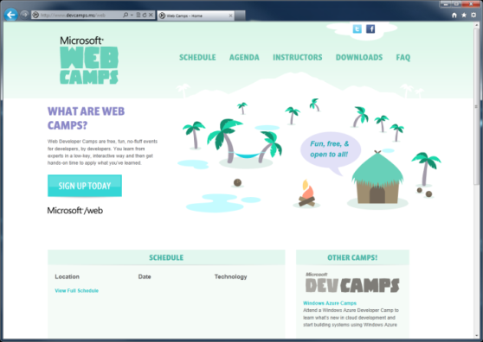

WebCamps Online
Twitter: Follow @webcamps Hashtag #devamps
SPEAKER NAME/HANDLE HERE
Website: http://www.devcamps.ms/web
What are web camps?
Web Developer Camps are free, fun, no-fluff events for developers, by developers. You learn from experts in a low-key, interactive way and then get hands-on time to apply what you’ve learned.

Slide 2
Building and Deploying Websites with ASP.NET MVC 4
Name
Title
Microsoft Corporation

Slide 3
Agenda
Introduction to ASP.NET MVC
Creating a new ASP.NET MVC site
Adding a model / view / controller
Entity Framework Code First
Deploying to Windows Azure Web Sites
Entity Framework Migrations

Slide 4
Introduction to ASP.NET MVC

