Slide 1
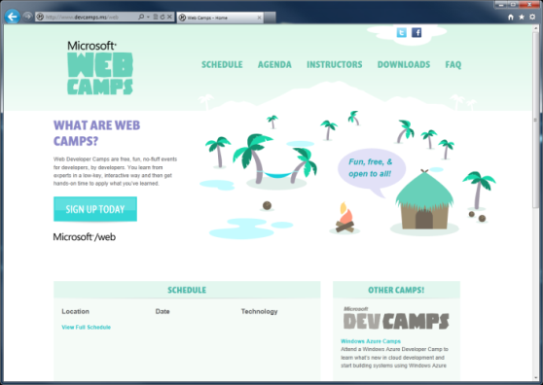

WebCamps Online
Twitter: Follow @webcamps Hashtag #devamps
SPEAKER NAME/HANDLE HERE
Website: http://www.devcamps.ms/web
What are web camps?
Web Developer Camps are free, fun, no-fluff events for developers, by developers. You learn from experts in a low-key, interactive way and then get hands-on time to apply what you’ve learned.

Slide 2
Building and Deploying Websites with ASP.NET MVC 4
Name
Title
Microsoft Corporation

Slide 3
Agenda
Introduction to ASP.NET MVC
Creating a new ASP.NET MVC site
Adding a model / controller / view
Entity Framework Code First
Deploying to Windows Azure Web Sites
Entity Framework Migrations

Slide 4
MVC is Another Alternative in the Stack
XML
HTML
JSON
Web Forms
Razor View Engine
Code
Web Pages
MVC
MVC 4
Web API
ASP.NET Core
Self Host
Modules
Handlers
Membership
Intrinsics
Caching
Etc.
Notes:
Main thing from this slide: MVC builds on the same ASP.NET core as ASP.NET Web Forms, Web Pages, etc.

Slide 5
How MVC Works
What does MVC look like?
Request
Controller
Controller
Retrieves Model
“Does Stuff”
Response
View
View
Visually represents
the model
Notes:
Estimated Time: 4 minutes
So what does MVC look like when implemented over the web?
When an HTTP request comes into the application it is mapped to a controller. Remember as we mentioned in the previous slide, in the MVC design pattern, the controller is the piece of the triad that handles all user input. In the case of a web application, user input is represented as HTTP requests [Advance Animation].
Once the controller has received input, it performs whatever operations it needs to and then assembles a presentation model [Advance Animation].
The controller then takes the model and passes it off to the view. Remember that the view is simply a visual representation of the model [Advance Animation].
The view then “transforms” the model into whatever format it uses to represent it. In a web application, this would typically be HTML [Advance Animation].
The view then serves the request by responding with its visual representation.

Slide 6
Creating a new ASP.NET MVC 4 Application
demo…
Notes:
Steps (10 minutes):
File / New MVC Project
Explain different templates
Select Internet Application Template
Explain folder structure
Show HomeController and /Views/Home/Index.cshtml
Run application and demonstrate the the HomeController displays the Home Index view

Slide 7
Adding a model, controller, view
demo…
Notes:
Steps (10 minutes)
Create an Album model class
Right-click Model folder
Add Album class
Add int AlbumId property
Add string Title property
Add decimal Price property
Build the application
Create a Store controller
Right-click Controllers folder
Add a new MVC controller with read/write actions and views, using Entity Framework
Select Album model class
New Data context named StoreContext
Demonstrate the scaffolded Store controller
Browse to /Store
Add an Album
Edit the album
Delete the album
Show the Store controller actions and views
Show App_Start\RouteConfig.cs to show how urls map to actions

Slide 8
Entity Framework Code First
demo…
Notes:
Steps (10 minutes)
Open the StoreContext class created in the previous demo
Show the database in App_Data and explain that the Albums table is inferred from the Ablum class
Enable automatic migrations (note – if running late, skip this section)
Enable migrations using the Enable-Migrations –EnableAutomaticMigrations -ContextType StoreContext command in the package manager console
Add an int Rating property to the Album class
In the package manager console, run Update-Database –Verbose –Script
Show the output and script
Run the command again and show that EF detects no changes were made so no migration is necessary

Slide 9
Deploying to Windows Azure Web Sites
demo…
Notes:
Deploy the site as shown here: https://www.windowsazure.com/en-us/develop/net/tutorials/web-site-with-sql-database/#header-3

Slide 10
Entity Framework Migrations
demo…
Notes:
Time permitting – add a new property to the model and re-deploy to show the database was updated

Slide 11
Notes:
Robot icon purchased from The Noun Project: http://thenounproject.com/noun/robot/#icon-No5762

