Slide 1
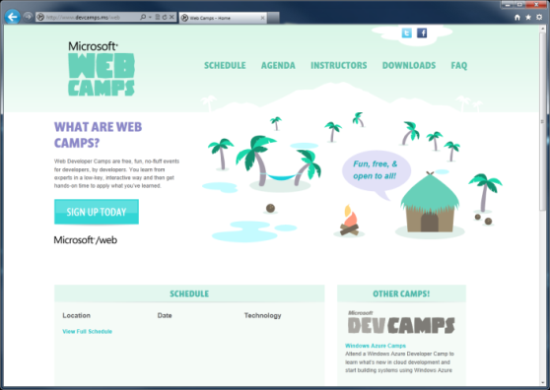

WebCamps Online
Twitter: Follow @webcamps Hashtag #devamps
SPEAKER NAME/HANDLE HERE
Website: http://www.devcamps.ms/web
What are web camps?
Web Developer Camps are free, fun, no-fluff events for developers, by developers. You learn from experts in a low-key, interactive way and then get hands-on time to apply what you’ve learned.
Notes:
Adaptive rendering in ASP.NET 4.5 and ASP.NET MVC 4 (10)
Display Modes (10)
Mobile Template and jQuery Mobile (10)

Slide 2
Building For The Mobile Web
Name
Title
Microsoft Corporation

Slide 3
Agenda
Adaptive rendering in ASP.NET 4.5 and ASP.NET MVC 4
Display Modes
Mobile Template and jQuery Mobile

Slide 4
Adaptive Rendering
demo…

Slide 5
Mobile Web Development
Adaptive Rendering
Display Modes
Mobile Template
Mostly
Desktop
Mostly
Mobile

Slide 6
Display Modes
demo…

Slide 7
Custom Modes: Views\Shared\_Layout.WinPhone.cshtml
DisplayModeProvider.Instance.Modes.Insert(0,
new DefaultDisplayMode(“WinPhone")
{ ContextCondition = (
c => c.Request.UserAgent
.IndexOf(“Windows Phone OS") > 0)
});

Slide 8
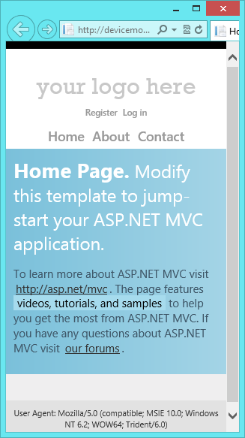
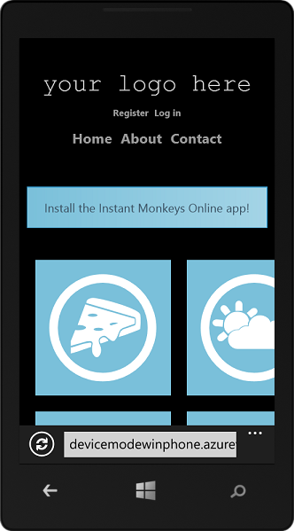
Windows Phone Display
Mode Example
Same URL
Different view
Based on custom view
mode criteria

Slide 9
Mobile Template
demo…

Slide 10
Resources
http://www.asp.net/mobile
http://aka.ms/mvc4-adaptive-rendering
http://aka.ms/mvc4-mobile-tutorial

