Slide 1
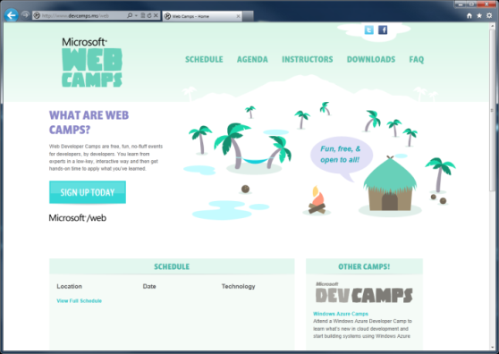

WebCamps Online
Twitter: Follow @webcamps Hashtag #devamps
SPEAKER NAME/HANDLE HERE
Website: http://www.devcamps.ms/web
What are web camps?
Web Developer Camps are free, fun, no-fluff events for developers, by developers. You learn from experts in a low-key, interactive way and then get hands-on time to apply what you’ve learned.
Notes:
How does ASP.NET Web API fit in? (10)
Introduction to Web API
File / New project and looking at the Values Controller (5)
Help documentation & Tracing (5)
Exploring services with browser tools (5)
Creating a Person service (5)
Consuming an ASP.NET Web API from jQuery
File / New (10)
Deploy to Azure (5)
Consuming an ASP.NET Web API from Windows 8 (10)
Challenge: First person to insert their contact information wins a prize (5)

Slide 2
Building a Service Layer with ASP.NET Web API
Name
Title
Microsoft Corporation

Slide 3
Agenda
How does ASP.NET Web API fit in?
Introduction to Web API
Consuming Web API from jQuery
Consuming Web API from Windows 8

Slide 4
Web API is a part of ASP.NET
HTML
XML
JSON
Web Forms
Razor View Engine
Code
Web Pages
MVC
MVC 4
Web API
ASP.NET Core
Modules
Handlers
Membership
Intrinsics
Caching
Etc.

Slide 5
Where Can You Get Web API?

Slide 6
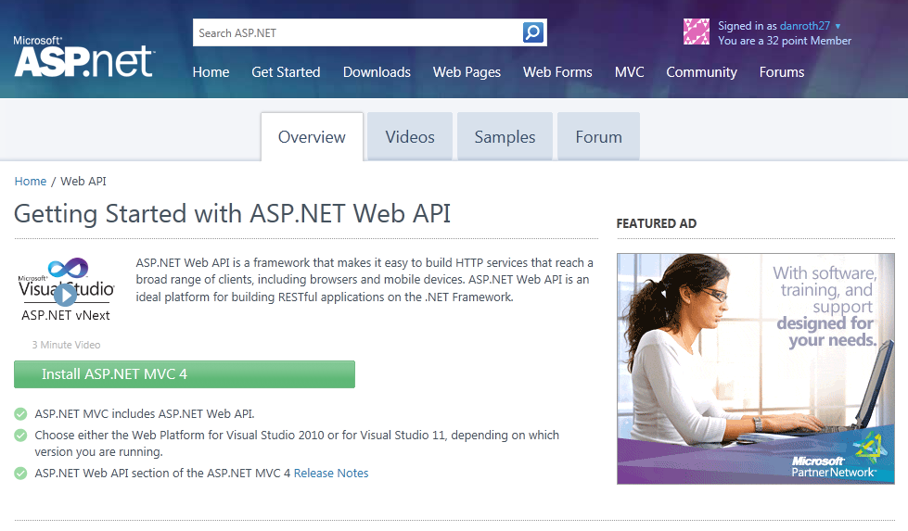
Homepage: asp.net/web-api

Slide 7
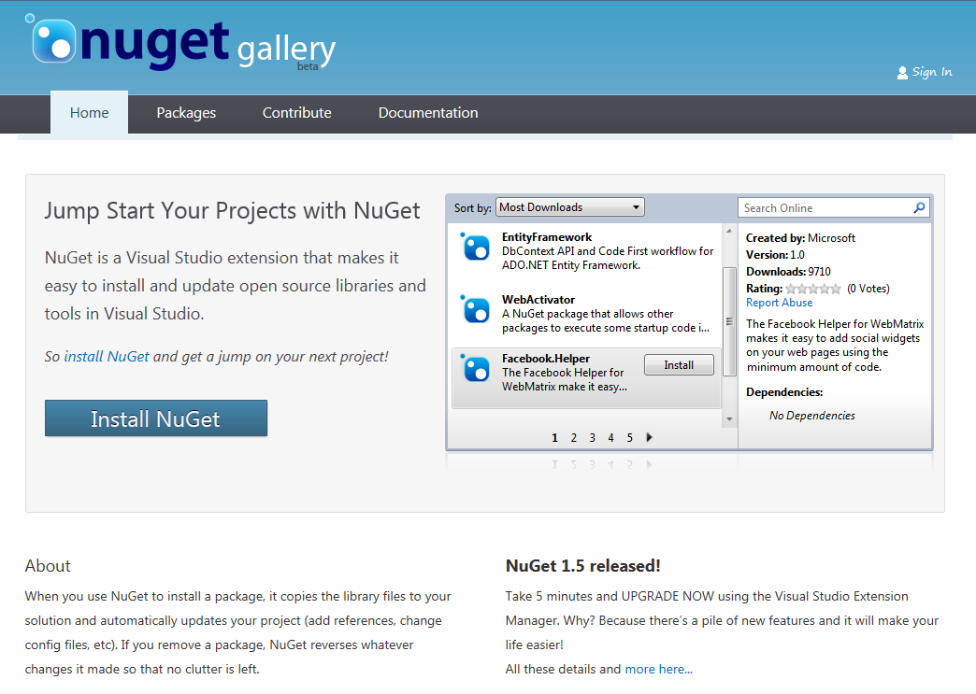
Find Us on Nuget
Nuget Packages
WebApi
WebApi.OData
JsonValue
HttpClient
WebApi.Enhancements

Slide 8
Building a Read Only Web API
Why?
Allow browser or other clients to easily retrieve information from your system

Slide 9
Sample Read-only Model and Controller
Step 1:
Create a Model
public class Person
{
public int Id { get; set; }
public string Name { get; set; }
}
Step 2:
Make an API Controller
public class PersonController : ApiController
{
List<Person> _people;
public PersonController()
{
_people = new List<Person>();
_people.AddRange(new Person[]
{
new Person { Id = 1, Name = "Chuck Norris" },
new Person { Id = 2, Name = "David Carradine" },
new Person { Id = 3, Name = "Bruce Lee" }
});
}
}

Slide 10
Read-only Controller Actions to return data
Step 3:
Return everything
// GET /api/person
public IEnumerable<Person> Get()
{
return _people;
}
Step 4:
Return one item
// GET /api/person/5
public Person Get(int id)
{
return _people.First(x => x.Id == id);
}

Slide 11
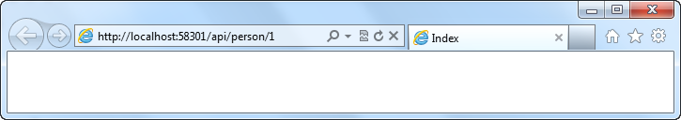
Routing a Web API Using Global.asax.cs
Routing:
Familiar syntax, conventional approach
public static void RegisterRoutes(RouteCollection routes)
{
routes.MapHttpRoute(
name: "DefaultApi",
routeTemplate: "api/{controller}/{id}",
defaults: new { id = RouteParameter.Optional }
);
}

Slide 12
Manipulating HTTP Responses
Return HttpResponseMessage<T> to modify response headers
Example
Find a person and return it, but what happens if we don’t find a match?
// GET /api/person/5
public HttpResponseMessage<Person> Get(int id)
{
try
{
var person = _people.First(x => x.Id == id);
return new HttpResponseMessage<Person>(
person,
HttpStatusCode.OK
);
}
catch
{
return new HttpResponseMessage<Person>(HttpStatusCode.NotFound);
}
}

Slide 13
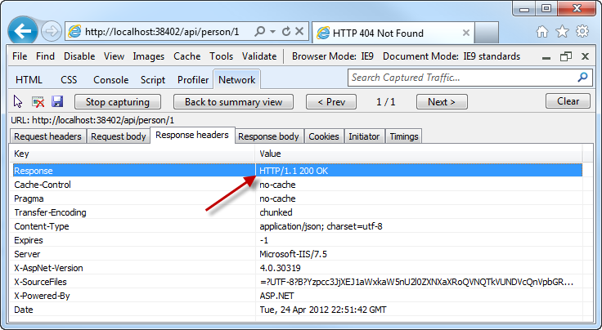
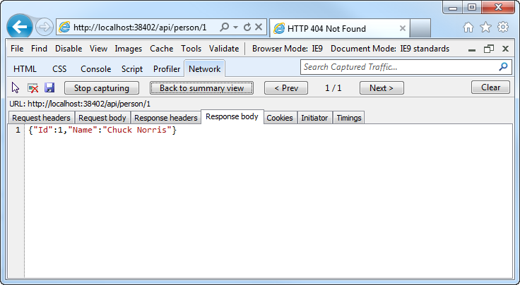
Manipulating HTTP Responses
A successful API call returns an HTTP OK and the JSON data

Slide 14
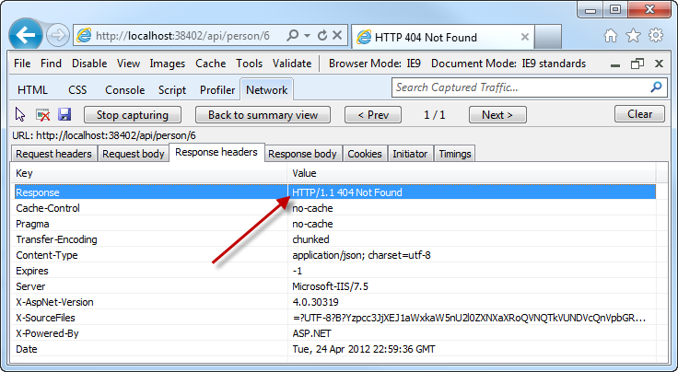
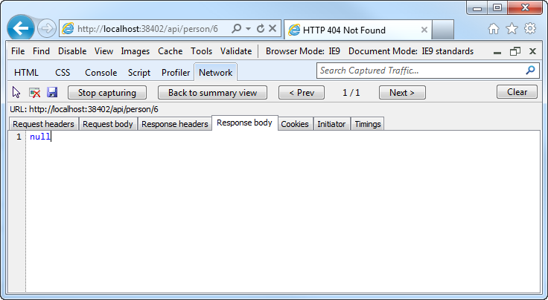
Manipulating HTTP Responses
An unsuccessful API call returns an HTTP 404 (and no JSON)

Slide 15
Making an API Updatable
Why?
Allow clients to modify the state of the server

Slide 16
Posting Data to a Web API
Use HTTP Post:
Pass a Model
public HttpResponseMessage Post(Person person)
{
person.Id = _people.Count + 1;
if (_people.Any(x => x.Id == person.Id))
return new HttpResponseMessage(HttpStatusCode.BadRequest);
try
{
_people.Add(person);
}
catch
{
return new HttpResponseMessage(HttpStatusCode.BadRequest);
}
return new HttpResponseMessage(HttpStatusCode.OK);
}

Slide 17
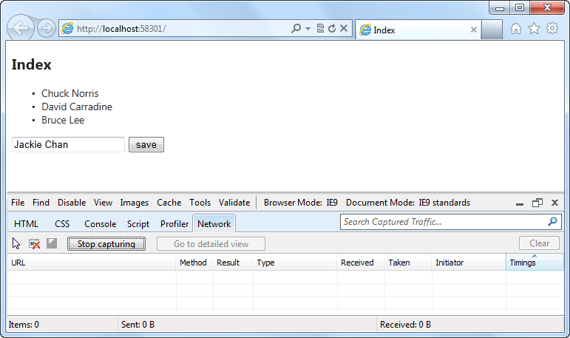
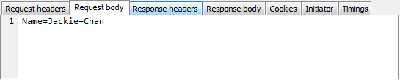
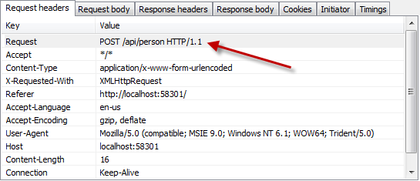
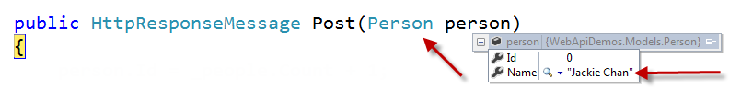
Posting Data to a Web API

Slide 18
Introduction to ASP.NET Web API
demo
Notes:
File / New project and looking at the Values Controller (5)
Help documentation & Tracing (5)
Exploring services with browser tools (5)
Creating a Person service (5)

Slide 19
MVC SPA template uses WebAPI
Demo
Notes:
Show how jQuery in SPA template talks to WebAPI

Slide 20
Windows Store Apps Talk to WebAPI
Demo
Notes:
Show how Windows Store App talks to WebAPI
Without change, Windows Store App can use form authentication
With slight modification, windows store app can use webAPI with facebook authentication (not the best technique here, possibly use HttpClient to do it)

Slide 21
Resources
Feedback and questions http://forums.dev.windows.com
Session feedback http://bldw.in/SessionFeedback

Slide 23
Web API is a part of ASP.NET
HTML
XML
JSON
Web Forms
Razor View Engine
Code
Web Pages
MVC
MVC 4
Web API
ASP.NET Core
Self Host
Modules
Handlers
Membership
Intrinsics
Caching
Etc.

Slide 24
Comparison of WCF & ASP.NET Web API
WCF
Back-end Services
SOAP, WS-*
ASP.NET Web API
Front-end Services
Media Types: JSON, XML, form-URL-encoded, custom
Transports: HTTP, TCP, UDP, Queues, WebSockets, custom
Message patterns: request-reply, one-way, duplex
Use WCF Web HTTP to add HTTP endpoints to existing WCF services
Use WCF Data Services for full OData support
HTTP only
Request-reply only
REST, resource-centric
Use SignalR for asynchronous signaling (polling, long-polling, WebSockets)

