Slide 1
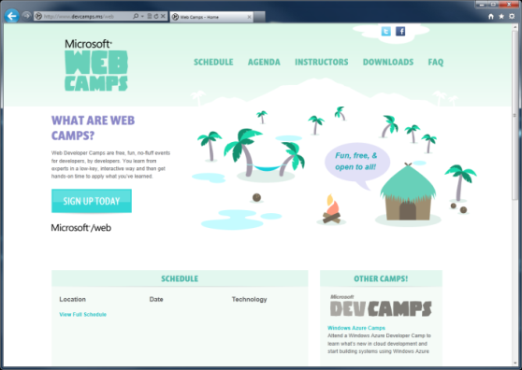

WebCamps Online
Twitter: Follow @webcamps Hashtag #devamps
SPEAKER NAME/HANDLE HERE
Website: http://www.devcamps.ms/web
What are web camps?
Web Developer Camps are free, fun, no-fluff events for developers, by developers. You learn from experts in a low-key, interactive way and then get hands-on time to apply what you’ve learned.

Slide 2
Building & Leveraging Social Services in ASP.NET
Name
Title
Microsoft Corporation

Slide 3
Agenda
Social Authentication
Facebook Development

Slide 4
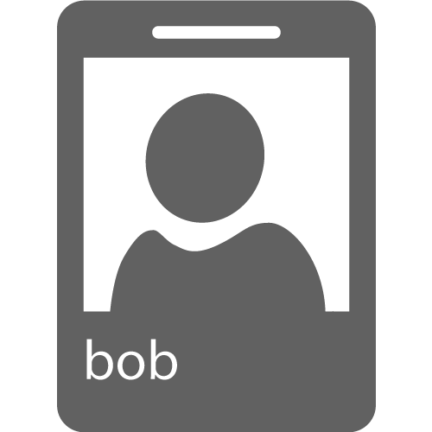
Social Authentication
Protocols
OAuth 1.0 & 2.0
OpenID
Identity
UserId
Possibly Name and Email
Permissions
User Information
Application Resources
Act on Behalf of User
Manage Data

Slide 5









OAuth Providers

Slide 6
OAuth Flow
Redirect to OAuth Provider
User Grants Authorizatoin
Redirect back to Application with Access Token

Slide 7
demo
OAuth

Slide 8
Facebook Applications
Identity
Social Graph
Application Integration

Slide 9
Open Graph
User
Action
Object

Slide 10
Facebook Graph API
Network of User, Actions, and Objects
REST API
JSON Format
Deep integration with Facebook
{ "id": "14812017", "name": "Nathan Totten", "first_name": "Nathan", "last_name": "Totten", "link": "https://www.facebook.com/totten", "username": "totten", "hometown": { "id": "108059045881132", "name": "Urbandale, Iowa" }, "location": { "id": "111723635511834", "name": "Bellevue, Washington" }, "bio": "Technical Evangelist at Microsoft", "work": [ { "employer": { "id": "20528438720", "name": "Microsoft" },
Notes:
Image Source:

Slide 11
Facebook C# SDK
Graph API
Authentication
All Major Microsoft Frameworks & Platforms:
.Net 3.5, .Net 4.0, and .Net 4.5
Windows Phone 7.1 and 8
Windows Store Apps

Slide 12
Flexible API: Dynamic Objects
var client = new FacebookClient("access_token");
// Get current user’s basic information
dynamic me = await client.GetTaskAsync("me");
string firstName = me.first_name;
// Post a message to the current user's wall
var post = new {
message = "This is a wall post!"
};
dynamic result = await client.PostTaskAsync("me/feed", post);

Slide 13
Facebook Template
ASP.NET MVC 4 Template (.Net 4.5 Only)
Includes the Facebook C# SDK
Authentication and Permissions
Storing and Caching Facebook Data
Graph API
Real-Time Updates

Slide 14
demo
Facebook App

