Slide 1
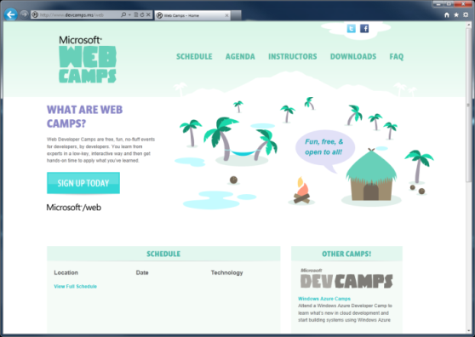

WebCamps Online
Twitter: Follow @webcamps Hashtag #webcamps
[Speaker] / [Twitter]
Website: http://www.devcamps.ms/web
What are web camps?
Web Developer Camps are free, fun, no-fluff events for developers, by developers. You learn from experts in a low-key, interactive way and then get hands-on time to apply what you’ve learned.

Slide 2
Building Social Web Apps in ASP.NET
[Speaker]
[Company]

Slide 3
Agenda
Social Authentication
Facebook Development

Slide 4










Slide 5
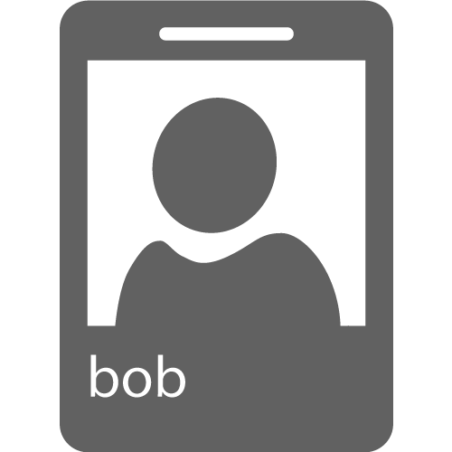
Social Authentication
Protocols
OAuth 1.0 & 2.0
OpenID
Identity
UserId
Possibly Name and Email
Permissions
User Information
Application Resources
Act on Behalf of User
Manage Data

Slide 6
OAuth Flow
How authentication works with OAuth
Your App
Redirect to Provider
Login Page
Login Page
Enter your credentials
Secure Page
Access Token
Permission Page
Permission Page
Grant requested permissions
Notes:
Estimated Time: 4 minutes
So what does MVC look like when implemented over the web?
When an HTTP request comes into the application it is mapped to a controller. Remember as we mentioned in the previous slide, in the MVC design pattern, the controller is the piece of the triad that handles all user input. In the case of a web application, user input is represented as HTTP requests [Advance Animation].
Once the controller has received input, it performs whatever operations it needs to and then assembles a presentation model [Advance Animation].
The controller then takes the model and passes it off to the view. Remember that the view is simply a visual representation of the model [Advance Animation].
The view then “transforms” the model into whatever format it uses to represent it. In a web application, this would typically be HTML [Advance Animation].
The view then serves the request by responding with its visual representation.

Slide 7
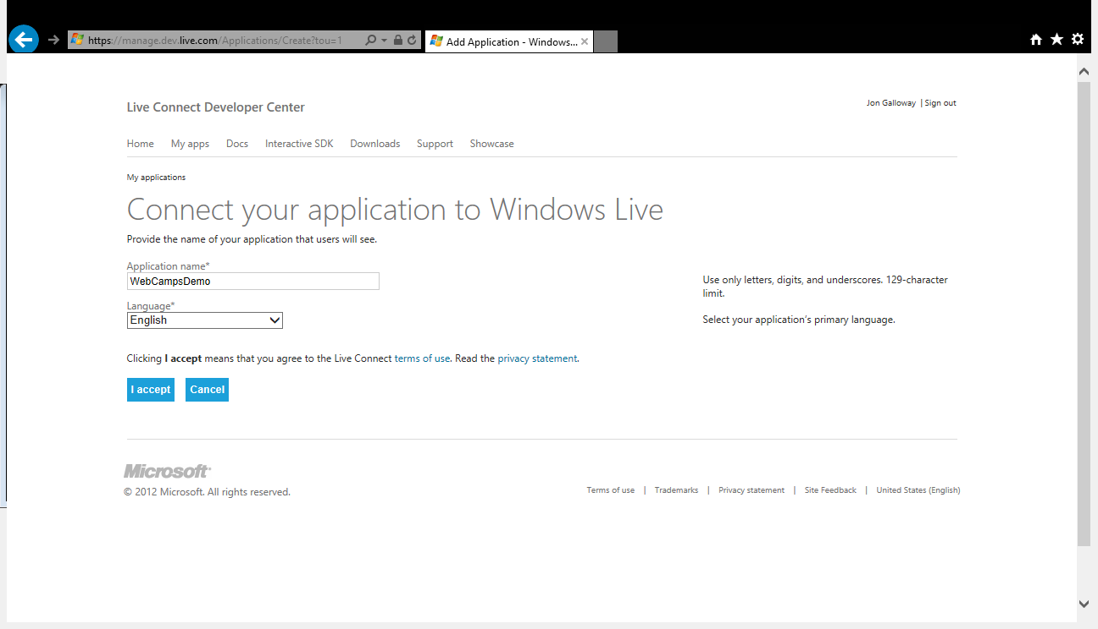
https://manage.dev.live.com/Applications/Index

Slide 8
demo
OAuth & OpenID

Slide 9
Facebook Applications
Identity
Social Graph
Application Integration
Real-Time Updates

Slide 10
Open Graph
User
Action
Object

Slide 11
Facebook Graph API
Network of User, Actions, and Objects
REST API
JSON Format
Deep integration with Facebook
{ "id": "14812017", "name": "Nathan Totten", "first_name": "Nathan", "last_name": "Totten", "link": "https://www.facebook.com/totten", "username": "totten", "hometown": { "id": "108059045881132", "name": "Urbandale, Iowa" }, "location": { "id": "111723635511834", "name": "Bellevue, Washington" }, "bio": "Technical Evangelist at Microsoft", "work": [ { "employer": { "id": "20528438720", "name": "Microsoft" },
Notes:
Image Source:

Slide 12
demo
Facebook Graph API
Notes:
Navigate to: http://graph.facebook.com/Microsoft in a browser. Either view the result in a browser (Google Chrome works best for this) or download the Json file and open it in Visual Studio.

Slide 13
Facebook C# SDK
Graph API
Authentication
All Major Microsoft Frameworks & Platforms:
.Net 3.5, .Net 4.0, and .Net 4.5
Windows Phone 7.1 and 8
Windows Store Apps

Slide 14
Flexible API: Dynamic Objects
var client = new FacebookClient("access_token");
// Get current user’s basic information
dynamic me = await client.GetTaskAsync("me");
string firstName = me.first_name;
// Post a message to the current user's wall
var post = new {
message = "This is a wall post!"
};
dynamic result = await client.PostTaskAsync("me/feed", post);

Slide 15
Facebook Template
ASP.NET MVC 4 Template (.NET 4.5 Only)
Includes the Facebook C# SDK
Authentication and Permissions
Storing and Caching Facebook Data
Graph API
Real-Time Updates

Slide 16
demo
Facebook Template

Slide 17
demo
Birthday Manager

Slide 18
demo
Facebook App

