Slide 1
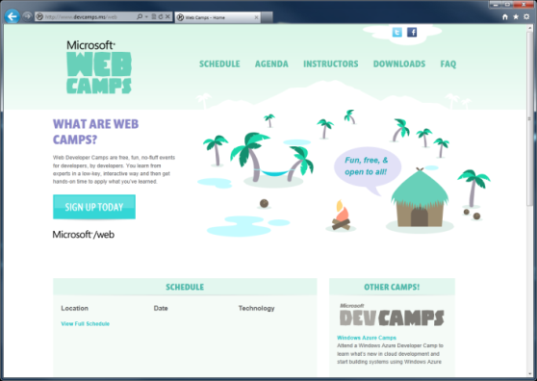

WebCamps Online
Twitter: Follow @webcamps Hashtag #devcamps
[Speaker] / [Twitter]
Website: http://www.devcamps.ms/web
What are web camps?
Web Developer Camps are free, fun, no-fluff events for developers, by developers. You learn from experts in a low-key, interactive way and then get hands-on time to apply what you’ve learned.
Notes:
Keynote (30 minutes)
We'll start with a quick keynote which lays out roadmap for the day. We'll make sure you're familiar with the core building blocks and tools used to create modern web applications on the Microsoft web platform, then examine some key web development scenarios the modern web platform helps you solve.
Outline:
Framework and tools (20 minutes)
ASP.NET
Tools
Visual Studio
NuGet
Windows Azure
Key Scenarios (10 minutes)
Overview key scenarios
Highlight scenarios we'll be covering today

Slide 2
Web Camps Wrap-up
[Speaker]
[Company]

Slide 3
Recap
What we learned today
What you can do next
Who you can contact for help
Where you can find more

Slide 4
What we learned today
Visual Studio
Windows Azure
NuGet
ASP.NET

Slide 5
What we learned today
HTML
XML
JSON
Web Forms
Razor View Engine
Code
Web Pages
MVC
MVC 4
Web API
ASP.NET Core
Self Host
Modules
Handlers
Membership
Intrinsics
Caching
Etc.
Notes:
Estimated Time: 2 minutes
No matter which type of developer you are, you get the benefit of the ASP.NET Core runtime, which provides many useful modules that provide functionality that you are likely to need when creating web applications. For example: Profile, Roles and Membership is important if you want to build in users and security around different parts of your website.
[Build x 3]
ASP.NET Web Forms, ASP.NET MVC and ASP.NET Web Pages are three different approaches to building web applications on the server side with ASP.NET. They all build on top of the same core runtime that provides them with the same powerful set of modules that web developers can leverage from within their web applications.
ASP.NET Web Forms is great for developers coming from desktop application development where they are accustomed to controls, event-driven development and code-behind. Despite not being concepts that are native to the web, Web Forms achieves this by abstracting away things like maintaining state, form posting and much more. This ease of development means that developers relinquish a certain amount of control as Web Forms manages communication between the server and client on your behalf.
ASP.NET MVC, in contrast, is for developers that like to be in full control of the interactions between client and server and provides a more “raw” approach to what happens in the web application. Due to its loosely coupled architecture, MVC is also very extensible with many places for developers to customize and plugin components as well write test code easily.
Developing in ASP.NET Web Pages is centered around inline code and is similar to PHP or classic ASP in that compilation of your application isn’t required (it is in WebForms and MVC). It is designed to provide the simplest approach to building websites with the fewest number of concepts to learn.
[Build x 2]
When it comes to controlling the markup that is rendered to the client there are two view engines you may use. The Web Forms view engine is shared by both Web Forms and MVC and uses the familiar <% %> syntax. With ASP.NET MVC 3 and ASP.NET Web Pages Microsoft introduced the Razor View Engine which uses a different syntax centered around the @ symbol. The Razor syntax uses fewer characters to achieve the same things in Web Forms and allows the developer to mix markup and code really easily.

Slide 6
What we learned today
HTML5
HTTP Services
Apps for Office
Realtime
Mobile
Social Apps
Visual Studio
Windows Azure
NuGet
ASP.NET
Notes:
Note: Should add other key scenarios we won’t be covering in depth

Slide 7




What you can do next
Build
Contribute
Grow

Slide 8
Who you can contact for help
Human | Title | Twitter
Jon Galloway | Technical Evangelist | @jongalloway
Brady Gaster | Technical Evangelist | @bradygaster
Vishal Joshi | WebMatrix Principal PM | @vishalrjoshi
Sayed Hashimi | Visual Studio Web Deployment PM | @sayedihashimi
Nir Mashkowski | Windows Azure Web Sites Principal PM | @nirmsk
Mads Kristensen | Web Essentials PM | @mkristensen
Scott Hanselman | Principal Program Manager, ASP.NET | @shanselman

Slide 9
Questions
http://www.asp.net/feedback
[Twitter]
[EMail]

Slide 10
Where to get more information
Resources
http://bit.ly/vswebessentials
http://www.devcamps.ms
http://aka.ms/webcamps-training-kit
http://docs.nuget.org/
http://nuget.codeplex.com/releases
http://www.asp.net/vnext
http://www.asp.net/web-api
http://www.windowsazure.com/en-us/develop/net/
http://www.windowsazure.com/en-us/develop/net/other-resources/training-kit/

Slide 11
Where to get more information
Web Camps
http://www.devcamps.ms
http://aka.ms/webcamps-training-kit

Slide 12
Where to get more information
Tools
http://www.asp.net
http://www.asp.net/vnext
http://bit.ly/vswebessentials

Slide 13
Where to get more information
Windows Azure
http://www.windowsazure.com/en-us/develop/net/
http://www.devcamps.ms/windowsazure

Slide 14
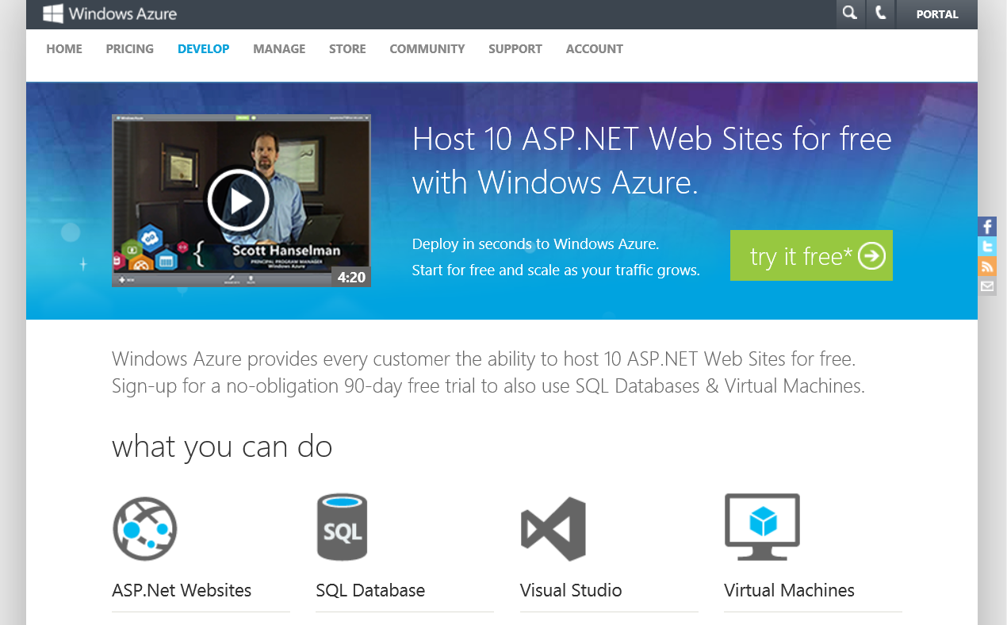
Windows Azure Trial
http://aka.ms/webcamps-azure

