Slide 1
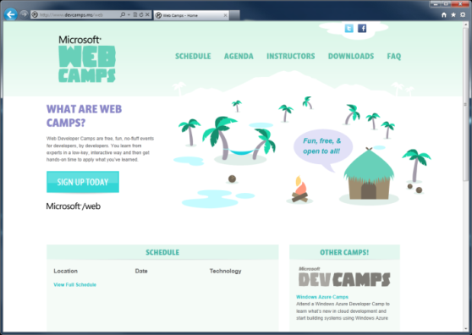

WebCamps Online
Twitter: Follow @webcamps Hashtag #devamps
[Speaker] / [Twitter]
Website: http://www.devcamps.ms/web
What are web camps?
Web Developer Camps are free, fun, no-fluff events for developers, by developers. You learn from experts in a low-key, interactive way and then get hands-on time to apply what you’ve learned.

Slide 2
Creating HTML5 Applications With jQuery
[Speaker]
[Company]

Slide 3
Agenda
Introduction to HTML5
Hands on HTML5 in ASP.NET MVC 4
jQuery overview
Visual Studio web tools
Web Essentials
SPA Template
Notes:
Introduction to HTML 5
Slides (5)
Demos [mural.ly contre jour] (5)
Hands on HTML5 in an ASP.NET MVC Application
Responsive design (5)
Semantic markup (5)
Leveraging Modernizr classes (5)
jQuery overview (10)
Visual Studio and Web Essentials tools (10)
SPA Template
Slides [5]
Knockout.js bindings (10)

Slide 4
HTML5

Slide 5

What is HTML5?
Umbrella term: vNext
HTML, CSS, ECMAScript
It isn’t a marketing message
A new standard for
a new web
A language with support on a variety of devices

Slide 6
Why do you care?
Browsers have become really powerful
Standards mean you can target features,
not browsers

Slide 7
HTML5 examples: mural.ly contre jour
demo…

Slide 8
Map of HTML5
ECMAScript 262
W3C
ECMA
HTML
CSS
Web Apps
SVG
Geolocation
ECMA Script 262
Geolocation API
Basic Shapes
DOM L2 Style
Web SQL Database
CSS Text
Filters
Document Structure
DOM L2 Events
Web DOM Core
CSS Cascading And Inheritance
CSS Writing Modes
HTML5 Diff From HTML4
Fonts
DOM L3 Abstract Schemas
DOM L2 Views
Uniform Messaging Policy
CSS Speech
CSS Values And Units
HTML5 Markup
Smil
DOM L3 Views And Formatting
DOM L2 Core
Server-sent Events
Element Traversal
CSS Color
CSS Media Queries
CSS Print Profile
Html+rdfa
Gradients And Patterns
DOM L3 Xpath
Dom L1
Selectors API L2
Cors
CSS Template Layout
CSS Paged Media
Microdata
Styling
DOM L3 Validation
Xmlhttprequest L2
Selectors API
CSS Animations
CSS Multi-column Layout
CSS Namespaces
Canvas 2D Context
Scripting
DOM L3 Load And Save
Xmlhttprequest
Progress Events
CSS Transitions
CSS Basic Box Model
CSS Snapshot 2007
Html5
Painting, Filling, Color
DOM L3 Events
Web Workers
CSS 3D Transformations
CSS Fonts
Text Alternatives
Transforms
DOM L3 Core
Web Storage
Programmable HTTP Caching And Serving
CSS 2D Transformations
CSS Backgrounds And Borders
Polyglot Markup
Text
Dom L2 Html
Web Sockets API
Index DB
CSS Image Values
Paths
DOM L2 Traversal And Range
Web IDL
File API
CSS Flexible Box Layout
CSS Generated Content For Paged Media
CSS Line Grid
CSS Grid Positioning
CSS Ruby
CSS Scoping
CSS Basic User Interface

Slide 9
New HTML5 Markup Elements
<header>
used to identify the page or application's introduction or navigational aids
<hgroup>
used to group heading elements
<nav>
represents a section of a document that links to other documents or to parts within the document itself
<aside>
represents content that is tangentially related to the content that forms the main textual flow of a document
<footer>
represents the footer for the nearest ancestor sectioning content or sectioning root element
<article>
represents a section of content that forms an independent part of a document or site
<section>
used to designate generic sections of a document
<figure>
used to enclose a figure like an illustration, diagram, or photo
<figcaption>
used to identify a figure's caption
<video>
represents a video player displayed to allow user control over video playback and a viewport to view a video
<audio>
represents an audio player displayed to allow user control over audio playback

Slide 10
Canvas
A block element that allows developers to draw 2d graphics using JavaScript
Methods for drawing include: paths, boxes, circles, text and rasterized images
<canvas id="myCanvas" width="200" height="200">
Your browser doesn’t support Canvas, sorry.
</canvas>
<script type="text/javascript">
var example = document.getElementById("myCanvas");
var context = example.getContext("2d");
context.fillStyle = "rgb(255,0,0)";
context.fillRect(30, 30, 50, 50);
</script>

Slide 11
HTML 5 <video>
Support for the HTML5 <video> element
Industry-standard MPEG-4/H.264 video
Video can be composited with anything else on the page
HTML content, images, SVG graphics
Hardware accelerated, GPU-based decoding

Slide 12
HTML 5 <video> Attributes
src – specifies the location to pull the source file
autoplay – if present starts playing as soon as it’s ready
controls – if present displays controls
preload – if present loads source at page load
loop – if present loops back to the beginning of the video
<video src="video.mp4" id="videoTag">
<!-- Only shown when browser doesn’t support video -->
<!-- You Could Embed Flash or Silverlight Video Here -->
</video>

Slide 13
Multiple HTML 5 <video> Sources?
source – child element used to specify the location to pull the source file(s)
<video poster="video.jpg">
<source src="video.mp4"/>
<source src="video.ogv"/>
<p>This is fallback content</p>
</video>

Slide 14
HTML 5 <audio>
Industry-standard MP3 and AAC audio
Fully scriptable via the DOM
Attributes
src – specifies the location to pull the source file
autoplay – if present starts playing as soon as it’s ready
controls – if present displays controls
preload – if present loads source at page load
<audio src="audio.mp3" id="audioTag" autoplay controls>
<!-- Only shown when browser doesn’t support audio -->
<!-- You could embed Flash or Silverlight audio here -->
</audio>

Slide 15
HTML5
demo
New markup features
Notes:
Open a MVC app and show /Views/Shared/_Layout.cshtml

Slide 16
JavaScript & jQuery

Slide 17
Who Uses jQuery?
19 million Web Sites
2.9 million of those sites rank in the top sites on the web
Source: http://trends.builtwith.com/javascript/jQuery

Slide 18
jQuery – why so popular?
Easy to learn
Loads of Plugins
Powerful DOM Selection
Lightweight
Community Support

Slide 19
jQuery Community
jquery.com
api.jquery.com
forum.jquery.com
meetups.jquery.com
plugins.jquery.com
jqueryui.com
Downloading
Documentation
Community
Local Community
Extending
UI Widgets and Effects

Slide 20
jQuery Fundamentals
Find something, Do something
Functional Syntax
DOM Manipulation
Changing of events
<script>
$(function() {
$('.submit').click( function(){
$('.submit').css('color', '#ff0000');
$('#container')
.append($('<span>Clicked!</span>')
.click(function(){ alert('foo'); }));
});
});
</script>
<script>
$(‘div’).hide();
</script>
<div>This will be hidden</div>
<div>So will this</div>
<div>Even this</div>
<script>
$(function() {
$('.submit').click(function(){
alert('post form');
});
});
</script>
<input class=“submit” type=“button” value=“Submit”/>
<script>
$(function() {
$('.submit').click(function(){
alert('post form');
});
});
</script>
<input class=“submit” type=“button” value=“Submit”/>

Slide 21
jQuery
demo
Notes:
jsBin demo: http://jsbin.com/ibaxad/1/edit

Slide 22
Single Page Application

Slide 23
Comparison: standard page requests
Client Browser
Request: http://site.com/products/
Web Server
HTML
CSS
Images
Javascript
Response: Full page
Request: http://site.com/products/6
HTML
CSS
Images
Javascript
Response: Full page

Slide 24
Single page application
Client Browser
Request: http://site.com/products/
Web Server
HTML
CSS
Images
Javascript
Response: Full page
JavaScript Request: http://site.com/api/products/6
Response: Tiny bit of data
{product}

Slide 25
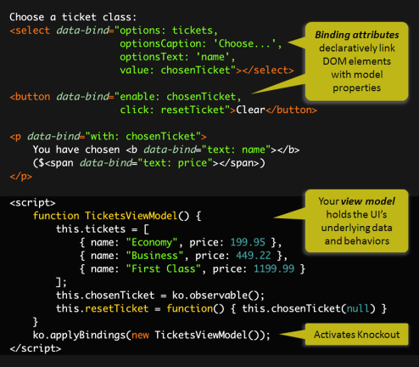
Knockout.js
Declarative Bindings
Automatic UI refresh
Dependency Tracking
Templating

Slide 26
Single Page Application
demo
Notes:
jsBin demo: http://jsbin.com/ibaxad/1/edit

