Slide 1
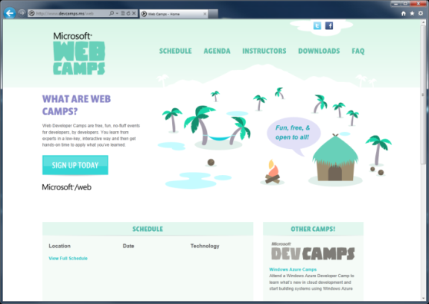

WebCamps Online
Twitter: Follow @webcamps Hashtag #devamps
SPEAKER NAME/HANDLE HERE
Website: http://www.devcamps.ms/web
What are web camps?
Web Developer Camps are free, fun, no-fluff events for developers, by developers. You learn from experts in a low-key, interactive way and then get hands-on time to apply what you’ve learned.

Slide 2
Creating HTML5 Applications With jQuery
Name
Title
Microsoft Corporation

Slide 3
Agenda
Introduction to HTML5
Hands on HTML5 in MVC 4
jQuery overview
Visual Studio web tools
Web Essentials
SPA Template
Notes:
Introduction to HTML 5
Slides (5)
Demos [mural.ly contre jour] (5)
Hands on HTML5 in an ASP.NET MVC Application
Responsive design (5)
Semantic markup (5)
Leveraging Modernizr classes (5)
jQuery overview (10)
Visual Studio and Web Essentials tools (10)
SPA Template
Slides [5]
Knockout.js bindings (10)

