Slide 1
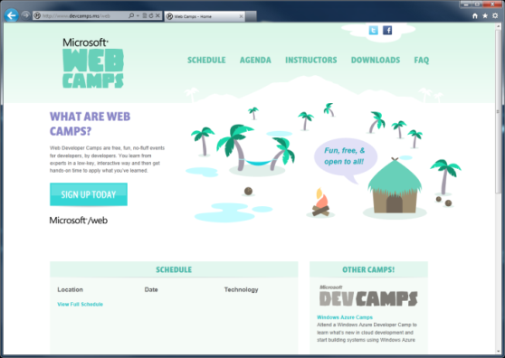

WebCamps Online
Twitter: Follow @webcamps Hashtag #devcamps
[Speaker] / [Twitter]
Website: http://www.devcamps.ms/web
What are web camps?
Web Developer Camps are free, fun, no-fluff events for developers, by developers. You learn from experts in a low-key, interactive way and then get hands-on time to apply what you’ve learned.
Notes:
Keynote (30 minutes)
We'll start with a quick keynote which lays out roadmap for the day. We'll make sure you're familiar with the core building blocks and tools used to create modern web applications on the Microsoft web platform, then examine some key web development scenarios the modern web platform helps you solve.
Outline:
Framework and tools (20 minutes)
ASP.NET
Tools
Visual Studio
NuGet
Windows Azure
Key Scenarios (10 minutes)
Overview key scenarios
Highlight scenarios we'll be covering today

Slide 2
Housekeeping notes
Wireless information:

Slide 3
Web Camps Keynote
[Speaker]
[Company]

Slide 4
Agenda
What’s new in ASP.NET 4.5
Building and deploying websites with ASP.NET MVC 4
Creating HTML5 Applications with jQuery
Building a service layer with ASP.NET Web API
Leveraging ASP.NET dev skills to build apps for Office
Building for the mobile web
Real-time communications with SignalR
Using Cloud Application Services

Slide 5
Welcome | 8:30am | 9:00am
What's new in ASP.NET 4.5 | 9:00am | 9:30am
Building and deploying websites with ASP.NET MVC 4 | 9:30am | 10:30am
Break | 10:30am | 10:45am
Creating HTML5 Applications with jQuery | 10:45am | 11:45am
Lunch | 11:45am | 12:45pm
Building a service layer with ASP.NET Web API | 12:45pm | 1:15pm
Leveraging your ASP.NET development skills to build Office Apps | 1:15pm | 1:45pm
Building and leveraging social services in ASP.NET | 1:45pm | 2:15pm
Break | 2:15pm | 2:30pm
Building for the mobile web | 2:30pm | 3:00pm
Realtime communications with SignalR | 3:00pm | 3:30pm
Break | 3:30pm | 3:45pm
Using Cloud Application Services | 3:45pm | 4:45pm
Wrap Up | 4:45pm | 5:00pm

Slide 6
The foundation: tools & frameworks
Visual Studio
Windows Azure
NuGet
ASP.NET

Slide 7


Visual Studio 2012: The editor for serious web dev
HTML5 / CSS3 standards and smarts
JavaScript language features
Page Inspector
One code editor for client and server
Web Essentials extension

Slide 8

NuGet: The smart, easy way to manage dependencies
Find the latest release
Install and configure in your project
Handle dependencies and versions
Updates with dependency checking
Common list of installed packages
Simplified uninstalls
Streamlined deployment with Package Restore

Slide 9
One ASP.NET: A Framework for us all
Sites
Services
Web
Forms
Web
Pages
Single Page Apps
SignalR
MVC
Web API
ASP.NET

Slide 10
ASP.NET: A Framework For All
HTML
XML
JSON
Web Forms
Razor View Engine
Code
Web Pages
MVC
MVC 4
Web API
ASP.NET Core
Self Host
Modules
Handlers
Membership
Intrinsics
Caching
Etc.
Notes:
Estimated Time: 2 minutes
No matter which type of developer you are, you get the benefit of the ASP.NET Core runtime, which provides many useful modules that provide functionality that you are likely to need when creating web applications. For example: Profile, Roles and Membership is important if you want to build in users and security around different parts of your website.
[Build x 3]
ASP.NET Web Forms, ASP.NET MVC and ASP.NET Web Pages are three different approaches to building web applications on the server side with ASP.NET. They all build on top of the same core runtime that provides them with the same powerful set of modules that web developers can leverage from within their web applications.
ASP.NET Web Forms is great for developers coming from desktop application development where they are accustomed to controls, event-driven development and code-behind. Despite not being concepts that are native to the web, Web Forms achieves this by abstracting away things like maintaining state, form posting and much more. This ease of development means that developers relinquish a certain amount of control as Web Forms manages communication between the server and client on your behalf.
ASP.NET MVC, in contrast, is for developers that like to be in full control of the interactions between client and server and provides a more “raw” approach to what happens in the web application. Due to its loosely coupled architecture, MVC is also very extensible with many places for developers to customize and plugin components as well write test code easily.
Developing in ASP.NET Web Pages is centered around inline code and is similar to PHP or classic ASP in that compilation of your application isn’t required (it is in WebForms and MVC). It is designed to provide the simplest approach to building websites with the fewest number of concepts to learn.
[Build x 2]
When it comes to controlling the markup that is rendered to the client there are two view engines you may use. The Web Forms view engine is shared by both Web Forms and MVC and uses the familiar <% %> syntax. With ASP.NET MVC 3 and ASP.NET Web Pages Microsoft introduced the Razor View Engine which uses a different syntax centered around the @ symbol. The Razor syntax uses fewer characters to achieve the same things in Web Forms and allows the developer to mix markup and code really easily.

Slide 11
ASP.NET and Web Tools 2012.2 RC
Just adds new project templates
No changes to .NET or ASP.NET runtime
Lightweight install (5 minutes, no reboot)
Download and information: http://asp.net/vnext

Slide 12

Deploying ASP.NET Apps to the Cloud
Windows Azure Web Sites (10 free!)
Fast site creation and deployment
Nothing new to learn
Easy to scale

Slide 13
Windows Azure signup
demo…
http://aka.ms/webcamps-azure
Notes:
http://aka.ms/webcamps-azure

Slide 14
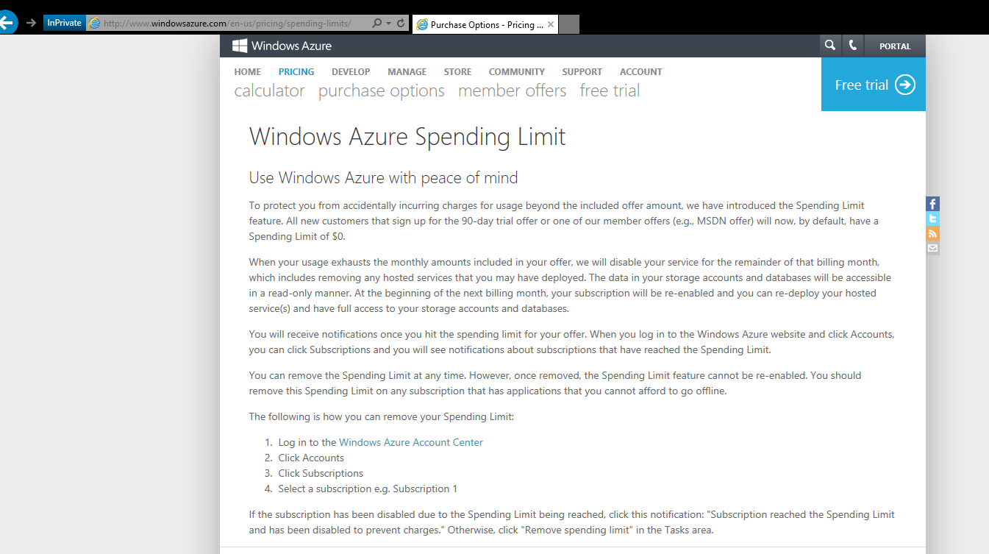

Slide 15
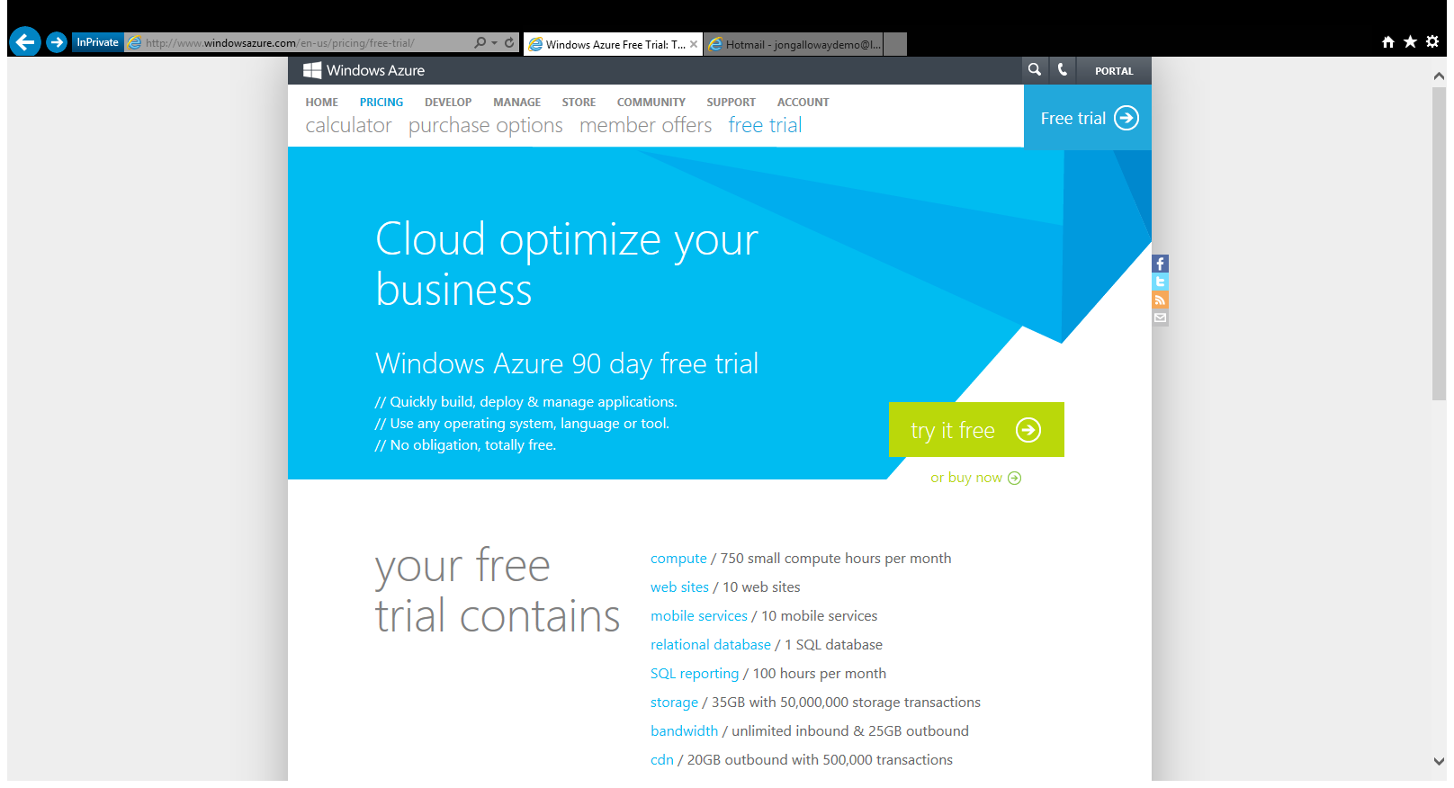

Slide 16
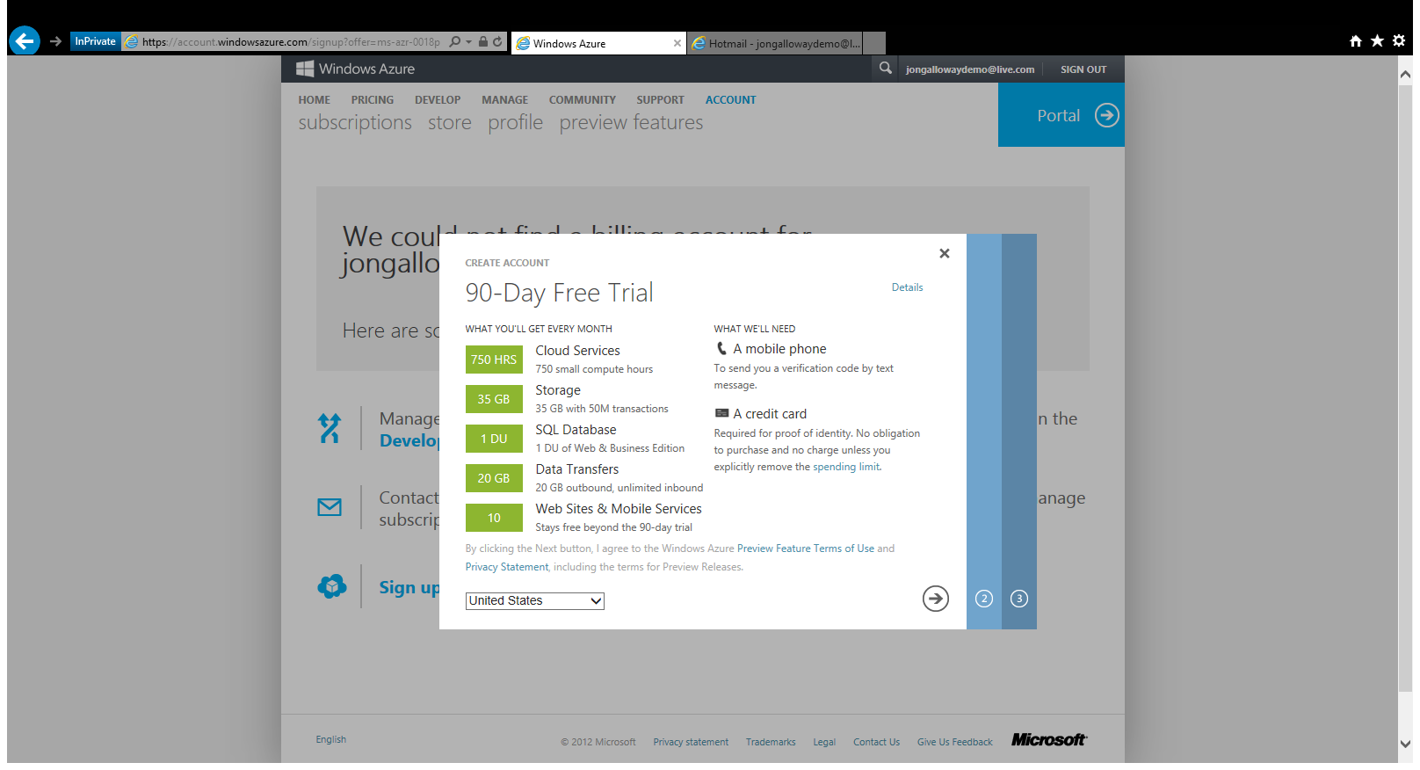

Slide 17
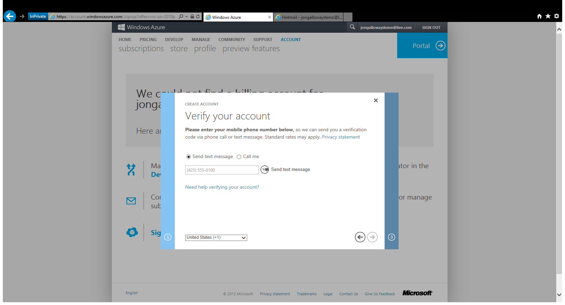

Slide 18
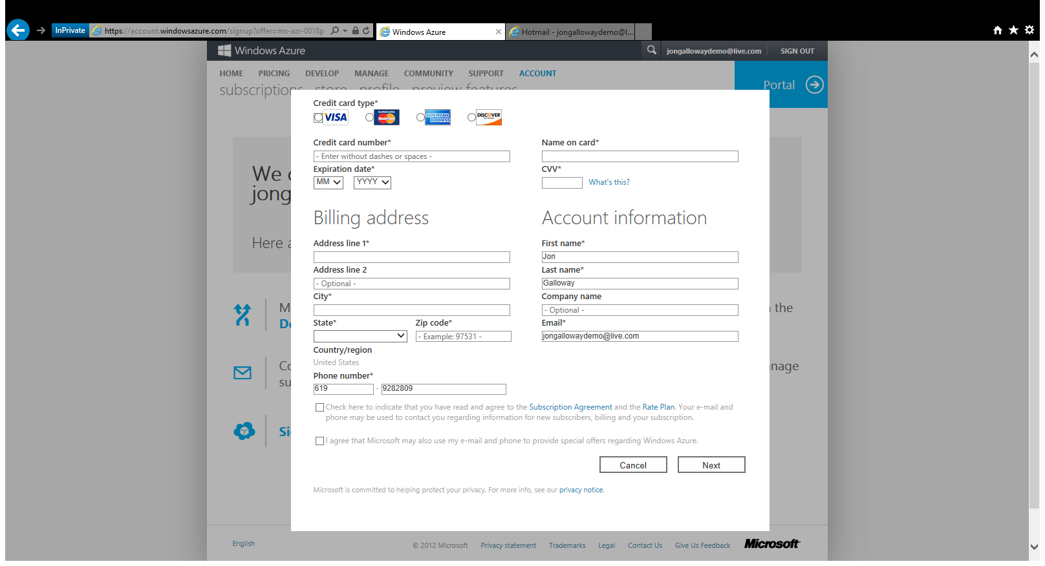

Slide 19
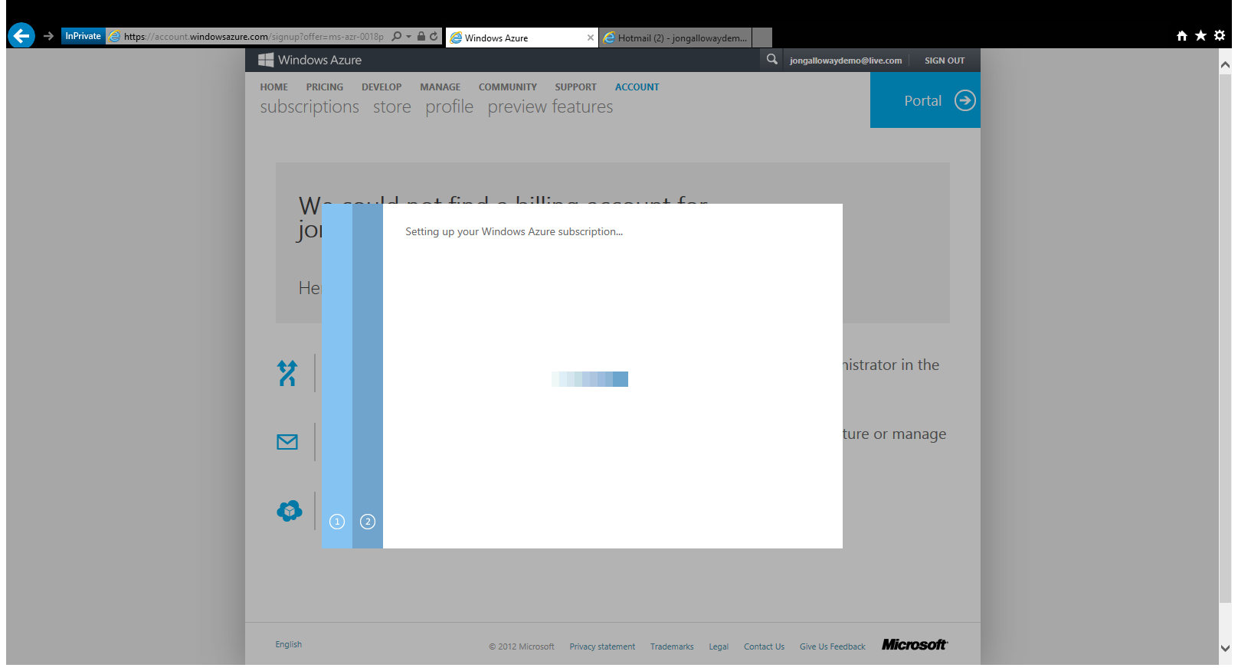

Slide 20
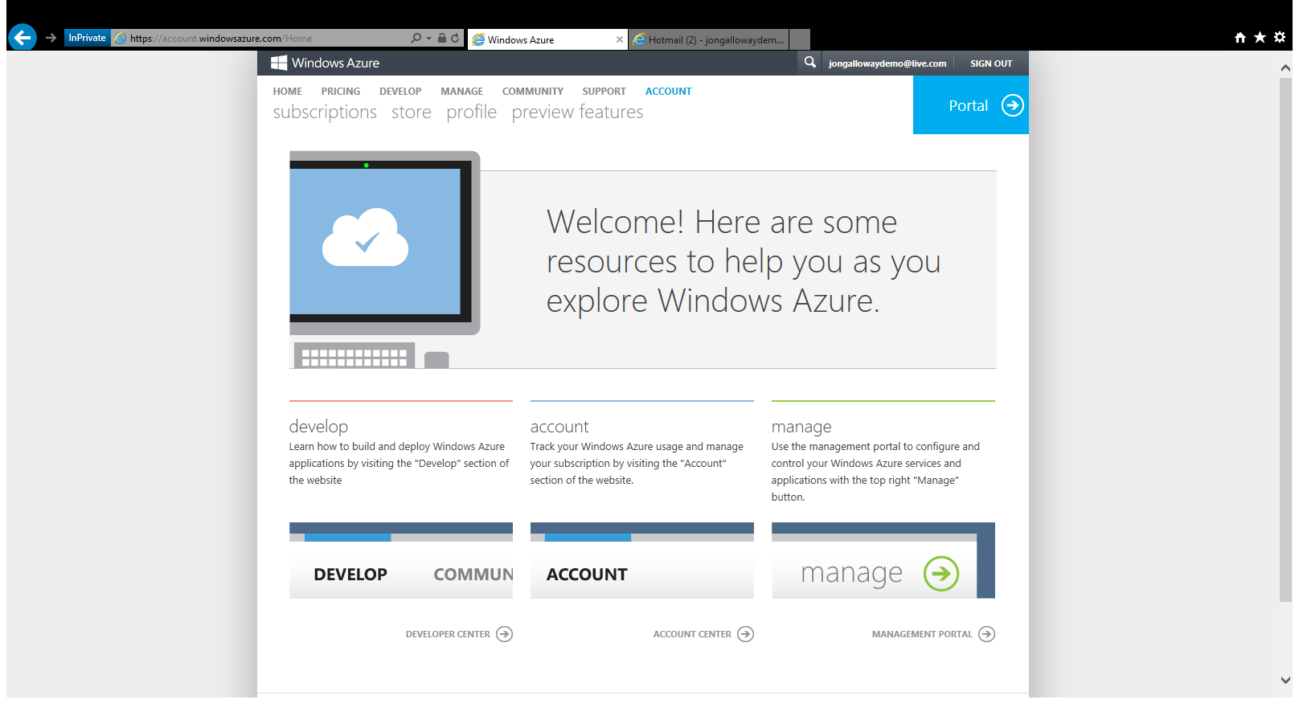

Slide 21
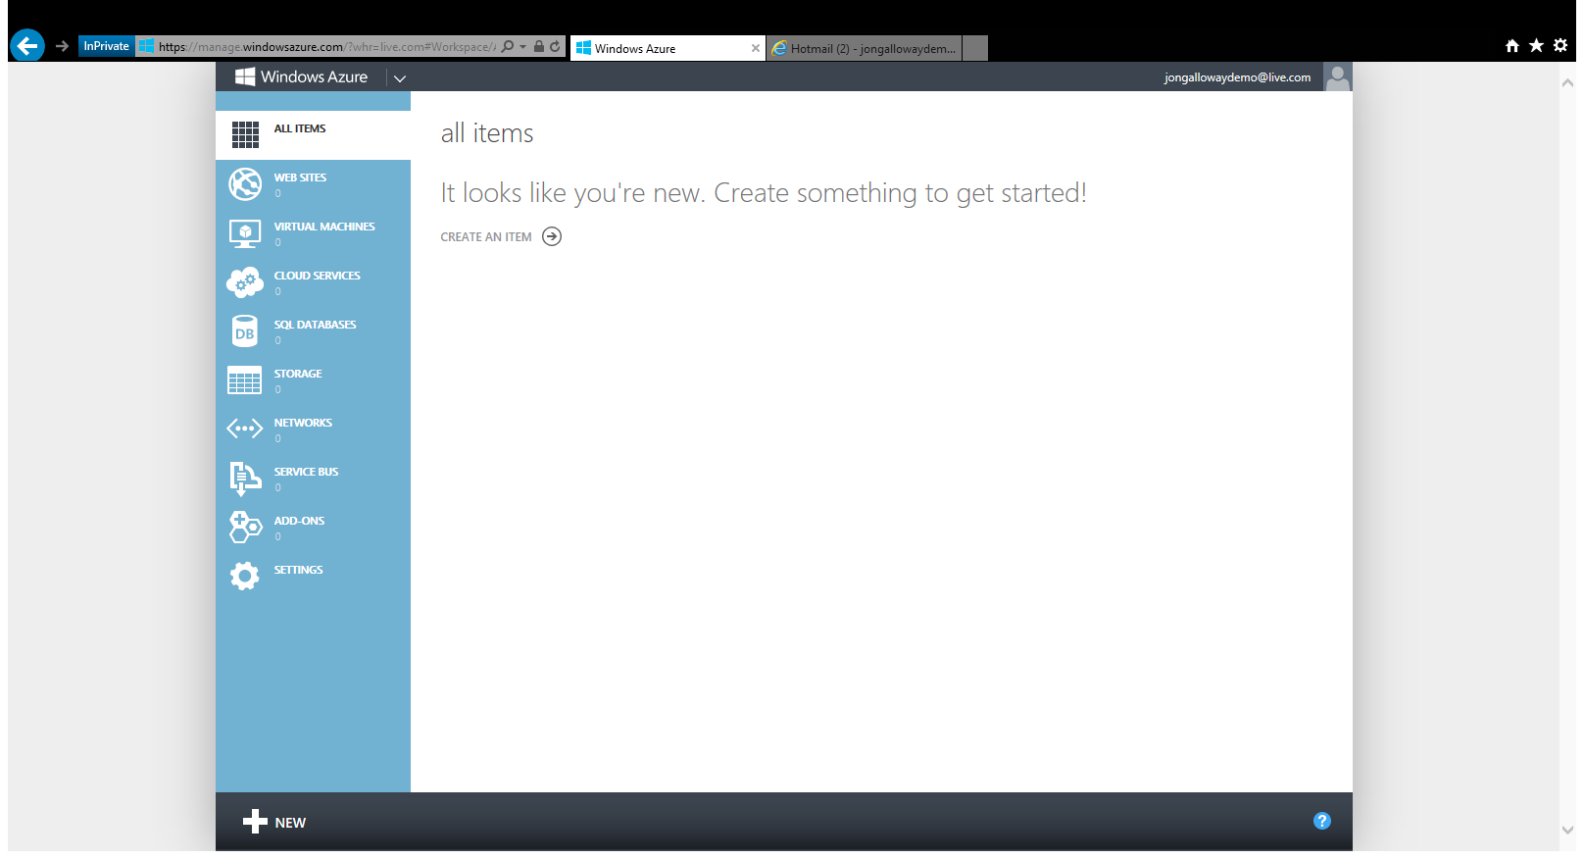

Slide 22
The foundation: tools & frameworks
Visual Studio
Windows Azure
NuGet
ASP.NET

Slide 23
Taking it further: key scenarios
HTML5
HTTP Services
Apps for Office
Realtime
Mobile
Social Apps
Visual Studio
Windows Azure
NuGet
ASP.NET
Notes:
Note: Should add other key scenarios we won’t be covering in depth

Slide 24
Resources
Feedback and questions http://asp.net
http://asp.net/vnext
http://www.devcamps.ms/web
http://windowsazure.com
http://aka.ms/webcamps-training-kit
http://aka.ms/webcamps-azure (free trial)

