Slide 1
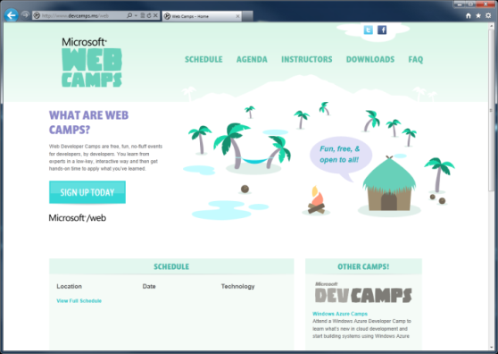

WebCamps Online
Twitter: Follow @webcamps Hashtag #devcamps
SPEAKER NAME/HANDLE HERE
Website: http://www.devcamps.ms/web
What are web camps?
Web Developer Camps are free, fun, no-fluff events for developers, by developers. You learn from experts in a low-key, interactive way and then get hands-on time to apply what you’ve learned.
Notes:
Keynote (30 minutes)
We'll start with a quick keynote which lays out roadmap for the day. We'll make sure you're familiar with the core building blocks and tools used to create modern web applications on the Microsoft web platform, then examine some key web development scenarios the modern web platform helps you solve.
Outline:
Framework and tools (20 minutes)
ASP.NET
Tools
Visual Studio
NuGet
Windows Azure
Key Scenarios (10 minutes)
Overview key scenarios
Highlight scenarios we'll be covering today

Slide 2
Web Camps Keynote
Name
Title
Microsoft Corporation

Slide 3
Agenda
What’s new in ASP.NET 4.5
Building and deploying websites with ASP.NET MVC 4
Creating HTML5 Applications with jQuery
Building a service layer with ASP.NET Web API
Leveraging your ASP.NET development skills to build apps for Office
Building for the mobile web
Real-time communications with SignalR
Using Cloud Application Services

Slide 4
The foundation: tools & frameworks
ASP.NET
NuGet
Visual Studio
Windows Azure

Slide 5
Taking it further: key scenarios
HTML5
HTTP Services
Apps for Office
Realtime
Mobile
Social Apps
ASP.NET
NuGet
Visual Studio
Windows Azure
Notes:
Note: Should add other key scenarios we won’t be covering in depth

Slide 6

Creating Rich HTML 5 Experiences
HTML 5 in IE 9 & 10
HTML5 Deep Dive
jQuery Fundamentals

Slide 7
Building Web Sites Using ASP.NET 4.5
MVC 4.0
What is the Entity Framework?
Database-first, Model-first, Code-First
Demos

Slide 8
Building Web APIs in Windows Azure
Why all the hype for Web APIs?
Building Web APIs for browser/JSON clients
Building Web APIs for native /non-browser clients

Slide 9
Deploying ASP.NET Apps to the Cloud
ASP.NET In Windows Azure
Web Forms & MVC
AJAX & Stateless Web Roles
Session State
DNS
Advanced Techniques
Full IIS
Multi-tenancy
Web Deploy
Challenges
File Upload

Slide 10
Resources
Feedback and questions http://asp.net
http://asp.net/vnext

