Slide 1




Windows Azure & apps for Office and SharePoint
Speaker name
Title
Microsoft corporation

Slide 2


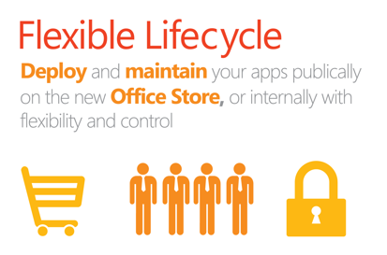
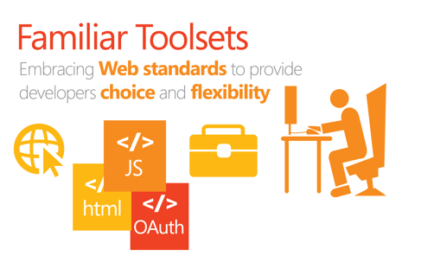
The new Cloud App Model for Office & SharePoint
Notes:
The new Cloud App Model for Office and SharePoint introduces the possibility of creating a whole new class of apps for Office and SharePoint.
With it, developers bring the reach of the web into Office and SharePoint using standard web technologies along with the Web development skills they already have.
Apps can be submitted to the office.com Store and discovered/inserted into Office and SharePoint from within the product.
Get started at dev.office.com – developers will setup a developer account to submit apps into the Office Store.

Slide 3
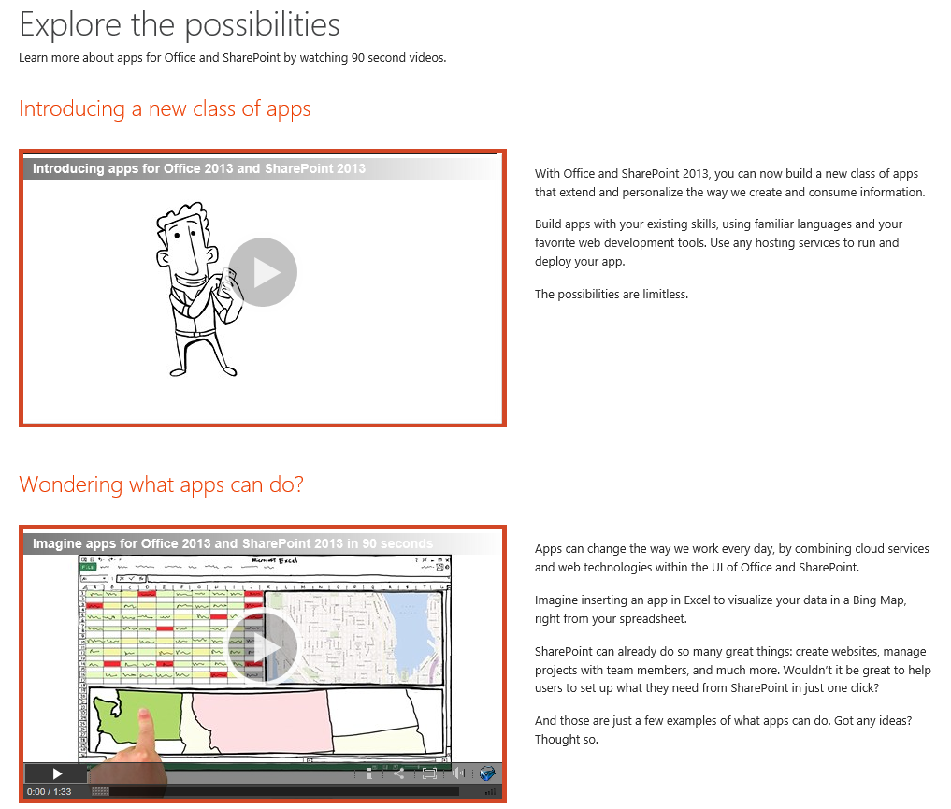
dev.office.com == one stop for app devs
http://msdn.microsoft.com/en-us/office/apps/fp123579
Notes:
These are 90 second or so videos that show apps concepts.
If you only have time to play one, play the 3rd one on the web page “How do apps work anyway?” – it’s more tech focused.

Slide 4
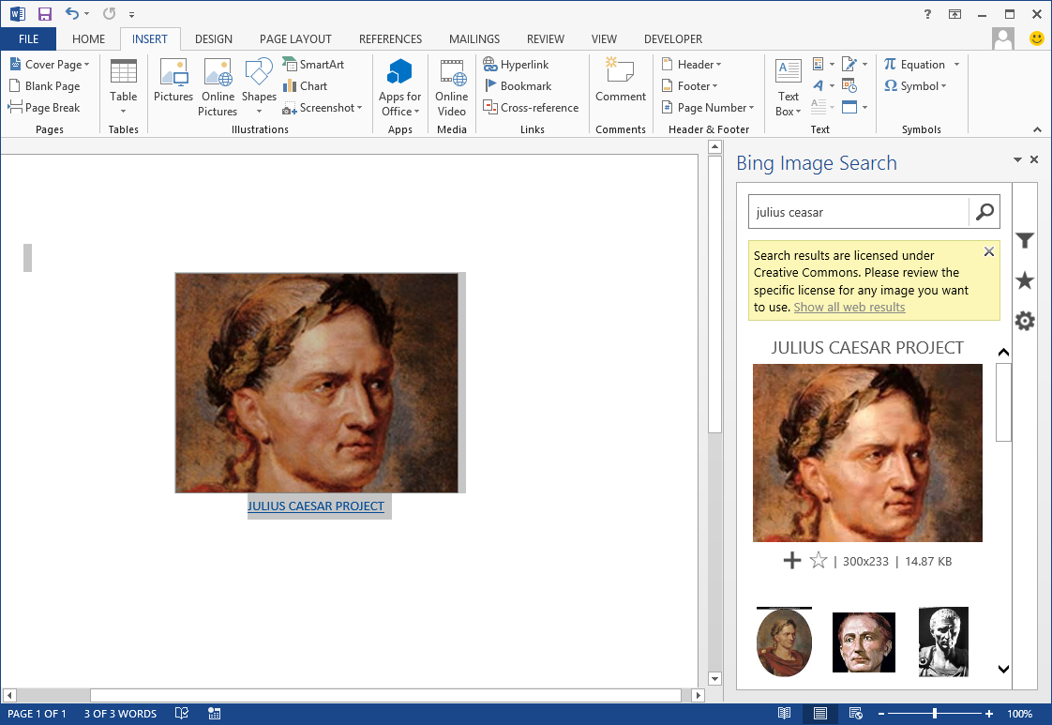
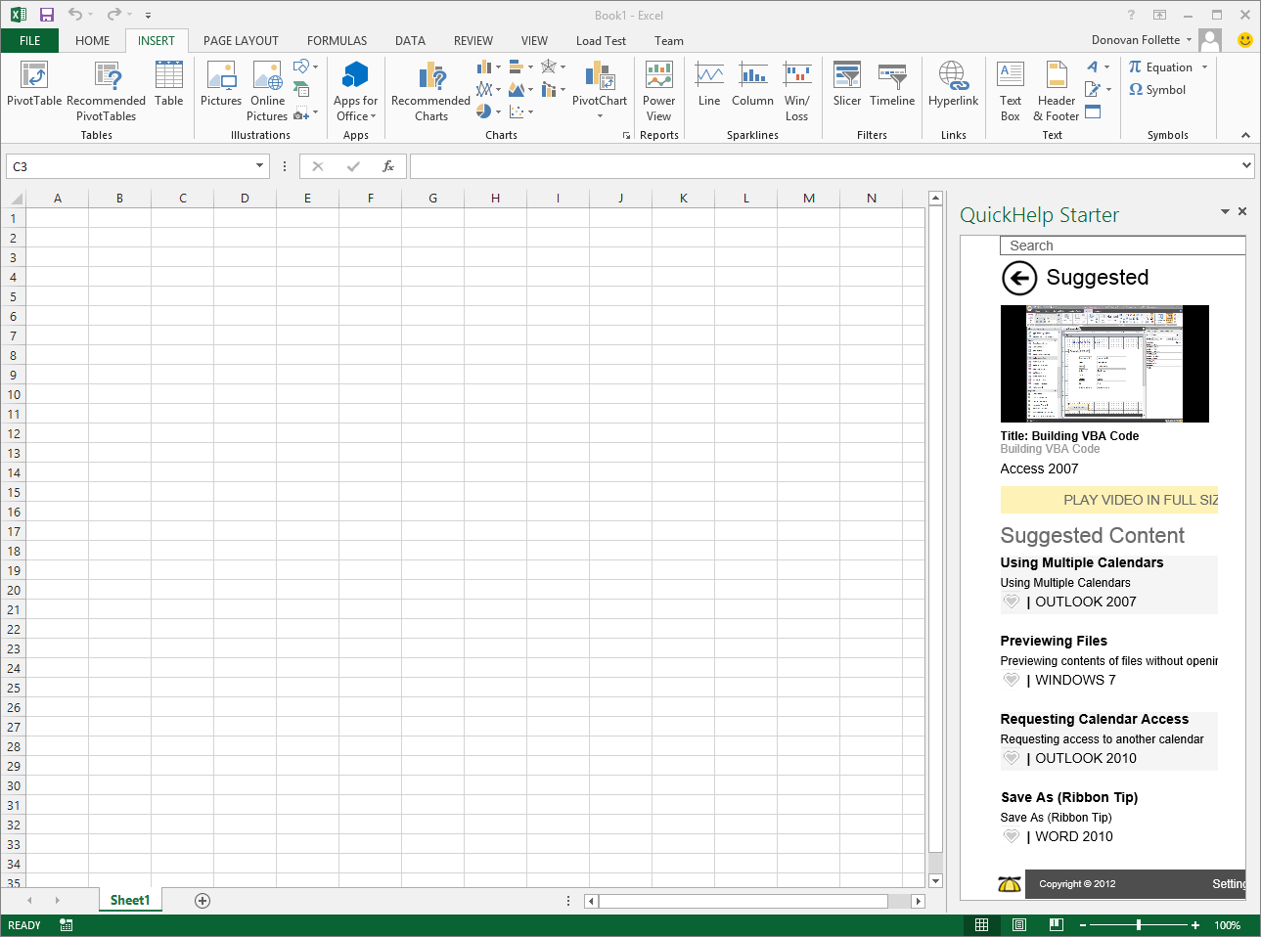
Demo
Some apps for Office & SharePoint currently in the store
Notes:
Browse the office.com Store
Show the following apps in Office 2013 – note: Requires you to have Office 2013 installed on your machine.
Bing image search app
Britannica
Brainstorm – you’ll need to login with your LiveID
Customers have multiple ways of obtaining apps. Developers can create apps and submit them to a public marketplace. These types of apps will be validated by Microsoft similar to how apps for the Windows Phone are validated. Customers can then acquire these apps and pay for them if they are not free.
Enterprises can also use a corporate catalog which is essentially a private marketplace for their tenant(or deployment in an on premises environment). Enterprise developers can deploy apps to their corporate catalog in order to distribute apps to SharePoint sites but not make them publically available.

Slide 5
What is an App for Office?
A Web page loaded inside an Office Application
Embedded inline or as task pane within documents, mails or appointments.
Works in both Office Applications and Office Web Applications
Allows Office applications to leverage Web technologies
HTML 5 and CSS for rendering user interface
JavaScript and jQuery to add behavior
Calls to REST APIs to retrieve and update data from across network
Notes:
An App for Office can be seen as a Web page loaded inside an Office Application. In some cases it will appear embedded inline within the document. In other cases it might appear as a task pane or within a message in Outlook. Note that the architecture for Apps for Office has been designed to work in both Office Applications and Office Web Applications.
WEF and Apps for Office allow Office applications to be extended in such as way so that they can leverage Web technologies such as HTML 5 and CSS for rendering user interface as well as JavaScript and jQuery to add behavior. When you write the JavaScript code for an App for Office, you can call REST APIs such as those added to SharePoint 2013 to retrieve and update data from across network.

Slide 6
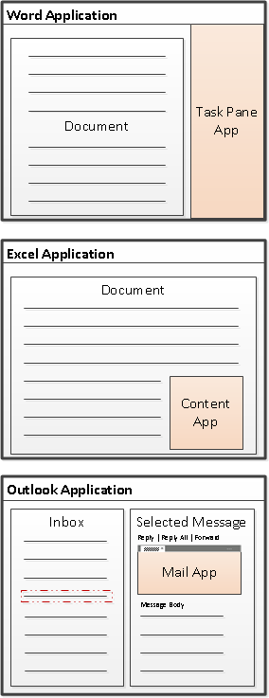
Types of apps for Office
Task Pane App for Office (Document-centric)
Assists user working with one or more documents
Works in Word, Excel and Project
Content App for Office (Document-centric)
Adds embedded content/functionality into document
Only used in Excel Application and Excel Web Application
Mail App for Office (Mailbox-centric)
Used in Outlook Application and Outlook Web App (OWA)
Extends Outlook items with custom UI and behaviors
Outlook items can be messages and events
Mail Apps require Exchange 2013
Notes:
There are three basic types (i.e. shapes) for Apps for Office.
Task Pane Apps are document-centric and are designed to assist user working with documents. For example, a task pane app can assist they using by searching the Internet for links related to the text that is currently selected buy the user. Task pane apps can be used in Word, Excel and Project.
Content Apps are document centric and are designed to add embedded content and functionality directly into document. Note that content apps are only used in Excel 2013 so the associated document will always be an Excel workbook.
Mail Apps are mailbox-centric and are used in in the Outlook Application as well as in Outlook Web App (OWA) . A mail app is designed to extend Outlook items such as messages and appointments with custom UI and behaviors. Note that the use of mail apps require Exchange 2013.

Slide 7
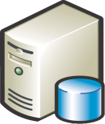



Anatomy of an app for Office
Each app for Office is based on a XML-based manifest
Manifest points to a Web page
Manifest defines the type of the app for Office
Manifest defines which Office applications it supports
Manifest defines required capabilities
App for Office
Catalog Server
Web Server
app for Office
App for Office
Manifest
<XML>
Web
Page
HTML+JS
Notes:
Every App for Office must be distributed with an XML-based manifest which contains information about the app itself. For example, the app manifest contains an address to a Web page on the Internet which is used to load the app. The app manifest also includes information which indicates which Office applications it supports. The app manifest also defines the required capabilities which represent the set of permissions that the app needs in order to run and complete its work.

Slide 8
Manifest + Windows Azure Web Site = app for Office
MVC 4 as an app for Office
Demo
Notes:
For this demo:
Prerequisite Setup:
Create a folder on the C: drive and name it “AppManifests”
Share the folder with “everyone” so that that you can use it as a file share
Open Word, click File->Options->Trust Center->Trust Center Settings…->Trusted App Catalogs:
In the Catalog URL type \\YourMachineNameHere\AppManifests\ and click Add Catalog
Make sure the Show in Menu checkbox is checked and click Ok all the way out of the dialogs.
For demo #1:
Spin up a new Windows Azure Web Site and download the publish profile
In VS 2012, create a new app for Office (File New Project->Office/SharePoint, Apps->App for Office 2013)
F5 to run the app, this will deploy locally to IIS express – show the interaction with the web page and document, close Excel to quit debugging.
Make any form of a modification to the HTML so the web page will be visually altered
Publish the Web app to your Windows Azure Web Site
Copy the Manifest file to the AppManifest folder
Open the manifest file in Notepad in the AppManifest folder, and put in your HTTPS Web Site URL.
Start Excel and open a blank document
Click the Insert (ribbon tab), click the down arrow under Apps for Office, Click See all…
Click SHARED FOLDER and Refresh if necessary, click on your app and click Insert.
For demo #2:
Have an MVC4 app for Office fully built and deployed to another Windows Azure Web Site
Simply open the manifest file again in Notepad and paste in the URL to the Web Site and save the file.
Run Excel or Word and Insert (may need to Refresh) the app for Office via the ribbon again. Demo your MVC4 app for Office.

Slide 9
Introducing apps for SharePoint Concepts
Apps are a philosophical change to extending SharePoint
More scenario-focused
Event Tracking
Ticket Management System
Travel Requests
Office Inventory Tracking
Equipment Reservations
Robust
Built-in robust semantics for install, upgrade & uninstall
Cloud & Web-oriented
Solutions built using standard Web technologies
Apps are for End Users
Notes:
Apps introduce a breaking, now philosophical change to how people extend SharePoint.
Robust:
Unless the developer has put a lot of forethought into it, upgrading & uninstalling apps in SharePoint was not a great story in pre SharePoint 2013
SharePoint 2013 changes that with robust infrastructure to support upgrade & uninstallation of apps
The upgrade story for apps in SharePoint 2013 also ensures that if an app upgrade fails, it is rolled back so the site isn’t left in a bad state
Cloud Oriented Apps for SharePoint:
Distributing out the app resource requirements and not depending on SharePoint
Web Oriented Apps for SharePoint
Not necessarily cloud focused but leverage the best of the best on the web and run “in SharePoint”
Apps are for End Users:
Marketplace is attractive for end users to acquire apps
Apps are validated to ensure people can acquire & install apps without worrying they will steal their data
Apps always ask users/administrators for permission to access the site & data
IT staff can elect to permit their farm to allow users to install apps from the marketplace
IT can see what apps & things are running in their farm / tenancy
IT can see the health & reporting of apps

Slide 10
User Experience: App Shapes
 | Shape | Description | Example
 | Immersive Full Page App | App that implements a new scenario for customers | Resource Tracking, Budgeting
 | App Part | Provides new parts you can add to your sites | Weather, News, Stock Ticker
 | Extension App | Add new actions for documents and items to a context menu or ribbon | Display Document Visualization, Print to a Print Service Vendor
Notes:
The app model enables developers to create new solutions that can be implemented using various different UX approaches. These different approaches can be used individually or combined:
Immersive: This would be an app that does not leverage much from SharePoint except possibly the user interface. An example of this would be the Office Web Apps or an app such as a CRM or accounting system.
Part App: These types of app may simply add a Web Part to a site that act as the gateway/window to another app or service. Examples could be a time reporting or news control.
Extension App: These types of apps could be a mix of SharePoint & non-SharePoint assets. For example a time reporting app could use SharePoint document libraries to store timesheets and extend the ribbon / Site Actions menu to submit new timesheets and approve them.

Slide 11
Introducing the Cloud App Model for SharePoint
SharePoint applications no longer live in SharePoint
Custom code executes in the client, cloud or on-premises
Apps are granted permissions to SharePoint via OAuth
Apps communicate with SharePoint via REST/CSOM
Notes:
The new SharePoint app model is designed to not only address issues around the solution package approach to SharePoint customization, but also to introduce new capabilities. SharePoint apps do not live in SharePoint, rather they execute in the browser client or on a non-SharePoint server such as an IIS server or in the cloud. Apps are granted permission into SharePoint sites via OAuth and communicate over the new investments in the REST and CSOM (client-side object model) APIs.

Slide 12
Hosting: Choice of two cloud-based Architectures
Provider-Hosted App
“Bring your own server hosting infrastructure”
SharePoint Web
Your Hosted Site
(Windows Azure an Option)
Cloud-based Apps
Get remote events from SharePoint Use CSOM/REST + OAuth to work with SP
Autohosted App
Windows Azure + SQL Azure provisioned automatically as apps are installed
SharePoint Web
Windows Azure
Web Sites
Notes:
Cloud Hosted Apps:
You app is hosted either in your own hosting (private cloud, 3rd party cloud, IIS web site, etc) or using an auto provisioning process in Windows Azure
Provider Hosted App
Customers can create their app in any technology stack and host on any platform they choose.
This could even be using a 3rd party cloud using PHP and developed using Eclipse.
Developers would then create a SharePoint app package that would define how to extend SharePoint for use with the app
Menu extensions
Web Parts
Ribbon extensions
App permissions (OAuth app principal ID)
Windows Azure Auto-Provisioned App
Create a SharePoint app package
Includes the SharePoint extensions & everything needed to deploy the application to Windows Azure automatically
Uses an existing subscription in Windows Azure configured by the tenant administrators
Customers (tenant admins) would configure the subscriptions in Windows Azure where apps are deployed to and not use SharePoint resources
Apps do share a few common things though. Within each app you will find an AppManfiest.xml file that will describe the app to SharePoint. This contains some basic metadata about the app (ID, title, description & thumbnail) as well as a list of all the permissions the app needs when it is installed.

Slide 13
Autohosted app for SharePoint
MVC 4 as an autohosted app
MVC4 hosted on Windows Azure Web Sites
Demo
Notes:
For demo #1:
In VS 2012, create a new app for SharePoint(File New Project->Office/SharePoint, Apps->App for SharePoint 2013, Select autohosted in app settings.)
F5 to run the app, this will deploy locally to IIS express – Talk the deployment as you get prompted through the install process, “Trust It” registers the app with SharePoint and Windows Azure ACS for OAuth. Once the app loads it simple gets the name of the site from SharePoint via the client-side object model (CSOM), OAuth authorizes this call back into SharePoint from the remote Web application. Close the browser to quit debugging.
Now, right-click on the project and select Deploy. This will now deploy the app to a Windows Azure Web Site automatically, this WAWS is managed by Office 365, devs do not have access to it. A new WAWS is created each time the app is deployed, great for scenarios where their app for SharePoint is a point solution, i.e. fire-and-forget, no need to manage mutli-tenancy.
When the app loads, show the URL which now points to the O365-managed WAWSs. (https://a-GUID-will-be-here.o365apps.net)
Close the browser, right-click the SharePoint project and select, Retract, to remove the app from SharePoint.
Remove the Web project from the solution
Right-click the Solution and choose to add an Existing MVC4 project you have already built out.
Wire-up the MVC 4 app to be autohosted, click on the SharePoint project. In the properties window, Click the Web Project property and select your MVC4 project.
You will be prompted that you need to change the target framework to .NET 4.
And you will be prompted that VS will add some things to the MVC4 project, the SharePoint references, and the TokenHelper class are the primary ones. TokenHelper provides the OAuth helper methods you’ll need to call into SharePoint.
BE SURE TO CHANGE THE .NET Framework target to 4. (Note: this is temporary since the process of upgrading clusters to 4.5 is moving forward)
NOTE: By removing the Web project from the Web Project property you can then manage the deployment of the app to WA as you would like if you need more scale, etc.
Right-click the SharePoint project and select, Deploy, when the browser loads, Trust your app for SharePoint and demo its goodness.

Slide 14
Summary – Call to action
apps for Office and SharePoint can be:
Built using standard Web technologies
Written in any language
Hosted on Windows Azure or any platform
apps for Office and SharePoint have the worldwide reach of the Office Store on office.com
apps can be monetized now in the Office Store
dev.office.com – to get started now
www.devcamps.ms/office – training locations worldwide
Notes:
Key points for developers to know.

Slide 15
Training day topics include…
Developing apps for Office
Task Pane, Content and Mail apps
The Office JavaScript object model
and more…
Developing apps for SharePoint
app for SharePoint architectures
SharePoint API access via OAuth, REST, etc.
and more…
Getting apps into the Office Store
Notes:
This just gives a flavor of the topics covered during training. The training pushes into these as deeply as possible in a day with the intent to help developers to get bootstrapped on building apps for the office.com Store.

Slide 16

© 2012 Microsoft Corporation. All rights reserved. Microsoft, Windows, Windows Vista and other product names are or may be registered trademarks and/or trademarks in the U.S. and/or other countries.
The information herein is for informational purposes only and represents the current view of Microsoft Corporation as of the date of this presentation. Because Microsoft must respond to changing market conditions, it should not be interpreted to be a commitment on the part of Microsoft, and Microsoft cannot guarantee the accuracy of any information provided after the date of this presentation. MICROSOFT MAKES NO WARRANTIES, EXPRESS, IMPLIED OR STATUTORY, AS TO THE INFORMATION IN THIS PRESENTATION.

