Slide 1
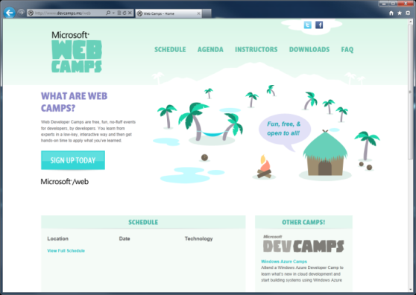

WebCamps Online
Twitter: Follow @webcamps Hashtag #devamps
SPEAKER NAME/HANDLE HERE
Website: http://www.devcamps.ms/web
What are web camps?
Web Developer Camps are free, fun, no-fluff events for developers, by developers. You learn from experts in a low-key, interactive way and then get hands-on time to apply what you’ve learned.

Slide 2
Leveraging your ASP.NET Development Skills To Build Office Apps
Name
Title
Microsoft Corporation

Slide 3
Agenda

