Slide 1
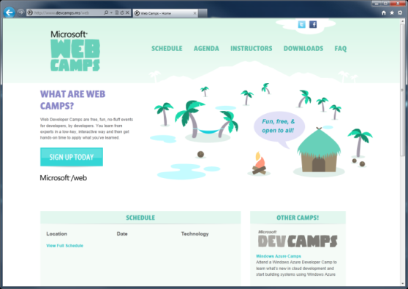

WebCamps Online
Twitter: Follow @webcamps Hashtag #devcamps
[Speaker] / [Twitter]
Website: http://www.devcamps.ms/web
What are web camps?
Web Developer Camps are free, fun, no-fluff events for developers, by developers. You learn from experts in a low-key, interactive way and then get hands-on time to apply what you’ve learned.
Notes:
Keynote (30 minutes)
We'll start with a quick keynote which lays out roadmap for the day. We'll make sure you're familiar with the core building blocks and tools used to create modern web applications on the Microsoft web platform, then examine some key web development scenarios the modern web platform helps you solve.
Outline:
Framework and tools (20 minutes)
ASP.NET
Tools
Visual Studio
NuGet
Windows Azure
Key Scenarios (10 minutes)
Overview key scenarios
Highlight scenarios we'll be covering today

Slide 2



Windows Azure & apps for Office and SharePoint
[Speaker]
[Company]

Slide 3
Agenda
Introduction to the new Cloud App Model
HTML5 + jQuery = New app for Office
Adding in ASP.NET Web API
Developer resources

Slide 4
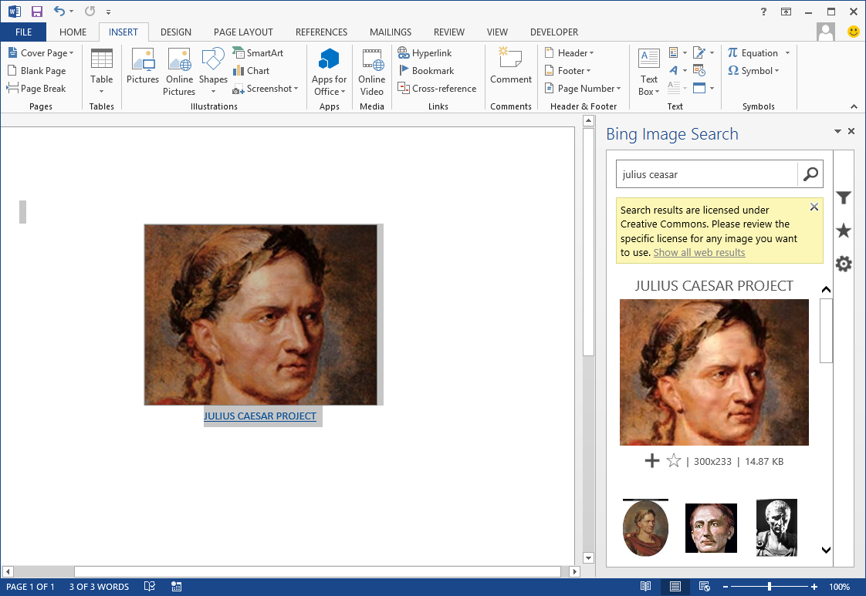
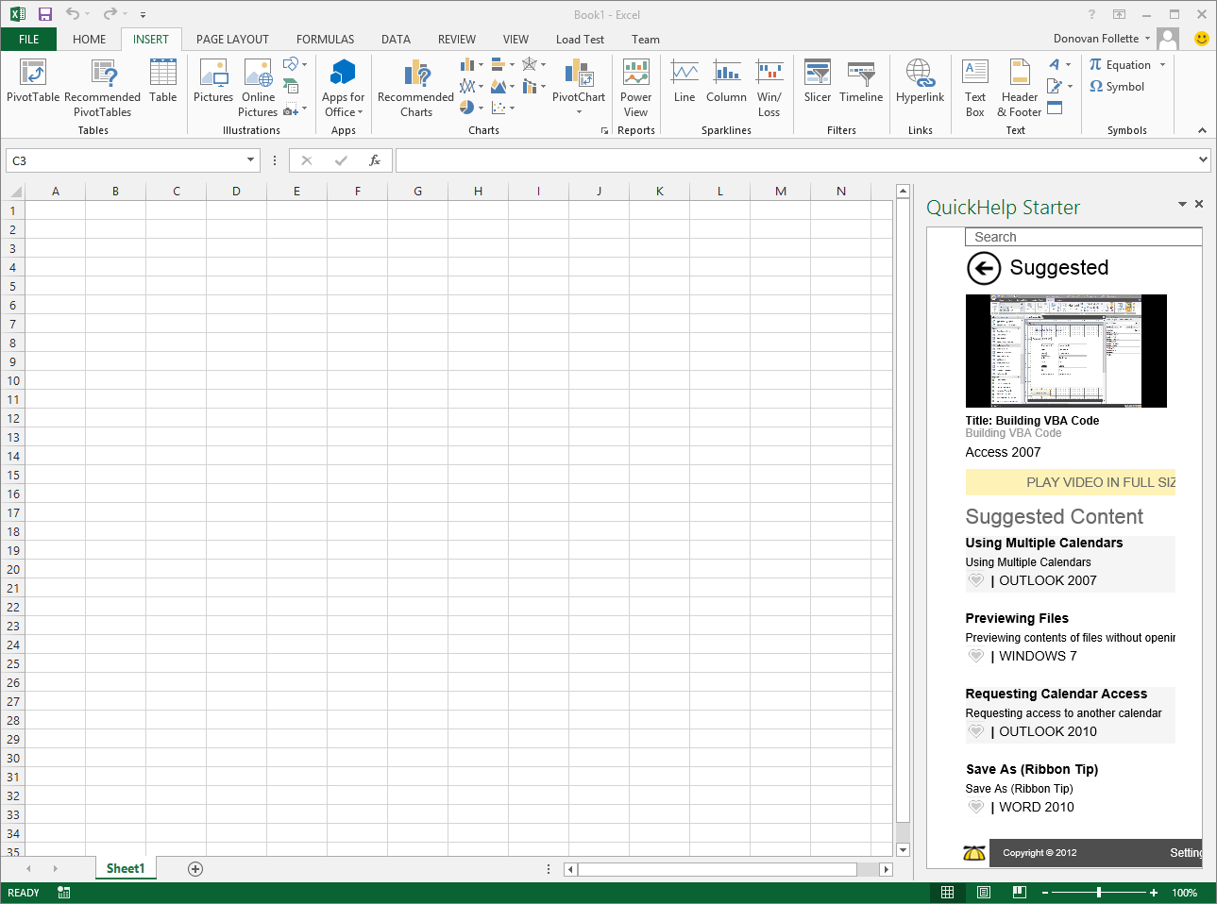
Demo
Some apps for Office & SharePoint currently in the store
Notes:
Browse the office.com Store
Show the following apps in Office 2013 – note: Requires you to have Office 2013 installed on your machine.
Bing image search app
Britannica
Brainstorm – you’ll need to login with your LiveID
Customers have multiple ways of obtaining apps. Developers can create apps and submit them to a public marketplace. These types of apps will be validated by Microsoft similar to how apps for the Windows Phone are validated. Customers can then acquire these apps and pay for them if they are not free.
Enterprises can also use a corporate catalog which is essentially a private marketplace for their tenant(or deployment in an on premises environment). Enterprise developers can deploy apps to their corporate catalog in order to distribute apps to SharePoint sites but not make them publically available.

Slide 5
What is an App for Office?
A Web page loaded inside an Office Application
Embedded inline or as task pane within documents, mails or appointments.
Works in both Office Applications and Office Web Applications
Allows Office applications to leverage Web technologies
HTML 5 and CSS for rendering user interface
JavaScript and jQuery to add behavior
Calls to REST APIs to retrieve and update data from across network
Notes:
An App for Office can be seen as a Web page loaded inside an Office Application. In some cases it will appear embedded inline within the document. In other cases it might appear as a task pane or within a message in Outlook. Note that the architecture for Apps for Office has been designed to work in both Office Applications and Office Web Applications.
WEF and Apps for Office allow Office applications to be extended in such as way so that they can leverage Web technologies such as HTML 5 and CSS for rendering user interface as well as JavaScript and jQuery to add behavior. When you write the JavaScript code for an App for Office, you can call REST APIs such as those added to SharePoint 2013 to retrieve and update data from across network.

Slide 6
Manifest + Windows Azure Web Site = app for Office
MVC 4 as an app for Office
Demo
Notes:
For this demo:
Prerequisite Setup:
Create a folder on the C: drive and name it “AppManifests”
Share the folder with “everyone” so that that you can use it as a file share
Open Word, click File->Options->Trust Center->Trust Center Settings…->Trusted App Catalogs:
In the Catalog URL type \\YourMachineNameHere\AppManifests\ and click Add Catalog
Make sure the Show in Menu checkbox is checked and click Ok all the way out of the dialogs.
For demo #1:
Spin up a new Windows Azure Web Site and download the publish profile
In VS 2012, create a new app for Office (File New Project->Office/SharePoint, Apps->App for Office 2013)
F5 to run the app, this will deploy locally to IIS express – show the interaction with the web page and document, close Excel to quit debugging.
Make any form of a modification to the HTML so the web page will be visually altered
Publish the Web app to your Windows Azure Web Site
Copy the Manifest file to the AppManifest folder
Open the manifest file in Notepad in the AppManifest folder, and put in your HTTPS Web Site URL.
Start Excel and open a blank document
Click the Insert (ribbon tab), click the down arrow under Apps for Office, Click See all…
Click SHARED FOLDER and Refresh if necessary, click on your app and click Insert.
For demo #2:
Have an MVC4 app for Office fully built and deployed to another Windows Azure Web Site
Simply open the manifest file again in Notepad and paste in the URL to the Web Site and save the file.
Run Excel or Word and Insert (may need to Refresh) the app for Office via the ribbon again. Demo your MVC4 app for Office.

Slide 7
Introducing the Cloud App Model for SharePoint
SharePoint applications no longer live in SharePoint
Custom code executes in the client, cloud or on-premises
Apps are granted permissions to SharePoint via OAuth
Apps communicate with SharePoint via REST/CSOM
Notes:
The new SharePoint app model is designed to not only address issues around the solution package approach to SharePoint customization, but also to introduce new capabilities. SharePoint apps do not live in SharePoint, rather they execute in the browser client or on a non-SharePoint server such as an IIS server or in the cloud. Apps are granted permission into SharePoint sites via OAuth and communicate over the new investments in the REST and CSOM (client-side object model) APIs.

Slide 8
Hosting: Choice of two cloud-based Architectures
Provider-Hosted App
“Bring your own server hosting infrastructure”
SharePoint Web
Your Hosted Site
(Windows Azure an Option)
Cloud-based Apps
Get remote events from SharePoint Use CSOM/REST + OAuth to work with SP
Autohosted App
Windows Azure + SQL Azure provisioned automatically as apps are installed
SharePoint Web
Windows Azure
Web Sites
Notes:
Cloud Hosted Apps:
You app is hosted either in your own hosting (private cloud, 3rd party cloud, IIS web site, etc) or using an auto provisioning process in Windows Azure
Provider Hosted App
Customers can create their app in any technology stack and host on any platform they choose.
This could even be using a 3rd party cloud using PHP and developed using Eclipse.
Developers would then create a SharePoint app package that would define how to extend SharePoint for use with the app
Menu extensions
Web Parts
Ribbon extensions
App permissions (OAuth app principal ID)
Windows Azure Auto-Provisioned App
Create a SharePoint app package
Includes the SharePoint extensions & everything needed to deploy the application to Windows Azure automatically
Uses an existing subscription in Windows Azure configured by the tenant administrators
Customers (tenant admins) would configure the subscriptions in Windows Azure where apps are deployed to and not use SharePoint resources
Apps do share a few common things though. Within each app you will find an AppManfiest.xml file that will describe the app to SharePoint. This contains some basic metadata about the app (ID, title, description & thumbnail) as well as a list of all the permissions the app needs when it is installed.

Slide 9
Summary
apps for Office and SharePoint can be:
Built using standard Web technologies
Written in any language
Hosted on Windows Azure or any platform
apps for Office and SharePoint have the worldwide reach of the Office Store on office.com
apps can be monetized now in the Office Store
dev.office.com – to get started now
www.devcamps.ms/office – training locations worldwide
Notes:
Key points for developers to know.

