Slide 1
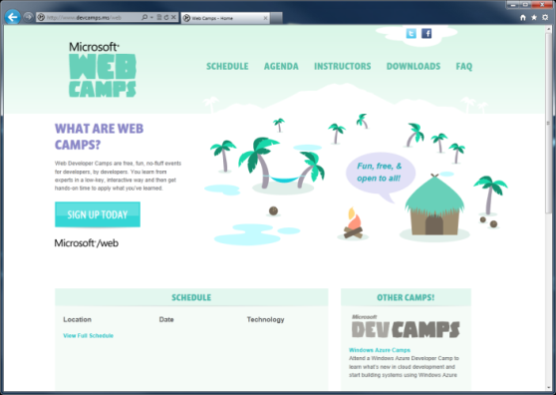

WebCamps Online
Twitter: Follow @webcamps Hashtag #devamps
SPEAKER NAME/HANDLE HERE
Website: http://www.devcamps.ms/web
What are web camps?
Web Developer Camps are free, fun, no-fluff events for developers, by developers. You learn from experts in a low-key, interactive way and then get hands-on time to apply what you’ve learned.

Slide 2
Real-time Communications With SignalR
Name
Title
Microsoft Corporation
Notes:
Lead: One of the things people say when they see a cool technology is that it seems like magic. That quote pops up in these sessions.

Slide 3
Agenda
What is SignalR?
Build a Chat Application
Build a Multi-player Game
Load Balancing SignalR

Slide 4

What is SignalR?
An open-source series of libraries that provide an abstraction around persistent HTTP connections
[In English, please]
SignalR makes real-time HTTP so easy
it seems like magic that it works

Slide 5
Arthur C. Clarke
Any sufficiently advanced technology is indistinguishable from magic.
Notes:
This quote, by Arthur C. Clarke, does a great job of explaining SignalR. It does so well what it does that it tends to seem like what it’d doing isn’t realli

Slide 6
Demo
Chat
Notes:
The best way to start talking about SignalR is to show what it does. This demo is the “Hello World” of SignalR applications. As you’ll see if you try out Jabbr.net, there’s a lot that can be done using SignalR if you want to build a real-time communication app.
SignalR Chat App Demo Script
----------------------------
1. Open the Chat.sln solution in the Chat-Begin folder
2. Right-click the project and select Add -> New Item
3. From the New Item dialog, select "SignalR Hub Class" and name the file "ChatHub.cs"
4. Note the addition of some script files and new references to Microsoft.AspNet.SignalR.*
5. Replace the code in the ChatHub.cs file with the code below.
[HubName("chat")]
public class ChatHub : Hub
{
public void SendMessage(dynamic message)
{
Clients.All.onReceiveMessage(message);
}
}
6. Right-click the Controllers folder and select Add > Controller
7. Name the controller HomeController and select "Empty MVC Controller" from the menu
8. Right-click within the Index method and select "Add View"
9. Select the _Layout.cshtml file as the layout for the view
10. Change the Index.cshtml view file to include the following code:
@{
ViewBag.Title = "Index";
Layout = "~/Views/Shared/_Layout.cshtml";
}
<h2>Chat</h2>
<div id="connectionStatus">Waiting</div>
<!-- insert form here -->
@section scripts{
<script src="~/Scripts/jquery.signalR-1.0.0-alpha1.js"></script>
<script type="text/javascript">
$(function () {
var cn = $.hubConnection();
var hub = cn.createHubProxy('chat');
// TODO: set up the event handler
// TODO: set up the push button event handler
cn.start().done(function () {
$('#connectionStatus').text('Connected');
});
});
</script>
}
11. Replace the <!-- insert form here --> comment with the code below
<div>
<label>Username</label>
<input type="text" id="username" value="someuser" />
</div>
<div>
<label>Message</label>
<input type="text" id="message" value="Hello World!" />
</div>
<div>
<button id="send">Send</button>
</div>
<ul id="messages"></ul>
12. Replace the // TODO: set up the event handler comment with the code below
hub.on('onReceiveMessage', function (msg) {
$('#messages').prepend('<li><b>' + msg.username + '</b>: ' + msg.message + '</li>');
});
13. Replace the // TODO: set up the push button event handler comment with the code below
$('#send').click(function () {
hub.invoke('sendMessage', { username: $('#username').val(), message: $('#message').val() });
});
14. Run the site
15. Open a second browser instance
16. Chat with yourself

Slide 7
SignalR on Old Servers or Clients
Got Data?
Got Data?
Got Data?
Got Data?
Client Browser
Web Server
Here’s some data!
Got Data?
Got Data?
Got Data?
Got Data?
Notes:
This demonstrates the way SignalR works over an HTTP connection using long polling or one of the other pre-Web Socket or pre-Server Sent Events methods.
The web server makes an outbound request to the web server. CLICK
If the web server is ready to return something, it does so. CLICK
Once the server responds, the client begins making the requests again until the server responds. CLICK

Slide 8
SignalR on New Servers and Clients
I do real time, do you?
Client Browser
Web Server
Absolutely!
Let’s Party in Real-time!
Notes:
This demonstrates the way SignalR works over an HTTP connection using Web Sockets or Server Sent Events.
The client makes the request to determine if the server does real-time. CLICK
The server responds to the client to let the client know Web Sockets or SSE are supported. CLICK
The real-time connection is established and used for the lifetime of the conversation. CLICK
If both ends of the connection support one of the later, real-time connection methods, real-time communication is enabled.

Slide 9
Basically…
Client Browser
SignalR!!!
Web Server
Notes:
This demonstrates the way SignalR works over an HTTP connection using Web Sockets or Server Sent Events.
The client makes the request to determine if the server does real-time. CLICK
The server responds to the client to let the client know Web Sockets or SSE are supported. CLICK
The real-time connection is established and used for the lifetime of the conversation. CLICK
If both ends of the connection support one of the later, real-time connection methods, real-time communication is enabled.

Slide 10
Demo
Online Gaming
Notes:
The Fireworks demo is a simple multi-player game that demonstrates more of what’s possible with SignalR.
Demo Script
Open Firework-End solution.
Walk through server-side SignalR Hub to show what it does
Walk through JavaScript code that makes the Hub connection

Slide 11
SignalR Components
Clients
JQuery
Native .NET
WP7
iOS
Silverlight
WinRT
Android
(via Mono)
ASP.NET
OWIN
SQL
Redis
Service Bus
Hosts
Backplanes
Notes:
SignalR is comprised of multiple components that can be thought of in three parts.
Clients – the operating system or programming environment that can make calls using SignalR. Numerous SignalR clients exist for everything from JavaScript to iOS, most of which began as community contributions. CLICK to fade in Clients
Hosts – SignalR can be hosted in ASP.NET, as is the traditional method. There also exists capability to self-host SignalR, so you could host a hub in an EXE or in a Windows Azure worker role. CLICK to fade in Hosts
Backplanes – SignalR isn’t load-balancer friendly out of the box. Hubs live on one server or role instance. If an application that is to be load-balanced needs to make use of SignalR, that application needs a backplane behind the servers or instances running the application.
Backplane support was completely re-written for the 1.0 alpha release. Currently, three backplanes exist – SQL Server, Service Bus, and Redis.

Slide 12
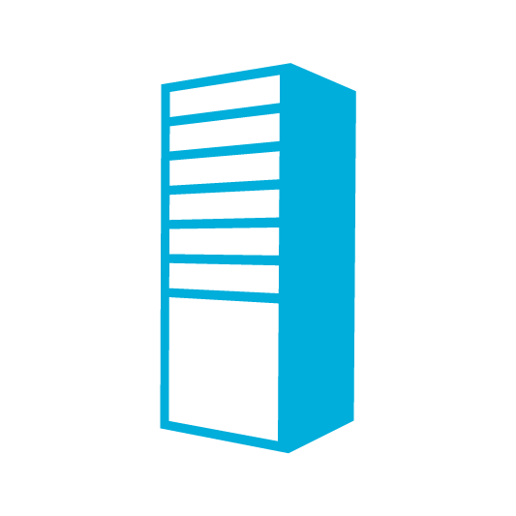
SignalR Backplanes
Load balancing via a common transport mechanism
Backplane
Load Balancer
Notes:
SignalR needs a backplane to scale. In a multi-server or multi-instance environment, communication sent from the client will only land on the server from which the originating call was made. If other users are actively connected to the application, but on different servers, the real-time communication won’t cross the servers. Click to play first animation.
If your application needs to run in a multiple-instance manner, a backplane is necessary. Click to fade in the backplane
Now that the backplane has been added to the architecture, the server or instances nodes can transmit data between the other servers or instances, enabling load-balanced real-time communication. Click to play the animation showing multi-server communication

Slide 13
Demo
Service Bus Backplane

