Slide 1
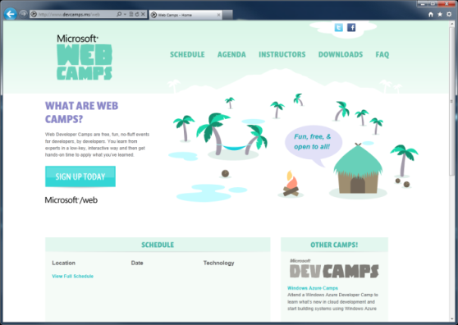

WebCamps Online
Twitter: Follow @webcamps Hashtag #devamps
SPEAKER NAME/HANDLE HERE
Website: http://www.devcamps.ms/web
What are web camps?
Web Developer Camps are free, fun, no-fluff events for developers, by developers. You learn from experts in a low-key, interactive way and then get hands-on time to apply what you’ve learned.

Slide 2
Real-time Communications With SignalR
Name
Title
Microsoft Corporation

Slide 3
Agenda
What is SignalR?
Build a Chat Application
Build a Multi-player Game
Load Balancing SignalR

Slide 4

What is SignalR?
An open-source series of libraries that provide an abstraction around persistent HTTP connections
[In English, please]
SignalR makes real-time HTTP so easy
it seems like magic that it works

Slide 5
Arthur C. Clarke
Any sufficiently advanced technology is indistinguishable from magic.

Slide 6
Got Data?
Got Data?
Got Data?
Got Data?
Client Browser
Web Server
Here’s some data!
Got Data?
Got Data?
Got Data?
Got Data?

Slide 7
SignalR Components
Clients
JQuery
Native .NET
WP7
iOS
Silverlight
WinRT
Android
(via Mono)
ASP.NET
OWIN
Self
SQL
Redis
Service Bus
Hosts
Backplanes

Slide 8

Load Balancing
A SignalR backplane in action
Backplane
Load Balancer

