Slide 1
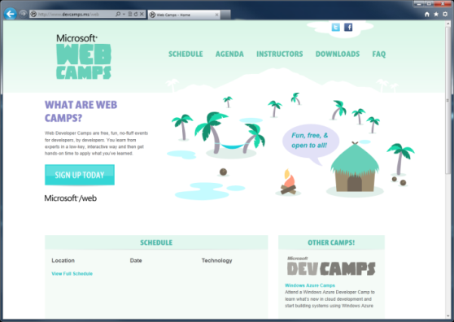

WebCamps Online
Twitter: Follow @webcamps Hashtag #devamps
SPEAKER NAME/HANDLE HERE
Website: http://www.devcamps.ms/web
What are web camps?
Web Developer Camps are free, fun, no-fluff events for developers, by developers. You learn from experts in a low-key, interactive way and then get hands-on time to apply what you’ve learned.

Slide 2
Real-time Communications With SignalR
Name
Title
Microsoft Corporation
Notes:
Lead: One of the things people say when they see a cool technology is that it seems like magic. That quote pops up in these sessions.

Slide 3
Agenda
Build a Real-time Hit Counter
What is SignalR?
Build a Chat Application
Build a Multi-player Game
Load Balancing SignalR

Slide 4
Demo
Hit Counter
Notes:
The best way to start talking about SignalR is to show what it does. This demo is a throwback to the old days of when hit counters were all the rage, but we’ll put a real-time spin on the idea of a hit counter to make it more interesting.
SignalR Hit Counter/Active User Counter Demo Script
---------------------------------------------------
1. Open the HitCounter-Begin solution
2. Install-Package Microsoft.AspNet.SignalR -pre
3. Add a new SignalR Hub class to the project named HitCounter.cs and add the following code to that class:
static int _hitCount;
public void RecordHit()
{
_hitCount += 1;
Clients.All.onHitRecorded(_hitCount);
}
4. Open the Default.htm page in the editor
5. Replace the <!-- add script references here --> comment with the following script references (or drag them into the file from the Scripts folder):
<script src="Scripts/jquery-1.6.4.js"></script>
<script src="Scripts/jquery.signalR-1.0.0-alpha2.js"></script>
6. Replace the <!-- add custom script to run the hit counter here --> comment with the following custom JavaScript code:
<script type="text/javascript">
$(function () {
var cn = $.hubConnection();
var hub = cn.createHubProxy('hitCounter');
hub.on('onHitRecorded', function (i) {
$('#hitCount').text(i);
});
cn.start(function () {
hub.invoke('RecordHit');
});
});
</script>
7. Run the project. Open multiple browsers to show the hit counter escalating with each hit.
8. Close all browser instances
9. Open the HitCounter.cs Hub class in the editor again. Add the following override to the class:
public override System.Threading.Tasks.Task OnDisconnected()
{
_hitCount -= 1;
Clients.All.onHitRecorded(_hitCount);
return base.OnDisconnected();
}
10. Set up the next demo by saying something like "does he mean to tell me this thing will know when the browser closes down?" and follow it up by saying "yes, that's exactly what it's going to do."
11. Re-run the application. Open up multiple browsers to show the hit counter escalating.
12. Individually (and slowly) close individual browser instances to show the hit counter descending.

Slide 5
SignalR Components
Clients
JQuery
Native .NET
WP7
iOS
Silverlight
WinRT
Android
(via Mono)
ASP.NET
OWIN
SQL
Redis
Service Bus
Hosts
Backplanes
Notes:
SignalR is comprised of multiple components that can be thought of in three parts.
Clients – the operating system or programming environment that can make calls using SignalR. Numerous SignalR clients exist for everything from JavaScript to iOS, most of which began as community contributions. CLICK to fade in Clients
Hosts – SignalR can be hosted in ASP.NET, as is the traditional method. There also exists capability to self-host SignalR, so you could host a hub in an EXE or in a Windows Azure worker role. CLICK to fade in Hosts
Backplanes – SignalR isn’t load-balancer friendly out of the box. Hubs live on one server or role instance. If an application that is to be load-balanced needs to make use of SignalR, that application needs a backplane behind the servers or instances running the application.
Backplane support was completely re-written for the 1.0 alpha release. Currently, three backplanes exist – SQL Server, Service Bus, and Redis.

Slide 6

What is SignalR?
An open-source series of libraries that provide an abstraction around persistent HTTP connections
[In English, please]
SignalR makes real-time HTTP so easy
it seems like magic that it works

Slide 7
Arthur C. Clarke
Any sufficiently advanced technology is indistinguishable from magic.
Notes:
This quote, by Arthur C. Clarke, does a great job of explaining SignalR. It does so well what it does that it tends to seem like what it’d doing isn’t realli

Slide 8
Demo
Chat
Notes:
The best way to start talking about SignalR is to show what it does. This demo is the “Hello World” of SignalR applications. As you’ll see if you try out Jabbr.net, there’s a lot that can be done using SignalR if you want to build a real-time communication app.
SignalR Chat App Demo Script
------------------------------------
1. Open the Chat-Begin solution
2. Install-Package Microsoft.AspNet.SignalR -pre
3. Add a new SignalR Hub class to the project named ChatHub.cs and add the following code to it:
[HubName("chat")]
public class ChatHub : Hub
{
public void SendMessage(dynamic message)
{
Clients.All.receiveMessage(message);
}
}
4. Open the Default.htm page in the editor.
5. Replace the <!-- insert script references --> comment with this code to reference jQuery and SignalR (or drag and drop the scripts from the scripts folder into the page):
<script src="Scripts/jquery-1.6.4.js"></script>
<script src="Scripts/jquery.signalR-1.0.0-alpha2.js"></script>
6. Replace the <!-- insert chat script --> comment with this custom JavaScript code:
<script type="text/javascript">
$(function () {
var cn = $.hubConnection();
var hub = cn.createHubProxy('chat');
hub.on('receiveMessage', function (msg) {
$('#messages').prepend('<li><b>' + msg.username + '</b>: ' + msg.message + '</li>');
});
cn.start(function () {
$('#send').removeAttr('disabled');
});
$('#send').click(function () {
hub.invoke('SendMessage', { username: $('#username').val(), message: $('#message').val() });
});
});
</script>
7. Run the sample and open multiple browsers to see how the chat works

Slide 9
SignalR on Old Servers or Clients
Got Data?
Got Data?
Got Data?
Got Data?
Client Browser
Web Server
Here’s some data!
Got Data?
Got Data?
Got Data?
Got Data?
Notes:
This demonstrates the way SignalR works over an HTTP connection using long polling or one of the other pre-Web Socket or pre-Server Sent Events methods.
The web server makes an outbound request to the web server. CLICK
If the web server is ready to return something, it does so. CLICK
Once the server responds, the client begins making the requests again until the server responds. CLICK

Slide 10
SignalR on New Servers and Clients
I do real time, do you?
Client Browser
Web Server
Absolutely!
Let’s Party in Real-time!
Notes:
This demonstrates the way SignalR works over an HTTP connection using Web Sockets or Server Sent Events.
The client makes the request to determine if the server does real-time. CLICK
The server responds to the client to let the client know Web Sockets or SSE are supported. CLICK
The real-time connection is established and used for the lifetime of the conversation. CLICK
If both ends of the connection support one of the later, real-time connection methods, real-time communication is enabled.

Slide 11
Basically…
Client Browser
SignalR!!!
Web Server
Notes:
This demonstrates the way SignalR works over an HTTP connection using Web Sockets or Server Sent Events.
The client makes the request to determine if the server does real-time. CLICK
The server responds to the client to let the client know Web Sockets or SSE are supported. CLICK
The real-time connection is established and used for the lifetime of the conversation. CLICK
If both ends of the connection support one of the later, real-time connection methods, real-time communication is enabled.

Slide 12
Online Gaming
Examples of how SignalR provides online games real-time already exist
ShootR – http://shootr.signalr.net
Fireworks – http://firework.cloudapp.net

Slide 13
Demo
Online Gaming
Notes:
The Fireworks demo is a simple multi-player game that demonstrates more of what’s possible with SignalR.
Demo Script
Open Firework-End solution.
Walk through server-side SignalR Hub to show what it does
Walk through JavaScript code that makes the Hub connection

Slide 14
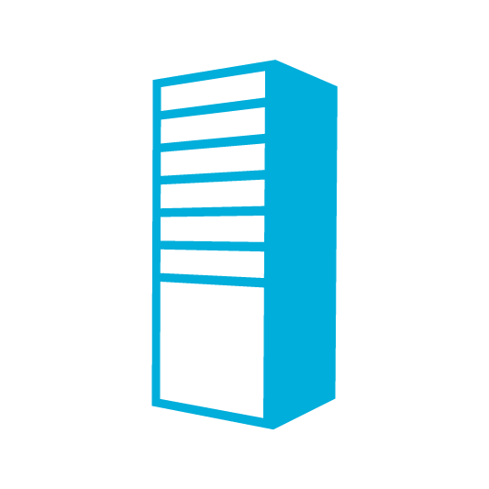
SignalR Backplanes
Load balancing via a common transport mechanism
Backplane
Load Balancer
Notes:
SignalR needs a backplane to scale. In a multi-server or multi-instance environment, communication sent from the client will only land on the server from which the originating call was made. If other users are actively connected to the application, but on different servers, the real-time communication won’t cross the servers. Click to play first animation.
If your application needs to run in a multiple-instance manner, a backplane is necessary. Click to fade in the backplane
Now that the backplane has been added to the architecture, the server or instances nodes can transmit data between the other servers or instances, enabling load-balanced real-time communication. Click to play the animation showing multi-server communication

