Slide 1
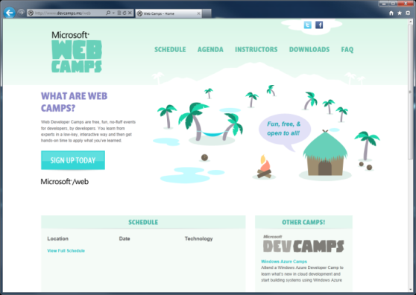

WebCamps Online
Twitter: Follow @webcamps Hashtag #devcamps
[Speaker] / [Twitter]
Website: http://www.devcamps.ms/web
What are web camps?
Web Developer Camps are free, fun, no-fluff events for developers, by developers. You learn from experts in a low-key, interactive way and then get hands-on time to apply what you’ve learned.

Slide 2
Going further with Windows Azure
[Speaker]
[Company]

Slide 3
Agenda
Scale (up and down)
Mobile Services
Virtual Machines
Caching and Storage
Windows Azure Store

Slide 4
Scale
devcamps.ms

Slide 5










Big Data
Database
Storage
Traffic
Mobile
Caching
Service Bus
Identity
Building Blocks
Media
CDN
Networking

Slide 6
Big Data
Database
Storage
Traffic
Mobile
Caching
Service Bus
Identity
Mobile Services
Media
CDN
Networking

Slide 7
Big Data
Database
Storage
Traffic
Mobile
Caching
Cache
Service Bus
Identity
Caching
Caching
Media
CDN
Networking

Slide 8
Caching
Twitter Reader
Use Caching to improve performance

Slide 9
Database
Storage
Mobile
Big Data
Storage
Traffic
Cache
Service Bus
Identity
Caching
Storage
Media
CDN
Networking

Slide 10




Windows Azure Store
Great Extensions to Windows Azure Ecosystem
Great Opportunities
Services
Data

Slide 11
New Relic
Twitter Reader
Use New Relic to monitor service performance

