Slide 1
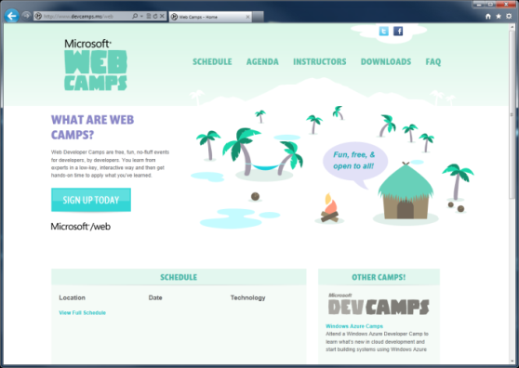

WebCamps Online
Twitter: Follow @webcamps Hashtag #devamps
SPEAKER NAME/HANDLE HERE
Website: http://www.devcamps.ms/web
What are web camps?
Web Developer Camps are free, fun, no-fluff events for developers, by developers. You learn from experts in a low-key, interactive way and then get hands-on time to apply what you’ve learned.

Slide 2
Using Cloud Application Services
Name
Title
Microsoft Corporation

Slide 3
Agenda
Using Windows Azure building block services
Caching
Storage
n-Tier architecture
Windows Azure Store

Slide 4










Big Data
Database
Storage
Traffic
Mobile
Caching
Service Bus
Identity
Building Blocks
Media
CDN
Networking

Slide 5
Big Data
Database
Storage
Traffic
Mobile
Caching
Cache
Service Bus
Identity
Caching
Caching
Media
CDN
Networking

Slide 6
Caching
Twitter Reader
Use Caching to improve performance

Slide 7
Database
Storage
Mobile
Big Data
Storage
Traffic
Cache
Service Bus
Identity
Caching
Storage
Media
CDN
Networking

Slide 8
Storage
Twitter Reader
Use Windows Azure Table Storage to save hot topics

Slide 9
n-Tier
Separation of concerns
Scale different layers separately
Asynchronous workload processing
Notes:
Speaker Notes:
Mention inter-tier communication options: Service Bus Queue (used in demo to send data key), shared storage / cache (used in demo to get actual data), Internal endpoint for direct communication, etc.

Slide 10
n-Tier
Twitter Reader
User a background worker role to analyze trending data

Slide 11




Windows Azure Store
Great Extensions to Windows Azure Ecosystem
Great Opportunities
Services
Data

Slide 12
New Relic
Twitter Reader
Use New Relic to monitor service performance

