Slide 1
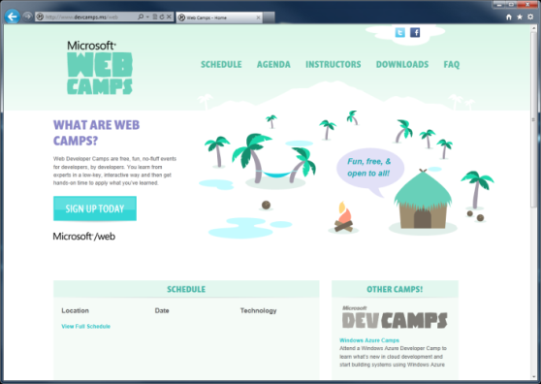

WebCamps Online
Twitter: Follow @webcamps Hashtag #devamps
SPEAKER NAME/HANDLE HERE
Website: http://www.devcamps.ms/web
What are web camps?
Web Developer Camps are free, fun, no-fluff events for developers, by developers. You learn from experts in a low-key, interactive way and then get hands-on time to apply what you’ve learned.
Notes:
ASP.NET 4.5 Web Forms [slides]
Binding & strongly typed controls (5 minutes)
Friendly URLs (5 minutes)
Visual Studio 2012 features for web developers [demo]
Page Inspector (5 minutes)
JavaScript & CSS (5 minutes)
Web Essentials (5 minutes)
Bundling & Optimization (5 minutes) [slides]

Slide 2
What’s New In ASP.NET 4.5
Name
Title
Microsoft Corporation

Slide 3
Agenda
Web Forms Model Binding
Friendly URLs
Page Inspector
Visual Studio web editor features
Web Essentials
Bundling & Optimization

Slide 4
Web Forms: Model Binding

Slide 5
Web Forms: Friendly URLs

Slide 6
Bundling and Optimization

Slide 7
Visual Studio 2012 web dev features
Page Inspector
CSS and HTML editor
JavaScript editor
Web Essentials

Slide 8
Visual Studio 2012 and Web Essentials
demo

