Slide 1
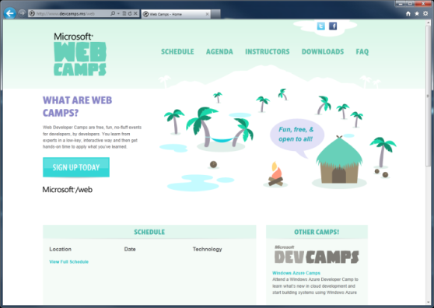

WebCamps Online
Twitter: Follow @webcamps Hashtag #webcamps
[Speaker] / [Twitter]
Website: http://www.devcamps.ms/web
What are web camps?
Web Developer Camps are free, fun, no-fluff events for developers, by developers. You learn from experts in a low-key, interactive way and then get hands-on time to apply what you’ve learned.
Notes:
ASP.NET 4.5 Web Forms [slides]
Binding & strongly typed controls (5 minutes)
Friendly URLs (5 minutes)
Visual Studio 2012 features for web developers [demo]
Page Inspector (5 minutes)
JavaScript & CSS (5 minutes)
Web Essentials (5 minutes)
Bundling & Optimization (5 minutes) [slides]

Slide 2
What’s New In ASP.NET 4.5 and Visual Studio 2012 for Web
[Speaker]
[Company]

Slide 3
Agenda
Web Forms: Strongly Typed Data Controls
Web Forms: Model Binding
Friendly URLs
Page Inspector
Visual Studio web editor features
Web Essentials
Bundling & Optimization

Slide 4
Model Binding with ASP.NET Web Forms: Strongly Typed Data Controls
Step 1:
Set the ItemType
<ul>
<asp:Repeater ID="customersRepeater" runat="server"
ItemType="WebFormsLab.Model.Customer">
</asp:Repeater>
</ul>
Step 2:
Reference the properties as needed using the Item keyword
<ul>
<asp:Repeater ID="customersRepeater" runat="server“ ItemType="WebFormsLab.Model.Customer">
<ItemTemplate>
<li>
<a href="CustomerDetails.aspx?id=<%#: Item.Id %>">
<%#: Item.FirstName %> <%#: Item.LastName %>
</a>
</li>
</ItemTemplate>
</asp:Repeater>
</ul>
Notes:
1 minute
The transition from code to markup is one of the most elegant things about Razor but there a few rules that are worth knowing about.
Option 1:
Code is the primary citizen in a code block, not HTML. This means the parser will always expect code unless it finds valid opening (and closing) tags. In the first option block you see that after the @{ a name variable is defined. No additional tag is necessary.
A <div> section tells Razor that what follows should be taken as literal. Then the @name indicates a variable that needs to be replaced with its value.
Option 2:
Similarly, to explicitly call out text in a code block as HTML, wrap it in a <text> tag
Option 3:
Single line of output within markup can be denoted by @:
This option is useful when you don’t want to render an HTML element as part of the output.
Extra Knowledge (Advanced):
The Parser that understands Razor is itself a standalone assembly (System.Web.Razor.dll) which has no dependencies on ASP.NET which means you can use it to parse CSHTML/VBHTML files and produce C#/VB code in any .NET application.

Slide 5
Web Forms: Model Binding Getting Data
Step 1:
Set Select Method
<ul>
<asp:Repeater ID="customersRepeater" runat="server"
ItemType="WebFormsLab.Model.Customer" SelectMethod="GetCustomers">
</asp:Repeater>
</ul>
Step 2:
Get method returns IEnumerable or IQueryable
public IQueryable<Customer> GetCustomers([Control]DateTime? createdSince)
{
IQueryable<Customer> query = _db.Customers;
if (createdSince.HasValue)
{
query = query.Where(
i => i.CreatedOn >= createdSince.Value);
}
return query;
}
Notes:
1 minute
The transition from code to markup is one of the most elegant things about Razor but there a few rules that are worth knowing about.
Option 1:
Code is the primary citizen in a code block, not HTML. This means the parser will always expect code unless it finds valid opening (and closing) tags. In the first option block you see that after the @{ a name variable is defined. No additional tag is necessary.
A <div> section tells Razor that what follows should be taken as literal. Then the @name indicates a variable that needs to be replaced with its value.
Option 2:
Similarly, to explicitly call out text in a code block as HTML, wrap it in a <text> tag
Option 3:
Single line of output within markup can be denoted by @:
This option is useful when you don’t want to render an HTML element as part of the output.
Extra Knowledge (Advanced):
The Parser that understands Razor is itself a standalone assembly (System.Web.Razor.dll) which has no dependencies on ASP.NET which means you can use it to parse CSHTML/VBHTML files and produce C#/VB code in any .NET application.

Slide 6
Web Forms: Model Binding Inserting Data
Step 1:
Set Insert Method
<asp:FormView runat="server" ID="customerForm"
InsertMethod="InsertCustomer" UpdateMethod="UpdateCustomer"
<EditItemTemplate>
<asp:Label runat="server" Text="Name:" AssociatedControlID="Name" />
<asp:TextBox runat="server" ID="Name" Text="<%# BindItem.Name %>" />
<!-- etc. -->
Step 2:
Use TryUpdateModel to validate, then save
public void InsertCustomer()
{
var customer = new Customer();
TryUpdateModel(customer);
if (ModelState.IsValid)
{
_db.Customers.Add(customer);
SaveChanges(customer);
}
}
Notes:
1 minute
The transition from code to markup is one of the most elegant things about Razor but there a few rules that are worth knowing about.
Option 1:
Code is the primary citizen in a code block, not HTML. This means the parser will always expect code unless it finds valid opening (and closing) tags. In the first option block you see that after the @{ a name variable is defined. No additional tag is necessary.
A <div> section tells Razor that what follows should be taken as literal. Then the @name indicates a variable that needs to be replaced with its value.
Option 2:
Similarly, to explicitly call out text in a code block as HTML, wrap it in a <text> tag
Option 3:
Single line of output within markup can be denoted by @:
This option is useful when you don’t want to render an HTML element as part of the output.
Extra Knowledge (Advanced):
The Parser that understands Razor is itself a standalone assembly (System.Web.Razor.dll) which has no dependencies on ASP.NET which means you can use it to parse CSHTML/VBHTML files and produce C#/VB code in any .NET application.

Slide 7
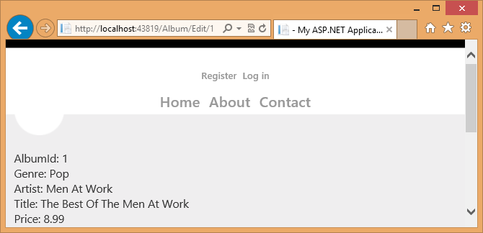
Web Forms: Friendly URLs
/Album/Edit/1
\Album\Edit.aspx
ID passed to controls
Segments can be bound or accessed programmatically
public Album EditAlbum_GetItem([FriendlyUrlSegments] int? id)
{
return _db.Albums.Find(id);
}

Slide 8
Web Forms Model Binding & Friendly URLs, Mobile Support
demo…

Slide 9
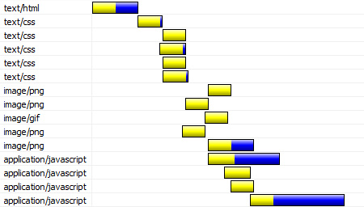
Bundling and Optimization
Web pages have many external references:
CSS, Images, JavaScript

Slide 10
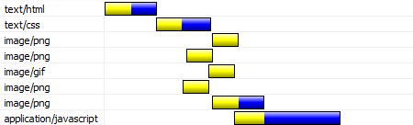
Bundling and Optimization
Bundling combines CSS and JavaScript requests

Slide 11
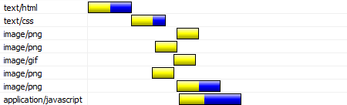
Bundling and Optimization
Minification compresses the files before sending

Slide 12
Visual Studio 2012 web dev features
Page Inspector
CSS and HTML editor
JavaScript editor
Web Essentials
Notes:
HTML - HTML5 audio
CSS – Regions, snippets (e.g. media)
JavaScript – Regions, DOM
2012.2 – Knockout, Paste JSON as classes

Slide 13
Visual Studio 2012 and Web Essentials
demo
Notes:
http://visualstudiogallery.msdn.microsoft.com/07d54d12-7133-4e15-becb-6f451ea3bea6

