Slide 1
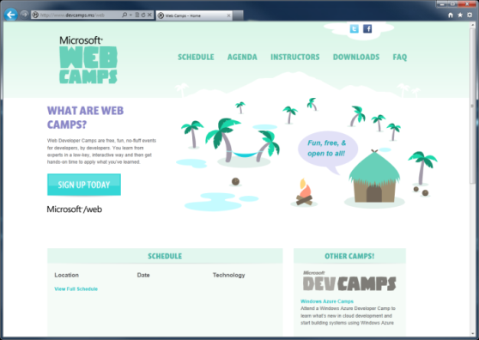

WebCamps Online
Twitter: Follow @webcamps Hashtag #devamps
SPEAKER NAME/HANDLE HERE
Website: http://www.devcamps.ms/web
What are web camps?
Web Developer Camps are free, fun, no-fluff events for developers, by developers. You learn from experts in a low-key, interactive way and then get hands-on time to apply what you’ve learned.

Slide 2
Building a Service Layer with ASP.NET Web API
Name
Title
Microsoft Corporation

Slide 3
Agenda
Why all the hype for Web APIs?
Building Web APIs for browser/JSON clients
Building Web APIs for native/non-browser clients

Slide 4


Today
Today if you want to reach your user, you have to reach their device
In this talk you’ll learn how

Slide 5
Comparison of WCF & ASP.NET Web API
WCF
Back-end Services
SOAP, WS-*
ASP.NET Web API
Front-end Services
Media Types: JSON, XML, form-URL-encoded, custom
Transports: HTTP, TCP, UDP, Queues, WebSockets, custom
Message patterns: request-reply, one-way, duplex
Use WCF Web HTTP to add HTTP endpoints to existing WCF services
Use WCF Data Services for full OData support
HTTP only
Request-reply only
REST, resource-centric
Use SignalR for asynchronous signaling (polling, long-polling, WebSockets)

Slide 6
Web API is a part of ASP.NET
HTML
XML
JSON
Web Forms
Razor View Engine
Code
Web Pages
MVC
MVC 4
Web API
ASP.NET Core
Modules
Handlers
Membership
Intrinsics
Caching
Etc.
Notes:
Estimated Time: 2 minutes
No matter which type of developer you are, you get the benefit of the ASP.NET Core runtime, which provides many useful modules that provide functionality that you are likely to need when creating web applications. For example: Profile, Roles and Membership is important if you want to build in users and security around different parts of your website.
[Build x 3]
ASP.NET Web Forms, ASP.NET MVC and ASP.NET Web Pages are three different approaches to building web applications on the server side with ASP.NET. They all build on top of the same core runtime that provides them with the same powerful set of modules that web developers can leverage from within their web applications.
ASP.NET Web Forms is great for developers coming from desktop application development where they are accustomed to controls, event-driven development and code-behind. Despite not being concepts that are native to the web, Web Forms achieves this by abstracting away things like maintaining state, form posting and much more. This ease of development means that developers relinquish a certain amount of control as Web Forms manages communication between the server and client on your behalf.
ASP.NET MVC, in contrast, is for developers that like to be in full control of the interactions between client and server and provides a more “raw” approach to what happens in the web application. Due to its loosely coupled architecture, MVC is also very extensible with many places for developers to customize and plugin components as well write test code easily.
Developing in ASP.NET Web Pages is centered around inline code and is similar to PHP or classic ASP in that compilation of your application isn’t required (it is in WebForms and MVC). It is designed to provide the simplest approach to building websites with the fewest number of concepts to learn.
[Build x 2]
When it comes to controlling the markup that is rendered to the client there are two view engines you may use. The Web Forms view engine is shared by both Web Forms and MVC and uses the familiar <% %> syntax. With ASP.NET MVC 3 and ASP.NET Web Pages Microsoft introduced the Razor View Engine which uses a different syntax centered around the @ symbol. The Razor syntax uses fewer characters to achieve the same things in Web Forms and allows the developer to mix markup and code really easily.

Slide 7
Where Can You Get Web API?

Slide 8
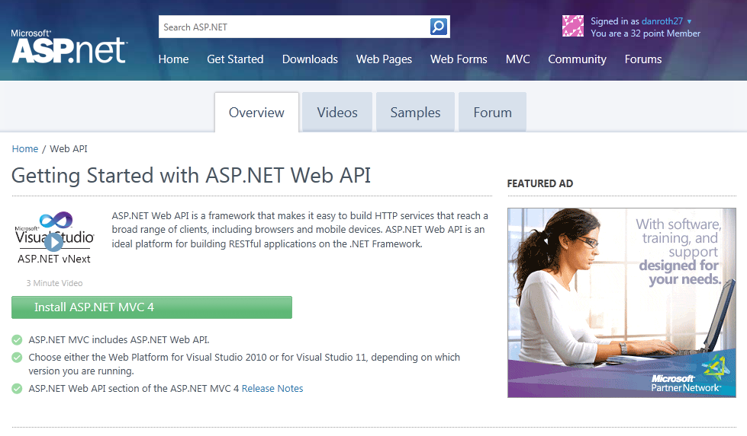
Homepage: asp.net/web-api

Slide 9
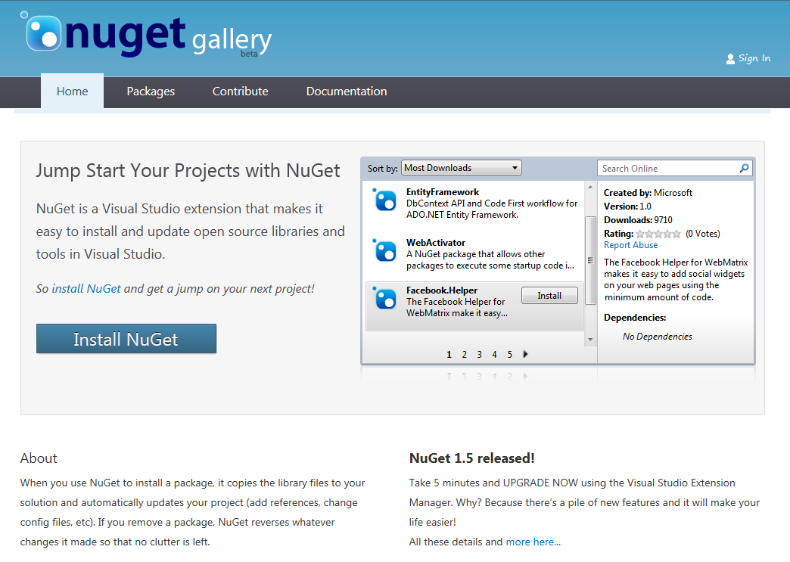
Find Us on Nuget
Nuget Packages
WebApi
WebApi.OData
JsonValue
HttpClient
WebApi.Enhancements

Slide 10
Building a Read Only Web API
Why?
Allow browser or other clients to easily retrieve information from your system

Slide 11
Sample Read-only Model and Controller
Step 1:
Create a Model
public class Person
{
public int Id { get; set; }
public string Name { get; set; }
}
Step 2:
Make an API Controller
public class PersonController : ApiController
{
List<Person> _people;
public PersonController()
{
_people = new List<Person>();
_people.AddRange(new Person[]
{
new Person { Id = 1, Name = "Chuck Norris" },
new Person { Id = 2, Name = "David Carradine" },
new Person { Id = 3, Name = "Bruce Lee" }
});
}
}
Notes:
1 minute
The transition from code to markup is one of the most elegant things about Razor but there a few rules that are worth knowing about.
Option 1:
Code is the primary citizen in a code block, not HTML. This means the parser will always expect code unless it finds valid opening (and closing) tags. In the first option block you see that after the @{ a name variable is defined. No additional tag is necessary.
A <div> section tells Razor that what follows should be taken as literal. Then the @name indicates a variable that needs to be replaced with its value.
Option 2:
Similarly, to explicitly call out text in a code block as HTML, wrap it in a <text> tag
Option 3:
Single line of output within markup can be denoted by @:
This option is useful when you don’t want to render an HTML element as part of the output.
Extra Knowledge (Advanced):
The Parser that understands Razor is itself a standalone assembly (System.Web.Razor.dll) which has no dependencies on ASP.NET which means you can use it to parse CSHTML/VBHTML files and produce C#/VB code in any .NET application.

Slide 12
Read-only Controller Actions to return data
Step 3:
Return everything
// GET /api/person
public IEnumerable<Person> Get()
{
return _people;
}
Step 4:
Return one item
// GET /api/person/5
public Person Get(int id)
{
return _people.First(x => x.Id == id);
}
Notes:
1 minute
The transition from code to markup is one of the most elegant things about Razor but there a few rules that are worth knowing about.
Option 1:
Code is the primary citizen in a code block, not HTML. This means the parser will always expect code unless it finds valid opening (and closing) tags. In the first option block you see that after the @{ a name variable is defined. No additional tag is necessary.
A <div> section tells Razor that what follows should be taken as literal. Then the @name indicates a variable that needs to be replaced with its value.
Option 2:
Similarly, to explicitly call out text in a code block as HTML, wrap it in a <text> tag
Option 3:
Single line of output within markup can be denoted by @:
This option is useful when you don’t want to render an HTML element as part of the output.
Extra Knowledge (Advanced):
The Parser that understands Razor is itself a standalone assembly (System.Web.Razor.dll) which has no dependencies on ASP.NET which means you can use it to parse CSHTML/VBHTML files and produce C#/VB code in any .NET application.

Slide 13
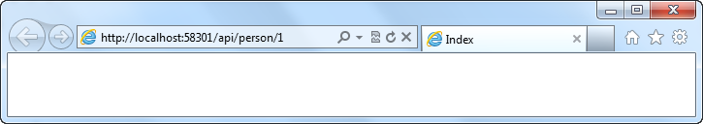
Routing a Web API Using Global.asax.cs
Routing:
Familiar syntax, conventional approach
public static void RegisterRoutes(RouteCollection routes)
{
routes.MapHttpRoute(
name: "DefaultApi",
routeTemplate: "api/{controller}/{id}",
defaults: new { id = RouteParameter.Optional }
);
}
Notes:
1 minute
The transition from code to markup is one of the most elegant things about Razor but there a few rules that are worth knowing about.
Option 1:
Code is the primary citizen in a code block, not HTML. This means the parser will always expect code unless it finds valid opening (and closing) tags. In the first option block you see that after the @{ a name variable is defined. No additional tag is necessary.
A <div> section tells Razor that what follows should be taken as literal. Then the @name indicates a variable that needs to be replaced with its value.
Option 2:
Similarly, to explicitly call out text in a code block as HTML, wrap it in a <text> tag
Option 3:
Single line of output within markup can be denoted by @:
This option is useful when you don’t want to render an HTML element as part of the output.
Extra Knowledge (Advanced):
The Parser that understands Razor is itself a standalone assembly (System.Web.Razor.dll) which has no dependencies on ASP.NET which means you can use it to parse CSHTML/VBHTML files and produce C#/VB code in any .NET application.

Slide 14
Manipulating HTTP Responses
Return HttpResponseMessage<T> to modify response headers
Example
Find a person and return it, but what happens if we don’t find a match?
// GET /api/person/5
public HttpResponseMessage<Person> Get(int id)
{
try
{
var person = _people.First(x => x.Id == id);
return new HttpResponseMessage<Person>(
person,
HttpStatusCode.OK
);
}
catch
{
return new HttpResponseMessage<Person>(HttpStatusCode.NotFound);
}
}

Slide 15
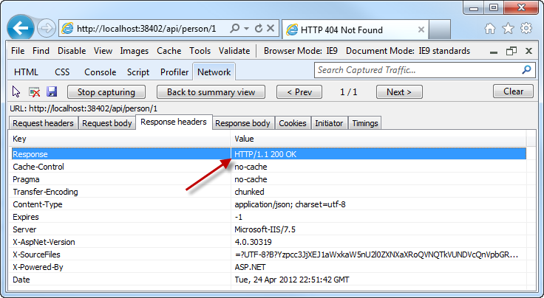
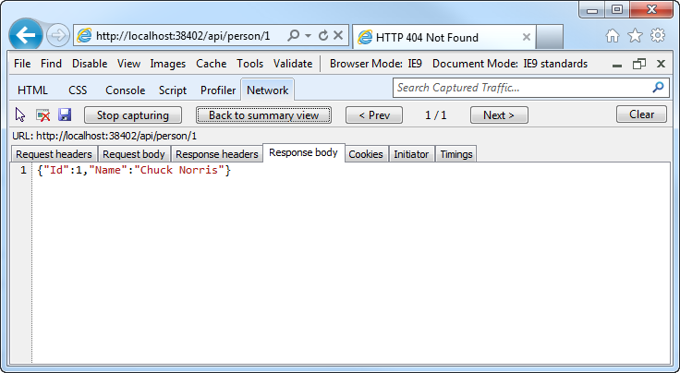
Manipulating HTTP Responses
A successful API call returns an HTTP OK and the JSON data

Slide 16
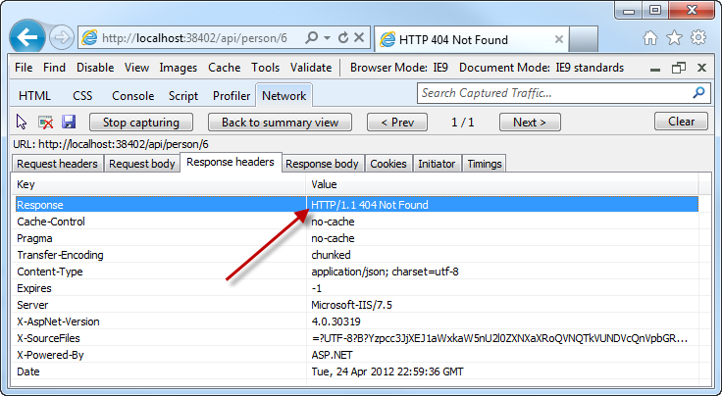
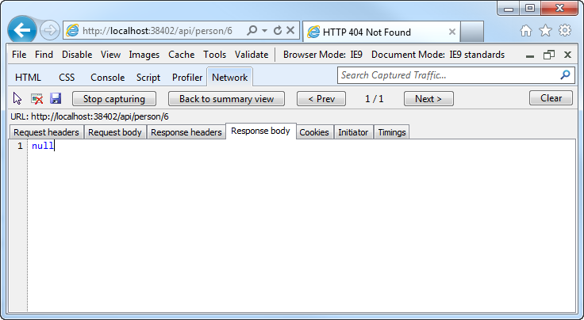
Manipulating HTTP Responses
An unsuccessful API call returns an HTTP 404 (and no JSON)

Slide 17
Building a read only Web API
demo

Slide 18
Making an API Updatable
Why?
Allow clients to modify the state of the server

Slide 19
Posting Data to a Web API
Use HTTP Post:
Pass a Model
public HttpResponseMessage Post(Person person)
{
person.Id = _people.Count + 1;
if (_people.Any(x => x.Id == person.Id))
return new HttpResponseMessage(HttpStatusCode.BadRequest);
try
{
_people.Add(person);
}
catch
{
return new HttpResponseMessage(HttpStatusCode.BadRequest);
}
return new HttpResponseMessage(HttpStatusCode.OK);
}
Notes:
1 minute
The transition from code to markup is one of the most elegant things about Razor but there a few rules that are worth knowing about.
Option 1:
Code is the primary citizen in a code block, not HTML. This means the parser will always expect code unless it finds valid opening (and closing) tags. In the first option block you see that after the @{ a name variable is defined. No additional tag is necessary.
A <div> section tells Razor that what follows should be taken as literal. Then the @name indicates a variable that needs to be replaced with its value.
Option 2:
Similarly, to explicitly call out text in a code block as HTML, wrap it in a <text> tag
Option 3:
Single line of output within markup can be denoted by @:
This option is useful when you don’t want to render an HTML element as part of the output.
Extra Knowledge (Advanced):
The Parser that understands Razor is itself a standalone assembly (System.Web.Razor.dll) which has no dependencies on ASP.NET which means you can use it to parse CSHTML/VBHTML files and produce C#/VB code in any .NET application.

Slide 20
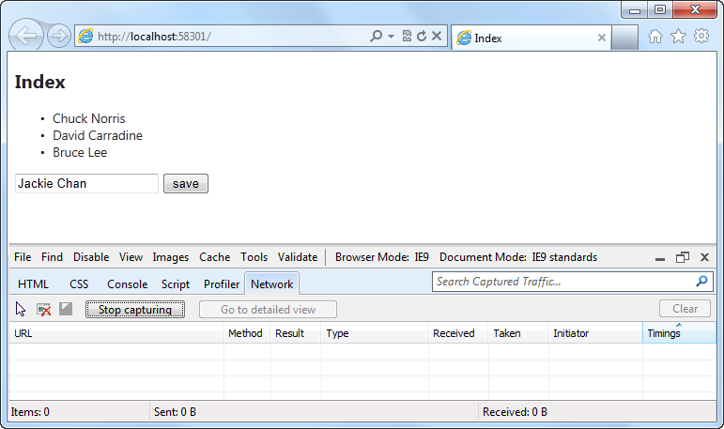
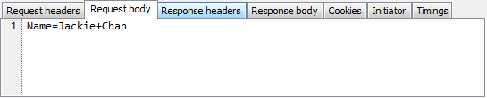
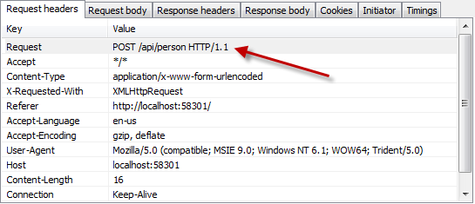
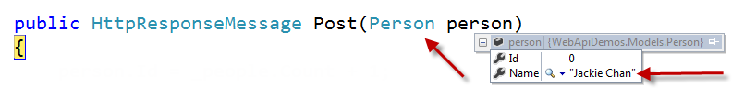
Posting Data to a Web API
Notes:
1 minute
The transition from code to markup is one of the most elegant things about Razor but there a few rules that are worth knowing about.
Option 1:
Code is the primary citizen in a code block, not HTML. This means the parser will always expect code unless it finds valid opening (and closing) tags. In the first option block you see that after the @{ a name variable is defined. No additional tag is necessary.
A <div> section tells Razor that what follows should be taken as literal. Then the @name indicates a variable that needs to be replaced with its value.
Option 2:
Similarly, to explicitly call out text in a code block as HTML, wrap it in a <text> tag
Option 3:
Single line of output within markup can be denoted by @:
This option is useful when you don’t want to render an HTML element as part of the output.
Extra Knowledge (Advanced):
The Parser that understands Razor is itself a standalone assembly (System.Web.Razor.dll) which has no dependencies on ASP.NET which means you can use it to parse CSHTML/VBHTML files and produce C#/VB code in any .NET application.

Slide 21
Making an API updatable
demo

Slide 22
Supporting HTML File Upload
Why?
Allow clients to send files from a browser

Slide 23
Support HTML File Upload
IsMimeMultipartContent – checks if multipart
MultipartFormDataStreamProvider – parses the streams
BodyPartFileNames – returns the list of files sent in the stream

Slide 24
Uploading Files
Use HTTP Post:
Pass a Model
public async Task<IList<string>> Post()
{
List<string> result = new List<string>();
if (Request.Content.IsMimeMultipartContent())
{
MultipartFormDataStreamProvider stream =
new MultipartFormDataStreamProvider("c:/uploads/");
IEnumerable<HttpContent> bodyparts =
await Request.Content.ReadAsMultipartAsync(stream);
IDictionary<string, string> bodyPartFiles = stream.BodyPartFileNames;
bodyPartFiles
.Select(i => { return i.Key; })
.ToList()
.ForEach(x => result.Add(x));
}
return result;
}
Notes:
1 minute
The transition from code to markup is one of the most elegant things about Razor but there a few rules that are worth knowing about.
Option 1:
Code is the primary citizen in a code block, not HTML. This means the parser will always expect code unless it finds valid opening (and closing) tags. In the first option block you see that after the @{ a name variable is defined. No additional tag is necessary.
A <div> section tells Razor that what follows should be taken as literal. Then the @name indicates a variable that needs to be replaced with its value.
Option 2:
Similarly, to explicitly call out text in a code block as HTML, wrap it in a <text> tag
Option 3:
Single line of output within markup can be denoted by @:
This option is useful when you don’t want to render an HTML element as part of the output.
Extra Knowledge (Advanced):
The Parser that understands Razor is itself a standalone assembly (System.Web.Razor.dll) which has no dependencies on ASP.NET which means you can use it to parse CSHTML/VBHTML files and produce C#/VB code in any .NET application.

Slide 25
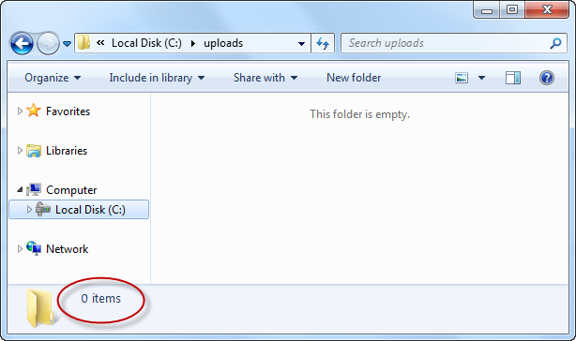
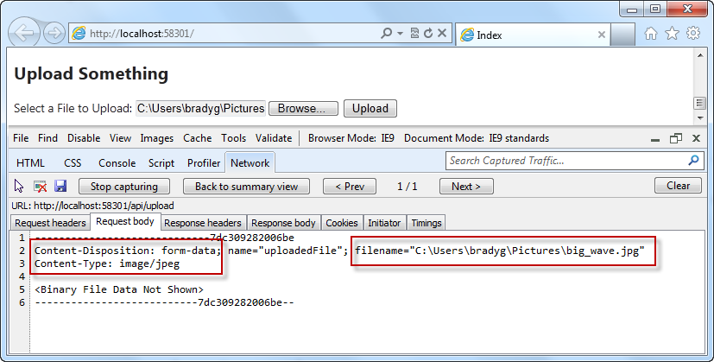
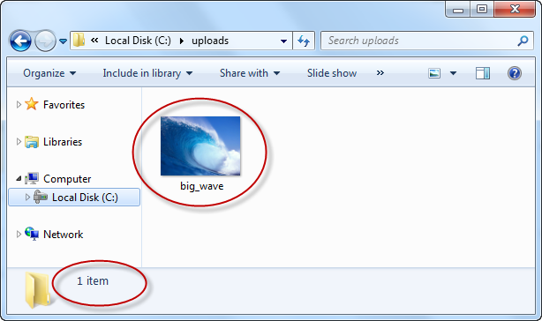
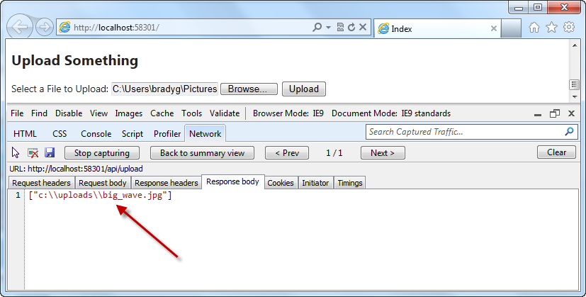
So what happens during upload?
Request – Note incoming filename
Response – Note saved filename

Slide 26
HTML file upload
demo
Using HttpContent to work with the body of the request

Slide 27
Web API is a part of ASP.NET
HTML
XML
JSON
Web Forms
Razor View Engine
Code
Web Pages
MVC
MVC 4
Web API
ASP.NET Core
Self Host
Modules
Handlers
Membership
Intrinsics
Caching
Etc.
Notes:
Estimated Time: 2 minutes
No matter which type of developer you are, you get the benefit of the ASP.NET Core runtime, which provides many useful modules that provide functionality that you are likely to need when creating web applications. For example: Profile, Roles and Membership is important if you want to build in users and security around different parts of your website.
[Build x 3]
ASP.NET Web Forms, ASP.NET MVC and ASP.NET Web Pages are three different approaches to building web applications on the server side with ASP.NET. They all build on top of the same core runtime that provides them with the same powerful set of modules that web developers can leverage from within their web applications.
ASP.NET Web Forms is great for developers coming from desktop application development where they are accustomed to controls, event-driven development and code-behind. Despite not being concepts that are native to the web, Web Forms achieves this by abstracting away things like maintaining state, form posting and much more. This ease of development means that developers relinquish a certain amount of control as Web Forms manages communication between the server and client on your behalf.
ASP.NET MVC, in contrast, is for developers that like to be in full control of the interactions between client and server and provides a more “raw” approach to what happens in the web application. Due to its loosely coupled architecture, MVC is also very extensible with many places for developers to customize and plugin components as well write test code easily.
Developing in ASP.NET Web Pages is centered around inline code and is similar to PHP or classic ASP in that compilation of your application isn’t required (it is in WebForms and MVC). It is designed to provide the simplest approach to building websites with the fewest number of concepts to learn.
[Build x 2]
When it comes to controlling the markup that is rendered to the client there are two view engines you may use. The Web Forms view engine is shared by both Web Forms and MVC and uses the familiar <% %> syntax. With ASP.NET MVC 3 and ASP.NET Web Pages Microsoft introduced the Razor View Engine which uses a different syntax centered around the @ symbol. The Razor syntax uses fewer characters to achieve the same things in Web Forms and allows the developer to mix markup and code really easily.

Slide 28
Self Hosting Your Web API
Why?
More granular control
No need for a web server
Isolated cases requiring minimal resources via standard protocol sets
Why Not?

Slide 29
Configuring Your Web API for Self Host
HttpConfiguration provides a code based configuration mechanism
New it up directly or derive from it
Pass HttpConfiguration instance to HttpServiceHostFactory/HttpServiceHost

Slide 30
Self Hosting a Web API Controller is Easy
Console Host:
First set up the configuration and the routes, just like in Global.asax.cs.
Then, host the controller using HttpSelfHostServer and open the server up to listen for requests.
class Program
{
static void Main(string[] args)
{
// configure the server
var baseAddress = "http://localhost:8080/";
var config = new HttpSelfHostConfiguration(baseAddress);
config.Routes.MapHttpRoute(
name: "DefaultApi",
routeTemplate: "api/{controller}/{id}",
defaults: new { id = RouteParameter.Optional }
);
// Create and open the server
var server = new HttpSelfHostServer(config);
server.OpenAsync().Wait();
Console.WriteLine("The server is running...");
Console.ReadLine();
}
}
Notes:
1 minute
The transition from code to markup is one of the most elegant things about Razor but there a few rules that are worth knowing about.
Option 1:
Code is the primary citizen in a code block, not HTML. This means the parser will always expect code unless it finds valid opening (and closing) tags. In the first option block you see that after the @{ a name variable is defined. No additional tag is necessary.
A <div> section tells Razor that what follows should be taken as literal. Then the @name indicates a variable that needs to be replaced with its value.
Option 2:
Similarly, to explicitly call out text in a code block as HTML, wrap it in a <text> tag
Option 3:
Single line of output within markup can be denoted by @:
This option is useful when you don’t want to render an HTML element as part of the output.
Extra Knowledge (Advanced):
The Parser that understands Razor is itself a standalone assembly (System.Web.Razor.dll) which has no dependencies on ASP.NET which means you can use it to parse CSHTML/VBHTML files and produce C#/VB code in any .NET application.

Slide 31
Self Hosting a Web API Controller is Easy
Controller:
This simple controller provides information about the server hosting the controller.
public class EnvironmentStatus
{
public string MachineName { get; set; }
public DateTime TimeOnServer { get; set; }
}
public class EnvironmentController : ApiController
{
public EnvironmentStatus Get()
{
Console.WriteLine(“User agent " + Request.Headers.UserAgent);
return new EnvironmentStatus
{
MachineName = Environment.MachineName,
TimeOnServer = DateTime.Now
};
}
}
Notes:
1 minute
The transition from code to markup is one of the most elegant things about Razor but there a few rules that are worth knowing about.
Option 1:
Code is the primary citizen in a code block, not HTML. This means the parser will always expect code unless it finds valid opening (and closing) tags. In the first option block you see that after the @{ a name variable is defined. No additional tag is necessary.
A <div> section tells Razor that what follows should be taken as literal. Then the @name indicates a variable that needs to be replaced with its value.
Option 2:
Similarly, to explicitly call out text in a code block as HTML, wrap it in a <text> tag
Option 3:
Single line of output within markup can be denoted by @:
This option is useful when you don’t want to render an HTML element as part of the output.
Extra Knowledge (Advanced):
The Parser that understands Razor is itself a standalone assembly (System.Web.Razor.dll) which has no dependencies on ASP.NET which means you can use it to parse CSHTML/VBHTML files and produce C#/VB code in any .NET application.

Slide 32
Self Hosting Your Web API
demo

Slide 33
Configuring Media Type Formatters
Why?
Tweak our Xml/Json formatters
OData clients
Other native/non-browser clients
Custom media types

Slide 34
Configuring media type formatters
demo
ODATA, JSON.NET, HAL

Slide 35
What We Learned
Why Web APIs are important
How to author Web APIs for multiple clients
How configure a Web API
Enabling HTML file upload
Enabling OData and custom formats
Using the Web API test client

Slide 36
For More Information
http://www.asp.net/web-api
http://channel9.msdn.com/Shows/Web+Camps+TV/Dan-Roth-on-the-new-ASPNET-Web-API
http://blogs.msdn.com/b/henrikn/archive/2012/02/19/using-web-api-with-mongodb.aspx
Documentation & Articles

Slide 37
Resources
Feedback and questions http://forums.dev.windows.com
Session feedback http://bldw.in/SessionFeedback

