Slide 1
Creating Rich HTML 5 Experiences
Name
Title
Microsoft Corporation

Slide 2
Agenda
First Topic
Second Topic
Third Topic

Slide 3
What is HTML5?
It isn’t a marketing message

Slide 4
What is HTML5?
It is the future of the web

Slide 5
What is HTML5?
A language with support on a variety of devices

Slide 6
HTML 5 in IE 9 & 10

Slide 7
HTML5 in IE9
HTML5
New Markup Elements
CSS3
2D Transforms
SVG
Shapes
Others
Canvas
Audio
Video
Local Storage
Cross-Window Messaging
Text Selection APIs
Parsing SVG in HTML
Border Radius
Box-Shadow
Fonts (WOFF)
Media Queries
Multiple Backgrounds
Namespaces
Opacity
rgba(), hsl(), hsla()
Selectors (IE8)
Clipping, Masking, and Compositing
Transforms
Extensibility
Gradients
Interactivity
Linking and Views
Painting and Colors
Paths
Text
ECMA Script 5 (all but Strict Mode)
Native JSON support
Performance API
Geo-Location
Data-uri (IE8)
DOM L2, L3
Selectors API L2
AJAX Navigation
DOMParser and XMLSerializer
ICC v2 and Color Profile
ARIA
Hardware Acceleration

Slide 8
HTML5 in IE10
HTML5
CSS3
Others
Application Cache
Drag&Drop
File API
Forms Validation
History
IndexedDB
Sandbox
Web Sockets
Web Workers
3D Transforms
Animations
Flexible Box
Floats
Gradient
Grid
Multi-Column
Region
SVG Filter Effects
Text Shadow
Transitions
Advanced Hit Testing APIs
Async
Media Queries Listeners
Web Performance APIs

Slide 9
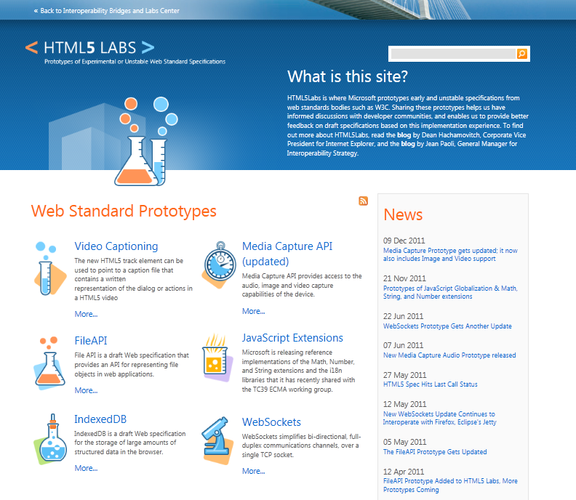
html5labs.com
HTML5 IndexedDB, Web Sockets, File API, and Media Capture API

Slide 10
Resources
News http://blogs.msdn.com/IE
Demos http://www.beautyoftheweb.com
Technical Samples http://www.ietestdrive.com
HTML5 Labs http://www.html5labs.com

Slide 11
HTML5 Deep Dive

Slide 12
Map of HTML5
W3C
HTML
HTML5
Canvas 2D Context
Microdata
HTML+RDFa
HTML5 Markup
HTML5 Diff from HTML4
Polyglot Markup
CSS
CSS Snapshot 2007
CSS Namespaces
CSS Paged Media
CSS Print Profile
CSS Values and Units
CSS Cascading and Inheritance
CSS Text
CSS Writing Modes
CSS Line Grid
CSS Ruby
CSS Generated Content for Paged Media
CSS Backgrounds and Borders
CSS Fonts
CSS Basic Box Model
CSS Multi-column Layout
CSS Template Layout
CSS Media Queries
CSS Speech
CSS Color
CSS Basic User Interface
CSS Scoping
CSS Grid Positioning
CSS Flexible Box Layout
CSS Image Values
CSS 2D Transformations
CSS 3D Transformations
CSS Transitions
CSS Animations
Web Apps
CORS
Element Traversal
File API
Index DB
Programmable HTTP Caching and Serving
Progress Events
Selectors API
Selectors API L2
Server-Sent Events
Uniform Messaging Policy
Web DOM Core
Web SQL Database
Web IDL
Web Sockets API
Web Storage
Web Workers
XmlHttpRequest
XmlHttpRequest L2
DOM L1
DOM L2 Core
DOM L2 Views
DOM L2 Events
DOM L2 Style
DOM L2 Traversal and Range
DOM L2 HTML
DOM L3 Core
DOM L3 Events
DOM L3 Load and Save
DOM L3 Validation
DOM L3 XPath
DOM L3 Views and Formatting
DOM L3 Abstract Schemas
Geolocation
Geolocation API
ECMA
ECMA Script 262
ECMAScript 262
SVG
Document Structure
Basic Shapes
Paths
Text
Transforms
Painting, Filling, Color
Scripting
Styling
Gradients and Patterns
SMIL
Fonts
Filters
Text alternatives

Slide 13
New HTML5 Markup Elements
<header>
<hgroup>
<nav>
<aside>
<footer>
<article>
<section>
<figure>
<figcaption>
used to identify the page or application's introduction or navigational aids
used to group heading elements
represents a section of a document that links to other documents or to parts within the document itself
represents content that is tangentially related to the content that forms the main textual flow of a document
represents the footer for the nearest ancestor sectioning content or sectioning root element
represents a section of content that forms an independent part of a document or site
used to designate generic sections of a document
used to enclose a figure like an illustration, diagram, or photo
used to identify a figure's caption
<video>
represents a video player displayed to allow user control over video playback and a viewport to view a video
<audio>
represents an audio player displayed to allow user control over audio playback

Slide 14
Canvas
A block element that allows developers to draw 2d graphics using JavaScript
Methods for drawing include: paths, boxes, circles, text and rasterized images
<canvas id="myCanvas" width="200" height="200">
Your browser doesn’t support Canvas, sorry.
</canvas>
<script type="text/javascript">
var example = document.getElementById("myCanvas");
var context = example.getContext("2d");
context.fillStyle = "rgb(255,0,0)";
context.fillRect(30, 30, 50, 50);
</script>

Slide 15
Scalable Vector Graphics (SVG)
Create and draw 2D vector graphics using XML
Vector images are composed of shapes instead of pixels
Based on the SVG 1.1 2nd Edition Full specification
Full DOM access to SVG elements
Document structure, scripting, styling, paths, shapes, colors, transforms, gradients, patterns, masking, clipping, markers, linking and views

Slide 16
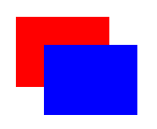
SVG Code Example
A block element that allows developers to draw 2d graphics using JavaScript
Methods for drawing include: paths, boxes, circles, text and rasterized images
<svg width="400" height="200" xmlns="http://www.w3.org/2000/svg">
<rect fill="red" x="20" y="20" width="100" height="75" />
<rect fill="blue" x="50" y="50" width="100" height="75" />
</svg>

Slide 17
HTML 5 <video>
Support for the HTML5 <video> element
Industry-standard MPEG-4/H.264 video
Video can be composited with anything else on the page
HTML content, images, SVG graphics
Hardware accelerated, GPU-based decoding

Slide 18
HTML 5 <video> Attributes
src – specifies the location to pull the source file
autoplay – if present starts playing as soon as it’s ready
controls – if present displays controls
preload – if present loads source at page load
loop – if present loops back to the beginning of the video
height & width – specifies the height & width of the player
<video src="video.mp4" id="videoTag" width="640px" height="360px">
<!-- Only shown when browser doesn’t support video -->
<!-- You Could Embed Flash or Silverlight Video Here -->
</video>

Slide 19
HTML 5 <audio>
Industry-standard MP3 and AAC audio
Fully scriptable via the DOM
Attributes
src – specifies the location to pull the source file
autoplay – if present starts playing as soon as it’s ready
controls – if present displays controls
preload – if present loads source at page load
<audio src="audio.mp3" id="audioTag" autoplay controls>
<!-- Only shown when browser doesn’t support audio -->
<!-- You could embed Flash or Silverlight audio here -->
</audio>

Slide 20
HTML5
demo
new markup features

Slide 21
SVG
Basic Shapes
Paths
Text
Transforms
Painting, Filling, Color
Scripting
Styling
Gradients, Patterns

Slide 22
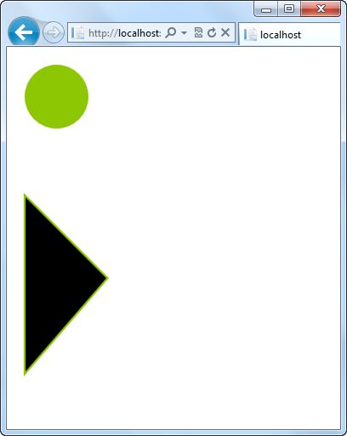
Creating SVG Shapes
Declarative creation of shapes
Numerous shapes available: circle, rect, ellipse, line, polyline, polygon, path
<svg height="200" xmlns="http://www.w3.org/2000/svg">
<circle id="blueCircle"
cx="70"
cy="70" r="50"
fill="#8dc703" />
</svg>
<svg height="200" xmlns="http://www.w3.org/2000/svg">
<path d="M 20 20 L 150 150 L 20 300 z"
fill="#000"
stroke="#8dc703"
stroke-width="3" />
</svg>

Slide 23
SVG
demo
vector graphics via markup

Slide 24
CSS3 Fonts & @font-face
Web Open Font Format allows you to package and deliver fonts as needed, per site
Designed for web use with the @font-face declaration
<style type="text/css">
@font-face {
font-family:MyFontName;
src: url('FontFile.woff');
}
</style>
<div style="font: 24pt MyFontName, sans-serif;">
This will render using MyFontName in FontFile.woff
</div>

Slide 25
CSS3 Media Queries
Selectively style page based on properties of the media
<style type="text/css">
@font-face {
font-family:MyFontName;
src: url('FontFile.woff');
}
</style>
<div style="font: 24pt MyFontName, sans-serif;">
This will render using MyFontName in FontFile.woff
</div>

Slide 26
CSS3 Colors
Alpha color with rgba() and hsla() color functions
Transparency control with the opacity property
Can be used with any property that takes the color property
div.top {
background-color: rgba(0, 0, 0, 0.5);
color: azure;
}
div.bottom {
background-color: hlsa(0, 0%, 0%, 0.5);
color: cornsilk;
}

Slide 27
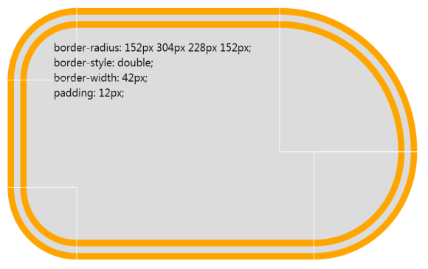
CSS3 Backgrounds & Borders
Round corners with the border-radius property
Multiple background images per element
Box-shadow property on block elements
div {
border-radius: 152px 304px 228px 152px;
border-style: double;
border-width: 42px;
padding: 12px;
}

Slide 28
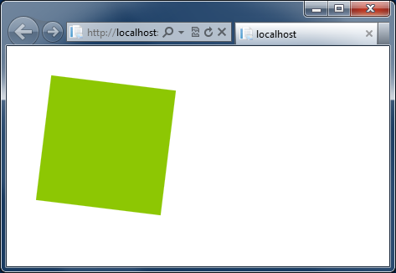
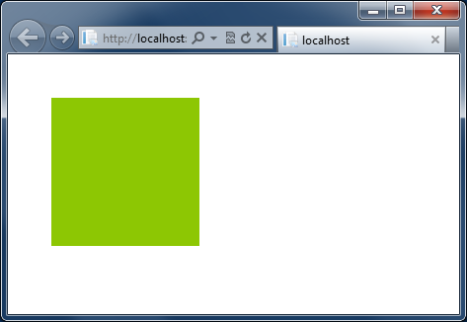
CSS3 Transform
Applies 2D or 3D effects to the target element
No native support, better to use all alternatives simultaneously
.box { width: 200px; height: 200px; background-color: #8dc703; }
.box:hover
{
transform:rotate(7deg);
/* IE 9 */
-ms-transform:rotate(7deg);
/* Firefox */
-moz-transform:rotate(7deg);
/* Safari and Chrome */
-webkit-transform:rotate(7deg);
/* Opera */
-o-transform:rotate(7deg);
}

Slide 29
CSS3 Demo
demo

Slide 30
Resources
W3C HTML5 Working Group http://www.w3.org/html/wg
HTML5 Demo Gallery http://www.beautyoftheweb.com
IE Blog http://blogs.msdn.com/IE
IE9 Test Drive http://www.ietestdrive.com

Slide 31
jQuery Fundamentals

Slide 32
Who Uses jQuery?
25,343,057 Web Sites
1,778,334 of those sites rank in the top sites on the web
Source: http://trends.builtwith.com/javascript/jQuery

Slide 33

jQuery Community
Downloading http://code.jquery.com
Documentation http://docs.jquery.com
Community http://forum.jquery.com
Extending http://plugins.jquery.com
API Docs http://api.jquery.com
Local Community http://meetups.jquery.com
Widgets & Effects http://jqueryui.com

Slide 34
Adding jQuery
demo
How to wire your site up with jQuery

Slide 35
jQuery Fundamentals
Find something using a selector
Do something to what’s been selected
<script>
$(‘div’).hide();
</script>
<div>This will be hidden</div>
<div>So will this</div>
<div>Even this</div>

Slide 36
Functional Syntax
Introduces functional handling of browser or DOM events
<script>
$(document).ready(function() {
$('.submitButton').click( function(){
alert('post form');
});
});
</script>
<input class=“submitButton” type=“button” value=“Submit”/>

Slide 37
DOM Manipulation
jQuery can create new elements or alter existing elements
<script>
$(document).ready(function() {
$('.submitButton').click( function(){
$('.submitButton').css('color', '#ff0000');
$('#container').append('<span>Clicked!</span>');
});
});
</script>
<div id="container">
<input class="submitButton" type="button" value="Submit"/>
</div>

Slide 38
Chaining with jQuery
DOM events can be attached to elements as they are added to the DOM
<script>
$(document).ready(function() {
$('.submitButton').click( function(){
$('.submitButton').css('color', '#ff0000');
$('#container')
.append($('<span>Clicked!</span>')
.click(function(){
alert('foo');
})
);
});
});
</script>

Slide 39
jQuery Fundamentals
demo

Slide 40
AJAX and jQuery
Start
here

Slide 41
What We Learned
First Topic
Second Topic
Third Topic

Slide 42
For More Information
Related sessions
Documentation & articles

Slide 43
Resources
Feedback and questions http://forums.dev.windows.com

