Slide 1
Integrating Your Site with Internet Explorer 9 (& 10!)
Name
Title
Microsoft Corporation

Slide 2
Agenda
Windows and the Web
Pinned Sites
Interoperable
IE9 & HTML5
Building a Fast Web Experience
Getting Ready for Internet Explorer 10

Slide 3
Windows & the Web

Slide 4
Windows & the Web
57% of all time spent on a PC is in a browser

Slide 5
Web browsing is core to the Windows Experience
The browser is the stage, not the play

Slide 6
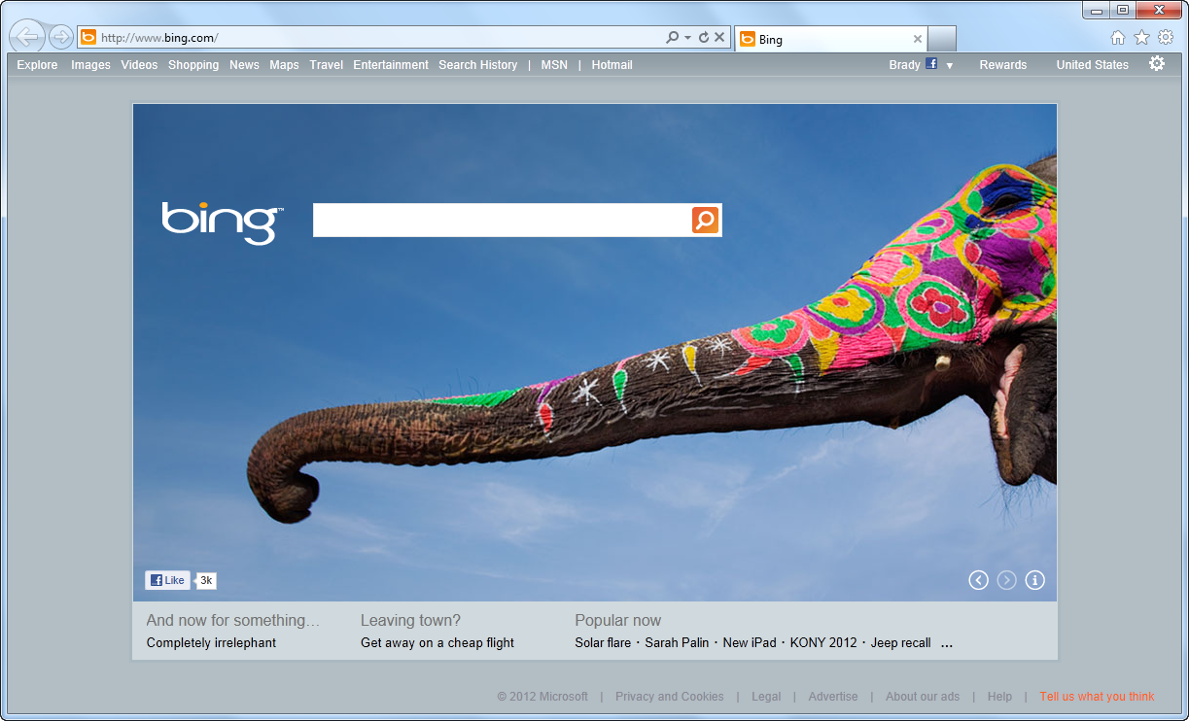
IE Puts the Focus Back on Your Site

Slide 7
Pinned Sites

Slide 8
Behind the Scenes
Pinned site execution details:
Creates an isolated instance of Internet Explorer
Generates an AppID for a specific URL
BHOs and other toolbars are not enabled
Share the same real estate as Windows applications

Slide 9
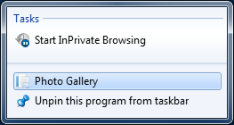
Pinning a Site Using Meta
<head>
<title>@Page.Title</title>
<meta name="application-name" content="Photo Gallery" />
<meta name="msapplication-tooltip" content="Photo Gallery" />
<meta name="msapplication-window" content="width=1024;height=768" />
<meta name="msapplication-starturl" content="http://localhost:42179/" />
</head>

Slide 10
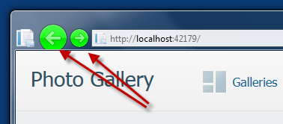
Pinning a Site Using Meta
<head>
<title>@Page.Title</title>
<meta name="application-name" content="Photo Gallery" />
<meta name="msapplication-tooltip" content="Photo Gallery" />
<meta name="msapplication-window" content="width=1024;height=768" />
<meta name="msapplication-starturl" content="http://localhost:42179/" />
<meta name="msapplication-navbutton-color" content="#00FF00" />
</head>

Slide 11
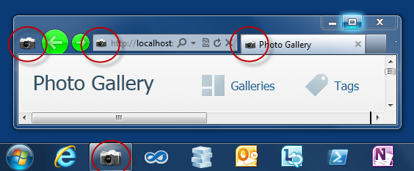
Customizing the Icon
<head>
<title>@Page.Title</title>
<meta name="application-name" content="Photo Gallery" />
<meta name="msapplication-tooltip" content="Photo Gallery" />
<meta name="msapplication-window" content="width=1024;height=768" />
<meta name="msapplication-starturl" content="http://localhost:42179/" />
<meta name="msapplication-navbutton-color" content="#00FF00" />
<link rel="shortcut icon" href="~/slr_camera.ico"/>
</head>

Slide 12
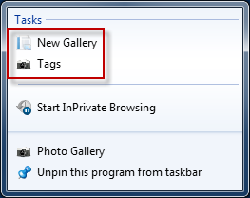
Adding a Jump List
<head>
<title>@Page.Title</title>
…
<link rel="shortcut icon" href="~/slr_camera.ico"/>
<meta name="msapplication-task" content="name=New Gallery;
action-uri=http://localhost:42179/New;
icon-uri=favicon.ico"/>
<meta name="msapplication-task"
content="name=Tags;
action-uri=http://localhost:42179/Tag;
icon-uri=slr_camera.ico"/>
</head>

Slide 13
Pinning a Site
demo

Slide 14
Interoperable

Slide 15
Working with Standards Bodies
Member of many W3C Working Groups

Slide 16
The HTML Working Group
40 W3C Member Organizations
411 group participants
280 invited experts
9 mailing lists
around 4000 emails on public-html

Slide 17
Keep up with standards adoption
Internet Explorer Testing Center http://samples.msdn.microsoft.com/ietestcenter

Slide 18
IE9 & HTML5

Slide 19
HTML 5 At a Glance
Commonly used to refer to modern open web standards like HTML5, CSS3, and more
Adds new rich media and graphics support (canvas, video, audio, inline SVG…)
Standardizes behavior for browser vendors, enabling same markup

Slide 20
Canvas
A block element that allows developers to draw 2d graphics using JavaScript
Methods for drawing include: paths, boxes, circles, text and rasterized images
<canvas id="myCanvas" width="200" height="200">
Your browser doesn’t support Canvas, sorry.
</canvas>
<script type="text/javascript">
var example = document.getElementById("myCanvas");
var context = example.getContext("2d");
context.fillStyle = "rgb(255,0,0)";
context.fillRect(30, 30, 50, 50);
</script>

Slide 21
Scalable Vector Graphics (SVG)
Create and draw 2D vector graphics using XML
Vector images are composed of shapes instead of pixels
Based on the SVG 1.1 2nd Edition Full specification
Full DOM access to SVG elements
Document structure, scripting, styling, paths, shapes, colors, transforms, gradients, patterns, masking, clipping, markers, linking and views

Slide 22

SVG Code Example
A block element that allows developers to draw 2d graphics using JavaScript
Methods for drawing include: paths, boxes, circles, text and rasterized images
<svg width="400" height="200" xmlns="http://www.w3.org/2000/svg">
<rect fill="red" x="20" y="20" width="100" height="75" />
<rect fill="blue" x="50" y="50" width="100" height="75" />
</svg>

Slide 23
HTML 5 <video>
Support for the HTML5 <video> element
Industry-standard MPEG-4/H.264 video
Video can be composited with anything else on the page
HTML content, images, SVG graphics
Hardware accelerated, GPU-based decoding

Slide 24
HTML 5 <video> Attributes
src – specifies the location to pull the source file
autoplay – if present starts playing as soon as it’s ready
controls – if present displays controls
preload – if present loads source at page load
loop – if present loops back to the beginning of the video
height & width – specifies the height & width of the player
<video src="video.mp4" id="videoTag" width="640px" height="360px">
<!-- Only shown when browser doesn’t support video -->
<!-- You Could Embed Flash or Silverlight Video Here -->
</video>

Slide 25
HTML 5 <audio>
Industry-standard MP3 and AAC audio
Fully scriptable via the DOM
Attributes
src – specifies the location to pull the source file
autoplay – if present starts playing as soon as it’s ready
controls – if present displays controls
preload – if present loads source at page load
<audio src="audio.mp3" id="audioTag" autoplay controls>
<!-- Only shown when browser doesn’t support audio -->
<!-- You could embed Flash or Silverlight audio here -->
</audio>

Slide 26
Fonts & @font-face
Web Open Font Format allows you to package and deliver fonts as needed, per site
Designed for web use with the @font-face declaration
<style type="text/css">
@font-face {
font-family:MyFontName;
src: url('FontFile.woff');
}
</style>
<div style="font: 24pt MyFontName, sans-serif;">
This will render using MyFontName in FontFile.woff
</div>

Slide 27
CSS3 Media Queries
Selectively style page based on properties of the media
<style type="text/css">
@font-face {
font-family:MyFontName;
src: url('FontFile.woff');
}
</style>
<div style="font: 24pt MyFontName, sans-serif;">
This will render using MyFontName in FontFile.woff
</div>

Slide 28
CSS3 Colors
Alpha color with rgba() and hsla() color functions
Transparency control with the opacity property
Can be used with any property that takes the color property
div.top {
background-color: rgba(0, 0, 0, 0.5);
color: azure;
}
div.bottom {
background-color: hlsa(0, 0%, 0%, 0.5);
color: cornsilk;
}

Slide 29
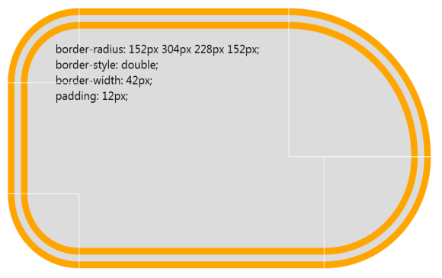
CSS3 Backgrounds & Borders
Round corners with the border-radius property
Multiple background images per element
Box-shadow property on block elements
div {
border-radius: 152px 304px 228px 152px;
border-style: double;
border-width: 42px;
padding: 12px;
}

Slide 30
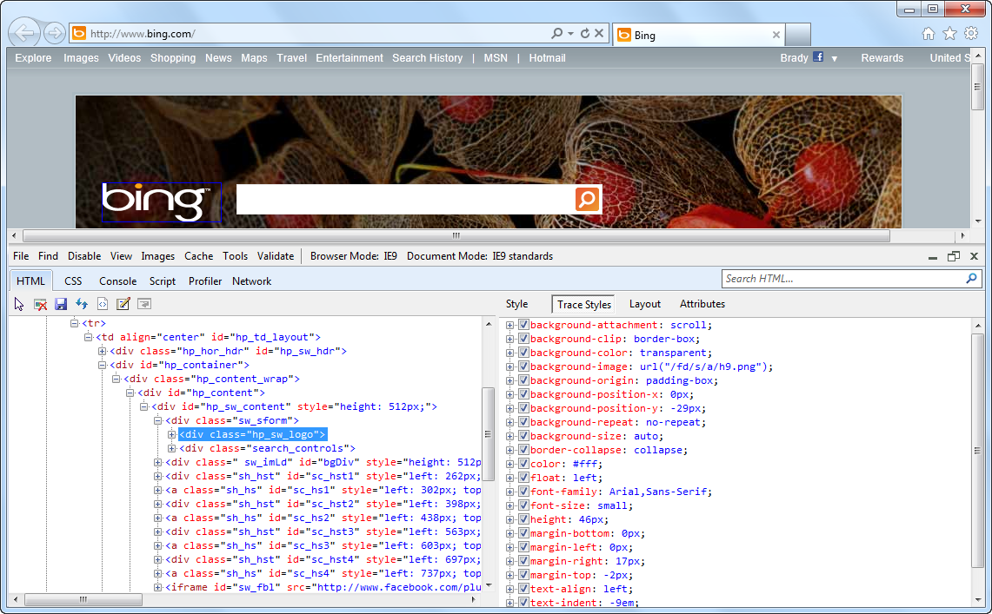
1 Key Press (F12) Developer Tools

Slide 31
Building a Fast Web Experience

Slide 32
Extract Old Deck Here
03 - Building A Fast Web Experience.pptx

Slide 33
Getting Ready for Internet Explorer 10

Slide 34
TBD
Need to discuss with Business Owner

Slide 35
What We Learned
First Topic
Second Topic
Third Topic

Slide 36
For More Information
Related sessions
Documentation & articles

Slide 37
Resources
Feedback and questions http://forums.dev.windows.com

