Slide 1
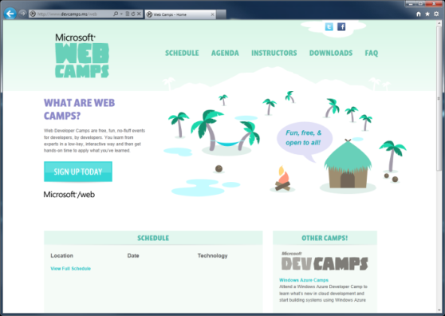

WebCamps Online
Twitter: Follow @webcamps Hashtag #webcamps
SPEAKER NAME/HANDLE HERE
Website: http://www.devcamps.ms/web
What are web camps?
Web Developer Camps are free, fun, no-fluff events for developers, by developers. You learn from experts in a low-key, interactive way and then get hands-on time to apply what you’ve learned.

Slide 2
Building a Service Layer with ASP.NET Web API
Name
Title
Microsoft Corporation

Slide 3
Agenda
Why all the hype for Web APIs?
Building Web APIs for browser/JSON clients
Building Web APIs for native/non-browser clients

Slide 4


Today
Today if you want to reach your user, you have to reach their device
In this talk you’ll learn how

Slide 5
Building a Read Only Web API
Why?
Allow browser or other clients to easily retrieve information from your system

Slide 6
ASP.NET Web API – Best of Both Worlds
ASP.NET MVC
WCF Web API
ASP.NET Routing
Model binding
Validation
Filters
Link generation
Testability
Dependency Resolution
Modern HTTP programming model
Formatting, content negotiation
Task-based async
Server-side query composition
Test client, help page
Self-host

Slide 7
Building a read only Web API
demo

Slide 8
Building a Read Only Web API
WebApi and WebApi.Enhancements nugets
WebGet attribute defines the URI template
Return JsonValue/List<JsonValue>, you don’t have to craft a CLR type

Slide 9
Manipulating HTTP Responses
Why?
Enable client/intermediary caching
Handle status codes
Add links via link headers

Slide 10
Manipulating HTTP responses
demo

Slide 11
Manipulating HTTP Responses
Return HttpResponseMessage<T> to modify response headers
Throw HttpResponseException<T> to stop processing immediately and return a response, such as a status 404

Slide 12
Making an API Updatable
Why?
Allow clients to modify the state of the server

Slide 13
Making an API updatable
demo

Slide 14

Making an API Updatable
Use WebInvoke for specifying HTTP method
Use HttpResponseMessage<T> to access headers like location header
Use WebApi.Enhancements to support FormUrlEncoding
On IIS, make sure to configure to allow PUT/DELETE

Slide 15
Supporting HTML File Upload
Why?
Allow clients to send files from a browser

Slide 16
HTML file upload
demo
Using HttpContent to work with the body of the request

Slide 17
Support HTML File Upload
IsMimeMultipartContent – checks if multipart
MultipartFormDataStreamProvider – parses the streams
BodyPartFileNames – returns the list of files sent in the stream

Slide 18
Configuring Your Web API
Why?
Change common settings like MaxRecievedMessageSize
Enable web api test client
Wire up an IoC container
Enable security
Configure handlers and formatters
Adding custom error handlers

Slide 19
Configuring your Web API
demo

Slide 20
Configuring Your Web API
HttpConfiguration provides a code based configuration mechanism
New it up directly or derive from it
Pass config to HttpServiceHostFactory/HttpServiceHost

Slide 21
Building a Web API for Any Client

Slide 22
Configuring Media Type Formatters
Why?
Tweak our Xml/Json formatters
OData clients
Other native/non-browser clients
Custom media types

Slide 23
Configuring media type formatters
demo
ODATA, JSON.NET, HAL

Slide 24
Configuring Media Type Formatters
Modify HttpConfiguration.Formatters to add/remove formatters
Formatters.XmlFormatter/Formatters.JsonFormatter to tweak existing formatter
ODataMediaTypeFormatter
Derive from MediaTypeFormatter to create your own custom

Slide 25
What’s on Our Road Map?

Slide 26

What Else is on Our Road Map
OAuth 2.0/Basic over HTTPs
RIA Services integration
Deeper integration with ASP.NET MVC/richer routing support
OData linking
Deeper Azure integration: ServiceBus, Caching

Slide 27
Where Can You Get it?

Slide 28
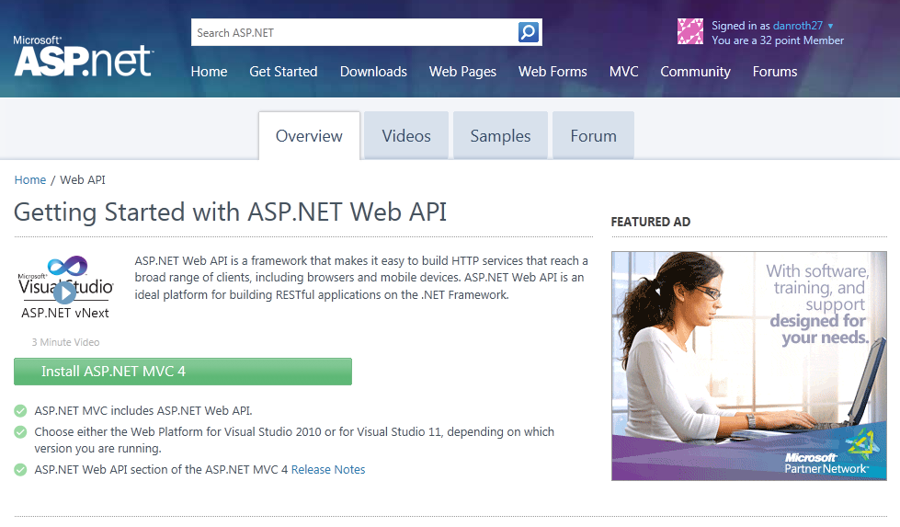
Homepage: asp.net/web-api

Slide 29
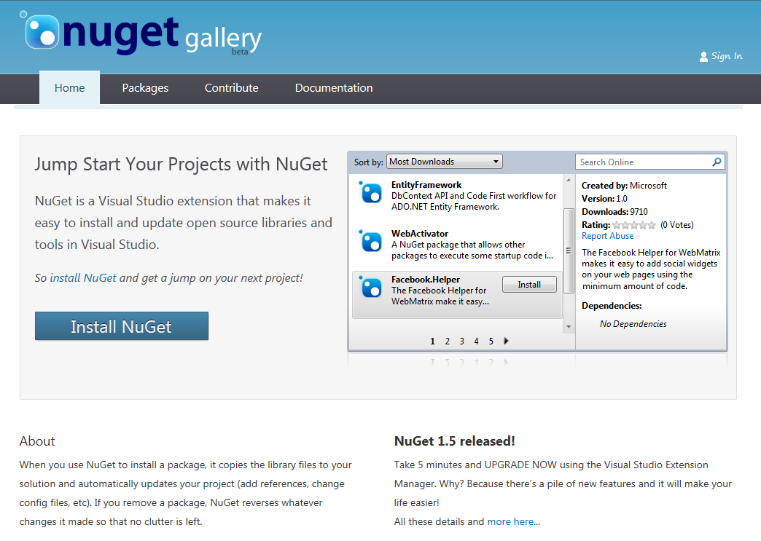
Find Us on Nuget
Nuget Packages
WebApi
WebApi.OData
JsonValue
HttpClient
WebApi.Enhancements

Slide 30
What We Learned
Why Web APIs are important
How to author Web APIs for multiple clients
How configure a Web API
Enabling HTML file upload
Enabling OData and custom formats
Using the Web API test client

Slide 31
For More Information
Related sessions
TOPOL-796T: ASP.NET 4.5 loves HTML5, CSS3 & JavaScript
TOOL-797T: It’s not a great phone app without ASP.NET services and push notifications
TOOL-800T: Building data-driven HTML5 apps with WCF RIA Services
TOOL-803T: Enabling Mobile apps with ASP.NET MVC
SAC-807T: Building real-time web apps with WebSockets using IIS, ASP.NET and WCF
wcf.codeplex.com
blogs.msdn.com/gblock
codebetter.com/howard
Documentation & articles

Slide 32
Resources
Feedback and questions http://forums.dev.windows.com
Session feedback http://bldw.in/SessionFeedback

