Slide 1
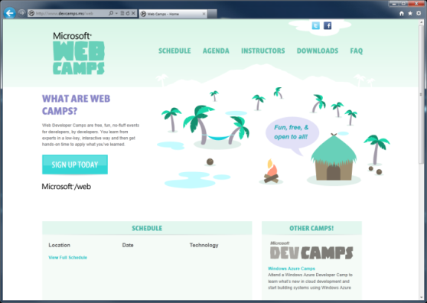

WebCamps Online
Twitter: Follow @webcamps Hashtag #webcamps
SPEAKER NAME/HANDLE HERE
Website: http://www.devcamps.ms/web
What are web camps?
Web Developer Camps are free, fun, no-fluff events for developers, by developers. You learn from experts in a low-key, interactive way and then get hands-on time to apply what you’ve learned.

Slide 2
Welcome Back to the Microsoft Web Stack
Name
Title
Microsoft Corporation

Slide 3
Agenda
Integrating Your Site with Internet Explorer 9 (& 10!)
WebMatrix 2.0
Creating Rich HTML 5 Experiences
Building Web Sites Using ASP.NET 4.5
Building Web APIs in Windows Azure
Deploying ASP.NET Apps to the Cloud

Slide 4
Integrating Your Site with Internet Explorer 9 (& 10!)
Windows and the Web
Pinned Sites
Interoperable
IE9 & HTML5
Building a Fast Web Experience
Getting Ready for Internet Explorer 10

Slide 5
WebMatrix 2.0
Getting Started
Razor

Slide 6

Creating Rich HTML 5 Experiences
HTML 5 in IE 9 & 10
HTML5 Deep Dive
jQuery Fundamentals

Slide 7
Building Web Sites Using ASP.NET 4.5
MVC 4.0
What is the Entity Framework?
Database-first, Model-first, Code-First
Demos

Slide 8
Building Web APIs in Windows Azure
Why all the hype for Web APIs?
Building Web APIs for browser/JSON clients
Building Web APIs for native /non-browser clients

Slide 9
Deploying ASP.NET Apps to the Cloud
ASP.NET In Windows Azure
Web Forms & MVC
AJAX & Stateless Web Roles
Session State
DNS
Advanced Techniques
Full IIS
Multi-tenancy
Web Deploy
Challenges
File Upload

Slide 10
Resources
Feedback and questions http://forums.dev.windows.com

