Slide 1
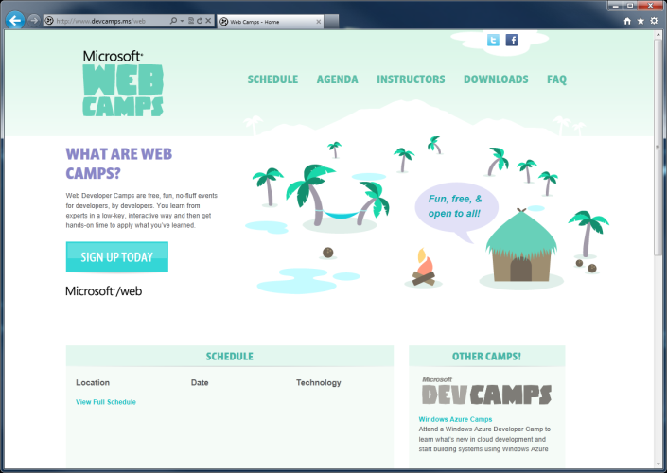

WebCamps Online
Twitter: Follow @webcamps Hashtag #webcamps
SPEAKER NAME/HANDLE HERE
Website: http://www.devcamps.ms/web
What are web camps?
Web Developer Camps are free, fun, no-fluff events for developers, by developers. You learn from experts in a low-key, interactive way and then get hands-on time to apply what you’ve learned.

Slide 2
Deploying ASP.NET Apps to the Cloud
Name
Title
Microsoft Corporation

Slide 3
Agenda
Preparing an ASP.NET Site for Windows Azure
Tools and Updates
Project Approaches
Configuration
State Considerations
Statelessness
AJAX
Session State in Azure
Advanced Topics
DNS
File Upload
Notes:
Slide Objective
Introduce the important of ASP.NET in Windows Azure applications
Introduce the topics to be covered in this session
Speaking Notes
Windows Azure can run a very broad variety of application types
ASP.NET Applications will be a very common type of application
Windows Azure supports ASP.NET very well
Core ASP.NET (HttpModules/HttpHandlers)
Web Forms
MVC
Because of the stateless nature of Windows Azure web roles important things to consider around
Session State
AJAX calls
Will discuss configuring DNS for Windows Azure
Will discuss some advanced features for Windows Azure
Both very much suited to SaaS types of applications
Finally touch on some Windows Azure common challenges
Notes
Some notes on Migration http://msdn.microsoft.com/en-us/windowsazure/ff356857.aspx
Azure Architecture guidance http://msdn.microsoft.com/en-us/library/ff728592.aspx

Slide 4
Preparing an ASP.NET Site for Windows Azure

Slide 5
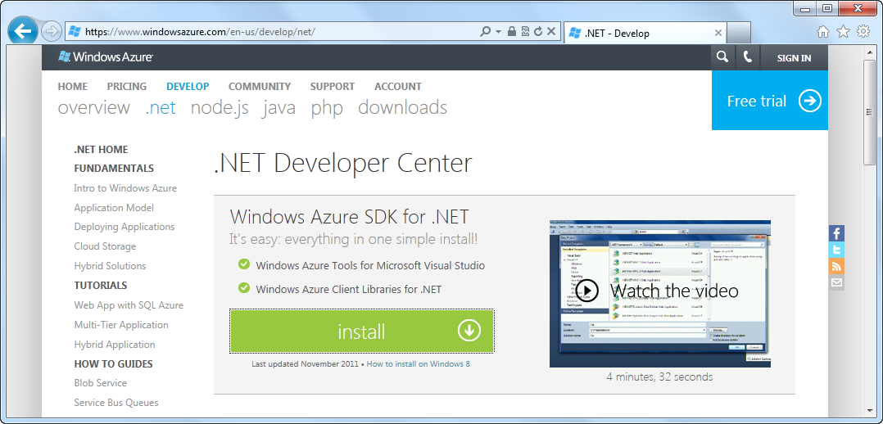
Preparing your IDE for Windows Azure
Windows Azure Tools for Visual Studio
Notes:
Slide Objective
Introduce the simple ASP.NET templates for Windows Azure
Speaking Notes
Visual Studio Tools for Windows Azure include templates
Web Forms and MVC preconfigured web roles
Both VB.Net and C# supported
Basic Asp.NET web role is equivalent to a new Web project- i.e. very simple and bare bones
ASP.NET MVC template includes significant amount of existing code including
Account model
Account and Home Views
Error pages and error handling
Account and Home controllers
Equivalent to creating a new MVC 2 Web Application (rather than an empty MVC site)
Notes

Slide 6
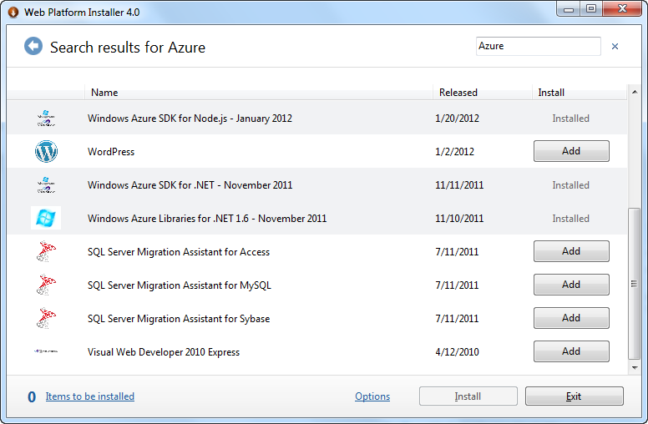
Up-to-date with Web Platform Installer
Notes:
Slide Objective
Introduce the simple ASP.NET templates for Windows Azure
Speaking Notes
Visual Studio Tools for Windows Azure include templates
Web Forms and MVC preconfigured web roles
Both VB.Net and C# supported
Basic Asp.NET web role is equivalent to a new Web project- i.e. very simple and bare bones
ASP.NET MVC template includes significant amount of existing code including
Account model
Account and Home Views
Error pages and error handling
Account and Home controllers
Equivalent to creating a new MVC 2 Web Application (rather than an empty MVC site)
Notes

Slide 7
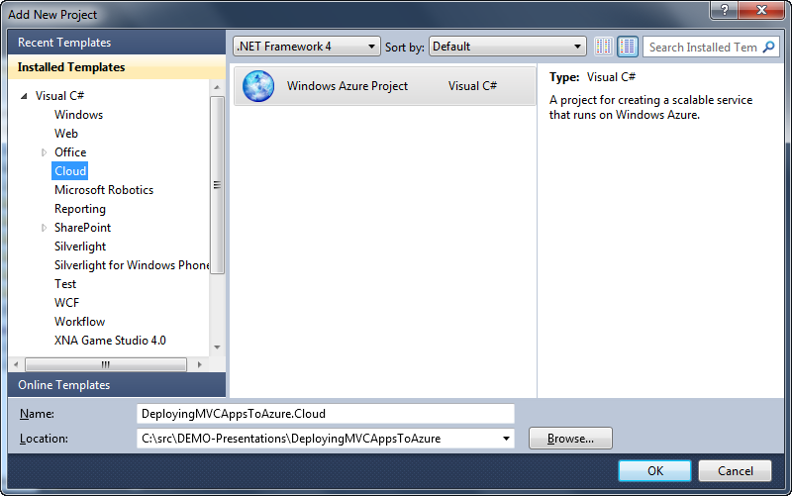
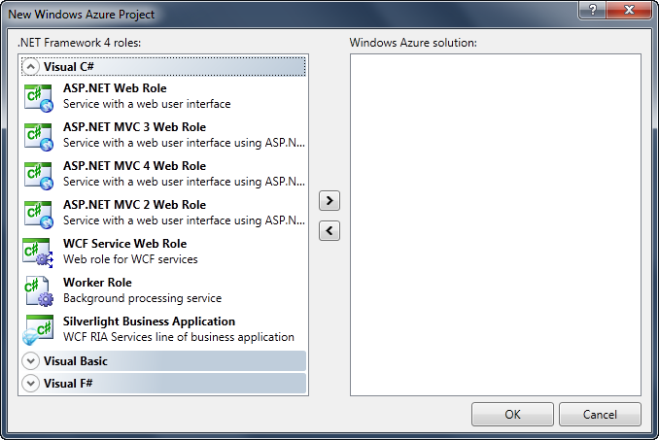
Create a new Cloud project
Create a new Windows Azure Project and add roles to it
Notes:
Slide Objective
Introduce the simple ASP.NET templates for Windows Azure
Speaking Notes
Visual Studio Tools for Windows Azure include templates
Web Forms and MVC preconfigured web roles
Both VB.Net and C# supported
Basic Asp.NET web role is equivalent to a new Web project- i.e. very simple and bare bones
ASP.NET MVC template includes significant amount of existing code including
Account model
Account and Home Views
Error pages and error handling
Account and Home controllers
Equivalent to creating a new MVC 2 Web Application (rather than an empty MVC site)
Notes

Slide 8
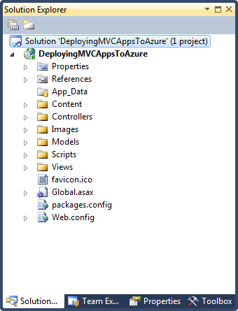
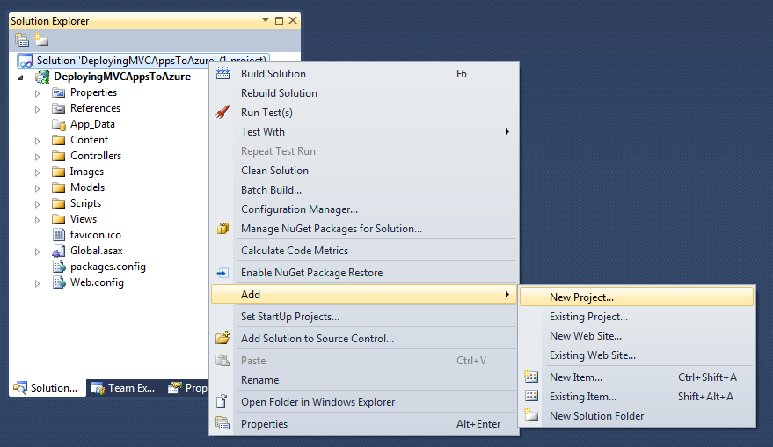
ASP.NET project turned Cloud project
Add a new Windows Azure project to the SLN
Take an MVC app
Notes:
Slide Objective
Introduce the simple ASP.NET templates for Windows Azure
Speaking Notes
Visual Studio Tools for Windows Azure include templates
Web Forms and MVC preconfigured web roles
Both VB.Net and C# supported
Basic Asp.NET web role is equivalent to a new Web project- i.e. very simple and bare bones
ASP.NET MVC template includes significant amount of existing code including
Account model
Account and Home Views
Error pages and error handling
Account and Home controllers
Equivalent to creating a new MVC 2 Web Application (rather than an empty MVC site)
Notes

Slide 9
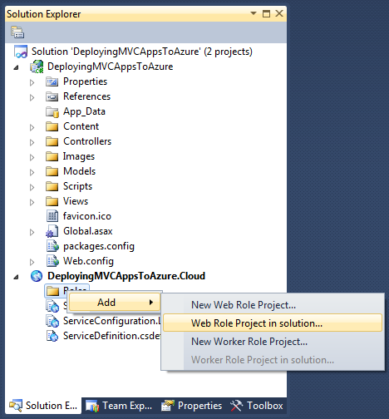
ASP.NET project turned Cloud project
Add a new Web Role to the project, but select the already-there ASP.NET site project
Notes:
Slide Objective
Introduce the simple ASP.NET templates for Windows Azure
Speaking Notes
Visual Studio Tools for Windows Azure include templates
Web Forms and MVC preconfigured web roles
Both VB.Net and C# supported
Basic Asp.NET web role is equivalent to a new Web project- i.e. very simple and bare bones
ASP.NET MVC template includes significant amount of existing code including
Account model
Account and Home Views
Error pages and error handling
Account and Home controllers
Equivalent to creating a new MVC 2 Web Application (rather than an empty MVC site)
Notes

Slide 10
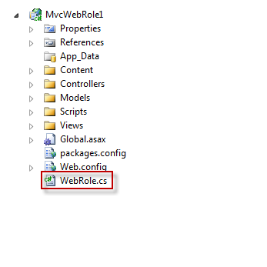
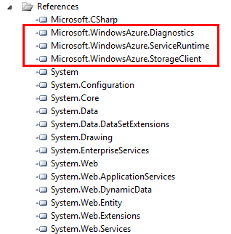
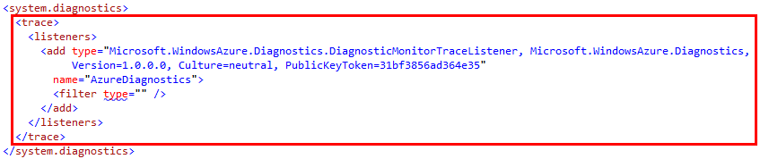
What’s Different?

Slide 11
Two Approaches for Configuration
Web Site
Web.config
<appSettings>
<add key="MyWebAppAppSetting" value="Hello from Site Config!"/>
</appSettings>
Web Role
ServiceConfiguration.cscfg
<Role name="DeployingMVCAppsToAzure">
<Instances count="1" />
<ConfigurationSettings>
<Setting name="MyAzureRoleAppSetting"
value="Hello from Windows Azure Config!" />
</ConfigurationSettings>
</Role>
Notes:
1 minute
The transition from code to markup is one of the most elegant things about Razor but there a few rules that are worth knowing about.
Option 1:
Code is the primary citizen in a code block, not HTML. This means the parser will always expect code unless it finds valid opening (and closing) tags. In the first option block you see that after the @{ a name variable is defined. No additional tag is necessary.
A <div> section tells Razor that what follows should be taken as literal. Then the @name indicates a variable that needs to be replaced with its value.
Option 2:
Similarly, to explicitly call out text in a code block as HTML, wrap it in a <text> tag
Option 3:
Single line of output within markup can be denoted by @:
This option is useful when you don’t want to render an HTML element as part of the output.
Extra Knowledge (Advanced):
The Parser that understands Razor is itself a standalone assembly (System.Web.Razor.dll) which has no dependencies on ASP.NET which means you can use it to parse CSHTML/VBHTML files and produce C#/VB code in any .NET application.

Slide 12
Two Approaches for Configuration
Web Site
App Settings
public ActionResult WebAppSetting()
{
ViewBag.Message = ConfigurationManager.AppSettings["MyWebAppAppSetting"];
return View();
}
Web Role
RoleEnvironment Settings
public ActionResult WindowsAzureAppSetting()
{
ViewBag.Message =
RoleEnvironment
.GetConfigurationSettingValue("MyAzureRoleAppSetting");
return View();
}
Use Both
Be Flexible
if(!RoleEnvironment.IsAvailable)
ViewBag.Message =
ConfigurationManager.AppSettings["MyWebAppAppSetting"];
else
ViewBag.Message =
RoleEnvironment
.GetConfigurationSettingValue("MyAzureRoleAppSetting");
Notes:
1 minute
The transition from code to markup is one of the most elegant things about Razor but there a few rules that are worth knowing about.
Option 1:
Code is the primary citizen in a code block, not HTML. This means the parser will always expect code unless it finds valid opening (and closing) tags. In the first option block you see that after the @{ a name variable is defined. No additional tag is necessary.
A <div> section tells Razor that what follows should be taken as literal. Then the @name indicates a variable that needs to be replaced with its value.
Option 2:
Similarly, to explicitly call out text in a code block as HTML, wrap it in a <text> tag
Option 3:
Single line of output within markup can be denoted by @:
This option is useful when you don’t want to render an HTML element as part of the output.
Extra Knowledge (Advanced):
The Parser that understands Razor is itself a standalone assembly (System.Web.Razor.dll) which has no dependencies on ASP.NET which means you can use it to parse CSHTML/VBHTML files and produce C#/VB code in any .NET application.

Slide 13
An ASP.NET MVC site running in (and out of) Windows Azure
demo

Slide 14
State Considerations

Slide 15
Statelessness
Load balancer round-robins requests in multi instance roles
Follow web farm best practices
Do not store state on individual instances
Do not assume subsequent requests will hit the same instance
Don’t forget things like dynamically generated images loaded by a page
Notes:
Slide Objective
Recap on statelessness
Reinforces nature of stateless servers in the context of web requests
Speaking Notes
Windows Azure uses load balancers that round robin requests to each instance
When running in Windows Azure with multiple instances there is no guarantee that subsequent requests will hit the same instance
Some things to remember here
Subsequent requests may not always be obvious e.g. Think of an ASP.NET page that includes an image url that is served by an HTTP Handler Can’t assume that the image will be loaded form the same instances that served the original ASP.NET page
Which leads on to talking about AJAX…
Notes

Slide 16
AJAX and Windows Azure
Client side calls may not return to the same instance the original page came from
AJAX calls must be stateless
Don’t generate a page and leave state on the server to call via AJAX later
All instances require the same MachineKey for ViewState hashing
Fabric uses same machine key for all instances in a role
Notes:
Slide Objective
Reinforce the need to think about statelessness when working with AJAX
Speaking Notes
AJAX requests (e.g. JQuery calls to the server) may not go back to the instance that originally served the page
Can’t leave ‘nuggets’ of state inside a web role with the intention of fetching it via APAX later
Can push the state back into storage
Either store it up direct out of storage (e.g. grab an XML block using a Shared Access Signature)
May be better to use a Data Island in the original document in this case though
Push it into storage and re-fetch in web role when AJAX call arrives
ASP.NET Ajax requires a common machine key in web farm environments.
Windows Azure is pre-configured for this- all the instances in a role will have the exact same machine key
Can modify the machine key if you need to from code
There is NO support for sticky sessions.
Notes
http://wiki.asp.net/page.aspx/1248/aspnet-and-load-balancing/
Changing machine key in code
http://social.msdn.microsoft.com/Forums/en-US/windowsazure/thread/a6f00720-3aad-40c8-ac31-c585bc0c3b67

Slide 17

Windows Azure Session State
Windows Azure Load Balancer uses round-robin allocation. Session state must persist to client or storage on every request
session[“foo”] = 1;
session[“foo”] = 2;
LB
What is the value of session[“foo”]?
SQL Azure
Windows Azure Storage
Notes:
Slide Objective
Explains the operation of Session state in Windows Azure multi instance roles
Speaking Notes
Must move session state off the Web Role instances
In this animation
First request hits one instance
Subsequent request hits another instance
At the end of the animation the value of Foo is hard to determine.
Is it 1, 2 or null?
Will depend on which server the LB routes our request to
Notes

Slide 18
Solving Session State
Persist to Storage via Session State Provider
Windows Azure Caching
SQL Azure
Windows Azure Storage
Custom
Persist to Client
Use cookies
Don’t forget ASP.NET MVC TempData relies on Session State provider by default
Notes:
Slide Objective
Explains the implementation of Session state in Windows Azure multi instance roles
Speaking Notes
Must move session state off the Web Role instances
Move it into storage of some sort
Windows Azure caching is the obvious choice
Distributed, in-memory caching running in Windows Azure
SQL Azure and Windows Azure storage are are additional examples
Which is best will depend on the nature of the application load (due to the transaction charge for Windows Azure Storage)
SQL Server.
Will need to implement your own session cleanup code for SQL Azure which means you will probably need a custom session state provider
The Windows Azure Storage Provider is SAMPLE CODE ONLY. It should not be relied on for production apps without significant modification
Another option is to push the state to the client.
Could potentially write a custom session state provider that always persists the state to a cookie
This WILL have performance impact
Could also use a custom or 3rd party distributed cache to store session state in a shared everything (fully replicated) configuration (e.g. memcached)
Notes
3rd party Sql Azure session state provider
http://azuresqlsession.codeplex.com/wikipage?title=Home&ProjectName=azuresqlsession
Cookie size performance impact
http://www.yuiblog.com/blog/2007/03/01/performance-research-part-3/
http://blogs.msdn.com/b/eugeniop/archive/2010/06/05/windows-azure-architecture-guide-part-2-managing-sessions.aspx

Slide 19
SQL Server Session State
Use SQL Azure as backing store
Round trip to database twice per request
Read at request start
Write at request end
Enable ASP.NET 4 Session Compression
Scale out across multiple DBs
Use session state partitioning
http://bit.ly/scale-session
SQL Azure is competitive on cost basis
Notes:
Slide Objective
Explains the use of SQL Azure as a backing store
Speaking Notes
The Out of the Box SQL Server ASP.NET Session State mechanism is not suitable for Azure
Relies on SQL Server Agent which is not available in SQL Azure
Will need to implement a custom session state provider
Store and retrieve state
Cleanup
Will probably want to use some sort of partitioning mechanism.
Partitioning is a feature in the ASP.NET provider interfaces… so just need to implement the mechanism to reolsve the partition
For more on partitioning see the day 2 storage strategies session
SQL Azure is cost competitive
Particularly in high and consistent load scenarios
SQL Azure does not have the storage transaction charge
SQL Session state generally only requires a small amount of storage
Scale out across 1GB SQL Azure databases
Notes
3rd party Sql Azure session state provider
http://azuresqlsession.codeplex.com/wikipage?title=Home&ProjectName=azuresqlsession

Slide 20
SQL Azure Session State
Session state stored using SQL Server Session State Provider and session state partitioning
session[“foo”] = 1;
session[“foo”] = 2;
LB
What is the value of session[“foo”]?
Resolve partition
SQL Azure
3 x 1GB Databases
Notes:
Slide Objective
Explains the operation of Session state in Windows Azure multi instance roles using partitioned SQL Azure as the mechanism
Speaking Notes
In this approach
3 x 1GB SQL Azure databases are used
The appropriate partition is resolved by the Web Role and the session state is pushed to the correct database
At the end of this process the session state value will be reliably read as being 2
Notes

Slide 21
Windows Azure Storage Providers
Sample ASP.NET Providers (Session, Membership, Role etc…)
Sample Code http://code.msdn.microsoft.com/ windowsazuresamples
Uses Blob + Table Storage
Several storage transactions per request
Enable ASP.NET 4 Session Compression
Sample Provider should be treated as a starting point only.
Notes:
Slide Objective
Provides a pointer to and discussion of the Windows Azure Storage providers
Speaking Notes
Windows Azure storage also makes an ideal location for session state
The sample providers available on MSDN should be treated as a starting point only
Notes

Slide 22
Cookies
Serialize and Encrypt state into cookie
Possible to implement as Session State Provider
Cookies add significant performance overhead
Cookies sent with every request to domain
Use alternative host header to serve images, etc. http://www.myweb.com http://images.myweb.com
Use Windows Azure Storage for static content
Notes:
Slide Objective
Discusses the approach of using Cookies to hold state.
Speaking Notes
Avoiding session state and simply pushing the state to the client as a cookie
Could implement a session state provider on top of this approach
Avoids the need to roundtrip to/from the database or storage each request
Worth comparing the perf difference between the two approaches
Don’t forget that cookies are sent back and forth with every HTTP request- e.g. if you serve images from your Web Role you will end up with cookies being sent
Can use an alternative Host header in order to avoid this
Can also use Windows Azure Blob storage to serve images and other static content.
Notes

Slide 23
DNS

Slide 24
DNS
All services get a *.cloudapp.net address
Use A records to point domain root to your app
myservicename.cloudapp.net
TTL is 10 seconds
Must not delete your role or your IP address will change
Standard approach is to CNAME to *.cloudapp.net
IP Address for deployment is fixed for lifetime of that slot
Requires two DNS lookups
Limited caching due to low TTL
Notes:
Slide Objective
Discusses managing DNS entries for Windows Azure Web Role hosted sites
Speaking Notes
By default all sites get a *.cloudapp.net URL
Should avoid using this for anything other than testing your site
10 second TTL on the DNS entry means it will do a full DNS lookup an almost every request
Runs the risk of leaking data from cookies etc due to many sites using the same cloudapp.net domain
The standard approach of using a Cname has a number of limitations
It will require two DNS lookups
One to lookup the Cname resolving it to foo.cloudapp.net
Another to reoslve foo.cloudapp.net to the actual IP address
The low TTL on the cloudapp.net domain means there will be unnecessary lookups
It is not possible to Cname the root of a domain e.g. you may want to use http://myapp.com which will require an A record resolving to an IP address
The nice thing is that for the lifetime of your deployment you actually have a fixed IP address.
Let’s see how we can take advantage of this
Notes
Good thread
http://social.msdn.microsoft.com/Forums/en/windowsazure/thread/fa00d06d-b631-46ce-af66-f463cf667282

Slide 25
High Performance DNS Approach
Create service, deploy to staging slot
Resolve IP for yourapp.cloudapp.net
Create A Record for
www.yourapp.com
yourapp.com
If you need to plan to delete a service e.g. Because you need to change external endpoints
1
Lower TTL of A Records… wait a while…
2
Create new service, get new IP, re-point A Records
3
Delete old service
Notes:
Slide Objective
Discusses managing DNS entries for Windows Azure Web Role hosted sites
Speaking Notes
For all intents and purposes Windows Azure IPs are fixed.
They are fixed for the lifetime of a deployment
They remain fixed even when you VIP Swap
Therefore you can comfortably create A records against the IP address for your production slot.
This will save you the double lookup for a CName record.
It will also allow you to create an entry for the root of a domain
So the approach for high performance DNS is as follows
Create your hosted service
Deploy into the production slot
nslookup myapp.cloudapp.net to get the IP
Create A records for www.myapp.com and myapp.com with a decent length TTL
Run your service doing rolling upgrades and VIP swaps till your hearts content
If you need to delete your deployment (e.g. to reconfigure external endpoints) then you should;
lower the TTL on the A records
wait till the old TTL expires
create a new service
deploy to prod slot
NSLookup
swap the IP on the A records
delete the old deployment.
Notes
Good thread
http://social.msdn.microsoft.com/Forums/en/windowsazure/thread/fa00d06d-b631-46ce-af66-f463cf667282

Slide 26
Advanced Techniques

Slide 27
Full IIS
You can choose to deploy to Full IIS; no longer using required to use Hosted Web Core (HWC)
Differences:
In Full IIS, the RoleEntryPoint runs under WaIISHost.exe while the web site runs under the normal IIS w3wp.exe process
Support for running multiple websites
Load any IIS module
Makes migrating existing IIS-based applications a lot easier

Slide 28


Multi-Tenancy
SaaS Applications often need to serve multiple tenants out of a single service deployment
tenant1.saasservice.com
tenant2.saasservice.com
LB
Web Roles Shared by all Tenants
resolve tenant by examining host header
SQL Azure
1 DB per Tenant
Notes:
Slide Objective
Explains using host headers to route to an appropriate partition
Speaking Notes
Scenario in many multi-tenanted SaaS type applications want to run a separate DB per tenant
A neat approach is to map a wildcard DNS entry to your primary site
http://*.saasservice.com
Then have a specific subdomain for each customer
Tenant1.saasservice.com
Tenant2.saasservice.com
Needn’t just be subdomains- could lookup on any host name.
Use a mechanism to lookup the correct tenant DB based on the incoming host header
Send a unique UI down based on the tenant
Etc….
Notes

Slide 29
Web Deploy
IIS Web Deployment Tool
Simplifies the migration, management, and deployment of IIS Web servers, Web applications, and Web sites
Perform web deploy using standard IIS7 publishing from Visual Studio
Will not require you to deploy an entire package
Warning: use for development purposes only

Slide 30
Common Challenges

Slide 31
File Upload
ASP.NET File Upload Control uses ASP.NET temporary directory to buffer files
Temp path cannot be changed to Local Resource or Windows Azure Drive
Windows Azure Compute roles have 100MB of root disk space
Problems arise
Uploading large files (~100MB)
Multiple users uploading concurrently
10 users uploading 10MB files
Notes:
Slide Objective
Introduces the challenge of using Windows Azure for file uplaod
Speaking Notes
Windows Azure instances have a very limited amount of free space
In most cases this can be remedied with either Drives of Local resources
Both drives and local resources only expose their drive letter/path at run time
Problems
Uploading file to single instance – could be lost
Not good for big files, utilize resources of your website/server
Default ASP. NET file upload mechanism requires path to be changed in config
This causes issues when uploading large files >~100MB or where many users are uploading files
Notes

Slide 32
File Upload Solutions
Upload direct to Blob storage using Silverlight
Provide a Shared Access Signature to Silverlight control
Upload blocks direct to storage http://bit.ly/sl-blob
Use 3rd Party Control
Implement a custom IHttpHandler to receive file and buffer to disk
Notes:
Slide Objective
Provides approaches for resolving the file upload issue
Speaking Notes
Upload directly to blob storage
Provide a Shared Access Signature (generate in web role) to the client (Silverlight is a good option for an ASP.NET app)
Client performs blockwise upload to blob storage
Notify web role once upload complete (note cannot call Queue/Table storage directly from client in a secured fashion- i.e. would have to send down the storage key to the client)
Use 3rd Party Control
Use a 3rd party upload control with a mechanism to modify the drive location where files are streamed to
Implement a custom IHttpHandler to receive the uploaded file and buffer to a Local Resource location
Notes

Slide 33
Takeaways
ASP.NET In Windows Azure
Advanced Techniques
Challenges
Broad support for ASP.NET Features
Must understand and architect for scale out
SaaS Applications using Virtual Path Providers and Host header checking

