Slide 1
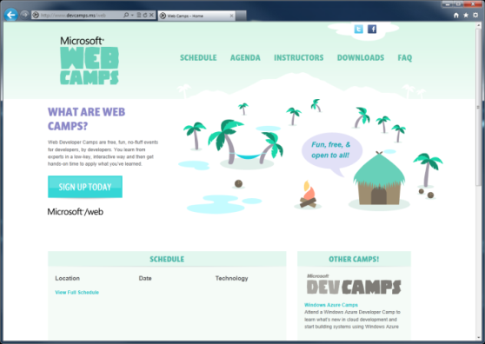

WebCamps
Twitter: Follow @webcamps Hashtag #devcamps
SPEAKER NAME | @SPEAKERHANDLE
Website: http://www.devcamps.ms/web
What are web camps?
Web Developer Camps are free, fun, no-fluff events for developers, by developers. You learn from experts in a low-key, interactive way and then get hands-on time to apply what you’ve learned.

Slide 2
Creating Rich HTML 5 Experiences

Slide 3
Agenda
HTML5
CSS3
ECMAScript (a.k.a. JavaScript, jQuery)
Down Level & Feature Detection
Take it a step futher

Slide 4

What is HTML5?
Umbrella term: vNext
HTML, CSS, ECMAScript
It isn’t a marketing message
A new standard for
a new web
A language with support on a variety of devices

Slide 5
Why do you care?
Smaller
Simpler
Semantic

Slide 6
Map of HTML5
ECMAScript 262
W3C
ECMA
HTML
CSS
Web Apps
SVG
Geolocation
ECMA Script 262
Geolocation API
Basic Shapes
DOM L2 Style
Web SQL Database
CSS Text
Filters
Document Structure
DOM L2 Events
Web DOM Core
CSS Cascading And Inheritance
CSS Writing Modes
HTML5 Diff From HTML4
Fonts
DOM L3 Abstract Schemas
DOM L2 Views
Uniform Messaging Policy
CSS Speech
CSS Values And Units
HTML5 Markup
Smil
DOM L3 Views And Formatting
DOM L2 Core
Server-sent Events
Element Traversal
CSS Color
CSS Media Queries
CSS Print Profile
Html+rdfa
Gradients And Patterns
DOM L3 Xpath
Dom L1
Selectors API L2
Cors
CSS Template Layout
CSS Paged Media
Microdata
Styling
DOM L3 Validation
Xmlhttprequest L2
Selectors API
CSS Animations
CSS Multi-column Layout
CSS Namespaces
Canvas 2D Context
Scripting
DOM L3 Load And Save
Xmlhttprequest
Progress Events
CSS Transitions
CSS Basic Box Model
CSS Snapshot 2007
Html5
Painting, Filling, Color
DOM L3 Events
Web Workers
CSS 3D Transformations
CSS Fonts
Text Alternatives
Transforms
DOM L3 Core
Web Storage
Programmable HTTP Caching And Serving
CSS 2D Transformations
CSS Backgrounds And Borders
Polyglot Markup
Text
Dom L2 Html
Web Sockets API
Index DB
CSS Image Values
Paths
DOM L2 Traversal And Range
Web IDL
File API
CSS Flexible Box Layout
CSS Generated Content For Paged Media
CSS Line Grid
CSS Grid Positioning
CSS Ruby
CSS Scoping
CSS Basic User Interface

Slide 7
HTML5 in IE 9 & 10

Slide 8
HTML5 in IE9
HTML5
CSS3
SVG
Others
New Markup Elements
Canvas
Audio
Video
Local Storage
Cross-Window Messaging
Text Selection APIs
Parsing SVG in HTML
2D Transforms
Border Radius
Box-Shadow
Fonts (WOFF)
Media Queries
Multiple Backgrounds
Namespaces
Opacity
rgba(), hsl(), hsla()
Selectors (IE8)
Shapes
Clipping, Masking, and Compositing
Transforms
Extensibility
Gradients
Interactivity
Linking and Views
Painting and Colors
Paths
Text
ECMA Script 5 (all but Strict Mode)
Native JSON support
Performance API
Geo-Location
Data-uri (IE8)
DOM L2, L3
Selectors API L2
AJAX Navigation
DOMParser and XMLSerializer
ICC v2 and Color Profile
ARIA
Hardware Acceleration

Slide 9
HTML5 in IE10
HTML5
CSS3
Others
Application Cache
Drag&Drop
File API
Forms Validation
History
IndexedDB
Sandbox
Web Sockets
Web Workers
3D Transforms
Animations
Flexible Box
Floats
Gradient
Grid
Multi-Column
Region
SVG Filter Effects
Text Shadow
Transitions
Advanced Hit Testing APIs
Async
Media Queries Listeners
Web Performance APIs

Slide 10
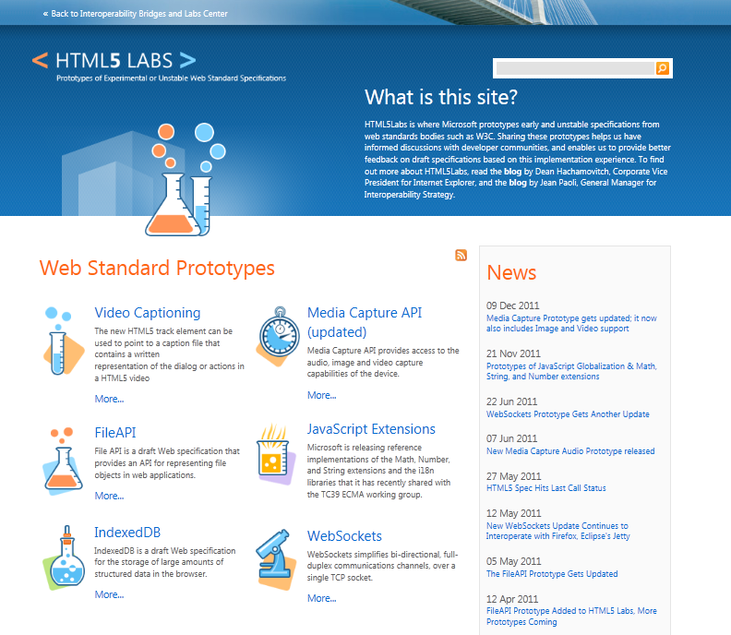
html5labs.com
HTML5 IndexedDB, Web Sockets, File API, and Media Capture API

Slide 11
HTML5

Slide 12
New HTML5 Markup Elements
<header>
used to identify the page or application's introduction or navigational aids
<hgroup>
used to group heading elements
<nav>
represents a section of a document that links to other documents or to parts within the document itself
<aside>
represents content that is tangentially related to the content that forms the main textual flow of a document
<footer>
represents the footer for the nearest ancestor sectioning content or sectioning root element
<article>
represents a section of content that forms an independent part of a document or site
<section>
used to designate generic sections of a document
<figure>
used to enclose a figure like an illustration, diagram, or photo
<figcaption>
used to identify a figure's caption
<video>
represents a video player displayed to allow user control over video playback and a viewport to view a video
<audio>
represents an audio player displayed to allow user control over audio playback

Slide 13
Canvas
A block element that allows developers to draw 2d graphics using JavaScript
Methods for drawing include: paths, boxes, circles, text and rasterized images
<canvas id="myCanvas" width="200" height="200">
Your browser doesn’t support Canvas, sorry.
</canvas>
<script type="text/javascript">
var example = document.getElementById("myCanvas");
var context = example.getContext("2d");
context.fillStyle = "rgb(255,0,0)";
context.fillRect(30, 30, 50, 50);
</script>

Slide 14
HTML 5 <video>
Support for the HTML5 <video> element
Industry-standard MPEG-4/H.264 video
Video can be composited with anything else on the page
HTML content, images, SVG graphics
Hardware accelerated, GPU-based decoding

Slide 15
HTML 5 <video> Attributes
src – specifies the location to pull the source file
autoplay – if present starts playing as soon as it’s ready
controls – if present displays controls
preload – if present loads source at page load
loop – if present loops back to the beginning of the video
<video src="video.mp4" id="videoTag">
<!-- Only shown when browser doesn’t support video -->
<!-- You Could Embed Flash or Silverlight Video Here -->
</video>

Slide 16
Multiple HTML 5 <video> Sources?
source – child element used to specify the location to pull the source file(s)
<video poster="video.jpg">
<source src="video.mp4"/>
<source src="video.ogv"/>
<p>This is fallback content</p>
</video>

Slide 17
HTML 5 <audio>
Industry-standard MP3 and AAC audio
Fully scriptable via the DOM
Attributes
src – specifies the location to pull the source file
autoplay – if present starts playing as soon as it’s ready
controls – if present displays controls
preload – if present loads source at page load
<audio src="audio.mp3" id="audioTag" autoplay controls>
<!-- Only shown when browser doesn’t support audio -->
<!-- You could embed Flash or Silverlight audio here -->
</audio>

Slide 18
HTML5
demo
New markup features

Slide 19
CSS3

Slide 20
CSS3 Fonts & @font-face
Web Open Font Format allows you to package and deliver fonts as needed, per site
Designed for web use with the @font-face declaration
<style type="text/css">
@font-face {
font-family:MyFontName;
src: url('FontFile.woff');
}
</style>
<div style="font: 24pt MyFontName, sans-serif;">
This will render using MyFontName in FontFile.woff
</div>

Slide 21
CSS3 Media Queries
Selectively style page based on properties of the media
<style type="text/css">
@media all and (min-width: 640px)
{
#media-queries-1 { background-color: #0f0; }
}
@media screen and (max-width: 2000px)
{
#media-queries-2 { background-color: #0f0; }
}
</style>
ASP.NET 4.5 project template CSS files have media queries out-of-the-box!

Slide 22
CSS3 Colors
Alpha color with rgba() and hsla() color definitions
Transparency control with the opacity property
Can be used with any property that takes the color property
div.top {
background-color: rgba(0, 0, 0, 0.5);
color: #eeoocc;
}
div.bottom {
background-color: hlsa(0, 0%, 0%, 0.5);
color: #99cc44;
}

Slide 23
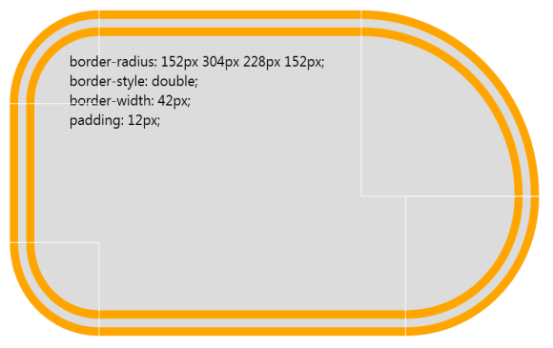
CSS3 Borders
Round corners with the border-radius property
Multiple background images per element
Box-shadow property on block elements
div {
border-radius: 152px 304px 228px 152px;
border-style: double;
border-width: 42px;
padding: 12px;
}

Slide 24
CSS3 Demo
demo

Slide 25
ECMAScript
a.k.a. javaScript, jQuery

Slide 26
Who Uses jQuery?
25,343,057 Web Sites
1,778,334 of those sites rank in the top sites on the web
Source: http://trends.builtwith.com/javascript/jQuery

Slide 27
jQuery – why so popular?
Easy to learn
Loads of Plugins
Powerful DOM Selection
Lightweight
Community Support

Slide 28
jQuery Community
jquery.com
api.jquery.com
forum.jquery.com
meetups.jquery.com
plugins.jquery.com
jqueryui.com
Downloading
Documentation
Community
Local Community
Extending
UI Widgets and Effects

Slide 29
jQuery Fundamentals
Find something, Do something
Functional Syntax
DOM Manipulation
Changing of events
<script>
$(function() {
$('.submit').click( function(){
$('.submit').css('color', '#ff0000');
$('#container')
.append($('<span>Clicked!</span>')
.click(function(){ alert('foo'); }));
});
});
</script>
<script>
$(‘div’).hide();
</script>
<div>This will be hidden</div>
<div>So will this</div>
<div>Even this</div>
<script>
$(function() {
$('.submit').click(function(){
alert('post form');
});
});
</script>
<input class=“submit” type=“button” value=“Submit”/>
<script>
$(function() {
$('.submit').click(function(){
alert('post form');
});
});
</script>
<input class=“submit” type=“button” value=“Submit”/>

Slide 30
jQuery
demo

Slide 31
Down Level &
Feature Detection

Slide 32
Down Level & Feature Detection
demo

Slide 33
A Step Further

Slide 34
SignalR &
Knockout.js
demo

Slide 35
What We Learned
HTML5
CSS3
ECMAScript (a.k.a. JavaScript, jQuery)
Down Level & Feature Detection
A Step Further

Slide 36
Resources
News http://blogs.msdn.com/IE
HTML5 Demo Gallery http://www.beautyoftheweb.com
HTML5 Labs http://www.html5labs.com
W3C HTML5 Working Group http://www.w3.org/html/wg
IE Blog http://blogs.msdn.com/IE
IE9 Test Drive http://www.ietestdrive.com

